Slide 1


Slide 2
Reviewing Some Basic Statistics, Economics, and Finance Concepts in an Operations Management Course
Problem 1
Problem 2

Slide 3

Sourcing Game

Slide 4
Problem 1.
Given the Total Costs vs. Quantity Produced (TC-Q) data, and the Price vs Quantity Sold (P-Q) data. Assume that the quantity produced is equal to the quantity sold.
1. Using TC-Q data, estimate the total fixed costs, and variable cost per unit of product.
2. Compute the Coefficient of Determination (R-Squared) , Correction Coefficient (CC), and Standard Deviation of the estimates (Standard Error) for the Total Costs.
3. Using the P-Q data, prepare a linear demand curve. Compute Max-P and Max-Q. Then prepare a non-linear demand curve.
The lecture on this problem is posted on the next slide. You do not need to watch the complete lecture since I discuss some additional concepts. It is enough to watch from 0 to 8:30 and from 11:30 to 19. That is a total of 16 minutes.

Slide 5

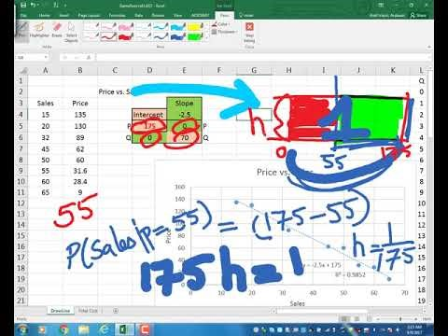
Recorded Lecture – From ECON to STAT
https://www.youtube.com/watch?v=2_qlQiYTLCs&t=1188s

Slide 6
Problem 1. Estimate Demand Curve: Max D(Q) and Max P
Prepare a linear demand curve using the following price and sales data.
(a) Estimate the Max possible price.
(b) Estimate the Max possible sales.
P=175-2.5Q
P=0 ➔ 175-2.5Q=0 ➔ 2.5Q=175

Slide 7
Problem 1. Estimate Fixed and Variable Costs
Estimate the total fixed costs and variable cost per unit of product.

Slide 8
General R² Values

Slide 9
Estimate Demand Curve: Max D(Q) and Max P
Draw the demand curve using exponential regression.
Another Example If You Wish

Slide 10
Problem 2.
1. At around what quantity of sales is the revenue maximized?
2. At around what volume of sales is total profit maximized?
3. At around what quantity of sales do you have the first break-even point (from loss to profit)?
3. At around what quantity of sales do you have the second break-even point (from loss to profit)?

Slide 11
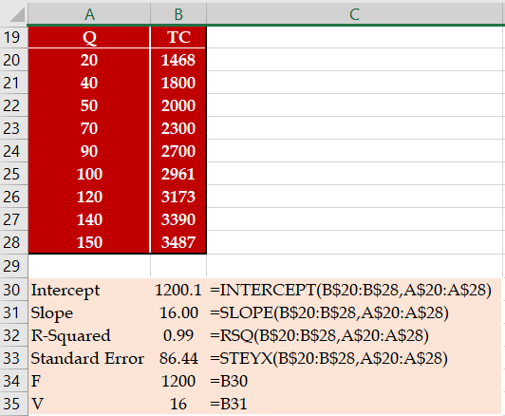
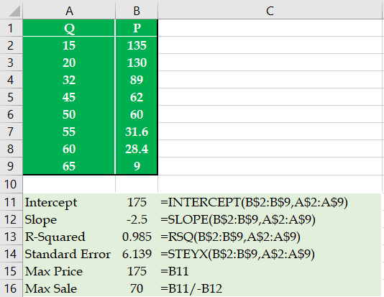
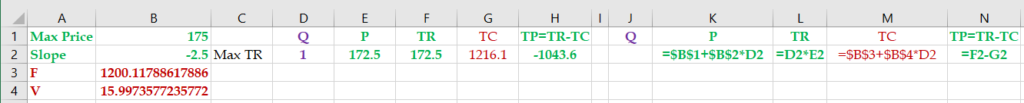
Problem 2
Given the following information on the first part of the problem.
Given any quantity, compute total revenue (TR), total cost (TC), and total profit (TP).
P = 175-2.5Q, TR=PQ, TC= 1200+16Q, TP = TR-TC

Slide 12
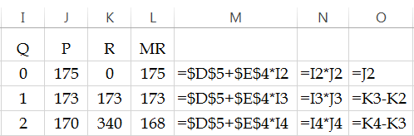
Problem 2
1. Draw the total revenue curve using the linear demand curve:
P=175-2.5Q
R=PQ

Slide 13
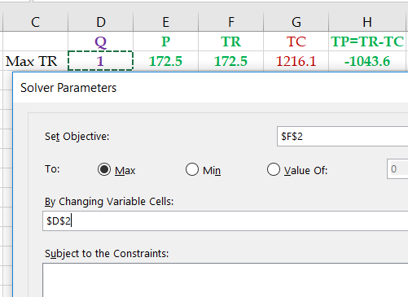
Problem 2
2. At around what quantity of sales is the revenue maximized?

Slide 14
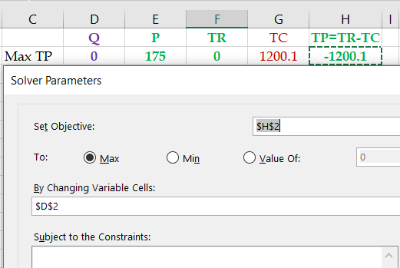
Problem 2
3. At around what volume of sales is total profit maximized?

Slide 15
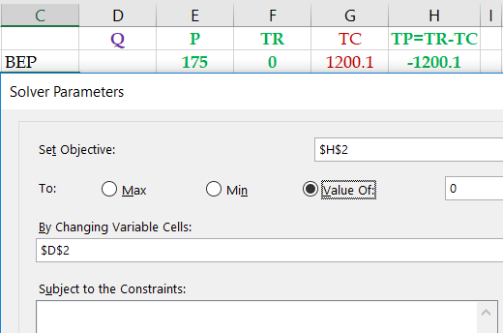
Problem 2
4. At around what quantity of sales do you have the first break-even point (from loss to profit)?

Slide 16
Problem 2
5. At around what quantity of sales do you have the first break-even point (from loss to profit)?
The two BEPs are on the opposite sides of the Q* that leads to the maximal profit (TP*).
If our previous BEP < Q* ➔ Add BEP ≥Q*+1, otherwise BEP≤Q*-1
Our previous BEP is 8.75, our Q* is 31.8 ➔ BEP≤Q*
Add a constraint BEP≥33

Slide 17
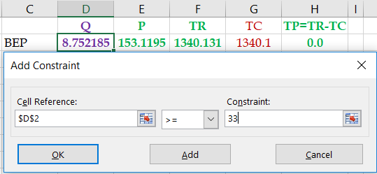
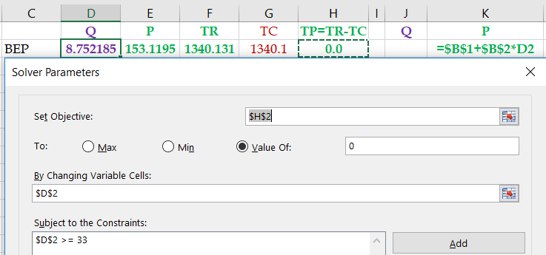
The Other BEP

Slide 18
Problem 2- One Additional Part
Draw the Marginal revenue curve, along with the linear demand curve:
P=175-2.5Q
R=PQ
MR=R_{t}-R_{t-1}
Three Other Examples If You Wish

Slide 19
Problem 3.
1. Given the daily linear demand curve of P=175-2.5 Q, define the Uniform Distribution associated to this linear demand curve. Define a, b, and f(x), where f(x) is the height of the U-Distribution.
2. Compute the probability of sale if the price is set to $105.
3. Given the above price of $105, compute the expected (average) revenue from each visitor.
4. Given the linear demand curve, compute the maximum daily demand (total number of visitors per day).
5. Given the above price of 105 dollars and the maximum number of visitors per day, compute the expected number of units sold per day.
6. Given the above price of 105 dollars, compute the average daily total revenue.
6a. On average 70(0.4) = 28 visitors will purchase our product at the price of $105 per unit.
6b. 70 visitors will purchase our product at the expected price of 0.4(105) = $42 per unit.
7. Given the above price, compute the standard deviation of the number of units sold per day.

Slide 20
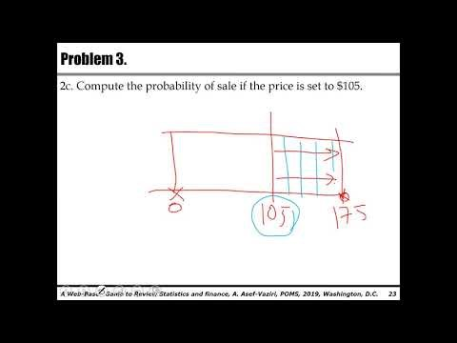
Problem 3. Lecture
https://youtu.be/LuQlX4OBAqU

Slide 21
Problem 3.
1. Given the daily linear demand curve of P=175-2.5 Q, define the Uniform Distribution associated to this linear demand curve. Define a, b, and f(x), where f(x) is the height of the U-Distribution.
If we set the price equal to $175, there will be no sale.
If we set the price equal to 0, all the visitors will buy our product. the total sales is
P= 175-2.5Q
0= 175-2.5Q
Q= 175/2.5 = 70
Even at the price of 0, sales is bounded up by 70 units.

Slide 22
Problem 3.
1. The associated Uniform distribution is then defined as
a=0 and b=175
The height of the Uniform distribution = h= f(x)
Area then = (175-0)h= 1
h=f(x) = 1/(175-0) = 1/175
The associated random variable is then defined as
f(x) = 1/(175-0) = 1/175 for 0≤x≤175
f(x) = 0, elsewhere

Slide 23
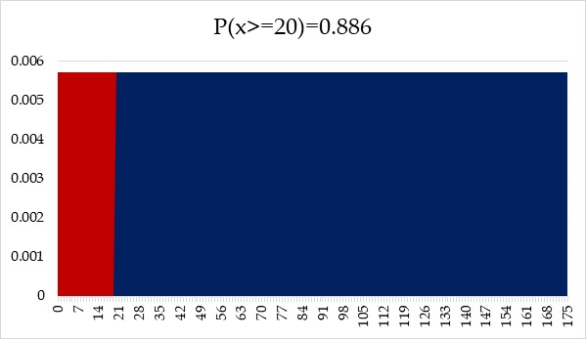
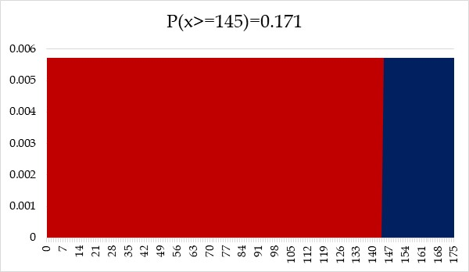
Problem 3.
2a. Compute the probability of sale if the price is set to $20.
Probability of sale =
(175-20)/175
1-20/175
2b. Compute the probability of sale if the price is set to $145.
Probability of sale =
1-145/175

Slide 24
Problem 3.
2c. Compute the probability of sale if the price is set to $105.
P(x≥ 105) = 1-P(x≤105) = 1-105/175=0.4
3. Given the above price of $105, compute the expected (average) revenue from each individual visitor.
Probability of sales is 0.4.
Sale Price is 105.
Expected revenue from each visiting customer = 105(0.4) = $42.

Slide 25
Problem 3.
4. Given the linear demand curve, compute the maximum daily demand (total number of visitors per day).
P= 175-2.5Q
0= 175-2.5Q
Q= 70
5. Given the above price of 105 dollars, and the maximum number of visitors per day, compute the expected number of units sold per day.
Probability of sales is 40%
Therefore, the expected number of units sold = 0.4(70) = 28 units.

Slide 26
Problem 3.
6. Given the above price of 105 dollars, compute the average daily total revenue.
Alternatively, Product price is $105, probability of sales is 0.4. Therefore, expected revenue is 0.4(105)= $42 per visitor.

Slide 27
Problem 3.
7. Given the above price, compute the standard deviation of the number of units sold per day.
Uniform Distribution: Mean = (b+a)/2 and Variance = [(b-a)²]/12.
Binomial Distribution: Mean = np and Variance = np(1-p).
Average μ= np =70(0.4) = 28
VAR =σ² = np(1-p) = 70(0.4)(1-0.4) = 16.8
Standard Deviation = σ = SQRT(16.8) = 4.1
Demand ~N(28, 4.1)
Two Other Example If you Wish

Slide 28
Problem 4.
The price that a customer is willing to pay for our product from our internet store is U~(0, 175). The total number of potential customers visiting this website is 70 per day.
1. Compute the price that maximizes the total revenue.
2. How many units are sold at the price that maximizes the total revenue?
3. Compute the maximum total revenue per day.
4. The variable cost per unit of product is $16 dollars. The total fixed cost is $1200 dollars per day. Compute the price that maximizes the total profit. Solver maximize Profit
5. How many units are sold per day at the price that maximizes the total profit?
6. Compute the maximum total profit per day.
7. Given the price that maximizes the total profit, compute the Variance of the daily sales.
8. Given the price that maximizes the total profit, and an ordering lead time is 4 days. Compute the Variance of the lead time demand.
9. Compute the re-order point. Service level is 90%.
10. Compute the safety stock.

Slide 29
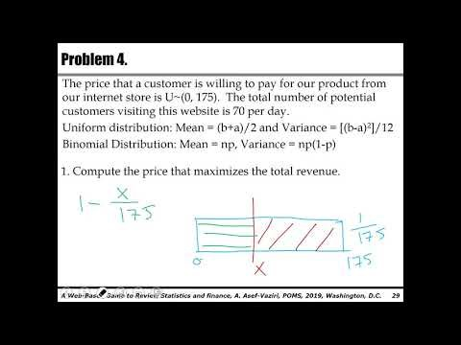
Problem 4. Lecture
https://youtu.be/4S6VMufq_Ok

Slide 30
Problem 4.
The price that a customer is willing to pay for our product from our internet store is U~(0, 175). The total number of potential customers visiting this website is 70 per day.
Uniform distribution: Mean = (b+a)/2 and Variance = [(b-a)²]/12
Binomial Distribution: Mean = np, Variance = np(1-p)
1. Compute the price that maximizes the total revenue.
Price =X
Probability of sales = (175-X)/175 = 1-X/175
Number of units sold = 70*((1-X/175))
Total Revenue = X*70*((1-X/175))
Solver: Maximize Revenue by changing X

Slide 31
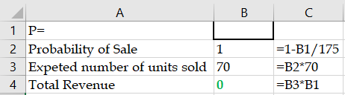
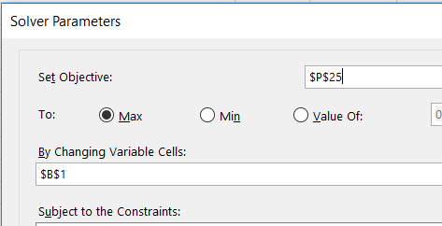

Problem 4.

Slide 32
Problem 4.
2. How many units are sold at the price that maximizes the total revenue?
Probability of Sales is 50%. There are 70 customers.
0.5(70)=35
3. Compute the maximum total revenue per day.
=35*87.5 = 3,062.5
4. The variable cost per unit of product is $16 dollars. The total fixed cost is $1200 dollars per day. Compute the price that maximizes the total profit. Solver maximize Profit

Slide 33
Problem 4.
5. How many units are sold per day at the price that maximizes the total profit?
0.45428571(70) = 31.8 units.
6. Compute the maximum total profit per day.
31.8 (95.5) = $1,328.1.
0.45428571(95.5)(70) = $1,328.1
7. Given the price that maximizes the total profit, compute the Variance of the daily sales.
n=70, P=95.5, Pmax= 175
Probability of sales = 1-95.5/175= 0.454
VAR_{R} = σ²_{R} =70(0.454)(1-0.454) = 17.3537
σ_{R} = SQRT(17.35379 ) = 4.166

Slide 34
Problem 4.
8. Given the price that maximizes the total profit, and an ordering lead time is 4 days. Compute the Variance of the lead time demand.
VAR_{LTD} = L*VAR_{R} = 4* 17.3537 = 69.415
σ_{LTD} = SQRT(L) σ_{R} = SQRT(4)* 4.166 = 8.33

Slide 35
Problem 4.
9. Compute the re-order point. Service level is 90%.
R~N[np,np(1-p)]
R~N(31.8, 4.17)
LTD = LR= 4(31.8) = 127.2
σ_{LTD}=SQRT(L)*σ_{R} = SQRT(4)(4.17) = 8.33
LTD~N(127.2, 8.33)
SL=0.9
=NORM.INV(0.9,127.2,8.33)
ROP =137.88
10. Compute the safety stock.
137.88-127.2 = 10.68
The Last Example if you Wish

Slide 36
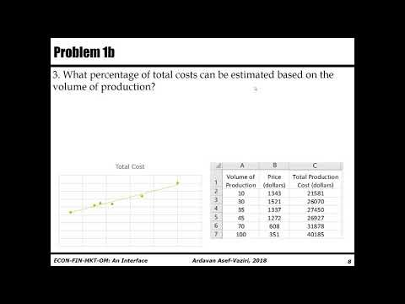
Problem 1b. Lecture on the Next Problem.
https://youtu.be/o-6RWQy-mGM

Slide 37
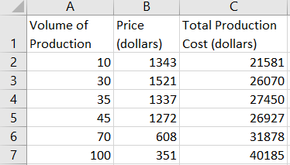
Problem 1b (Practice for Problem 1)
Given following file containing the volume of production (or sales), and corresponding sales price and total costs,
1. Compute the total fixed costs.
=INTERCEPT(C2:C7,A2:A7)= 19,544 dollars.
2. Compute the variable cost per unit of product.
SLOPE(C2:C7,A2:A7) = 196 dollars.

Slide 38
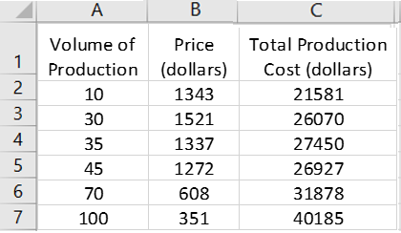
Problem 1b
3. What percentage of total costs can be estimated based on the volume of production?
=RSQ(C2:C7,A2:A7)= 97%
4. Compute the standard deviation of your total cost estimate.
=STEYX(C2:C7,A2:A7) = 1,283 dollars.

Slide 39
Problem 1b
5. Compute the maximum potential sales price.
=INTERCEPT(B2:B7,A2:A7)= 1,732 dollars.
6. Compute the slope of the demand curve.
=SLOPE(B2:B7,A2:A7)= -13.66
7. Compute the maximum potential sales quantity.
P=1732-13.66Q
If we set P=0
1732-13.66Q=0
Q=1732/13.66 =
127 units.
Return To The Slide You Came From

Slide 40
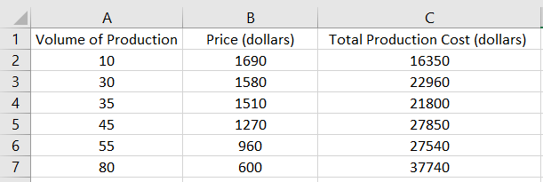
Problem 1c&2b (Practice for Problems 1 &2)
1. Compute the total fixed costs.
13016.58 =INTERCEPT(C2:C7,A2:A7)
2. Compute the variable cost per unit of product.
307.2229 =SLOPE(C3:C8,A3:A8)
3. What % of total costs can be estimated based on the volume of production?
0.961503 =RSQ(C2:C7,A2:A7)
4. Compute the standard deviation of your total cost estimate.
1591.296 =STEYX(C2:C7,A2:A7)

Slide 41
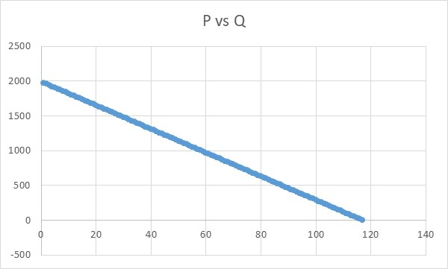
Problem 1c&2b
5. Compute the maximum potential sales price.
1992.144 =INTERCEPT(B2:B7,A2:A7)
6. Compute the slope of the demand curve.
-17.0308 =SLOPE(B2:B7,A2:A7)
7. Compute the maximum potential sales quantity.
P= Intercept+Slope*Q
P = 1992.144 -17.0308Q
0 = 1992.144 -17.0308Q
Q= 1992.144/17.0308
Q = 116.9728

Slide 42
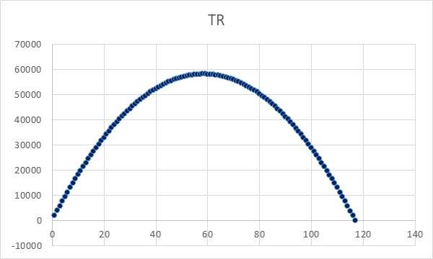
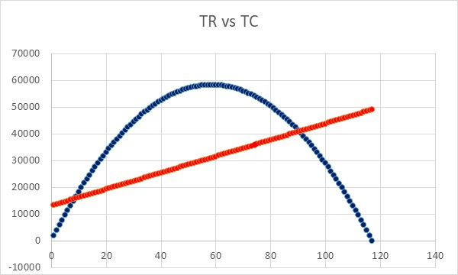
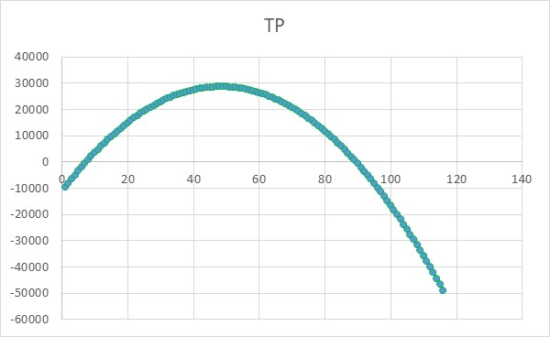
Problem 1c&2b
8. At what quantity is the total sales maximized?
Q
P= 1992.144 -17.0308Q
Total Revenue =TR= PQ
Use Solver to Maximize TR
9. At what quantity is the total profit maximized.
TC = F+VQ

Slide 43
Problem 1c&2b
10. Compute one break-even point
11.Compute the other break-even point

Slide 44
Practice - Problem 2c
Given the following information regarding a production and distribution system; The total fixed costs are equal to 15,700 dollars. The variable cost per unit of product is equal to 810 dollars. The linear demand curve intercept of the price axis is at 1,600 dollars. The slope of the linear demand curve is -5.
1. At around what quantity of sales is the revenue maximized?
Price = 1600-5Q
TR= PQ
2. At around what volume of sales is the total profit maximized?
79 units.

Slide 45
Practice - Problem 2c
2. At around what quantity of sales do you have the first break-even point (from loss to profit)?
23 units.
3. At around what quantity of sales do you have the second BEP?
>=Max Profit
>= 79
135 units.

Slide 46
Practice - Problem 2c
Return To The Slide You Came From

Slide 47
Problem 3b.
Given the demand curve of Qmax= 300 and Pmax = $200, what is the probability of sales if a customer visits our website and buys the product, if:
The price is set to $100.
The price is set to $20.
The price is set to $145.
Draw the total revenue curve using uniform distribution.
Draw the marginal revenue curve using uniform distribution.

Slide 48
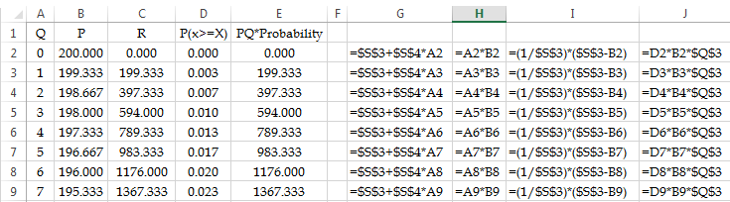
Problem 3b.

Slide 49
Problem 3b.
Therefore, in a linear demand curve with (Qmax, Pmax) = [300,200], if I set the price to a specific P, then the probability that a visitor buys the product is ________?
Therefore, in a linear demand curve with (Qmax, Pmax) = [300,200], if I set the price to a specific P, then the probability that a visitor buys the product is ________?

Slide 50
Problem 3c
The daily linear demand curve in an internet store intercepts the price axis at 708 dollars. The slope of the linear demand curve is -4.
Uniform Distribution: Mean = (b+a)/2 and Variance = [(b-a)²]/12.
Binomial Distribution: Mean = np and Variance = np(1-p).
Compute the height, f(x), of the uniform distribution associated with this linear demand curve.
If we set the price equal to 708, there will be no sale.
If we set the price equal to 0, the total sales are:
P= 708-4Q
0= 708-4Q
Q= 708/4 = 177
Even at the price of 0, sales is bounded up by 177.

Slide 51
Problem 3c
The associated binomial distribution is then defined as
a=0 and b=708
The height of the Uniform distribution = f(x) = 1/(708-0) = 1/708
= 0.001412
2. Compute the probability of sale if the price is set to 150 dollars.
Probability of sale = (708-150)/708 =
78.8136%
3. Given the above price of 150 dollars, compute the expected (average) revenue from each individual visitor.
Probability of sales is 78.8136%
Price is 150
Expected revenue from each customer = 150(78.8136%) = 118.2203 118.2 dollars.

Slide 52
Problem 3c
4. Given the linear demand curve, compute the maximum daily demand (total number of visitors per day).
P= 708-4Q
0= 708-4Q
Q= 708/4 = 177
5. Given the above price of 150 dollars, and given the maximum number of visitors per day, compute the average number of units sold per day.
Probability of sales is 78.8136%
177 visitors
(78.8136%)*177 = customers will buy at 150
Or: 177 customers will buy at (78.8136%)*150 =139.5 customers

Slide 53
Problem 3c
6. Given the above price of 150 dollars, compute the average daily total revenue.
We can say 177 customers will visit, and probability of sales is 78.8136%. Therefore 139.5 customers will purchase our product at $150 per unit.
We can say product price is $150, and the probability of sales is 78.8136%. Therefore 177 customers will purchase our product at $118.22 per unit.
20,925 dollars.
7. Given the above price, compute the standard deviation of the number of units sold per day.
VAR = np(1-p) = 177(.788136)(1-.788136) = 29.55508475
Standard Deviation = 5.44, Average = 177(.788136)= 139.5
Demand ~N(139.5, 5.44)
Return To The Slide You Came From

Slide 54
Problem 4b
Suppose the price that a customer is willing to pay for a product in an internet store is uniformly distributed between 0 and 1,560. The total number of potential customers visiting this website is 120 per day.
Uniform distribution: Mean = (b+a)/2 and Variance = [(b-a)²]/12
Binomial Distribution: Mean = np, Variance = np(1-p)
σ_{LTD}=SQRT(L)*σ_{R}, σ_{LTD}=Rσ_{L}, ROP=LTD+Isafety
1. Compute the price that maximizes the total revenue.
Price =X
Probability of sales = (1560-X)/1560
Total Revenue = 120{X[(1560-X)/1560]}
780 dollars.

Slide 55
Problem 4b
2. How many units are sold at the price that maximizes the total revenue?
Probability of Sales is 50%. There are 120 customers.
0.5(120)=60
3. Compute the maximum total revenue per day.
46800 dollars.
4. The variable cost per unit of product is 258 dollars. The total fixed cost is 14,000 dollars per day. Compute the price that maximizes the total profit.
909 dollars.

Slide 56
Problem 4b
5. How many units are sold per day at the price that maximizes the total profit?
50 units.
6. Compute the maximum total profit per day.
18,600 dollars.
6. Given the price that maximizes the total profit, compute the Variance of the daily sales.
N=120
p=909
Pmax= 1,560
Probability of sales = (1560-909)/1560= 0.417307694
VAR = 120(0.417307694)(1-0.41730769) = 29.1794379

Slide 57
Problem 4b
8. Given the price that maximizes the total profit, compute the Standard Deviation of the lead time demand. Ordering lead time is 9 days.
A: 26 units
B: 11 units
C: 10 units
D: 16 units
E: 14 units
9. Compute the re-order point. Service level is 90 percent.
A: 1,299 units
B: 224 units
C: 243 units
D: 471 units
E: 169 units
Not saved Submit Quiz
Keep Editing This Quiz
Keep Editing This Quiz
Questions
Haven't Answered Yet
Question 1
Time Elapsed: Hide

Slide 58
Problem 2
There is an online store. Each day 300 potential customers visit the website. If the price is $200, no product is sold. Draw the demand curve and the revenue curve in Excel.

