Slide 1
Reviewing Some Basic Statistics, Economics, and Finance Concepts in an Operations Management Course

Slide 2

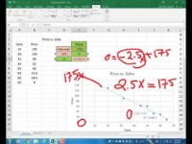
Lecture on Problem 1
https://youtu.be/ihcxHjUwLCw

Slide 3
Problem 1.
Given the Total Costs vs. Quantity Produced (TC-Q) data, and the Price vs Quantity Sold (P-Q) data. Assume that the quantity produced is equal to the quantity sold.
1. Using TC-Q data, estimate the total fixed costs, and variable cost per unit of product.
2. Compute the Coefficient of Determination (R-Squared) , Correlation Coefficient (CC), and Standard Deviation of the estimates (Standard Error) for the Total Costs.
3. Using the P-Q data, prepare a linear demand curve. Compute Max-P and Max-Q. Then prepare a non-linear demand curve.

Slide 4
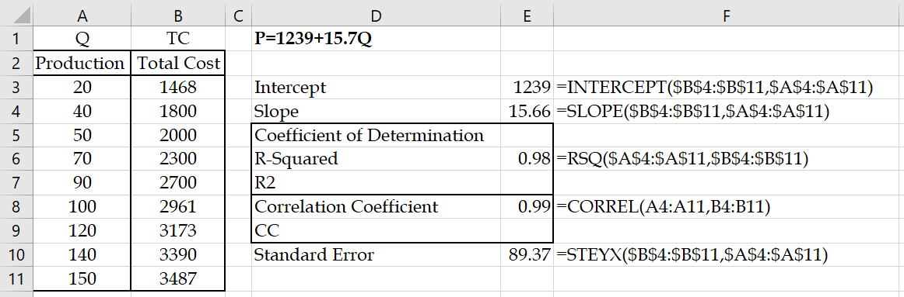
Problem 1. Estimate Fixed and Variable Costs

Slide 5
General R² Values

Slide 6
Problem 1. Estimate Demand Curve: Max D(Q) and Max P
Prepare a linear demand curve using the following price and sales data.

Slide 7
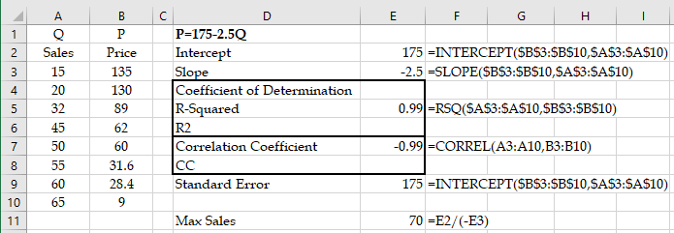
Problem 1. Estimate Demand Curve: Max D(Q) and Max P

Slide 8
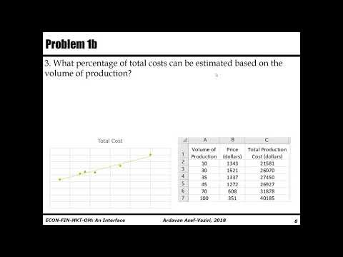
Problem 1b. Lecture on the Next Problem.
https://youtu.be/o-6RWQy-mGM

Slide 9
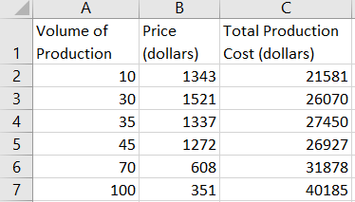
Problem 1b (Practice for Problem 1)
Given following file containing the volume of production (or sales), and corresponding sales price and total costs,
1. Compute the total fixed costs.
=INTERCEPT(C2:C7,A2:A7)= 19,544 dollars.
2. Compute the variable cost per unit of product.
SLOPE(C2:C7,A2:A7) = 196 dollars.

Slide 10
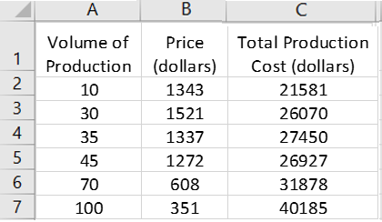
Problem 1b
3. What percentage of total costs can be estimated based on the volume of production?
=RSQ(C2:C7,A2:A7)= 97%
4. Compute the standard deviation of your total cost estimate.
=STEYX(C2:C7,A2:A7) = 1,283 dollars.

Slide 11
Problem 1b
5. Compute the maximum potential sales price.
=INTERCEPT(B2:B7,A2:A7)= 1,732 dollars.
6. Compute the slope of the demand curve.
=SLOPE(B2:B7,A2:A7)= -13.66
7. Compute the maximum potential sales quantity.
P=1732-13.66Q
If we set P=0
1732-13.66Q=0
Q=1732/13.66 =
127 units.

Slide 12
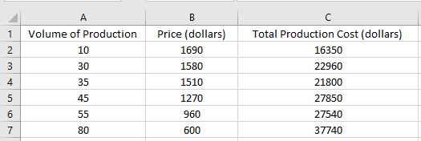
Problem 1c
1. Compute the total fixed costs.
13016.58 =INTERCEPT(C2:C7,A2:A7)
2. Compute the variable cost per unit of product.
298.5903 =SLOPE(C2:C7,A2:A7)
3. What % of total costs can be estimated based on the volume of production?
0.961503 =RSQ(C2:C7,A2:A7)
4. Compute the standard deviation of your total cost estimate.
1591.296 =STEYX(C2:C7,A2:A7)

Slide 13
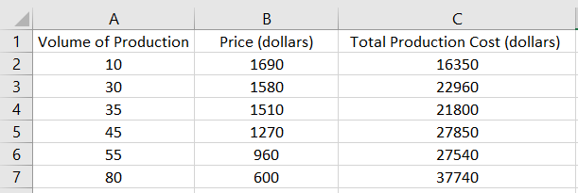
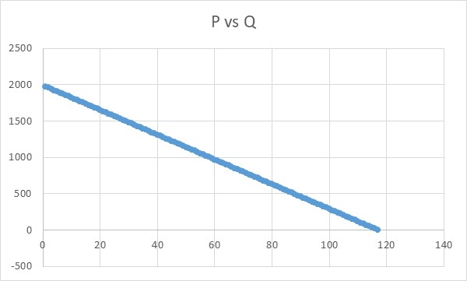
Problem 1c
5. Compute the maximum potential sales price.
1992.144 =INTERCEPT(B2:B7,A2:A7)
6. Compute the slope of the demand curve.
-17.0308 =SLOPE(B2:B7,A2:A7)
7. Compute the maximum potential sales quantity.
P= Intercept+Slope*Q
P = 1992.144 -17.0308Q
0 = 1992.144 -17.0308Q
Q= 1992.144/17.0308
Q = 116.9728

