Slide 1


Slide 2
Reviewing Some Basic Statistics, Economics, and Finance Concepts in an Operations Management Course

Slide 3
Problem 1.
Given the Total Costs vs. Quantity Produced (TC-Q) data, and the Price vs Quantity Sold (P-Q) data. Assume that the quantity produced is equal to the quantity sold.
1. Using TC-Q data, estimate the total fixed costs, and variable cost per unit of product.
2. Compute the Coefficient of Determination (R-Squared) , Correction Coefficient (CC), and Standard Deviation of the estimates (Standard Error) for the Total Costs.
3. Using the P-Q data, prepare a linear demand curve. Compute Max-P and Max-Q. Then prepare a non-linear demand curve.

Slide 4
Note
Please note that there are two recordings for this problem. One is on the next page and one is on page 11.
I recommend to watch the first one- If you follow everything you are fine. If not you may chose to watch the second one too.
They are mainly the same with some minor differences.

Slide 5

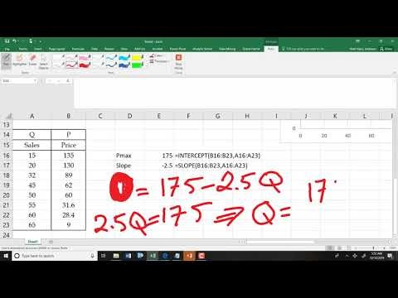
The Lecture On Problem 1

Slide 6
Problem 1. Estimate Demand Curve: Max D(Q) and Max P
Prepare a linear demand curve using the following price and sales data.
(a) Estimate the Max possible price.
(b) Estimate the Max possible sales.
P=175-2.5Q
P=0 ➔ 175-2.5Q=0 ➔ 2.5Q=175

Slide 7
Problem 1. Estimate Fixed and Variable Costs
Estimate the total fixed costs and variable cost per unit of product.

Slide 8
General R² Values

Slide 9
Estimate Demand Curve: Max D(Q) and Max P
Draw the demand curve using exponential regression.
Another Example If You Wish

Slide 10
Problem .
1. At around what quantity of sales is the revenue maximized?
2. At around what volume of sales is total profit maximized?
3. At around what quantity of sales do you have the first break-even point (from loss to profit)?
4. At around what quantity of sales do you have the second break-even point (from profit to loss)?

Slide 11
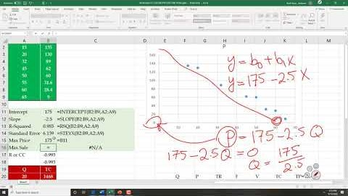
This is Another Recording For the Same Problem
https://youtu.be/a3f1vEa2OxY

Slide 12
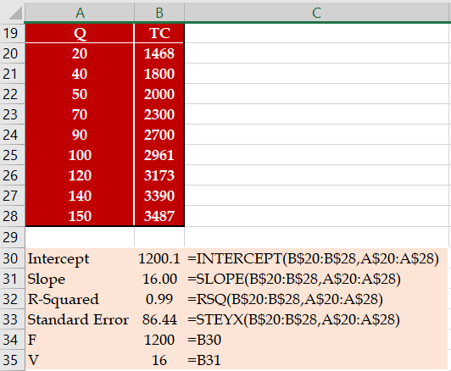
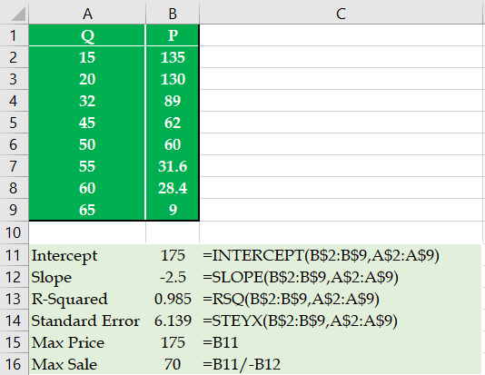
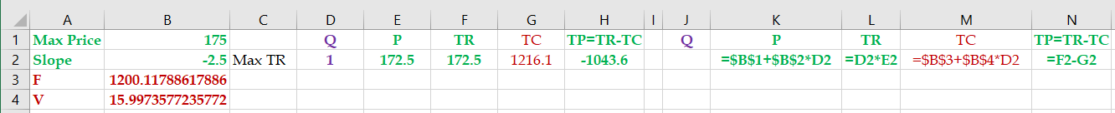
Problem 1
Given the following information on the first part of the problem.
Given any quantity, compute total revenue (TR), total cost (TC), and total profit (TP).
P = 175-2.5Q, TR=PQ, TC= 1200+16Q, TP = TR-TC

Slide 13
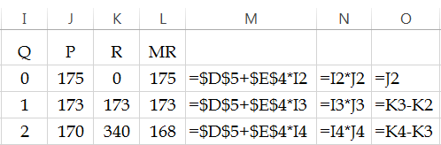
Problem 1
1. Draw the total revenue curve using the linear demand curve:
P=175-2.5Q
R=PQ

Slide 14
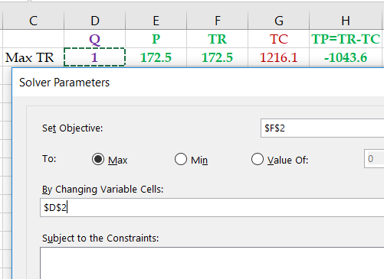
Problem 1
2. At around what quantity of sales is the revenue maximized?

Slide 15
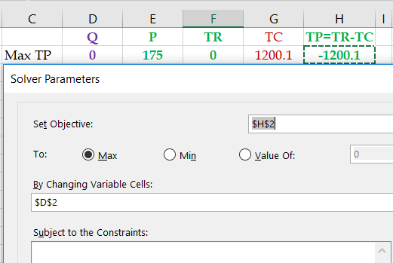
Problem 1
3. At around what volume of sales is total profit maximized?

Slide 16
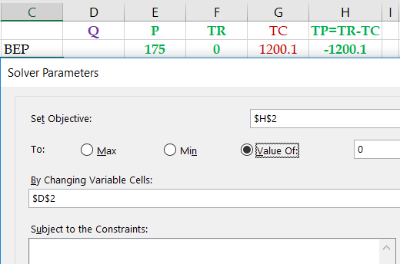
Problem 1
4. At around what quantity of sales do you have the first break-even point (from loss to profit)?

Slide 17
Problem 1
5. At around what quantity of sales do you have the first break-even point (from profit to loss)?
The two BEPs are on the opposite sides of the Q* that leads to the maximal profit (TP*).
If our previous BEP < Q* ➔ Add BEP ≥Q*+1, otherwise BEP≤Q*-1
Our previous BEP is 8.75, our Q* is 31.8 ➔ BEP≤Q*
Add a constraint BEP≥33

Slide 18
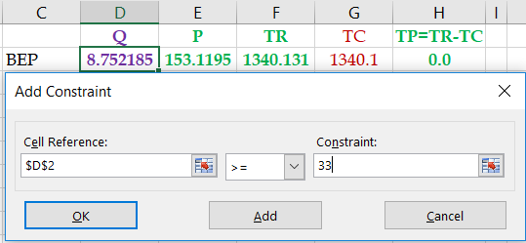
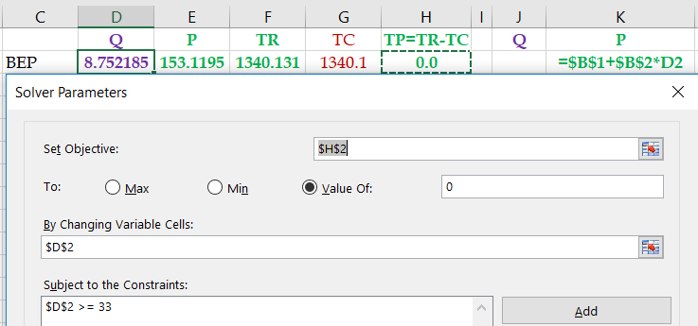
The Other BEP

Slide 19
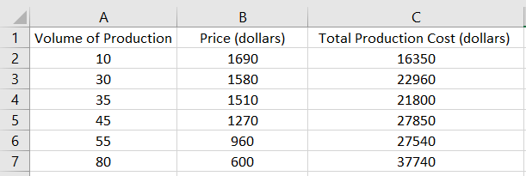
Problem 2
1. Compute the total fixed costs.
13016.58 =INTERCEPT(C2:C7,A2:A7)
2. Compute the variable cost per unit of product.
298.59 =SLOPE(C2:C7,A2:A7)
3. What % of total costs can be estimated based on the volume of production?
0.961503 =RSQ(C2:C7,A2:A7)
4. Compute the standard deviation of your total cost estimate.
1591.296 =STEYX(C2:C7,A2:A7)

Slide 20
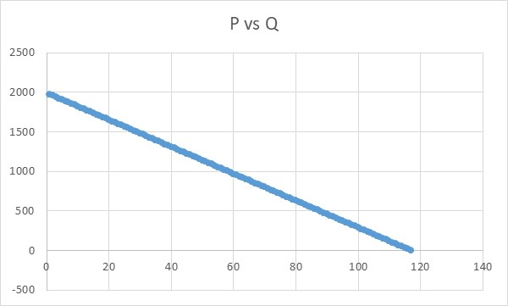
Problem 2
5. Compute the maximum potential sales price.
1992.144 =INTERCEPT(B2:B7,A2:A7)
6. Compute the slope of the demand curve.
-17.0308 =SLOPE(B2:B7,A2:A7)
7. Compute the maximum potential sales quantity.
P= Intercept+Slope*Q
P = 1992.144 -17.0308Q
0 = 1992.144 -17.0308Q
Q= 1992.144/17.0308
Q = 116.9728

Slide 21
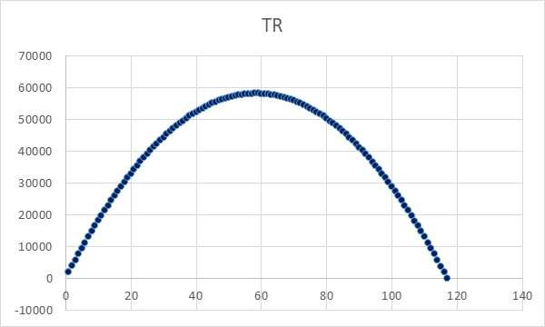
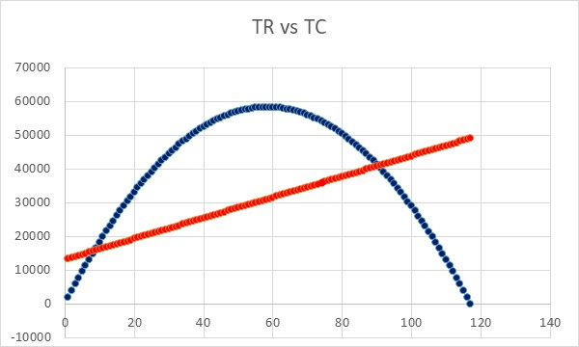
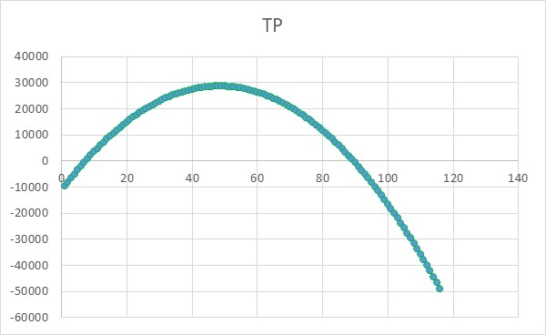
Problem 2
8. At what quantity is the total sales maximized?
Q
P= 1992.144 -17.0308Q
Total Revenue =TR= PQ
Use Solver to Maximize TR
9. At what quantity is the total profit maximized.
TC = F+VQ

Slide 22
Problem 2
10. Compute one break-even point
11.Compute the other break-even point

Slide 23
Practice - Problem 3
Given the following information regarding a production and distribution system; The total fixed costs are equal to 15,700 dollars. The variable cost per unit of product is equal to 810 dollars. The linear demand curve intercept of the price axis is at 1,600 dollars. The slope of the linear demand curve is -5.
1. At around what quantity of sales is the revenue maximized?
Price = 1600-5Q
TR= PQ
2. At around what volume of sales is the total profit maximized?
79 units.

Slide 24
Practice - Problem 3
2. At around what quantity of sales do you have the first break-even point (from loss to profit)?
23 units.
3. At around what quantity of sales do you have the second BEP?
>=Max Profit
>= 79
135 units.

Slide 25
Practice - Problem 3
Return To The Slide You Came From

Slide 26
Problem 1d
There is an online store. Each day 300 potential customers visit the website. If the price is $200, no product is sold. Draw the demand curve and the revenue curve in Excel.

Slide 27
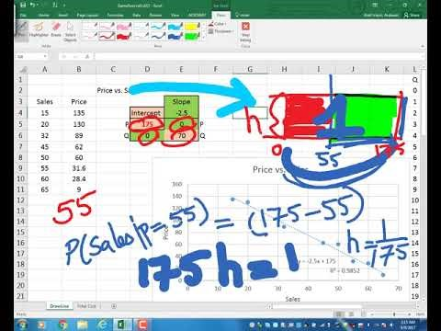
Lecture on Additional Concepts- Not Required
https://www.youtube.com/watch?v=2_qlQiYTLCs&t=1188s

