Slide 1
Flow Time
2-Critical Path Method
Based on the book: Managing Business Process Flows

Slide 2
Flow Time Example: Activity Times
4
6
A1
A3
E
4
3
S
A4
A6
3
2
A2
A5
What is the Theoretical Flow Time
Critical Path method
Ardavan Asef-Vaziri, June, 2015
2

Slide 3
Critical Path Method: Paths
How many paths?
4
6
A1
A3
E
4
3
S
A4
A6
3
2
A2
10
11
8
A5
Critical Path is the longest Path
Ardavan Asef-Vaziri, June, 2015

Slide 4
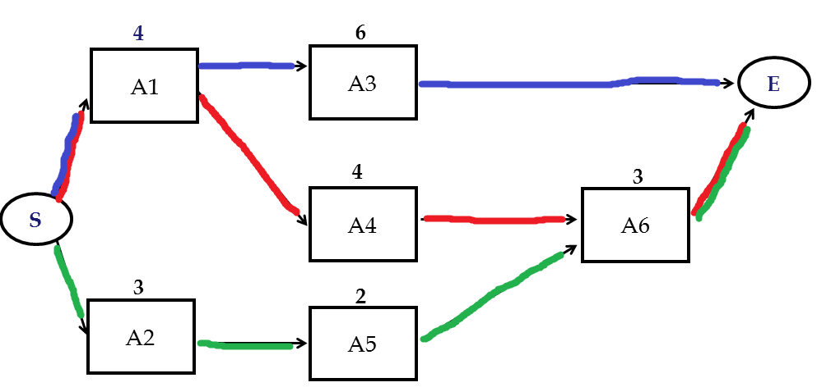
Critical Path Example of Flow Time
a) The Critical Path is A1-A4-A6. The theoretical flow time of the process is 4+4+3= 11.
b) What will happen if activity A5 is increased from 2 to 4?
10
11
8
A5 is not on critical path. Increasing its time by 2 increases the length of the path A2-A5-A6 from 8 to 10. It does not become a critical path. The flow time is still 11.
c) What will happen if activity A5 is increased from 2 to 5?
Critical Path method
Ardavan Asef-Vaziri, June, 2015
4

Slide 5
Critical Path Example of Flow Time
The length of the path A2-A5-A6 becomes 11.
Both A1-A4-A6 and A2-A5-A6 are critical path. The flow time is still 11.
10
11
8
d) What will happen if activity A1 is increased from 4 to 5?
Path A1-A4-A6 is still critical and the flow time increases to 12.
e) What will happen if activity A3 is increased from 6 to 8?
Now path A1-A3 becomes critical and the flow time increases to 4+8 =12.
Critical Path method
Ardavan Asef-Vaziri, June, 2015
5

Slide 6
Theoretical Critical Path vs. Critical Path
The time of the critical path differs from the time of the theoretical critical path. Why?
4
6
A1
W3
A3
W8
E
W1
W4
W9
4
3
S
A4
W6
A6
W2
3
2
W7
A2
W5
A5
The critical path itself also may differ from the theoretical critical path. Why?
Critical Path method
Ardavan Asef-Vaziri, June, 2015
6

Slide 7
Critical Path Methos: Forward Path; Earliest Starts
4
6
A1
4
4
A3
E
10
10
11
0
0
4
4
4
10
11
4
3
0
S
4
A4
8
8
A6
11
0
5
3
4
8
8
11
2
0
A2
A5
5
3
3
0
3
3
5
Critical Path method
Ardavan Asef-Vaziri, June, 2015
7

Slide 8
Forward Path; Earliest Starts
Max = 30
35
10
35
35
30
20
5
Critical Path method
Ardavan Asef-Vaziri, June, 2015
8

Slide 9
Backward Path; Latest Starts
0
4
4
5
6
11
5
5
11
11
11
A1
4
4
A3
E
4
10
10
0
11
11
0
0
4
4
4
10
11
0
4
4
8
8
3
11
11
0
4
8
8
S
4
A4
8
8
A6
3
8
11
0
5
3
3
3
6
4
8
8
11
6
2
8
0
6
8
A2
6
A5
3
3
5
0
3
3
5
Critical Path method
Ardavan Asef-Vaziri, June, 2015
9

Slide 10
Backward Path; Latest Starts
30
Min = 35
30
35
30
30
45
5
Critical Path method
Ardavan Asef-Vaziri, June, 2015
10

Slide 11
Activity Slack
Slack, or float: The amount of time a noncritical task can be delayed without delaying the project
Slack—LFT – EFT or LST – EST
EST—Earliest Start Time; Largest EFT of all predecessors
EFT—Earliest Finish Time; EST + duration for this task
LFT—Latest Finish Time; Smallest LST of following tasks
LST—Latest Start Time; LFT – duration for this task
Critical Path method
Ardavan Asef-Vaziri, June, 2015
11

Slide 12
Critical Path, Slacks
0
4
4
5
6
11
11
A1
A3
E
11
0
4
4
10
4
4
8
8
3
11
S
A4
A6
3
3
6
4
8
8
11
6
2
8
A2
A5
3
Critical Path method
Ardavan Asef-Vaziri, June, 2015
12

Slide 13
A Key Problem: The Impact Converging Activities
Which process has a longer flow time?.
Activity 1
Activity 2
In a deterministic world they both have a flow time of 30 mins.
The situation differs in real world where nothing is deterministic.
Suppose instead of an exact number of 15, the activity time is uniformly distributed in the range of 10 to 20. The average is still 15.
15
15
Activity 1
15
Activity
15
Activity 2
15
Critical Path method
Ardavan Asef-Vaziri, June, 2015
13

Slide 14
A Key Problem: The Impact Converging Activities
Activity time = 10+10rand()
rand() is a random number between 0 and 1.
If it is ranch = 0, the duration of the activity is 10, if rand() = 1, 1, the duration of the activity is 20.
For all possible rand() 10 ≤ Activity Time ≤ 20
For the fist project, the project duration is computed as the duration of Activity 1 + duration of Activity 2. That is
10+10rand()+10+10rand()
We can generate 1000 instance of each activity in excel and compute project duration.
Critical Path method
Ardavan Asef-Vaziri, June, 2015
15

Slide 15
A Key Problem: The Impact Converging Activities
For project 2, still duration of all the activities are computed as 10 ≤ 10+10rand() ≤ 20
However, the the project duration is computed as the MAX duration of (Activity 1, Activity 2) + duration of Activity 3.
Max duration of (Activity 1, Activity 2) > 10+10rand().
That is the significance of convergence points.
Not even in a single instance the duration of Project 1 was greater that that of Prject 2.
Critical Path method
Ardavan Asef-Vaziri, June, 2015
15

Slide 16
Key Problem Flow time: 10,000 Instances
Critical Path method
Ardavan Asef-Vaziri, June, 2015
17

Slide 17
Converging Activities + Common Resources
All activities are [10,20] minutes. 10+10RAND(). Average 15.
One Recourse Red, One Resource Blue, One Resource Green.
Project Duration >> 45
Activity B1
Activity R2
Activity G
Activity R1
Activity B2
Critical Path method
Ardavan Asef-Vaziri, June, 2015
18

Slide 20
A
C
H
D
F
S
F
B
E
G
I

