Slide 1

The Flipped Classroom of
Operations Management
A Not-For-Cost-Reduction Platform
Ardavan Asef-Vaziri,
Systems and Operations Management
California State University, Northridge

Slide 2
Lectures online, Fights inline
    By delivering the lectures online using recorded screen captures, the students are empowered to stop, rewind, and Fast Forward the professor.
    This is an excellent learning power.
    Class time is no
Problem solving
Trouble shouting
Participation
Enhancement
Real world Apps
and Discussions
Systems-thinking
Creative -thinking
Case studies
Web-based Simulation
    longer spent on teaching the basic concepts, but on more value-added activities

Slide 3
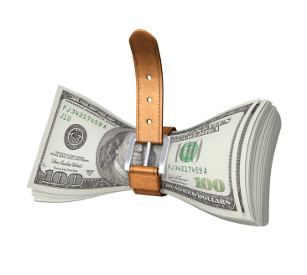

Cost World – Bounded World
Reduction in the cost of a traditional course delivery by switching it to online is bound by the total cost of the course.
Improvement by moving online or hybrid is also limited. 2%, 5%, 10%, or
-%?

Slide 4


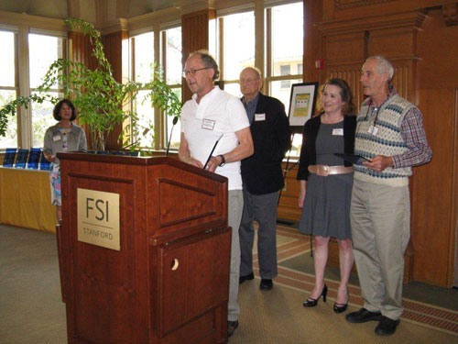
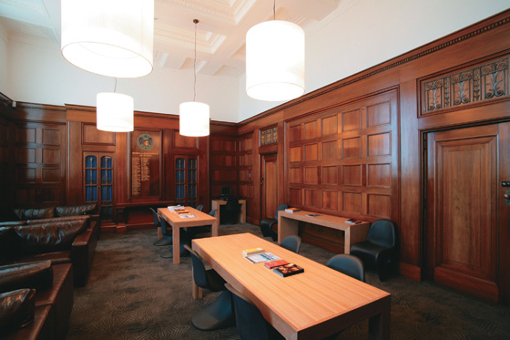
Costs = Trips, Professors, Classrooms, TAs
For the hybrid courses to achieve their cost reduction goal from the students’ perspective, it is important to bundle 2-4 courses in a hybrid form - to save a direct $ and indirect (time) cost of round trip to campus.
Online and hybrid, no prof., extensive TA hours?
Opportunity cost of room > Opportunity
cost of professor.

Slide 5

Cost World – Behavioral Aspects
Make the educational entity more efficient through workforce reduction? Human resources will informally resist.
First generation college students;
face-to-face, live communication with their professors; their role models, their future friends. That is a valuable chuck to put on their parents table.

Slide 6

Cost World vs. Throughput World
Flipped Courses belong to the throughout world. The feasible region of the throughput in the direction of improvement of the objective function is unbounded.
Online courses are Made To Stock products. Flipped classroom is Make to Order.

Slide 7
Cost World vs. Throughput World
Class discussions in a flipped classroom can differentiate us. Transfer our courses into a non-tradable products; a product renewing itself in each new offering. Flipped Courses add to dynamic capabilities of universities.
Not even a single class session is cancelled in a flipped classroom, while all the lectures are delivered online.

Slide 8
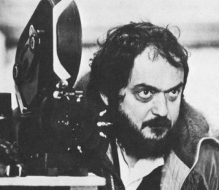


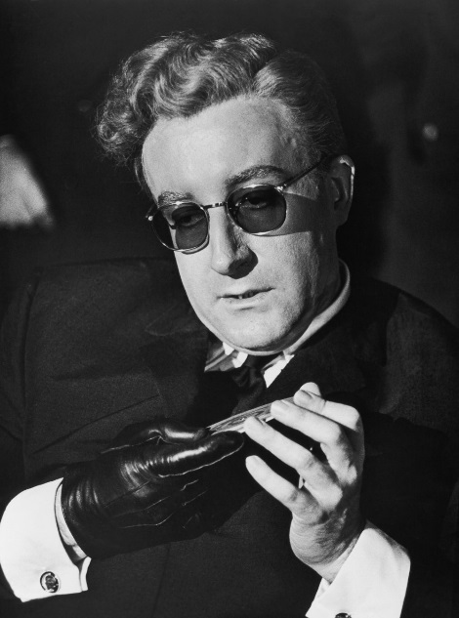
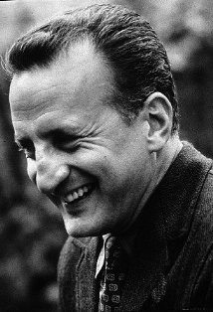
Great Films are not just a great Idea

Slide 9
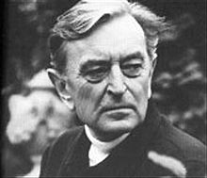




Great Films are a Network of Good Chunks well Integrated.

Slide 10
The Total; System

Slide 11
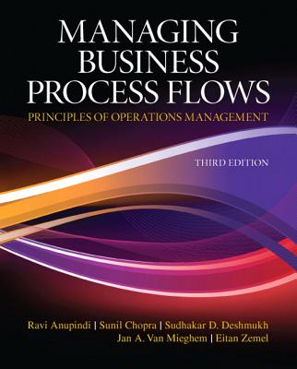
1. Text Book
Not thick
Not isolated islands of OM Tools.
Integrated approach to improve process flow in MFG and SERVS
The authors teach at the world class business schools.
Unfortunately the book do not have that much supporting material for undergraduate studies and no online material.

Slide 12
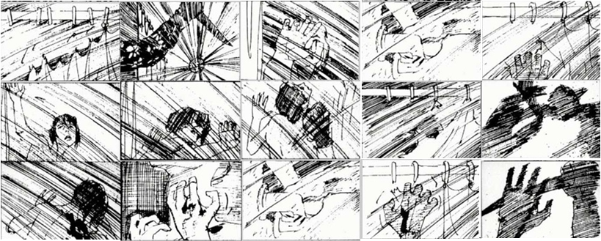
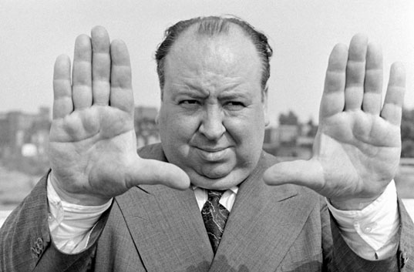
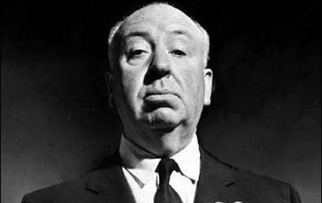
2. Lecture Captures- Philosophy
Record it in (i) classroom and leave it for (ii) 7 years !!??
As we learn from Hitch, before filming starts, all of the séances have already been pictured in a drawing booklet. The film has already been structurally made all he needs is to transfer it on another media.

Slide 13

3. Lecture Captures
Using Camtasia Studio software , lectures are captured in the office in a controlled environment.
The voice of the instructor is recorded along with what is happening on the screen; slides, animations, and what the instructor writes or draw on the screen. No close-up or long-shot of the instructor; no distract.
Well-designed structure, no room for a free flow of discussions, where the latter is the ideal case for the in-class recordings.
In order to close the loop, and to take the feedback from the face-to-face class-discussion and bring it into the lecture captures, re-capturing of 15% of the lectures per semester is recommended; a verage lecture age is < 2 years.

Slide 14

4. After Lecture and Before Class Quizzes
After lecture and before the students come to class to ensure that the they have listened to the lectures.
The students do not need anything except
listening to the lectures.
Basic quizzes are the same as problems in
the lecture, just numbers are changed.
They may also go thorough the basic
assignments if they wish.

Slide 15
5. Step-by-Step Animated-Narrated Solved Assignments
Step-by-step animated solutions to the assignments. Put assignments in the slide show mode. The next move is just one mouse click away. 2-10 mouse clicks from one slide to the next. Some assignments are also narrated.
Basic, Intermediate, Advanced assignments.
A below average student, after listening to the lecture, can independently solve! the solved assigned problems.

Slide 16
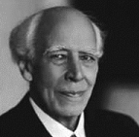
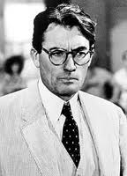
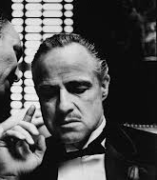
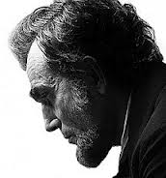
6. Pre-Class Meditation, State Zero
Constantine Stanislavsky had a more profound effect on the process of acting than anyone else in the twentieth century. Great actors such as Marlon Brando, Gregory Peck, and Daniel Day Lewis have followed his method.
The difference between the good actor and the great actor was the ability to be relaxed and to be private in public. Sate Zero; cut the mental links with unrelated environment.

Slide 17

7. In-class
Echo360 is another enabling technology to record the class discussions. The recordings will be posted the same day.
In-class recordings are in an open, lively, free flow environment; an environment for creativity, challenges and debates, frequent interruption.

Slide 18


7. Class Attendance, Class Participation, Class Engagement
Class Attendance
Class Enhancement
Class Participation

Slide 19

8. After Class Quizzes
The basic, intermediate, and advanced online algorithmic quizzes have been designed and implemented by the instructor. They differ from the types of quizzes available by publishers or educational service providers for similar books.
The quiz bank is a strategic fit for a text book designed for the world class business schools thought under the constraint of the quantitative capabilities of an average student in an average business school.

Slide 20
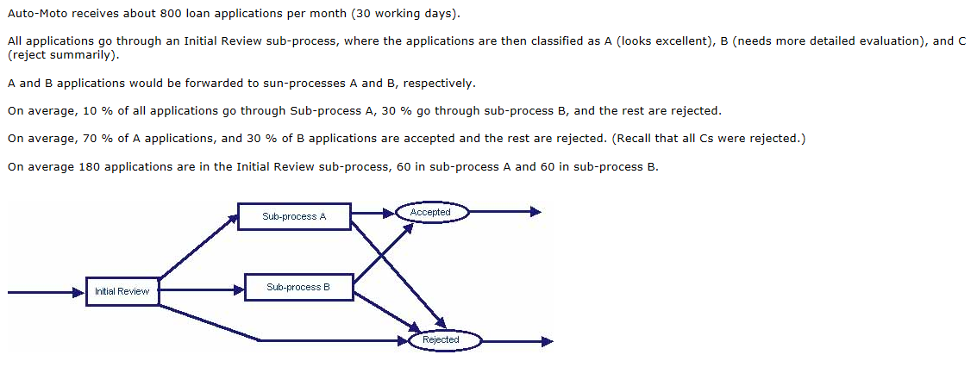
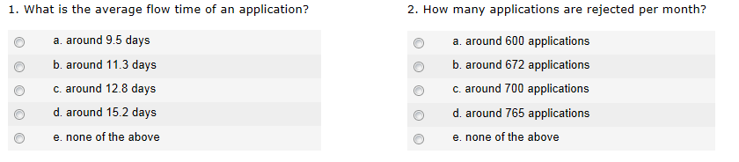
8. After Class Quizzes

Slide 21
8. After Class Quizzes
Only through a continuous set of quizzes one can assure that the learning process is lean and smooth. Otherwise, bundles of material will be postponed to be studies in the peak days or even peak hours of mid-term and final exams. What is learned in peak days will be forgotten in a shorter period.

Slide 22
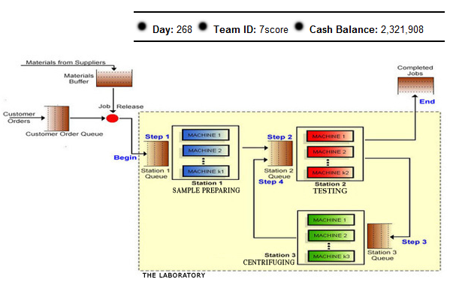
9. Web-based Games
Two computer games, each 1 week, each hour in the game equivalent to one day of operations, 7*24+100 = 268 days.
The students act as operations managers, apply the OM tools, techniques, and methodologies to the system under their supervision in a virtual environment.
After the first game, the students realize that understanding the course material plays a profound role in their performance in the game; therefore, they allocate more time to learn the course material related to the second game.
In a report, students will explain how they played the games, what operations management tools and techniques they used, the good and bad decisions they made, and what they learned throughout the games.

Slide 23

10. Online Communication System (Moodle)
To make sure the students have listened to the lecture captures, have taken basic quizzes, and have worked on the assignments.
We send emails at least once a day, and a few hours before the quiz due dates to the students who seem to have not listened to the lectures, or have not taken the basic quizzes.
We also send emails to the students who have taken the basic quizzes, instructing them to proceed ahead to the solve assignments, get ready for class discussion, and be prepared for the upcoming intermediate and advanced quizzes.
We also open forums on Moodle allowing the students to search for teammates or discuss specific topics.

Slide 24
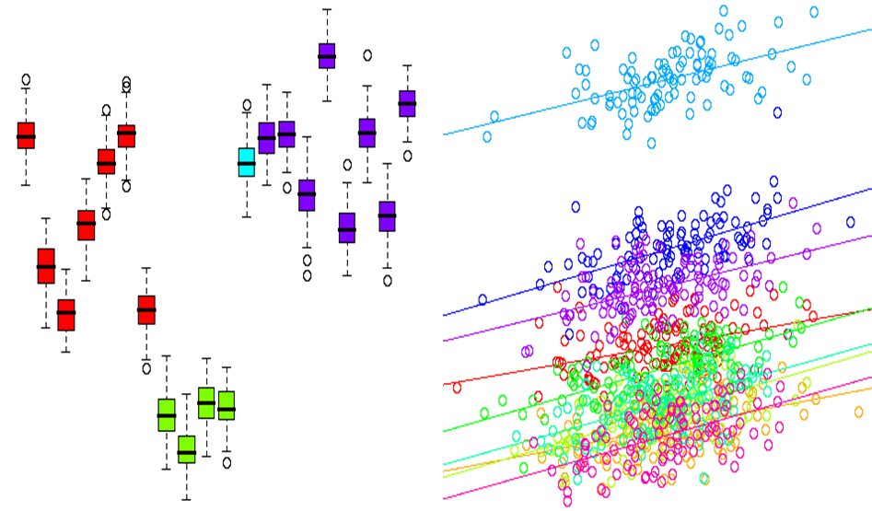
11. Academic Honesty Control System.
Moodle enables the instructor to play the role of big brother.
A wealth of data on student interactions is available
  the time and duration a student has listened to a lecture
  the time and duration a student has spent on quizzes, etc.
Several types of simple and multiple linear regression analyses are conducted in the back-ground to ensure academic integrity.
  If the ratio of the quiz-grade/time-spent by the student exceeds UCL, odds of monitoring and auditing the student increase. If it falls below LCL, we will try to support the student to improve his/her performance.
  If the StdDev of the quiz grades of a student exceeds UCL, odds of auditing the student increase.

Slide 25
Regression Analysis: quizzes vs. Mid-Term
The average grade online quizzes was 10% more than proctored midterm exams.
  quizzes are taken shortly after listening to the online lectures and shortly after in-class discussions
  are open book
  the lowest quiz was dropped,
  students have more time
  Have less stress during the quizzes.
Having named all these elements, along with the great set of random algorithmic problems, we can claim that there is no evidence supporting academic disintegration attributed to quizzes.

Slide 26
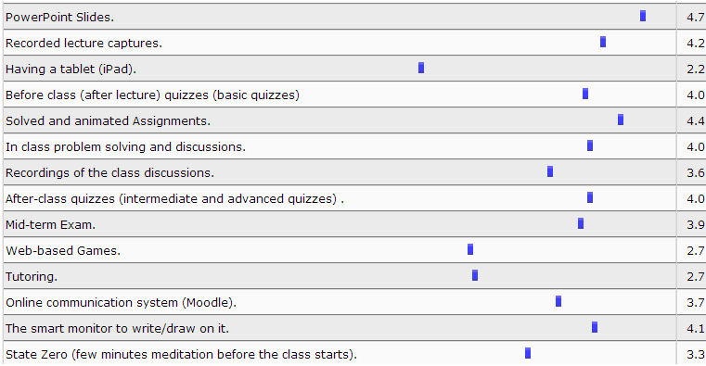

Slide 27
Descriptive Statistics

Slide 29
Pareto diagram for the four semester grades, Spring 2011 to Fall 2012

Slide 30
Class Attendance, Class Participation, Class Engagement

Slide 31
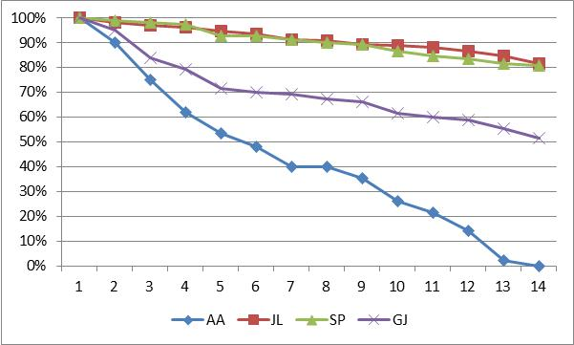
Traditional Components of a Flipped Classroom Must Outperform the Best of the Traditional Courses

Slide 32
The Gap Between Layers of Students
Focus on the top 20%
Focus on the bottom 20%
Turn D and F students into C students. Or Turn A and B students into MS and PhD candidates. Unlike Sci., Eng. and Soc. Science at CSUN, COBAE is not known for MS and PhD.

Slide 33
Flipped Classroom Has All the Competing Edges of Traditional, Hybrid, and Online Courses
In order for a flipped classroom to outperform its substitutes it need to at least have all online and hybrid capabilities.
Four competing edges of a successful course is clear, consistent, high expectations, just in time support, continual assessment (early feedback and understand secret of early effective warning system warning on performance and how to improve) , student engagement social engagement collaborative teaching

Slide 34
1.
By delivering the lectures online using screen capture technology, students can learn the material at a time and location of their choice, when they are in control to pause, rewind, and fast forward the professor. The class time can be spent on problem solving, exercises, answering questions, and improving quantitative and analytical skills of our students. We provide statistical evidence to show that a flipped classroom, when implemented in a quantitative and analytical course, can outperform its substitutes. The lectures captures will also contribute in the online repository asset in Operations Management.

Slide 35
2.
The freed-up class time can also be spent on active learning and problem based learning. Over the time, the classroom can actually turn into a workshop, where the students can create, collaborate, and put into practice what they have learned through the lecture captures. We provide specific examples on real world applications and discussions, collaborative exercises such as case studies, and virtual world applications such as web-based simulation games in our flipped class. Discussions of these kinds were unpreceded in the traditional version of our class due to class time constraint.

Slide 36
3.
Due to well-designed animated lecture slides, lecture captures videos, step-by-step pre-solved assignments and before and after class online quizzes, a flipped classroom is an online class and its online components must compete with the best of the online courses. We substantiate this claim through a survey in comparing the online component of our class with the average and the best online courses the students have taken. Since not even a single face-to-face live class is canceled, a flipped classroom is also a traditional class. We compare the fill rate of the flipped and the traditional sessions of our OM course, and show the attractiveness of the flipped classroom and its high demand level. Based on a survey, we substantiate that the high demand rate is not necessarily due to convenient class hours or ease of grading. Furthermore, we justify that a flipped classroom has a higher likelihood to ensure that the so-called Carnegie unit-hour (one unit credit requires 50 minutes of instructor-led activities and 100 minutes of independent work per week) requirements are followed.

Slide 37
4.
We develop a network of resources and learning processes to support the core concepts of the flipped classroom. While there is no single model for the flipped classroom, piecemeal implementation of these tools and techniques does not yield a lasting competitive edge. In a synchronized flipped course, all the components of the network of the resources and learning processes have to work in harmony. We report the effectiveness of these components from the students’ perspectives.

Slide 38
5.
We emphasize that a flipped classroom needs to be (a) smooth (the work-load is uniformly spread over the semester due to well-paced lecture captures), (b) lean (the students do not have the opportunity to postpone watching the lectures due to after-lecture-before-class quizzes), and (c) synchronized (online components facilitate the learning process in the classroom, and live face-to-face in-class problem solving and troubleshooting which reinforce the online material).

Slide 39
6.
One of the main characteristics of a flipped classroom is its differentiating power. The online wing of a flipped course can provide what is needed for the average and below average student. It can also help international students and students with some disabilities. However, the in-class wing of a flipped classroom, not only serves the higher layers of our students, but also transforms the courses into a non-tradable product, i.e., a product renewing itself in each new offering based on the questions and discussions brought up throughout the in-class discussions in the previous sessions and previous semesters. If an online class can be considered as a made-to-stock product, a flipped classroom is a make-to-order product.

Slide 40
7.
By comparing unproctored online quizzes with proctored midterm and final exams, we show that a flipped classroom benefits from a high level of academic honesty. It seems that when students have face-to-face communication with their professor (as is the case in a flipped classroom but not in an online course), the likelihood of academic dishonesty in online quizzes (in flipped classes) diminishes.

Slide 41
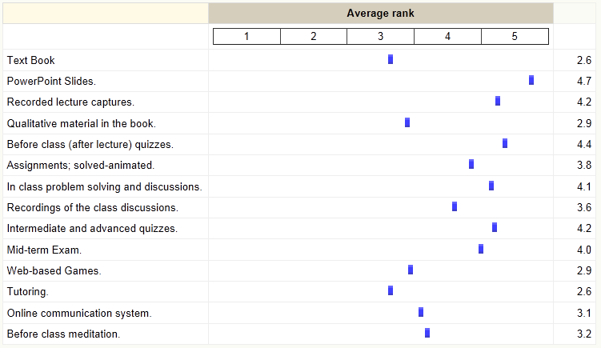
The network of 16 Resources and Learning Processes to Re-enforce the Core Concept

