Slide 1
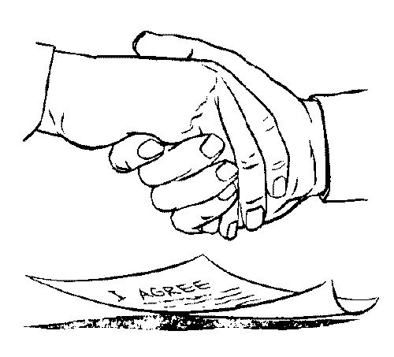
Lean Supply Chains and
Business Ecosystems
Our imagination is the only limit to what we can hope to have in the future.
Charles F. Kettering, Inventor

Slide 2
A Lean Supply Chain
Second tier supplier ➔ Supplier ➔ manufacturer ➔ Warehouse ➔ Distribution Center ➔ Retailer ➔ Consumer
  Under different ownership
  Lean
  Short cycle time
  Level Production Schedule
  Pull System
Such as vision was unattainable for many businesses in the past.

Slide 3
Has anything changed?
The whole business landscape has changed
  IT ➔ information sharing for supply chain members.
  Manufacturing methods ➔ quantum reduction in cycle time.
  Advances in logistics ➔ quantum reductions in the storage and transit times.
  Long-term partnership ➔ set aside traditional arms-length relationships.
A lean SC integrates all the key processes and partners. Adapts to changing customer needs and still deliver products quickly.

Slide 4
A Lean Supply Chain
On average, enterprises spent about 11% (about 1 trillion dollars) of revenue on SCM, yet best-in-class enterprises about 4.5%. These figures do not take into account
  Hidden costs or, in Dr. Deming's terms, “unknown and unknowable.”
  Less quantifiable benefits such as increased market share for supply chains that respond faster to customer needs.

Slide 5
A Lean Supply Chain
On average, enterprises spent about 11% (about 1 trillion dollars) of revenue on SCM, yet best-in-class enterprises about 4.5%. These figures do not take into account
  Hidden costs or, in Dr. Deming's terms, “unknown and unknowable.”
  Less quantifiable benefits such as increased market share for supply chains that respond faster to customer needs.

