Slide 1
Descriptive Statistics
Ardavan Asef-Vaziri

Slide 2
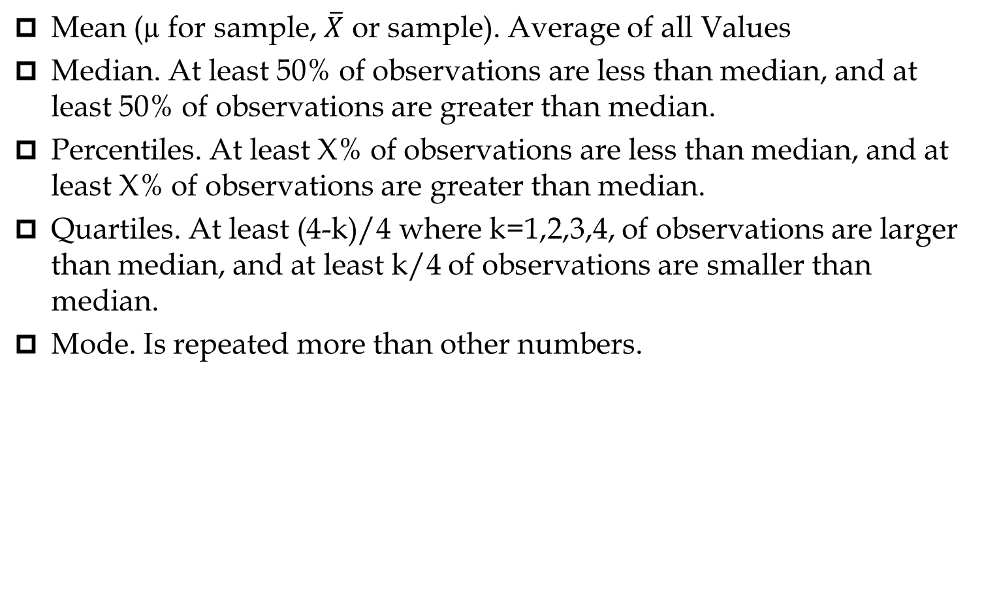
Measures of Centralization- Location
Mean (µ for sample, $\overline{X}$ or sample). Average of all Values
Median. At least 50% of observations are less than median, and at least 50% of observations are greater than median.
Percentiles. At least X% of observations are less than median, and at least X% of observations are greater than median.
Quartiles. At least (4-k)/4 where k=1,2,3,4, of observations are larger than median, and at least k/4 of observations are smaller than median.
Mode. Is repeated more than other numbers.

Slide 3
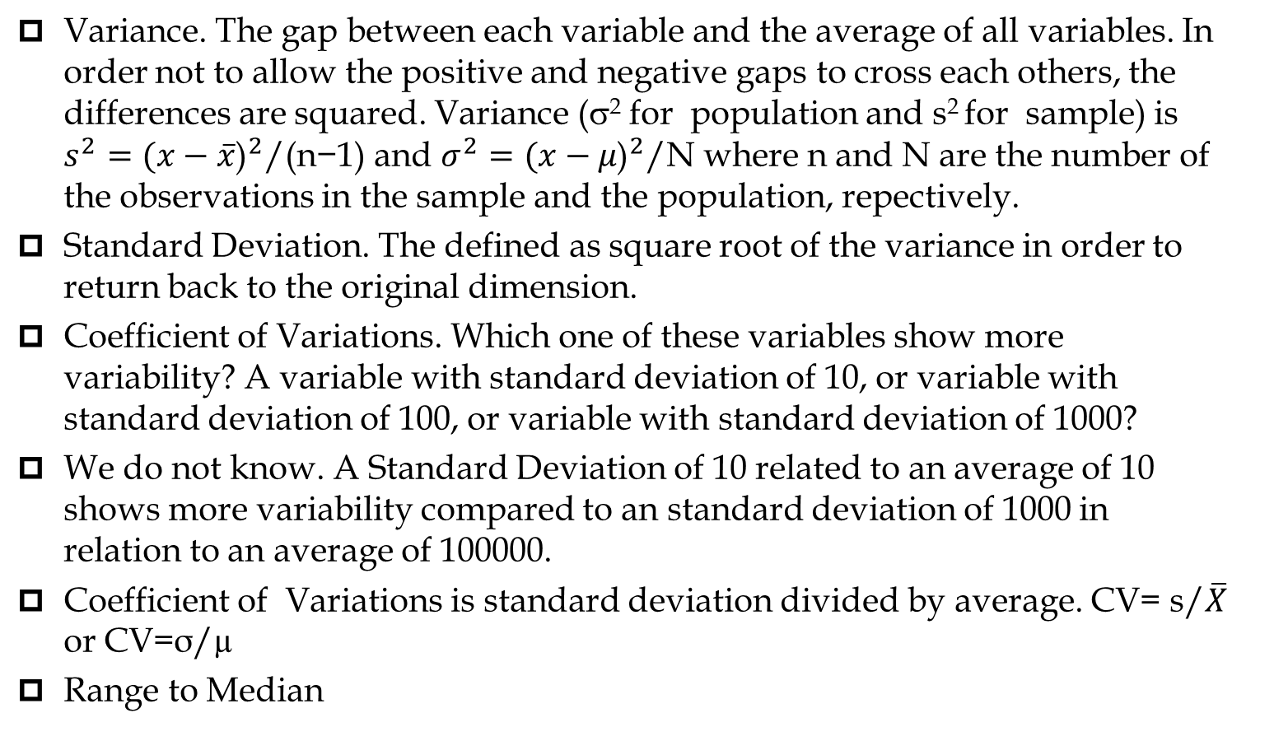
Measures of Dispersion- Variability
Variance. The gap between each variable and the average of all variables. In order not to allow the positive and negative gaps to cross each others, the differences are squared. Variance (σ² for population and s² for sample) is $s^{2}={(x−\overline{x}\text{)}}^{2}\text{/(}\text{n}\text{−1)}$ and $σ^{2}={(x−μ\text{)}}^{2}\text{/}\text{N}$ where n and N are the number of the observations in the sample and the population, repectively.
  Standard Deviation. The defined as square root of the variance in order to return back to the original dimension.
  Coefficient of Variations. Which one of these variables show more variability? A variable with standard deviation of 10, or variable with standard deviation of 100, or variable with standard deviation of 1000?
We do not know. A Standard Deviation of 10 related to an average of 10 shows more variability compared to an standard deviation of 1000 in relation to an average of 100000.
Coefficient of Variations is standard deviation divided by average. CV= s/$\overline{X}$ or CV=σ/µ
Range to Median

Slide 4
Some Measures of Centralization

Slide 5
Some Measures of Variability

Slide 6

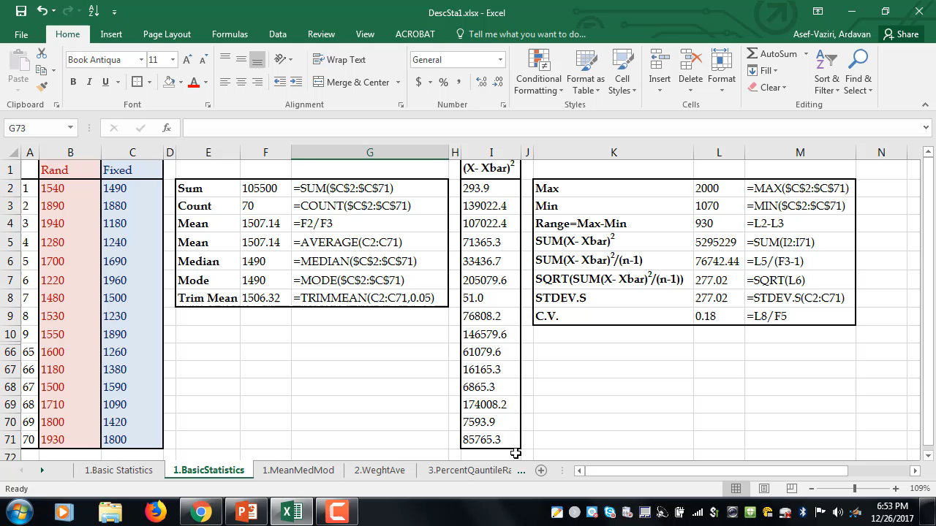
Descriptive Statistics

Slide 7
Descriptive Statistics

Slide 8
Rank & Percentile
Rank. Where a variable stands. Its rank compare to all the variables in the data set.
A percentile is the value below which a given % of observations fall.
The 20th percentile for the grades of the students in a given course is the value below which (at least) 20% of the observations may be found. A pth percentile is a value such that at least p% of the variables take on this value or less and at least (100 - p)% of the variables take on this value or more.
Location of PERCENTRANK.EXC➔ p(N+1)=pN+p
Location of PERCENTRANK.INC➔ p(N-1)+1=pN+(1-p)
EXC from 1/N to 1-1/N, INC from 0 to 1

Slide 9
Rank, Percentile, Quartile, Small, Large

