Slide 1
Descriptive Statistics
Ardavan Asef-Vaziri

Slide 2
Statistics Numerical Measures
Sample statistics: the measures are computed for data from a sample.
Population statistics: the measures are computed for data from a population.
Statistics
  Measures of Centralization - Measures of Location.
  Measures of Dispersion – Measures of Variability.

Slide 3
Measures of Location and Variability
Measures of Location
    Mean (µ for sample, $\overline{X}$ or sample)
    Median
    Mode
    Percentiles
    Quartiles
Measures of Variability
    Range (Max-Min)
    Variance
    Standard Deviation (σ for population, s for sample)
    Coefficient of Variations

Slide 4
Measures of Location
Measures of Location
    Mean (µ for sample, $\overline{X}$ or sample). Summation of all observations divided by the number of observations. $\overline{X}=\sum{x/}$n
    Median. At least 50% of observations are larger than median, and at least 50% of observations are smaller than median.
      What is the median of 1, 7, 3, 11, 4.
      What is the median of 1, 7, 3, 11, 4, 6.
      What is the median of 4, 1, 4, 4, 5.
    Mode. Is repeated more than other numbers.
      What is mode of 4, 1, 4, 7, 4, 5.
      What is mode of 4, 1, 7, 5.

Slide 5
Measures of Variability
Measures of Variability
  Range. Range is the gap between the maximum and the minimum values.
  Variance. Variance represents how the values of the variables are close or far from the average. It measures the gap between individual values and the average of all values. Since the gap could be positive or negative, in order not to allow the positive and negative gaps to cross each others out, the differences are squared.
  Variance (σ² for population and s² for sample) nis defined as $s^{2}={(x−\overline{x}\text{)}}^{2}\text{/(}\text{n}\text{−1)}$ and $σ^{2}={(x−μ\text{)}}^{2}\text{/}\text{N}$ where n is number of the observations in the sample and N is number of the observations in the population.

Slide 6
Measures of Variability
Measures of Variability
  Standard Deviation. In computing Variance, we squared the gaps between the value of each individual variable, and the average of all variables to avoid negative and positive values to cross each others out. Standard deviation is the defined as square root of the variance in order to return back to the original dimension.
  Coefficient of Variations. Which one of these variables show more variability? A variable with standard deviation of 10, or variable with standard deviation of 100, or variable with standard deviation of 1000?
  We do not know.

Slide 7
Measures of Variability
Measures of Variability
  A Standard Deviation of 10 related to an average of 10 shows more variability compared to an standard deviation of 1000 in relation to an average of 100000.
  Coefficient of Variations is standard deviation divided by average. CV= s/$\overline{X}$ or CV=σ/µ

Slide 8
Some Measures of Centralization

Slide 9
Some Measures of Variability

Slide 10
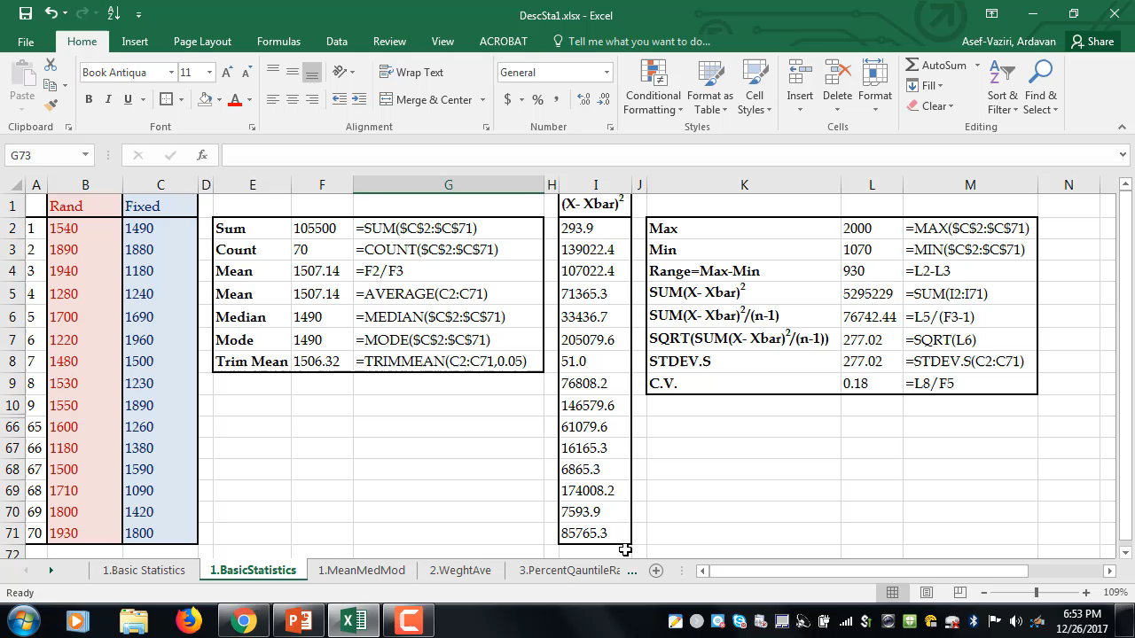
Descriptive Statistics

Slide 11
Descriptive Statistics

Slide 12
Rank & Percentile
Rank. Where a variable stands. Its rank compare to all the variables in the data set.
A percentile is the value below which a given % of observations fall.
The 20th percentile for the grades of the students in a given course is the value below which (at least) 20% of the observations may be found. A pth percentile is a value such that at least p% of the variables take on this value or less and at least (100 - p)% of the variables take on this value or more.
Location of PERCENTRANK.EXC➔ p(N+1)=pN+p
Location of PERCENTRANK.INC➔ p(N-1)+1=pN+(1-p)
EXC from 1/N to 1-1/N, INC from 0 to 1

Slide 13
Rank, Percentile, Quartile, Small, Large

