Slide 1
Relative, Absolute, and Mixed Referencing & Dynamic Sort
It is reasonable to love the Absolute absolutely for the same reason it is reasonable to love the Relative relatively. Peter Kreeft
Dear SOM306-Asef Friends. Put these slides in slide show mode.
After watching the video on the second slide, please post a two lines about it on “Find-Your-Teammates” forum. Through this forum find 3 teammates to form a team of 4 to play the games that we have throughout the semester (about 1/3 of the final course grade including the questions in Midterms and Final).
Teams’ Engagement Task. In column A of an Excel-sheet type A to Z (or type =CHAR(ROWS(A$1:A1)+96) in Cell A1 and copy down to row 26.
Type =RANDBETWEEN(0,9) in Cell B1 and copy it down. In column C, sort the letters of column A based on the scores of column B. Hint. It is not as easy as you may think. Please communicate with your teammates.
Post your teams’ understanding on the forum.

Slide 2
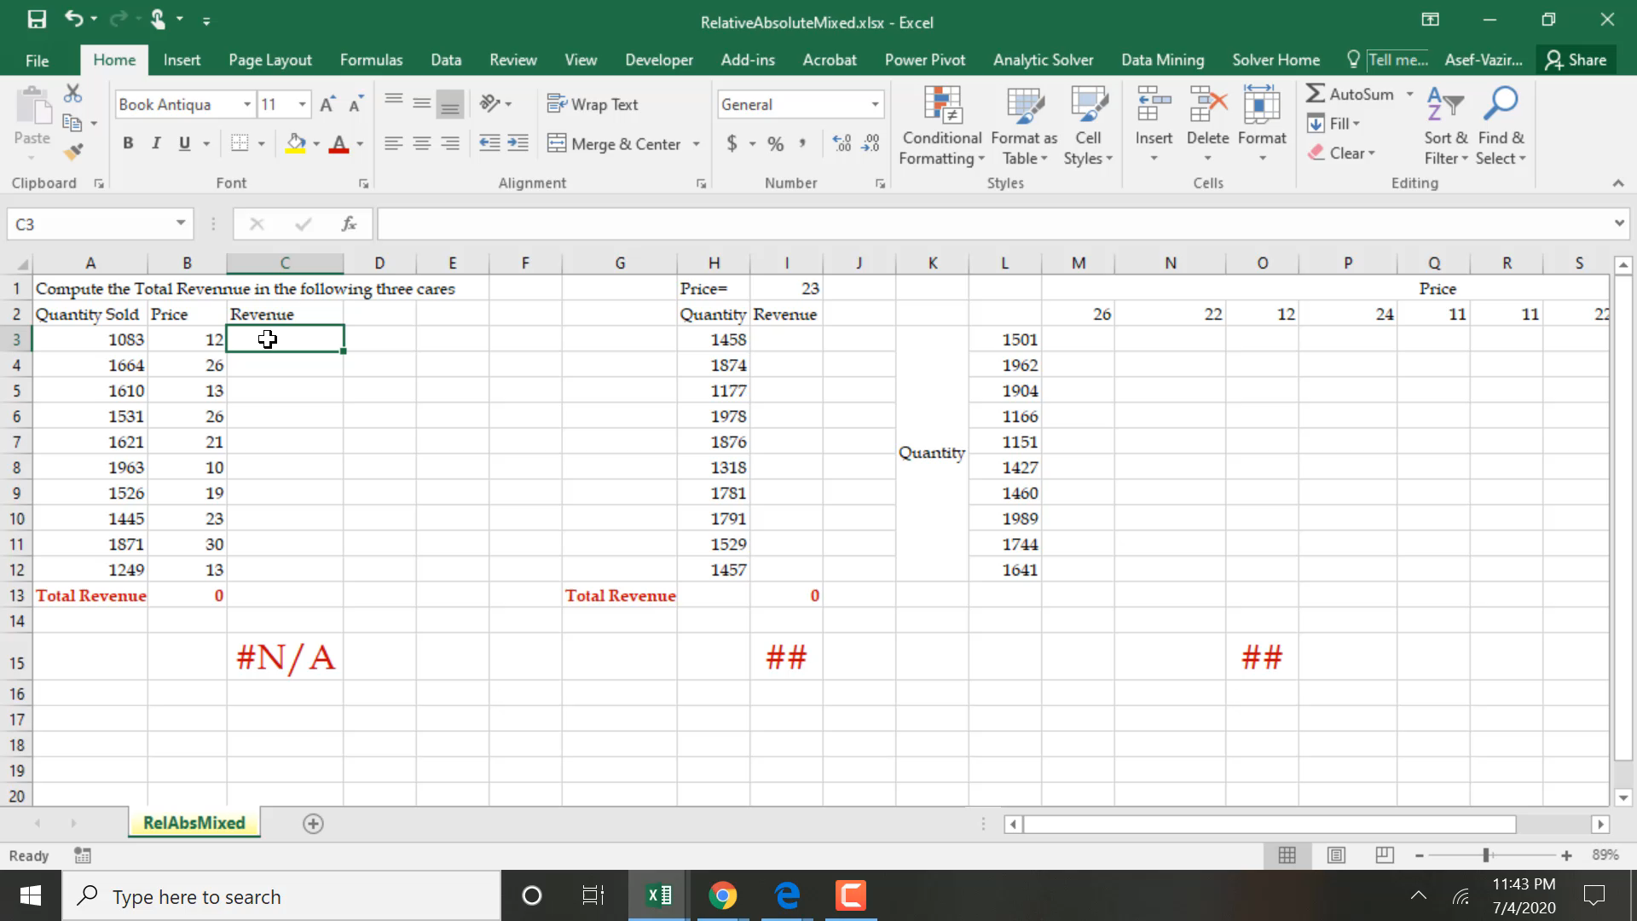
Relative, Absolute, Mixed Referencing, & Dynamic Sort

Slide 3
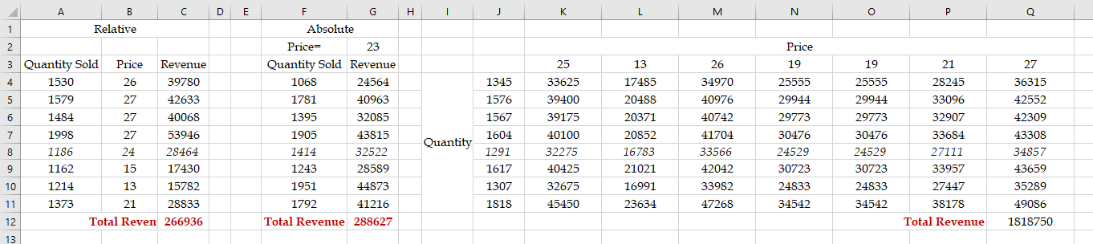
Relative, Absolute, and Mixed Referencing

Slide 4
Rank, Small, Row, Rows, Match, Index, Vlookup
Click on the Excel Table, they become active and you can work on them. If they do not open, close the file, re-open, then enable content when you are asked. You can also right click, and open the worksheet. You can do this on all Excel Tables inside the PowerPoint slides.

