Slide 1
Percentile Quartile
Ardavan Asef-Vaziri

Slide 2
Rank, Percentile, and Quartile
Rank. Where a variable stands compared to all the variables in the data set.
Median. At least 50% of observations are less than or equal to median, and at least 50% of observations are greater than or equal to median.
Median is 50th percentile.
Percentiles. Xth percentile =R means at least X% of observations are less than or equal R, and at least 100-X% of observations are greater than or equal R.
The 20th percentile for the grades of students in SOM307 is the score where at least 20% of the grades are less than or equal to this number.
In the set of the following 8 numbers, 125, 180, 180, 180, 200, 200,180, 200, 220, the 25th percentile is 180.
Given N as the number of observations
  Location of PERCENTRANK.EXC➔ p(N+1)=pN+p
  Location of PERCENTRANK.INC➔ p(N-1)+1=pN+(1-p)
PERCENTRANK.INC is from 0 to 1
PERCENTRANK.EXC is from 1/N to 1-1/N

Slide 3
Percentile
A 100th percentile in PERCENTILE.INC means at least 100% greater than or equal to a specific value and at least 0% less than or equal to that value. This is not possible.
The same is true for 0th percentile.
That is why 0th and 100th percentiles are not defined in PERCENTILE.EXC
Percentile and Rank are also available in Data Analysis ToolPack, but we prefer Excel functions

Slide 4
Quartile
Quartile is the same as Percentile, but it is only defined for 0%, 25%, 50%, 75%, and 100%
It is defined as 0st, 1st, 2nd, 3rd, 4th quartile.
Kth Quartiles where K=1,2,3,4, means K portion of observations are greater than or equal to this number, and (4-k)/4 portion of observations are less than or equal to this number.
QUARTILE.INC() is defined for 0,1, 2, 3, 4.
QUARTILE.EXC() is not defined for 0 and 4
If it is not specified INC or EXC, then use EXC.

Slide 5
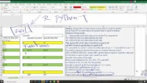
Percentile & Quartile https://youtu.be/eMa1YN-zKMQ (15 mins.)

Slide 6
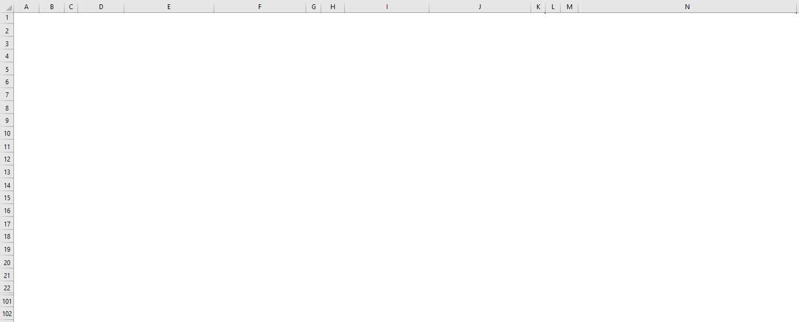
Percentile & Quartile (15 mins.)

Slide 7
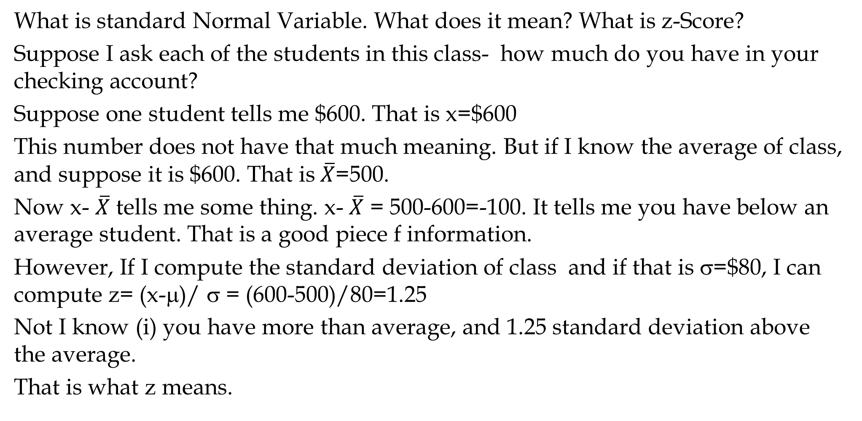
z-Score- Standard Normal Variable
  What is standard Normal Variable. What does it mean? What is z-Score?
  Suppose I ask each of the students in this class- how much do you have in your checking account?
  Suppose one student tells me $600. That is x=$600
  This number does not have that much meaning. But if I know the average of class, and suppose it is $600. That is$\overline{X}$=500.
  Now x- $\overline{X}$ tells me some thing. x- $\overline{X}$ = 500-600=-100. It tells me you have below an average student. That is a good piece f information.
  However, If I compute the standard deviation of class and if that is σ=$80, I can compute z= (x-μ)/ σ = (600-500)/80=1.25
  Not I know (i) you have more than average, and 1.25 standard deviation above the average.
  That is what z means.

Slide 8
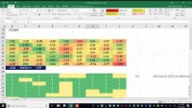
Percentile & Quartile https://youtu.be/eMa1YN-zKMQ (13 mins)

Slide 9
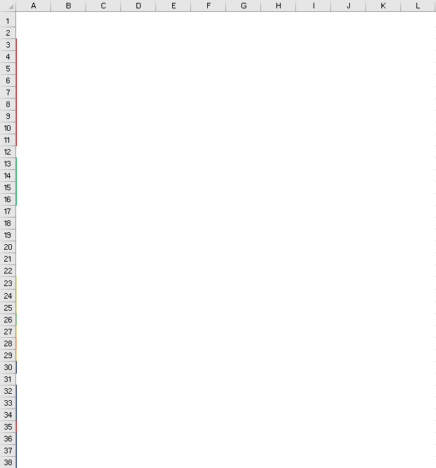
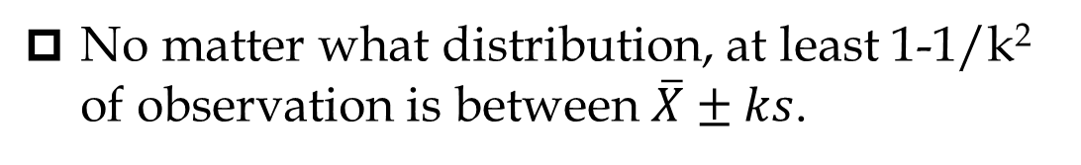
Percentile & Quartile
No matter what distribution, at least 1-1/k² of observation is between $\overline{X}±ks$.
Numbers that fall out of $\overline{X}±3s$ are outliers

