Slide 1
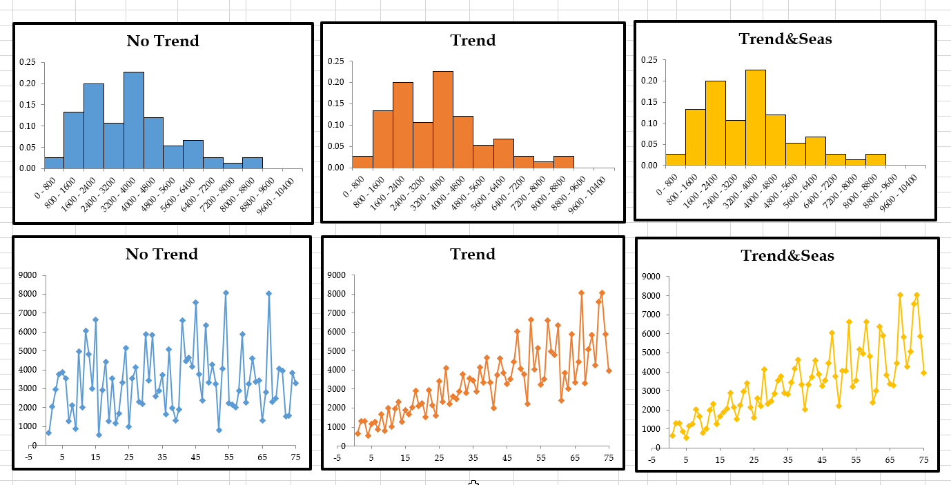
Descriptive Statistics
Ardavan Asef-Vaziri

Slide 2
Random Variables- Numerical, Categorical
A random Variable is an outcome of an experience!
Random Variables
  Numerical
  Categorical
Numerical Random Variables
  Height, Weight, Age
  Grade of a student in a course, GPA of a course
  The number of students attending a specific class in a specific day.
  Number of Roast-Beef sandwiches sold in an Arby’s on Reseda in one week.
  Number of refrigerators sold in a day.
  Number of pages in a book.
  Number of characters in a line.
  Number of courses taken this semester and up-to-now.
  Number of students entering a campus coffee shop in a two minutes time intervals.

Slide 3
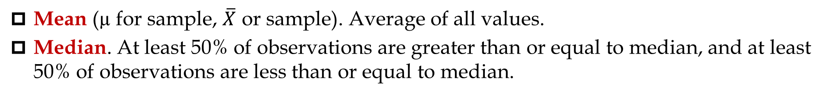
Random Variables- Numerical, Categorical
A random Variable is an outcome of an experience!
Random Variables
  Numerical
  Categorical
Categorical Random Variables
  FIN, MKT, MGT, ACCT, SOM, etc. majors.
  APT., CONDO, Attached Townhome, Detached Townhome, Single Family Residence, Mobile Home, etc.
A Sample is a representative of a population.
  Population: all incoming freshmen students in a college.
  Sample: a small random fraction of them that we may ask to fill a short questionnaire.
Mean (µ for sample, $\overline{X}$ or sample). Average of all values.
Median. At least 50% of observations are greater than or equal to median, and at least 50% of observations are less than or equal to median.

Slide 4
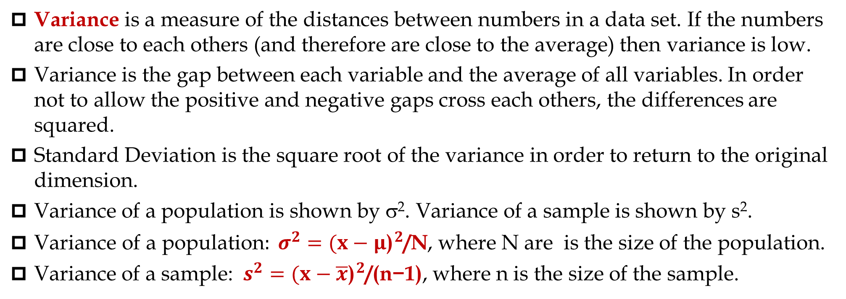
Measures of Centralization and Disperssion
Mode is a number that is repeated more than any other number in the sample. Some samples do not have a unique mode.
Variance is a measure of the distances between numbers in a data set. If the numbers are close to each others (and therefore are close to the average) then variance is low.
Variance is the gap between each variable and the average of all variables. In order not to allow the positive and negative gaps cross each others, the differences are squared.
Standard Deviation is the square root of the variance in order to return to the original dimension.
Variance of a population is shown by σ². Variance of a sample is shown by s².
${\text{Variance} \text{of} \text{a} \text{population}: σ}^{2}={(x−μ\text{)}}^{2}\text{/}\text{N}$, where N are is the size of the population.
Variance of a sample: $s^{2}={(x−\overline{x}\text{)}}^{2}\text{/(}\text{n}\text{−1)}\text{,}$ where n is the size of the sample.

Slide 5
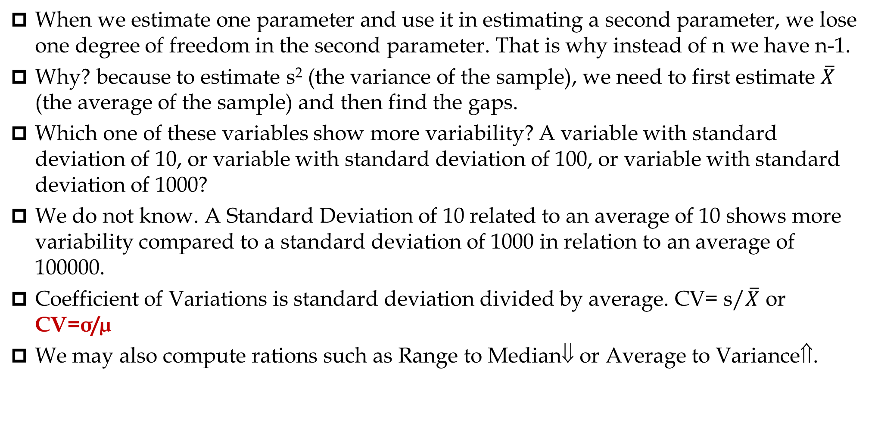
Measures of Dispersion- Variability
When we estimate one parameter and use it in estimating a second parameter, we lose one degree of freedom in the second parameter. That is why instead of n we have n-1.
Why? because to estimate s² (the variance of the sample), we need to first estimate $\overline{X}$ (the average of the sample) and then find the gaps.
Which one of these variables show more variability? A variable with standard deviation of 10, or variable with standard deviation of 100, or variable with standard deviation of 1000?
We do not know. A Standard Deviation of 10 related to an average of 10 shows more variability compared to a standard deviation of 1000 in relation to an average of 100000.
Coefficient of Variations is standard deviation divided by average. CV= s/$\overline{X}$ or CV=σ/µ
We may also compute rations such as Range to Median⇓ or Average to Variance⇑.

Slide 6


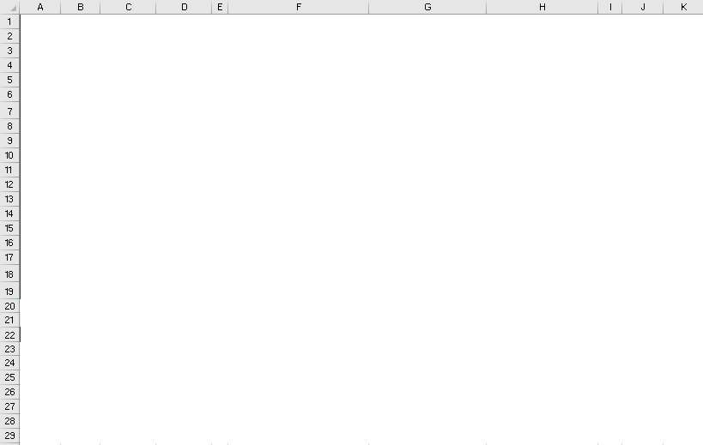
Excel Page- Lecture Only the First 6:35 mins

Slide 7
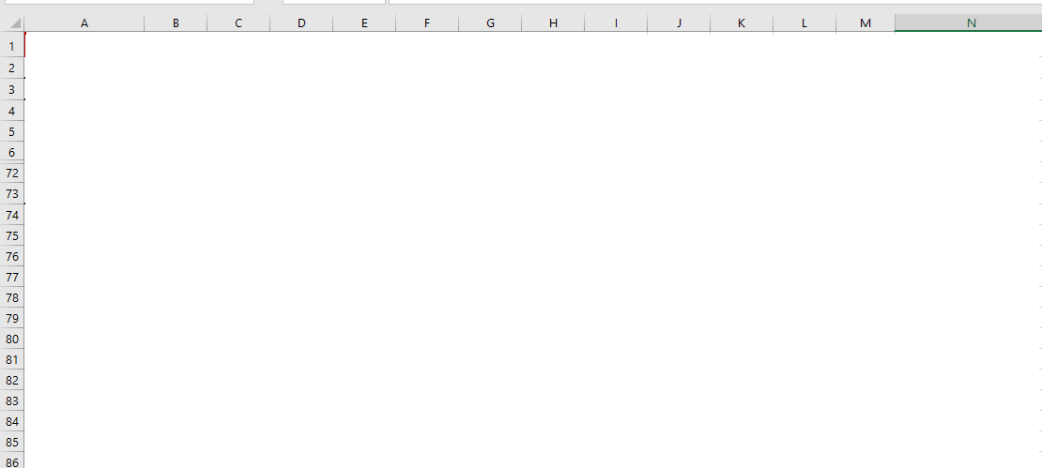
Descriptive Statistics: Data Analysis vs Excel Functions-15 mins

Slide 8
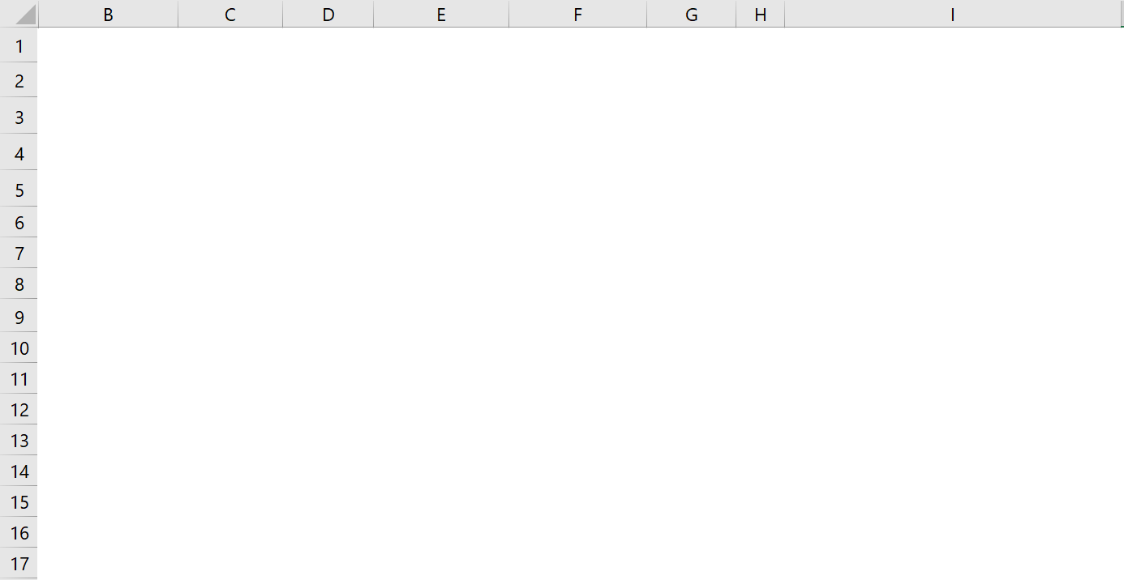
Average & Standard Deviation of Group of Data. 10 mins.

Slide 9
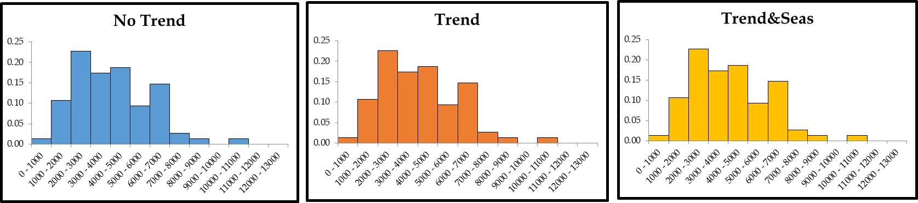
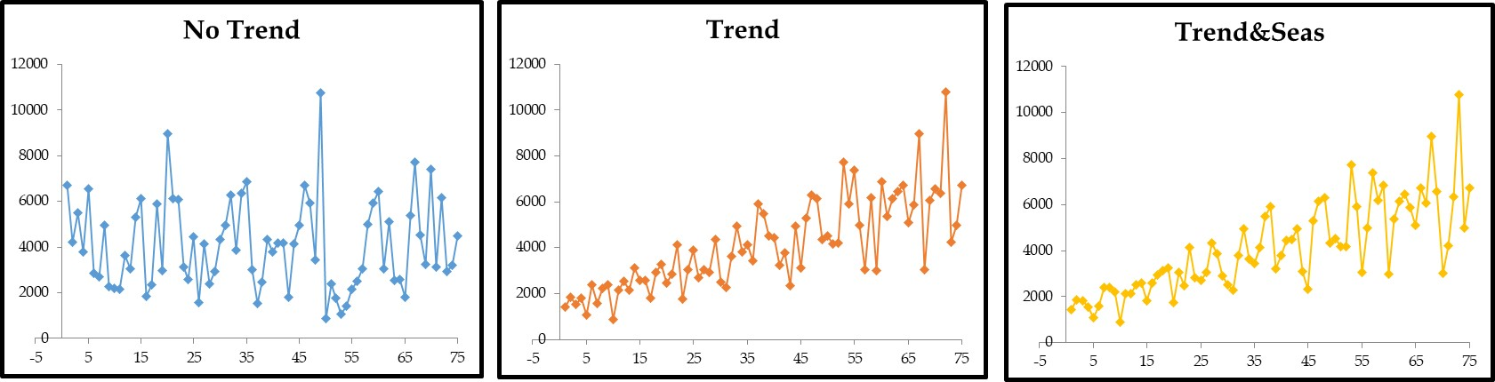
From Descriptive Statistics to Time Series

