Slide 1

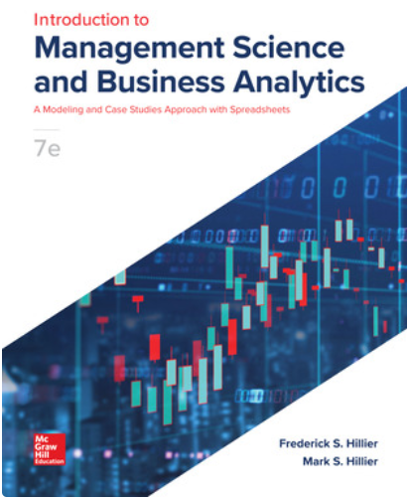


Decision Tree Analysis
Ardavan Asef-Vaziri

Slide 2
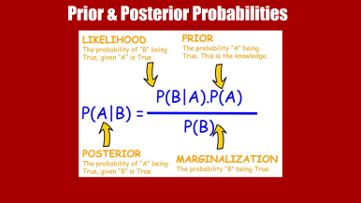
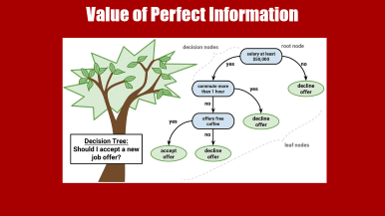
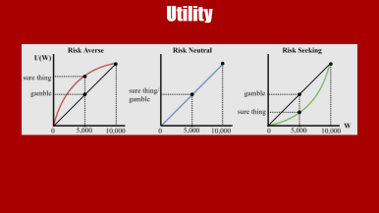
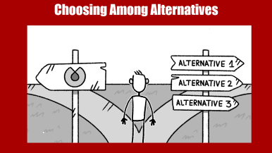

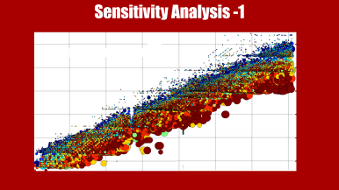




Slide 3
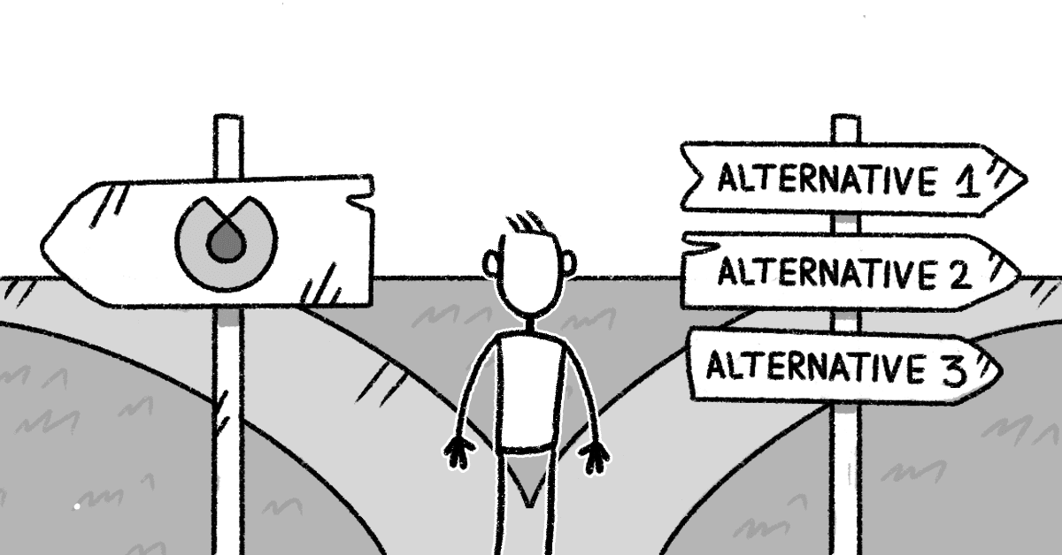
Choosing Among Alternatives

Slide 4
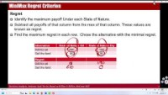
Choosing Among Alternatives

Slide 5
The Goferbroke Company Problem
The Goferbroke Company develops oil wells in unproven territory.
Another oil company has offered to purchase the tract of land for $90,000.
A consulting geologist has reported that there is a one-in-four chance of oil on a particular tract of land.
Drilling for oil on this tract would require an investment of about $100,000.
If the tract contains oil, it is estimated that the net revenue generated would be approximately $800,000. If the tract its Dry, its value drops to 0.
The outcomes are Drill and find Oil, Drill and Dry, Sell when there is Oil, Sell when Dry.
The Payoff table showing the monetary value of each outcome is given below.
Question: Should Goferbroke drill for oil or sell the tract?

Slide 6
Decision Analysis Terminology
Decision maker. The individual or group responsible for making the decision.
Alternatives. The options for the decision to be made.
Chance event. An uncertain future event that affects the consequence of a decision.
State of nature. The possible situations in a chance event.
Outcome. The result of a combination of a decision alternative and a state of nature.
Payoff. A quantitative measure associated with an outcome. It is often the monetary or utility value.
Prior probabilities. The relative likelihood of the possible states of nature.
Posterior probabilities. Additional probabilities that can be computed based on prior probabilities.

Slide 7
Optimistic (Maximax) & Conservative (Maximin) Criterion
MaxiMax (Optimistic) criterion
What is the maximum payoff of each alternative over all states of nature.
Select the alternative with Maximum of these Maximums.
Alternative
State of Nature Oil
State of Nature Dry
Drill for oil
700
-100
Maximax
Sell the land
90
90
MaxiMin (Conservative) criterion
What is the minimum payoff of each alternative over all states of nature.
Select the alternative with Maximum of these Minimums.
Alternative
State of Nature Oil
State of Nature Dry
Drill for oil
700
-100
Sell the land
90
90
Maximin
Notes:
Table 12.4 Application of the maximax criterion to the first Goferbroke Co. problem.

Slide 8
MiniMax Regret Criterion
Regret
Identify the maximum payoff Under each State of Nature.
Subtract all payoffs of that column from the max of that column. These values are known as regret.
Find the maximum regret in each row. Chose the alternative with the minimal regret.
Alternative
State of Nature Oil
State of Nature Dry
Drill for oil
700
-100
Sell the land
90
90
Regret
Drill for oil
0
190
Minimax
Sell the land
610
0
Notes:
Table 12.4 Application of the maximax criterion to the first Goferbroke Co. problem.

Slide 9
The Maximum Likelihood Criterion
The maximum likelihood criterion focuses on the most likely state of nature.
Procedure:
Identify the state of nature with the largest prior probability.
Choose the decision alternative that has the largest payoff for this state of nature.
Alternative
State of Nature Oil
State of Nature Dry
Drill for oil
700
-100
Sell the land
90
90
Step-2 Max
Prior probability
0.25
0.75
Step-1 Max
Access the text alternative for slide images.
Notes:
Table 12.6 Application of the maximum likelihood criterion to the first Goferbroke Co. problem.

Slide 10
Expected Values
It accounts for all the states of nature and their probabilities.
For each decision alternative, calculate the weighted average of its payoff by multiplying each payoff by the prior probability and summing these products. This is the expected payoff (EP).
The expected payoff can be interpreted as what the average payoff would become if the same situation were repeated many times. Therefore, on average, repeatedly applying probabilities to make decisions will lead to larger payoffs in the long run than any other criterion.
Choose the decision alternative that has the largest expected payoff.
It ignores typical aversion to risk. By focusing on average outcomes, expected (monetary) payoffs ignore the effect that the amount of variability in the possible outcomes should have on decision making.
Notes:
Figure 12.1 This spreadsheet shows the application of Bayes’ decision rule to the first Goferbroke Co. problem, where a comparison of the expected payoffs in cells F5:F6 indicates that the Drill alternative should be chosen because it has the largest expected payoff.

Slide 11
Expected Value and Risk

Slide 12
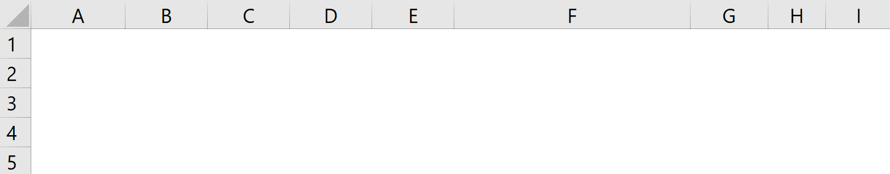
Example: Decisions & States of Nature
Management should decide whether to make a part at house or outsource it. Outsource at $11 per unit.
To make it at house; two processes: Advanced and Intermediate
(1) At house with intermediate process
Fixed Cost: $70,000/year
Variable Cost: $7 per unit
(2) At house with advanced process.
Fixed Cost: $140,000/year
Variable Cost: $4 per unit
Sales price is $12 per unit.
The are 10000, 20000, and 30000 units.
Prepare a payoff table for this problem
Payoff = Profit = PQ-F-VQ = (P-V)Q-F

Slide 13
Maximax, MaxiMin Expected
<==

Slide 14
MiniMax Regret
MiniMax Regret
10000
20000
30000
Buy
10000
20000
30000
Decision
Make1
-20000
30000
80000
Make2
-60000
20000
100000
Max
10000
30000
100000
Regret Table
Buy
0
10000
70000
70000
Make1
30000
0
20000
30000
<==
Make2
70000
10000
0
70000

Slide 15
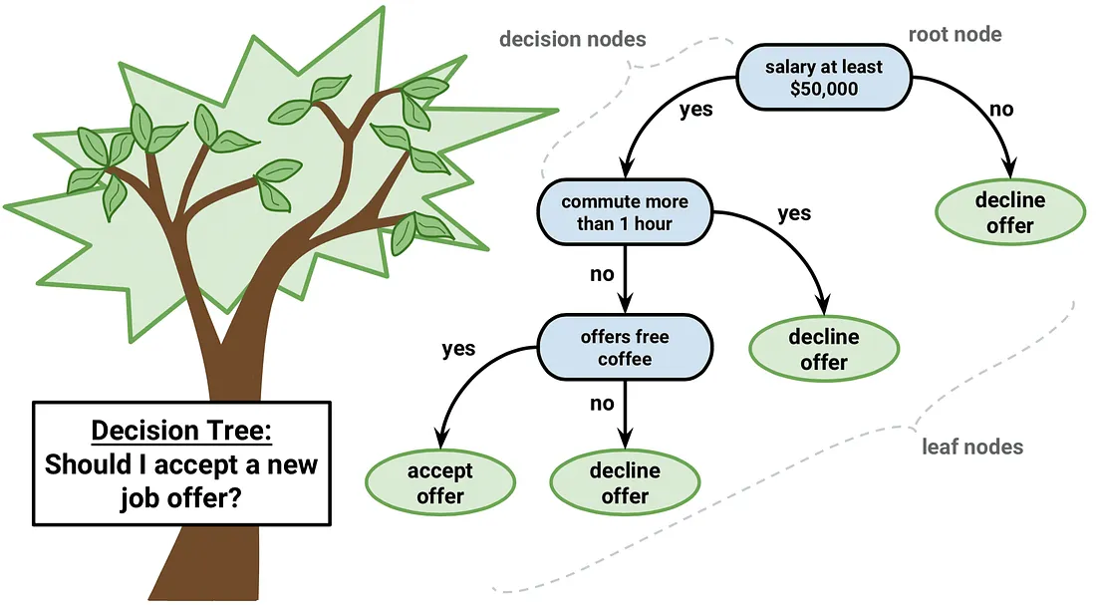
Value of Perfect Information

Slide 16
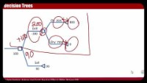

Slide 17
Decision Trees
A decision tree can apply probability decision rule while displaying and analyzing the problem graphically.
A decision tree consists of nodes and branches.
A decision node, represented by a square, indicates a decision to be made. The branches represent the possible decisions.
An event node, represented by a circle, indicates a random event. The branches represent the possible outcomes of the random event.

Slide 18
Decision Trees
Drill
-100
-100
90
Sell
90
90

Slide 19
Decision Trees
Oil
25%
800
200
100
Drill
=0.25(800)+(1-0.25)(0)
-100
Dry
75%
0
100
Sell
90
90
90

Slide 20
Checking Whether to Obtain More Information
Might it be worthwhile to spend money for more information to obtain better estimates?
A quick way to check is to pretend that it is possible to actually determine the true state of nature (“perfect information”).
EP (with perfect information) = Expected payoff if the decision could be made after learning the true state of nature.
EP (without perfect information) = Expected payoff from applying Bayes’ decision rule with the original prior probabilities.
The expected value of perfect information is then
EVPI = EP (with perfect information) − EP (without perfect information).

Slide 21
Expected Value of Perfect Information
700
Drill
Oil
25%
800
800
25%
-100
Oil
200
100
Drill
700
=0.25(800)+(1-0.25)(0)
-100
sell
90
Dry
75%
242.5
90
0
=0.25(700)+(1-0.25)(90)
Drill
100
75%
0
0
Dry
Sell
90
90
90
90
sell
90
90
EVPI = EPwithPI-EPwithoutPI = 242.5-100 =142.5

Slide 22

Value of Sample Information

Slide 23
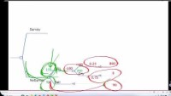

Slide 24
Posterior Probabilities
Goferbroke can obtain improved estimates of the chance of oil by conducting a detailed seismic survey of the land, at a cost of $30,000.
Possible findings from a seismic survey:
Favorable: Favorable seismic soundings; oil is fairly likely.
Unfavorable: Unfavorable seismic soundings; oil is quite unlikely.
Notes:
Table 12.8 Posterior probabilities of the states of nature, given the finding from the seismic survey, for the Goferbroke Co. problem.

Slide 25
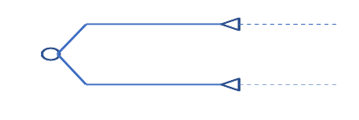
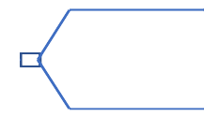
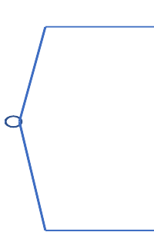

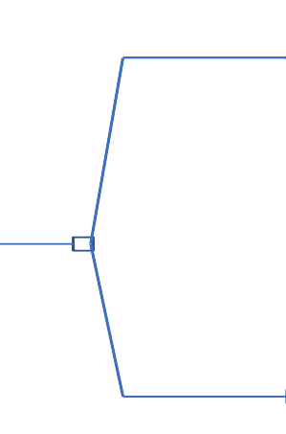
Silver Decisions
0.5
800
Drill
-100
300
400
Favorable
0
0.5
0.3
300
Sell
90
Survey
-30
153
123
1/7
14.29
-100
800
Drill
114.29
0.7
90
Unfavorable
6/7
0
123
Sell
90
Oil
0.25
800
100
Drill
-100
200
Dry
0
100
0.75
NoSurvey
90
Sell
90
Notes:
Figure 12.14 The decision tree for the full Goferbroke Co. problem (before including any numbers) when first deciding whether to conduct a seismic survey.

Slide 26
Value of Sample Information
EVPI = EP (with perfect information) − EP (without perfect information).
EVPI = 242.5-100 = 142.5 thousand dollars.
EVPI = 142.5
EVSI = EP (with sample or experiment information) − EP (without sample or experiment information).
EVSI = 123+30=153-100 = 53
EVSI =53
We are willing to pay up to 53K for this sample information.
We are will to pay more (EVPI = 142.5) if there are other methods with better prediction.

Slide 27
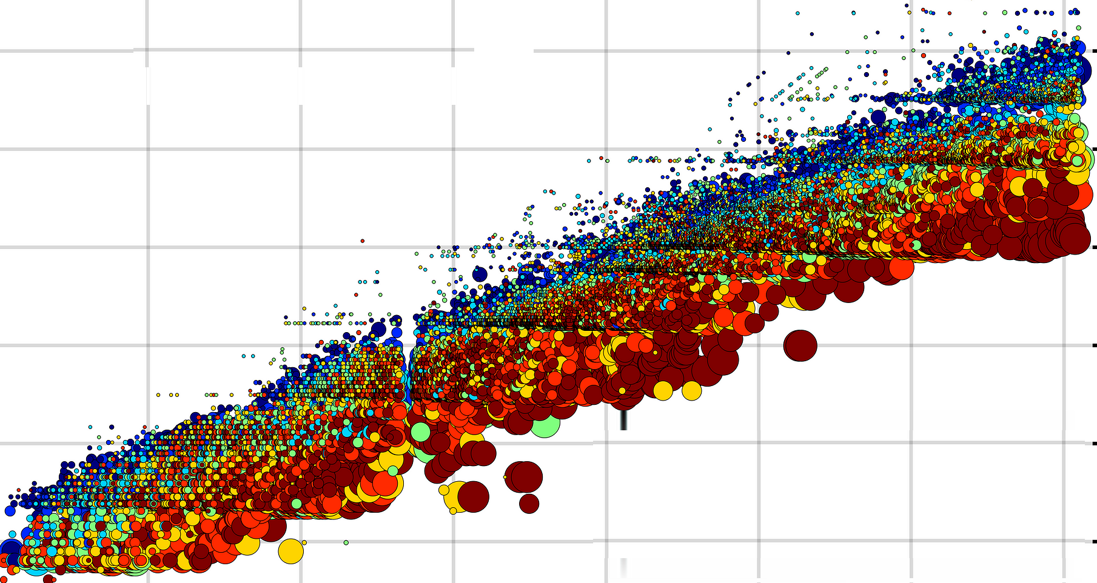
Sensitivity Analysis -1

Slide 28
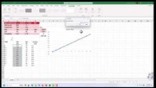
https://youtu.be/pOw4N6t8-Vk

Slide 29
Sensitivity Analysis- For What Probability Switch Sell to Drill

Slide 30
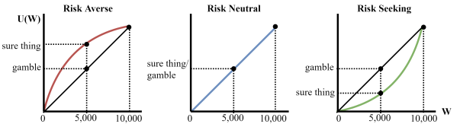
Utility

Slide 32
Using Utilities to Better Reflect the Values of Payoffs
We have assumed that the expected payoff in monetary terms is the appropriate measure of effectiveness. In many situations, this is not correct.
Suppose one is offered the following choice:
50–50 chance of $0 or $100,000.
$40,000 with certainty.
Many would pick $40,000, even though the expected payoff on the 50-50 chance of 0 or $100,000 is $50,000.
Risk aversion.
A utility function for money is a way of transforming monetary values to a more appropriate measure (for example, aversion to risk).

Slide 33
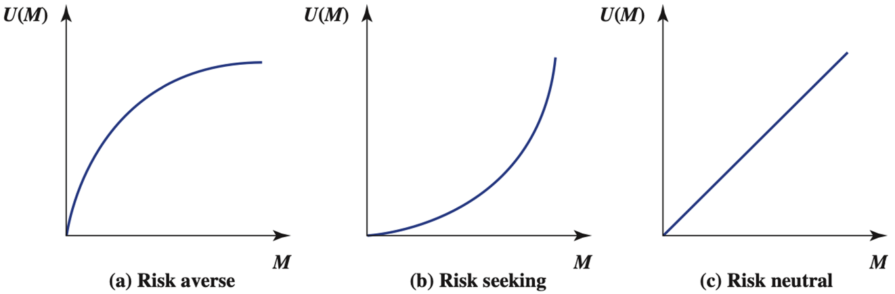
A Typical Utility Function for Money
EQ2Y
LT2Y
Y
Y
GT2Y
Y
X
2X
X
2X
X
2X
Notes:
Figure 12.20 A typical utility function for money, where U(M) is the utility of obtaining an amount of money M.

Slide 34
Utility Functions
Under the assumptions of utility theory, the decision maker’s utility function for money has the property that the decision maker is indifferent between two alternatives if the two alternatives have the same expected utility.
When utility function for money is used, monetary payoffs are replaced by the corresponding utilities.
The optimal decision (or series of decisions) is the one that maximizes the expected utility.

Slide 35
Compute Utilities Method 3: Given Payoffs, computer Probability
Determine the largest potential payoff ($Max) ➔ U($Max)= 1.
Determine the smallest potential payoff, ($Min) ➔ U($Min)= 0.
To determine the utility of another payoff $X, consider the two alternatives:
A1: Obtain a payoff of $Max with probability p, and a payoff of $Min with probability 1−p.
A2: Definitely obtain a payoff of $X.
What value of p makes you indifferent?
Then, U($X)=p

Slide 36
Compute Utilities Method 1: 50-50 Probabilities, Compute M
Assign utility of 1 to the largest potential payoff (100K for example). U(100)=1.
Assign utility of 0 to the smallest potential payoff ( 0 for example). U(0)=0.
What is the payoff you expect to replace 100@50% and 0@50%?
Suppose it is 30K. Therefore U(30)= (0+1)/2 = 0.5.
What is the payoff you expect to replace the above 30@50% and 0@50%?
  Suppose it is 10K. Therefore U(10)= (0+0.5)/2 = 0.25.
What is the payoff you expect to replace the above 30@50% and 100@50%?
Suppose it is 60K. Therefore U(60)= (1+0.5)/2 = 0.75.
Question: Given U(X1)= U1 and U(X2)=U2
What value of X makes you indifferent between X and 50% chance of winning X1 or and 50% chance of winning X2.
Then, U(X) = (U(X1)+U(X2))/2

Slide 37
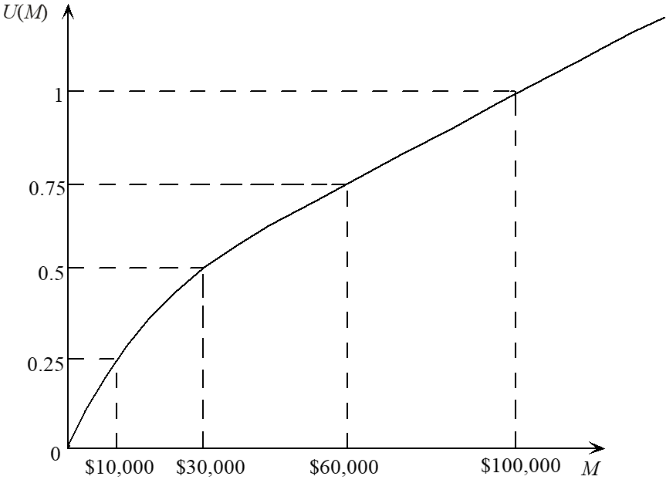
Illustration of Fundamental Property
By the fundamental property, a decision maker with the utility function below–right will be indifferent between each of the three pairs of alternatives below–left.
25% chance of $100K or $10K for sure
That means both have Utility of 0.25.
50% chance of $100K or 30K for sure
That means both have Utility of 0.5.
75% chance of $100K or $60K for sure
That means both have Utility of = 0.75.
Access the text alternative for slide images.

Slide 38
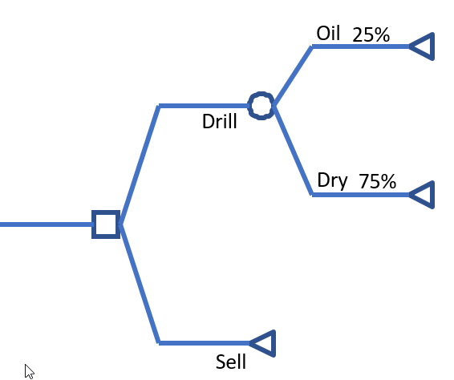
Decision Trees
1
700
0.25(700)+(1-0.25)(-100)= 100
0.25(1)+(1-0.25)(0)= 0.25
0
100
-100
0.3
90
0.33
90

Slide 39
Oil
800-100-30= 670
Drill
-100
Dry
Unfavorable
0-100-30 = -130
Sell
90-30 = 60
Survey
Oil
800-100-30= 670
Drill
-100
-30
Dry
Favorable
0-100-30 = -130
Sell
90-30 = 60
Oil
800-100 = 700
-100
Drill
Dry
NoSurvey
0-100=-100
Sell
90
Notes:
Figure 12.14 The decision tree for the full Goferbroke Co. problem (before including any numbers) when first deciding whether to conduct a seismic survey.

Slide 40
Generating the Utility Function for Max Flyer
The possible monetary payoffs in the Goferbroke Co. problem are −130, −100, 0, 60, 90, 670, and 700 (all in $thousands).
Set U(Max) = U(700) = 1.
Set U(Min) = U(−130) = 0.
To find U(X), use the equivalent lottery method.
For example, for =90, consider the two alternatives:
A1: Obtain a payoff of 700 with probability p.
Obtain a payoff of −130 with probability 1−p.
A2: Definitely obtain a payoff of 90.
If the decision maker chooses a point of indifference of p = 1/3, then U(90) = 1/3.

Slide 41
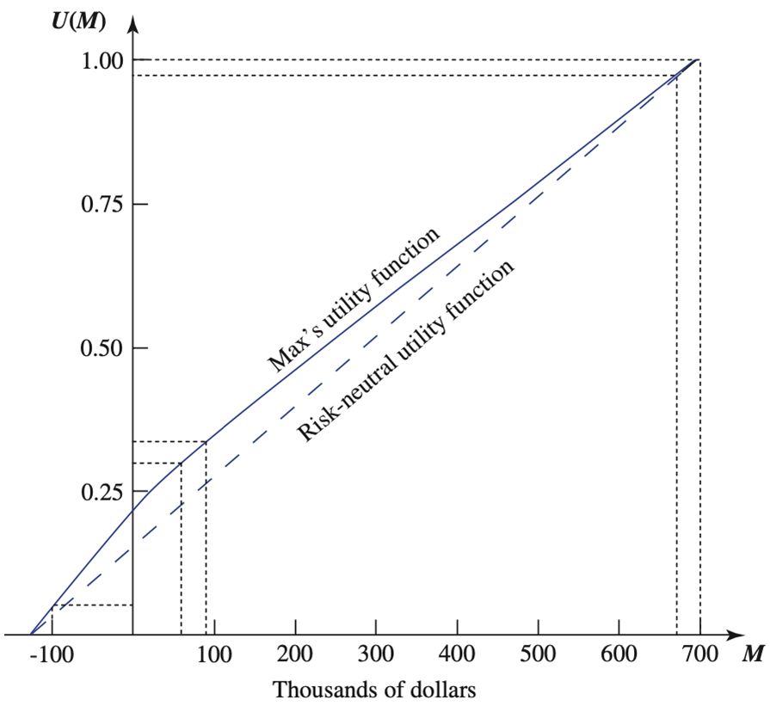
Max’s Utility Function for Money
Access the text alternative for slide images.
Notes:
Figure 12.22 Max’s utility function for money as the owner of Goferbroke Co.

Slide 42
Oil
97/7=13.9
97
1/7
30
Drill
Unfavorable
6/7
0
Dry
0.7
Sell
30
Survey
35.55
Oil
97
97/2=48.5
0.5
Drill
0.5
0.3
48.5
0
Dry
Favorable
35.55
Sell
30
Oil
100
26.25
0.25
Drill
0.75
33.3
5
Dry
NoSurvey
Sell
33.3
Notes:
Figure 12.14 The decision tree for the full Goferbroke Co. problem (before including any numbers) when first deciding whether to conduct a seismic survey.

Slide 43

Exponential Utility Function
Constructing U(X$) curve requires many decisions about probabilities.
Alternatively, we may use exponential utility function.
$$U\left(X\$\right)=1−e^{−X/R}$$
where R is the decision maker’s risk tolerance.
To estimate R, pick the value that makes you indifferent between the following two alternatives:
  a) A 50-50 gamble where you gain $R with probability 0.5 and lose R/2 dollars with probability 0.5.
  b) Neither gain nor lose anything.

Slide 44
Exponential Utility Function
Larger values of R indicate that the decision maker is less risk averse (closer to neutral).

Slide 45
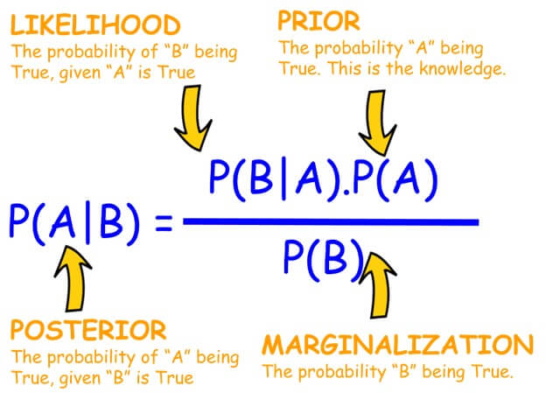
Prior & Posterior Probabilities

Slide 47
Posterior vs Prior Probabilities
We earlier stated that Goferbroke can obtain improved estimates and we provided the following inf.
But in reality we do not have the probability of oil given favorite P(O|F). Instead we have the probability of favorite if oil P(F|O). The same is true for P(D|F) and P(F|D and provability of unfavorite if dry P(U|D).
We need to compute P(O|F) and P(D|F) by using P(F|O) and P(D|O).The same is true for P(O|U) and P(D|U)
P(Finding|State) = Probability that the indicated finding will occur, given that the state of nature is the indicated one.
We have the second table and we need to compute the first table.
Notes:
Table 12.8 Posterior probabilities of the states of nature, given the finding from the seismic survey, for the Goferbroke Co. problem.

Slide 48
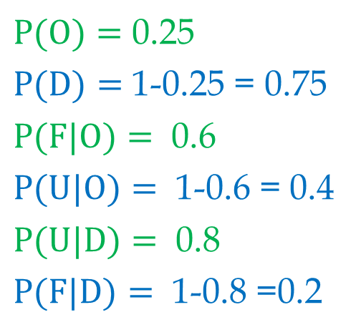
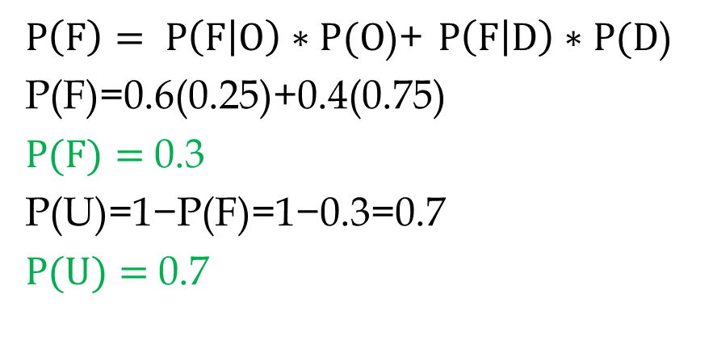
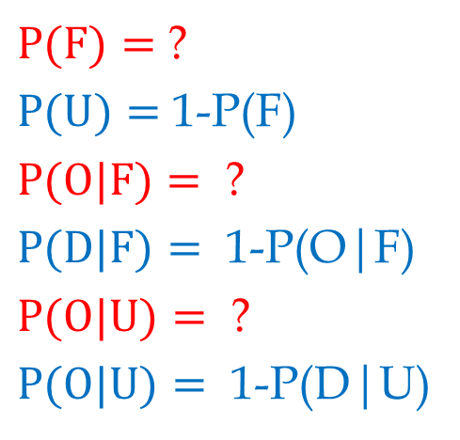
Prior Probabilities, Conditional Probabilities, Posterior Probabilities
$P(O)=$ 0.25
$P(D)=$ 1-0.25 = 0.75
$P(F|O)=$ 0.6
$P(U|O)=$ 1-0.6 = 0.4
$P(U|D)=$ 0.8
$P(F|D)=$ 1-0.8 =0.2
$P(F)=$ ?
$P(U)=$ 1-P(F)
$P(O|F)=$ ?
$P(D|F)=$ 1-P(O|F)
$P(O|U)=$ ?
$P(O|U)=$ 1-P(D|U)
  $P\left(F\right)= P\left(F | O\right)∗P(O$)+ $P\left(F | D\right)∗P(D$)
  P(F)=0.6(0.25)+0.4(0.75)
  $P(F)=$ 0.3
  P(U)=1−P(F)=1−0.3=0.7
  $P(U)=$ 0.7
Notes:
Figure 12.14 The decision tree for the full Goferbroke Co. problem (before including any numbers) when first deciding whether to conduct a seismic survey.

Slide 49
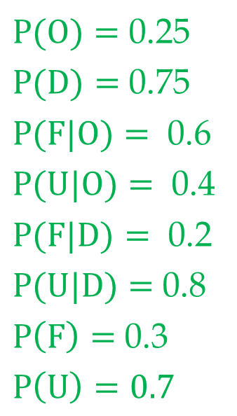
Prior Probabilities, Conditional Probabilities, Posterior Probabilities
$P(O)=$ 0.25
$P(D)=$ 0.75
$P(F|O)=$ 0.6
$P(U|O)=$ 0.4
$P(F|D)=$ 0.2
$P(U|D)=$ 0.8
$P\left(F\right)=$ 0.3
$$P\left(U\right)=0.7$$
P(F|O)=P(F&O)/P(O)
P(F&O)=P(F|O)*P(O)
P(O|F)=P(F&O)/P(F)
P(O&F)= P(F&O)
P(O|F)= P(F|O)*P(O)/P(F)
P(O|F)= 0.6*0.25/0.3
P(O|F)= 0.5
P(D|F)= 1-0.5=0.5
P(O|U)= P(U|O)*P(O)/P(U)
P(O|U)= 0.4*0.25/ 0.7
P(O|U)= 1/7
P(D|U)= 1-1/7=6/7
Notes:
Figure 12.14 The decision tree for the full Goferbroke Co. problem (before including any numbers) when first deciding whether to conduct a seismic survey.

Slide 50
Excel Implementation: Prior Probabilities to Posterior Probabilities
Prior Probabilities
P(Finding|State)
Joint Probabilities
P(Finding&State)
State of
Prior
Finding
State of
Prior
Finding
Nature
Probability
F
U
Nature
Probability
F
U
0.40
Oil
0.25
0.60
?
0.15
Oil
?
0.1
0.75
?
0.20
0.15
Dry
?
0.80
Dry
?
0.6
0.30
0.70
?
?
0.3
0.7
Posterior Probabilities
P(State|Finding)
State of
Prior
Finding
Nature
Probability
F
U
Oil
0.5
1/7
Dry
0.5
6/7
1
1
Notes:
Table 12.8 Posterior probabilities of the states of nature, given the finding from the seismic survey, for the Goferbroke Co. problem.

Slide 51
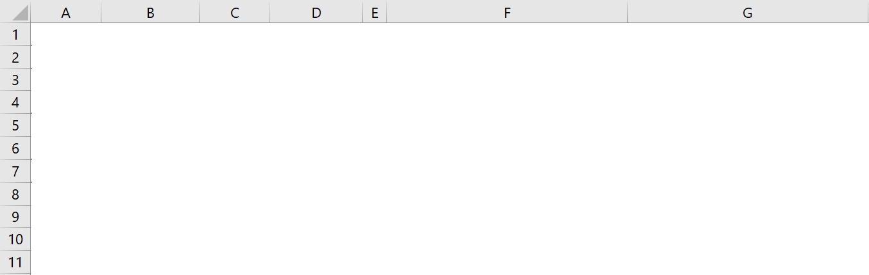
Excel Implementation: Prior, Joint, and Posterior Probabilities
Notes:
Table 12.8 Posterior probabilities of the states of nature, given the finding from the seismic survey, for the Goferbroke Co. problem.

Slide 52
Example. Prior, Joint, and Posterior Probabilities
We have three states of Nature: High, Med, Low.
The prior probabilities are: High (65%), Med (20%), and Low (15%).
A feasibility Study may lead to: Favorable or Unfavorable outcome.
If the State is Low, the probability of Unfavorable results is 75%. P(U|L)=0.75.
If the State is Med, the probability of Unfavorable results is 35%. P(U|M)=0.35.
If the State is High, the probability of Unfavorable results is 20%. P(U|H)=0.2.
Notes:
Table 12.8 Posterior probabilities of the states of nature, given the finding from the seismic survey, for the Goferbroke Co. problem.

Slide 53
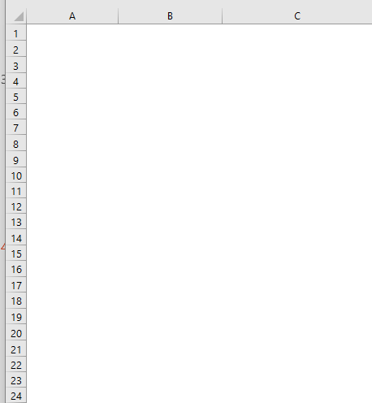
Example. Prior, Joint, and Posterior Probabilities
Sj is state of nature. U is one of the outcomes of an study
States of Nature
Prior Probabilities
Conditional Probabilities
State
P(State)
P(Finding (U)|State)
Low
0.65
0.75
Med
0.2
0.35
High
0.15
0.2
Compute joint probabilities of P(U&Sj)
States of Nature
P(State&Finding)
a) Compute Joint Probabilities of L&U, M&U, H&U.
Low
0.4875
=B4:B6*C4:C6
Med
0.07
High
0.03
Compute P(U)
0.5875
=SUM(B4:B6*C4:C6)
b) Compute Probability of an Unfavorable report.
Compute P
c) Compute Probability of a Favorable report.
(
¬U
)
0.4125
=1-B14
Compute P(Sj|U)
States of Nature
P(State|Finding)
d) Given an unfavorable report, compute probability of Low, Mid, and High.
Low
0.830
=B10/$B$14
Med
0.119
High
0.051
Notes:
Table 12.8 Posterior probabilities of the states of nature, given the finding from the seismic survey, for the Goferbroke Co. problem.

Slide 54
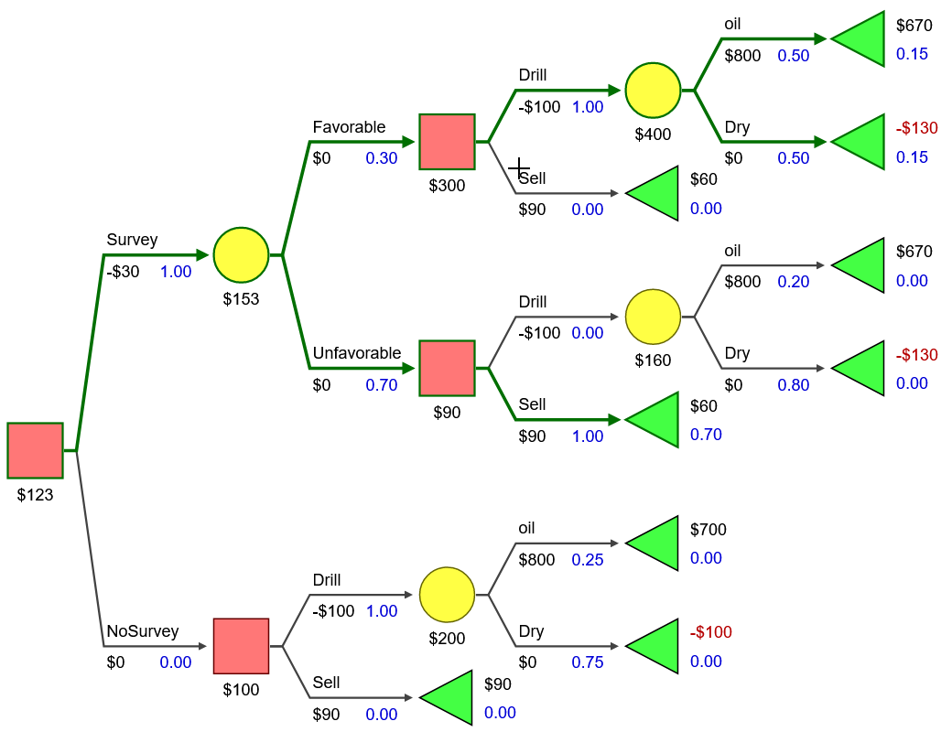
Silver Decisions

Slide 55


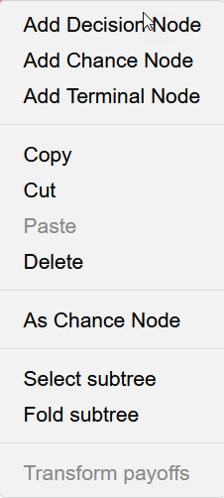
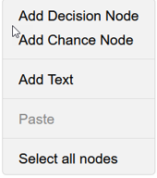
https://silverdecisions.pl/
https://silverdecisions.pl/

Slide 57
SilverDecisions can be used to construct decision trees and doo all the computations.
But SilverDecisions does not allow side Excel computations
Such as Excel computations to
Transform prior probs to
posterior probs.

Slide 58

Analytical Solver

Slide 60
Using Analytic Solver to Construct Decision Trees
Access the text alternative for slide images.
Notes:
Figure 12.3 The Decision Tree dialog box used to specify that the initial node of the first Goferbroke problem is a decision node with two branches, Drill and Sell, with values (partial payoffs) of -100 and 90, respectively.

Slide 61
Sensitivity Analysis-2

Slide 63
Sensitivity Analysis Made in Excel
Notes:
Figure 12.14 The decision tree for the full Goferbroke Co. problem (before including any numbers) when first deciding whether to conduct a seismic survey.

Slide 64
Practice: Product A and B. Product B with & without Competition
Notes:
Figure 12.14 The decision tree for the full Goferbroke Co. problem (before including any numbers) when first deciding whether to conduct a seismic survey.

Slide 65
Notes:
Figure 12.14 The decision tree for the full Goferbroke Co. problem (before including any numbers) when first deciding whether to conduct a seismic survey.

