Slide 1
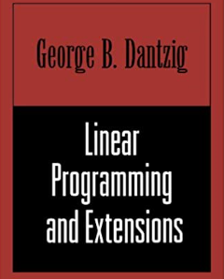
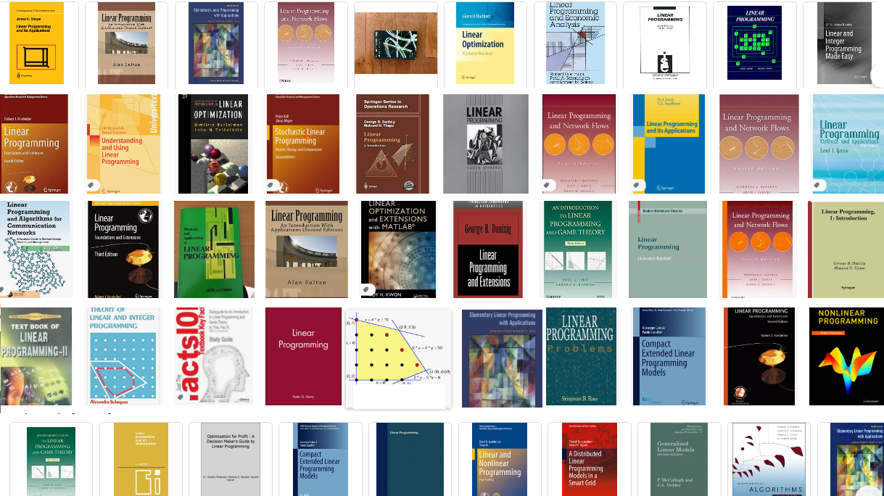

Slide 2
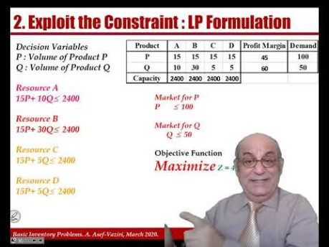
The Lecture https://youtu.be/aXPlkcPSlxs

Slide 3
Practice; Follow the 5 Steps Process
Two products, P and Q. Weekly demand for P is 100 units & for Q is 50 units.
$90 / unit
Q:
$100 / unit
P:
100 units / week
50 units / week
D
D
Purchased Part
15 min.
5 min.
$5 / unit
C
C
B
Operating expenses per week: $6,000. It includes $2000 administrative costs for the manager who works as operations, finances, and marketing manager, and $4000 non-
10 min.
5 min.
15 min.
A
B
A
15 min.
15 min.
10 min.
RM1
RM2
RM3
$20 per
$20 per
$20 per
unit
unit
unit
-administrative costs for the 4 operators working at the work-centers A, B, C, and D. Time available at each work center is 2,400 minutes per week.

Slide 4
Facility Layout : Job Shop
RM 2
RM1
A
B
RM3
C
D
Product P
Product Q
PP

Slide 5
Financial Throughput and Fixed Operating Costs
We define financial throughput as the rate at which the enterprise generates money. By selling one unit of product we generate P dollars, at the same time we incur V dollars pure variable cost. Pure variable cost is the cost directly related to the production of one additional unit - such as raw material. It does not include fixed costs such as salary, rent, and depreciation. Since we produce and sell X units per unit of time. The financial throughput is X(P-V).
Fixed Operating Expenses (F) include all costs not directly related to production of one additional unit. That includes costs such as human and capital resources.
In our example, F = $6,000 per week, P1= 90, P2= $100, V1= 45, V2= 40, and therefore, incoming $ per unit of product is $45 for product P and $60 for product Q.

Slide 6
2. Exploit the Constraint : LP Formulation
Decision Variables
P : Volume of Product P
Q : Volume of Product Q
Resource A
15P+ 10Q≤ 2400
Resource B
15P+ 30Q≤ 2400
Resource C
15P+ 5Q≤ 2400
Resource D
15P+ 5Q≤ 2400
Market for P
P ≤ 100
Market for Q
Q ≤ 50
Objective Function
Maximize Z = 45P+60Q-6000
Nonnegativity
P ≥ 0, Q≥ 0

Slide 7
LP Formulation and Solution

Slide 8
A Practice on Sensitivity Analysis –
What is the value of the objective function? Z= 45(100) + 60(?)-6000!
Shadow prices?
2400(Shadow Price A)+ 2400(Shadow Price C)+2400(Shadow Price C) + 2400(Shadow Price D)+100(Shadow Price P) + 50(Shadow Price Q).
2400(0)+ 2400(2)+2400(0) +2400(0)+100(15)+ 50(0).
4800+1500 = 6300
Is the objective function Z = 6300?
6300-6000 = 300

Slide 9
A Practice on Sensitivity Analysis
How many units of product Q?
What is the value of the objective function?
Z= 45(100) + 60(?)-6000 = 300.
4500+60X2-6000=300
60X2 = 1800
X2 = 30

Slide 10
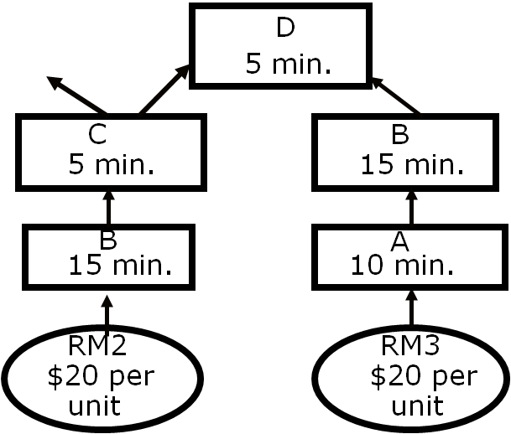
3: Subordinate Everything Else to This Decision
Keep Resource B running at all times.
Resource B can first work on RM2 for products P and Q, during which Resource A would be processing RM3 to feed Resource B to process RM3 for Q.
Do not allow starvation of B by purchased material RM2 or by output of Process A. Do not allow blockage of B by D.
Minimize the number of switches (Setups) of Process B from RM2 to RM3-Through-A and vice versa.
Minimize variability at Process B. Minimize variability at Process A and also in purchasing and arrival of RM2.
Do not miss even a single order of Product P.

Slide 11
Step 4 : Elevate the Constraint(s)
The bottleneck has now been exploited
Besides Resource B, we have found a market bottleneck.
  Generate more demand for Product P
  Buy another Resource B
The Marketing Director: A Great Market in Japan ! But the price discount, transportation cost, and other out of country costs adds up to 20% of the domestic sales price. Production costs remains as before.

Slide 12
Step 4 : Do We Try To Sell In Japan?
$/Constraint
Minute
3
2
1.8
1.33

Slide 13
Step 4 : Do We Try To Sell In Japan?
2
Right now, we can get at least $ per constraint minute in the domestic market.
So, should we go to Japan at all?
Okay, suppose we do not go to Japan. Is there something else we can do?
      Let’s buy another machine! Which one?
      Cost of the machine = $100,000.
      Cost of operator: $400 per week.
      What is weekly operating expense now?
      What is the pay-back period (PBP)?
Perhaps not.
B
$6,400

Slide 14
Step 5: Where is the New Constraint?

Slide 15
Step 5: If a Constraint Was Broken in previous Steps, Go to Step 1
80P, 50Q,0PJ, 70QJ
Total Profit = 3000
What is the payback period?
100000/3000 = 33.33 weeks
What is the payback period?
100000/(3000-300) = 37.03 weeks
The domestic P had the max profit per minute on B. Why we have not satisfied all the domestic demand.

Slide 16
Practice: A Production System Manufacturing Two Products, P and Q
$90 / unit
Q:
$100 / unit
P:
110 units / week
60 units / week
Purchased Part
D
D
10 min.
5 min.
$5 / unit
C
C
B
10 min.
5 min.
25 min.
B
A
A
15 min.
10 min.
10 min.
RM1
RM2
RM3
$20 per
$20 per
$25 per
unit
unit
unit
Time available at each work center: 2,400 minutes per week.
Operating expenses per week: $6,000. All the resources cost the same.

