Slide 1
Assignment
Capacity
More Problems

Slide 2
Problem 10
A local grocery store has 2 cashier stations, and 1 experienced cashier and 1 novice cashier. During a typical working day (8 hours), 120 customers will show up. The novice cashier will serve 48 customers and the experienced cashier will serve 72 customers. On average it takes 6 minutes for the novice cashier to serve one customer and 3 minutes for the experienced cashier to serve one customer.
R1 = 48/8 = 6, T1 = 6
R2 = 72/8 = 9, T2=3
These are Throughput and Flow time.
Are R1 = 6 and R2 = 9 Capacity?
No they are Throughput.
What are capacities?

Slide 3
Problem 10
a) During the rush hours, approximate 25 customers will show up in an hour. Does the store have enough capacity for the rush hour?
Yes, the capacity of the store is 25 customers per hour.
Yes, the capacity of the store is 30 customers per hour.
No, the capacity of the store is 10 customers per hour.
No, the capacity of the store is 20 customers per hour.
None of the above.
On average it takes 6 minutes for the novice cashier to serve a customer ➔ 60/6 = 10 customers/hr
On average it takes 3 minutes for the experienced cashier to serve a customer ➔ 60/3 = 20 customers/hr
Capacity = 10+20 = 30

Slide 4
Problem 10
b) During the day, both cashier stations on average have 2 customers waiting. On average, how long does a customer stay in the novice cashier’s waiting line?
  8 minutes
  11 minutes
  16 minutes
  20 minutes
  None of the above
The novice cashier will serve 48/8 = 6 customers/hr
R1 = 6 /hr
R1T1 = I1
6T1 = 2
T1 = 1/3 hr or 20 min

Slide 5
Problem 10
c) On average, how long does a customer stay in the experienced cashier’s line?
  7 minutes
  9.4 minutes
  13.3 minutes
  15 minutes
  None of the above
On the same token
the experienced cashier will serve 72/8 = 9 customers/hr
R2 = 9 /hr
T2R2 = I2 ➔ 9T2 = 2 ➔ T2=2/9 hr or 13.33 min

Slide 6
Problem 10
d) On average, how long does a customer spend in the store?
The novice and experienced cashier serve 6, and 9 customers per hour, respectively.
Customers served by Novice: 6 min service time, 20 min waiting time. T = 26 min for 6/15 customers.
Customers served by Experienced: 3 min service time, 13.33 min waiting time. T = 16.33 for 9/15 customers.
(6/15)(26) + (9/15)(16.33) = 20.2

Slide 7
Problem 10
To shorten the waiting time, the manager does a detailed study and finds that half of the customers purchase 5 items or less, and half of the customers purchase more than 5 items. The manager decides to let the novice cashier only serve the customers that purchase 5 items or less. After the change, it turns out that both cashier stations have 1.75 customers waiting on average. Assume that the novice cashier serves all of the customers purchasing 5 items or less and the experienced cashier serves all of the customers purchasing more than 5 items.

Slide 8
Problem 10
e) What is the average waiting time in the novice cashier’s line?
  13 minutes
  14 minutes
  17 minutes
  19 minutes
  None of the above
Each of the two cashiers will serve 120/2 = 60 customers per day or 60/8 =7.5 customers/hr
T1R = I1
7.5T1 = 1.75
T1 = 1.75/7.5 = 0.2333 hr or 14 min

Slide 9
Problem 10
f) What is the average waiting time in the experienced cashier’s line?
  9 minutes
  11 minutes
  12 minutes
  14 minutes
  None of the above
R and I are the same for Naïve and Experience
Therefore, T is the same; 14 min

Slide 10
Problem 2. Problem 5.3 in the book- At Your Own Will
Three hairstylists and a receptionist. On average it takes 10 minutes to shampoo, 15 minutes to style the hair and 5 minutes to bill a customer. The customer first checks in with the receptionist. This takes only 3 minutes. One of the three stylists then takes charge and performs all the three activities—shampooing, styling and billing—consecutively.
Receptionist
Hair Stylist
a) How many customers can be serviced per hour in this salon?
Check-in
Sh-Sty-Bill
3 minutes
10+15+5=30
The capacity of each stylists is 1/30 per min.
Capacity of the stylist pool is 3(1/30) = 3/30 = 1/10 per min.
Capacity of the stylist pool is 60(1/10) = 6 customers per hour.
Capacity of the receptionist is 1/3 per min or (60) = 20 per hour.

Slide 11
Problem 2. Problem 5.3 in the book- At Your Own Will
The capacity of the process is min (6, 20) = 6 customers per hour.
The bottleneck is the stylist pool.
Receptionist
Hair Stylist
b) What would be the impact on the theoretical capacity if
ChinBill
Sh-Sty
3+5 =8
10+15=25
the billing operation is transferred to the receptionist?
The capacity each stylists is 1/25 = per min.
Stylist pool has 3 stylists. Capacity of pool is 3/25 per min or 60(3/25) = 7.2 per hr.
Capacity of the receptionist is (1/8)(60) = 7.5 customers per hour.
The capacity is min (7.2, 7.5) = 7.2 customers per hour. Cross training increased capacity form 6 to 7.2.
The bottleneck is still the stylist pool.

Slide 12
Problem 3 – At Your Own Will
Eastern Coffee follows the flow chart below to serve its customers. It takes a worker two minutes to take order and receive payment, two minutes to prepare coffee, and three minutes to clean equipment.
Take Order & Receive Payment
Prepare Coffee
Clean Equipment
Eastern Coffee has two workers: worker A takes order and prepares coffee, while worker B handles the cleaning. Order processing takes 2 min., preparing the coffee takes 2 min., Cleaning takes 3 min.
a) How many customers can Eastern Coffee serve per hour?

Slide 13
Problem 3 – At Your Own Will
TpA = 2+2=4, TpB = 3
Capacity of worker A: 1/4 customers / hr or 60(1/4) = 15 / hr.
Capacity of worker B: 1/3 / min, or 60(1/3) = 20 / hr.
Capacity of the bottleneck is 15 customers/hour
Western Coffee follows the same flow chart above, and each activity takes the same amount of time as Eastern. Western Coffee also has two workers: worker C only takes order and payment, while worker D handles the coffee preparation and cleaning.
b) How many customers can Eastern Coffee serve per hour?
TpC = 2, TpD = 2+3=5
Capacity of worker C: 60(1/2) = 30 customers/hour
Capacity of worker D: 60(1/5) = 12 customers/hour
Capacity of the bottleneck is 12 customers/hour

Slide 14
Problem 4
Angels Inc. fabricates garage doors. Roofs are punched in a roof punching press (10 minutes per roof) and then formed in a roof forming press (5 minutes per roof). Bases are punched in a base punching press (10 minutes per base) and then formed in a base forming press (15 minutes per base), and the formed base is welded in a base welding machine (5 minutes per base). The base sub-assembly and the roof then go to final assembly where they are welded together (10 minutes per garage) on an assembly welding machine to complete the garage. Assume one operator at each station.
Draw a flowchart of the process.
What is the minimum time required to produce a garage (from starting an order to finishing it)?
What is the capacity of the factory in terms of garages per hour?
If you want to increase the capacity, what is the stage that you would put some additional resource?
STOP

Slide 15
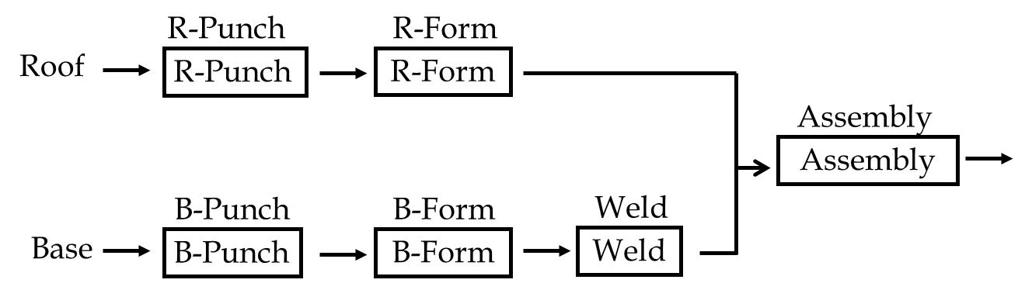
Flow Chart
STOP
R-Punch
R-Form
R-Punch
R-Form
Assembly
Assembly
B-Punch
B-Form
Weld
B-Punch
B-Form
Weld

Slide 16
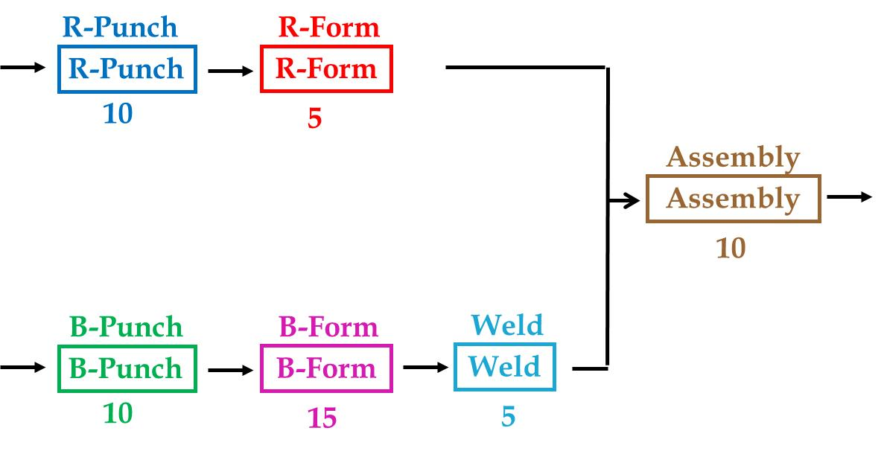
Problem 4
What is the Theoretical Flow Time? (The minimum time (the required to produce a garage from start to finish.)
Roof: 10+5+10 =25
Base: 10+15+5+10 = 40
STOP
➔ Max(25, 40) = 40 min
(b) What is the capacity of the factory in terms of garages per hour?
R-Punch:1/10 per min. or 6 per hr
R-Form:1/5 per min. or 12 per hr
B-Punch:1/10 per min. or 6 per hr
B-Form:1/15 per min. or 4 per hr
Welding: 1/5 per min. or 12 per hr
Assembly: 1/10 per min. or 6 per hr
4
Process Capacity is 4 per hour
(c) If you want to increase the capacity, what is the sub-process that you would put some additional resource?
B-Form

Slide 17
Problem 4
(d) Suppose the machines and operations of B-Punch and R-Bunch can do both Base-punching and Roof-punching. Also suppose there will be no change in the activity times. Further, make the same assumption regarding Forming operations.
STOP
R-Punch
Punch
R-Form
Form
R-Punch
R-Form
R-Punch
R-Form
10
10
5
5
Assembly
Assembly
Assembly
Assembly
10
10
B-Punch
B-Form
Punch
Form
Weld
Weld
Weld
B-Punch
B-Form
Weld
B-Punch
B-Form
10
10
15
15
5
5

Slide 18
Problem 4
Punching (R+B) = 10+10=20
Forming (R+B) = 5+ 15 = 20
Punching Capacity = 2/20 = 1/10 per min = 6 per hour
Forming Capacity = 2/20 = 1/10 per min = 6 per hour
Welding: 1/5 per min = 12 per hour
Assembly: 1/10 per min = 6 per hour
Process Capacity is 6 per hour
(c) If you want to increase the capacity, what is the stage that you would put some additional resource?
All the three departments except Welding.
STOP

Slide 19
Problem 9
Dr. Asef has enlisted the help of one of his students, Hansen, to help him bake cookies to raise money for his newly created “Race to the Top” program at CSUN. The money will be used to equip the graduate launch with better capital resources and encourage graduate students to spend more time in the launch and help each others to learn quantitative concepts. Orders are taken over the phone in the Grad Lounge. Prof. cleans the bowl and prepares cookie dough for each specific order. It takes a total of 7 minutes for these activities. Then the Prof. spends 3 minutes to artistically spoon the dough in the shape of a Matador. Hansen (in need of extra credit) takes 2 minutes to set the oven and insert the tray. Cookies bake for 13 minutes and cool for 5 minutes. Hansen spends 3 minutes packing cookies (careful not to break Matador shaped hats on each cookie), and then collects payment from the customer – a 1 minute activity.
a) Draw a flowchart and define the types of resources used.
STOP

Slide 20
Flowchart, Resources, and Resource units
Take
order
wash
mix
spoon
load
& set
bake
unload
STOP
7 min
3 min
2 min
13 min
cool
Capital resources – CSUN’s Oven. It is a fixed asset just like the assets seen on a balance sheet such as property, land, and equipment.
Human Resources – Prof. & Hansen. Any labor input used to create a product or deliver a service such as, engineers, chefs, customer service, and etc.
Each resource is allocated to one or more activities, and each activity may require one or more resources. For example loading the oven requires Hansen and the Oven.
Resource Units – Prof., Hansen, and the Oven are individual resource units.
Next: Determine Theoretical Flow Time and Cycle Time
5 min
pack
3 min
get
pay
1 min

Slide 21
Flow time, cycle time, bottlenecks.
Take
order
wash
mix
spoon
load
& set
bake
unload
STOP
7 min
3 min
2 min
13 min
cool
Theoretical Flow Time = 7 + 3 + 2 + 13 + 3 + 5 + 1 = 34 minutes.
The flow time is the amount of time required to produce a
batch of cookies from start to finish.
Cycle Time = Theoretical Bottleneck
The Oven is the bottleneck = 2 + 13 = 15 minutes. A batch of
cookies can exit every 15 minutes.
Therefore, Cycle Time = 15 minutes.
Next:
Determine unit load for each resource
Determine capacity for each resource
Determine the process capacity per hour
5 min
pack
3 min
get
pay
1 min

Slide 22
Unit load, capacity, process capacity.
Take
order
wash
mix
spoon
load
& set
bake
unload
STOP
7 min
3 min
2 min
13 min
cool
Unit load for each resource:
Hansen = 2 + 3 + 1 = 6 min/unit .
Prof. = 7 + 3 = 10 min/unit.
Oven = 2 + 13 = 15 min/unit.
Capacity for each resource:
Hansen = 60/6 = 10 orders/hour.
Kristen = 60/10 = 6 orders/hour.
Oven = 60/15 = 4 orders/hour min.
Process capacity per hour:
The oven is the theoretical bottleneck.
Therefore, process capacity = 4 orders of 1 dozen/hr.
Next: How many batches can be produced in an 8 hour day? 4 x 8 = 32?
5 min
pack
3 min
get
pay
1 min

Slide 23
Production capacity per day: Starting from 0
Take
order
wash
mix
spoon
load
& set
bake
unload
STOP
7 min
3 min
2 min
13 min
cool
5 min
How many batches can be produced in an 8 hour day?
Starting from zero, if you answered 32 batches, it would be incorrect!
Theoretical Flow Time = 7 + 3 + 2 + 13 + 3 + 5 + 1 = 34 minutes.
From start to finish it takes 34 minutes for Prof. and Hansen to
produce their first batch.
8 hours x 60 minutes = 480 – 34 = 446 minutes left over
Cycle Time = Bottleneck = 2 + 13 = 15 minutes.
446 minutes left/15 minutes = 29.73 = 29 batches.
*cannot have work in progress when baking so round 29.73 down to 29.
Total batches produced per day First batch + 29 batches = 30 per day
Next: Determine the utilization at full capacity for each resource:
pack
3 min
get
pay
1 min

Slide 24
Utilization
Take
order
wash
mix
spoon
load
& set
bake
unload
STOP
7 min
3 min
2 min
13 min
cool
Unit load for each resource: Capacity for each resource:
Hansen = 2 + 3 + 1 = 6 min/unit. Hansen = 60/6 = 10 orders/hour.
Prof. = 7 + 3 = 10 min/unit. Prof. = 60/10 = 6 orders/hour.
Oven = 2 + 13 = 15 min/unit. Oven = 60/15 = 4 orders/hour min.
The utilization at full capacity for each resource:
Hansen = 4/10 = 40%;
Prof = 4/6 = 67%;
Oven = 4/4 = 100%.
Alternative method for computing Utilization = Unit load/bottleneck
Bottleneck = 15 minutes.
Hansen = 6/15 = 40%, Prof = 10/15 = 67%, Oven = 15/15 = 100%
Next: What would be the impact if we bought another oven?
5 min
pack
3 min
get
pay
1 min

Slide 25
Resource pool, diminishing marginal returns
Oven
STOP
Bake Operation
Bake Operation
4 orders/hour
What is the impact of buying another Oven?
New oven resource pool capacity = 2 x 4 = 8 orders per hour.
Bottleneck has shifted to Prof. so new Process capacity = 6 orders/hour
but doubling the capacity of the oven did not double
production since the bottleneck shifted to the Prof. This is an example of
diminishing marginal return.
Resource Pooling – increases process flow rate, capacity, and
flow time,
Next: What will be the impact if we cross train Prof. and Hansen

Slide 26
Cross training, resource pool, process capacity.
Take
order
wash
mix
spoon
load
& set
bake
unload
STOP
7 min
3 min
2 min
13 min
cool
Cross training Prof. and Hansen will create a single
resource pool.
New unit load for resource pool = 6 + 10 = 16 minutes
Capacity of resource pool = (60)(2)/16 = 7.5/hour
Process Capacity will not increase with 1 oven since
the bottleneck still remains at 4 batches per hour.
With 2 ovens at 8 batches per hour process capacity
will increase to 7.5/hour.
Next: Managerial considerations - In general, what will
happen to capacity & flow time if we increase the set up
batch? (if more than one batch of dough is prepared at a time).
5 min
pack
3 min
get
pay
1 min

Slide 27
Setup Batch Size – Managerial Decisions
Determining the correct set up batch is a key managerial
consideration. What is the ideal setup batch size?
Setup Batch: the number of units produced consecutively
after a set up batch. 2 things to consider:
Increased Batch Setup = lower unit load and higher capacity,
but inventory will increase and with it flow time.
Load batch: the number of units processed simultaneously. In
our cookie scenario load batch will be constrained by oven
capacity. Load batch is often constrained by technological
difficulties.
Next: Managerial value analysis: identify & eliminate non-value
adding activities. What might they be?
STOP

Slide 28
Reducing Resource Capacity Waste ↓ Tp
STOP
Management has determined that waste factor is much higher when cookies are made in the shape of a Matador, especially during peak hours – Hansen stresses out and breaks too many Matador cookie hats and legs. Management has also determined that customers buy CSUN cookies because of taste and sales are not affected when they are shaped in a circle. Furthermore, Prof. will be able to increase his capacity when spooning dough. The Prof. will need to find another activity to fill his artistic passions.
Eliminating non-value-adding activities: it increases resource utilization, and eliminates waste. ↓ Tp or ↑ Net availability.

Slide 29
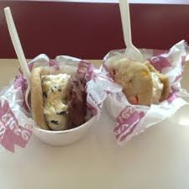
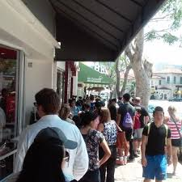
Investment Opportunity
Prof. and Hansen have developed new skills baking cookies for the “No Student Left Behind” program and now they have the entrepreneurial itch and are currently trying to decide if they should buy the a very popular cookie and ice cream hangout in Westwood – Diddy Riese. The wait line is staggering, averaging between 15 and 70 people any time during mid-afternoon or at night (real case scenario, real waiting lines!).
STOP
Diddy Riese

Slide 30
Internal Measures
The owner of Diddy Riese is retiring and has offered to sell his business to Prof. and Hansen at an exorbitantly high price. New businesses often fail in this neighborhood where rents are exceptionally high. Prof. and Hansen have determined they will make zero economic profit if they buy the store and are looking for a bigger return on their investment. The owner claims his store has the capacity to produce more than 3 times the number of cookies they currently produce, but they just can’t process orders fast enough! Diddy Riese may actually become much more profitable if process capacity can be increased. Mentor and student begin sharpening their pencils and look over their list of internal measures to see if they can increase process capacity by reducing unit load for processing customer orders. The two of them identify 6 key internal measures that can be re-worked to increase overall capacity for the Diddy Riese system.
Internal Measures:
Resource-Activity match High Utilization (Low Safety Capacity)
Division of Labor (Job-Simplification) High Standardization and Modularization
Effective Facility Layout Clear Material Flow Pattern
Flow-Shop Training
Method Improvement Technology
Job-shop U-shaped layout
Cross-trained workers Short setup time
Small batch size Internal uniformity vs external variability
STOP

Slide 31
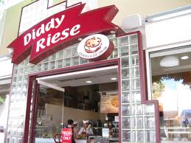
Internal Measures
Floor space is limited and Hansen noticed the entrance doors open inward and recommends they be re-configured to open outward and against the front of the building to make room for a more effective facility layout, and clear material flow pattern by using a U-shaped layout for the counters. The U-shape will increase flexibility and give Prof. and Hansen the ability to train their employees to use a flow shop design part of the time and a job shop design at other times.
STOP

Slide 32
Current Inefficient System
The existing system for taking orders makes use of job shop technique. 75% of sales are ice cream cookie sandwiches the rest are Hawaiin shaved ice & ice cream sundaes. One employee takes an order selects type of cookies, and walks around the cashier station to the other side of the store where the ice cream station is located and customer must follow the employee to select desired ice cream. The employee scoops the ice cream and makes the sandwich. There are 5 workers performing these same multiple activities. A cashier or an employee rings up the sale and collects payment. Only one cash register!
STOP

Slide 33
Future Efficient System
The new layout will make use of flow shop part of the time and job shop part of the time using a U-shaped layout. 75% of orders are for cookie sandwiches. One employee will take the cookie order, place the cookies in a cup and pass it down the counter to the next employee at the ice cream station. Once the sandwich is made, the worker slides it down the counter to the cashier. Both sides of the counter will employ the same techniques. We have 2 cash registers.
STOP

Slide 34
Future Efficient System
When the cookie worker is shaving ice, the worker from the ice cream station will work the cookie station, take the order, and step over to the ice cream station. While these activities are transpiring, the cashier will take the next order at the cookie station. When the sandwich is prepared the worker will ring up the sale and go back to the cookie station or the ice cream station depending on whether or not the shaved ice order has been completed. Since 75% of the orders are for cookie sandwiches a portion of activities can be performed using a more efficient flow shop technique and at other times job shop.
STOP

Slide 35
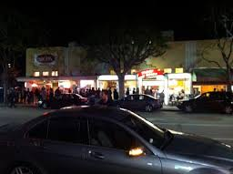
Conclusion
If any station bottleneck’s, the upstream or downstream worker can immediately double the capacity at the bottleneck to quickly free the constraint and resume smooth flow. If Prof. and Hansen can decrease customer waiting time, sales should increase. Prof. calculated lost sales due to long lines at ~48.5% revealing the hidden value of Diddy Riese. Lost sales do not appear on a cash flow statement or balance sheet when appraising the value of a firm.
STOP

Slide 36
Key Problem 2: The Impact Converging Activities
Which process has a longer flow time?.
STOP
Path 1
20
Activity
In a deterministic world they both have a flow time of 30 mins.
The situation differs in real world where nothing is deterministic.
Suppose instead of 20 , 15, and 10, we have 16-24, 13 to 17, and 6 to 12.
That means all the paths and activities have a coefficient of variations of 11.547%
10
Path 2
20
Path 1
20
Activity
10
Path 2
15

Slide 37
Key Problem 2: The Impact Converging Activities
Which process has a longer flow time?.
STOP
Path 1
20
Activity
In a deterministic world they both have a flow time of 30 mins.
The situation differs in real world where nothing is deterministic.
Suppose instead of 20 , 15, and 10, we have 16-24, 13 to 17, and 6 to 12.
That means all the paths and activities have a coefficient of variations of 11.547%
10
Path 2
20
Path 1
20
Activity
10
Path 2
15

Slide 38
Key Problem Flow Time: The Impact Converging Activities
Path 1 Time = 16+8rand()
rand() is a random number between 0 and 1.
If it is 0, Path 1 Time is 16, if it is 1, Path1 Time is 24.
For all possible rands 16 ≤ Path 1 Time ≤ 24
On the same token
Path 2 Time = 12+6rand()
For all possible rands 12 ≤ Path 2 Time ≤ 18
The last activity time = 8+4rand()
For all possible rands 8 ≤ Activity Time ≤ 12
The following is an instantiation of this situation
STOP

Slide 39
Key Problem Flow Time 5: Random Number Generation
Now suppose Path 2 is exactly the same as path 1. That is
Path 1 Time = 16+8rand()
Path 2 Time = 16+8rand()
The last activity time = 8+4rand()
The following is an instantiation of this situation
STOP
Now let’s see what is the results for 10,000 instances of each if these two processes.
The average flow time in the first process was 30.04 mins. While in the second process was 31.26.
In 64% of the instancess flow time of the second process was larger than that of the first process.

Slide 40
Key Problem Flow time: 10,000 Instances
STOP

Slide 41
Key Problem Flow Time: Converging Activities + Common Resources
All activities are [8,12] minutes.
One Recourse Red, One Resource Blue, One Resource Green.
STOP
Activity B1
Activity R2
Activity G
Activity R1
Activity B2

