Slide 1
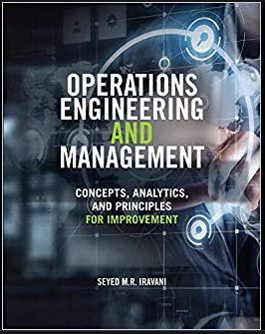
Cross-Training For Mass-Customization
Parts of the slides of this lectures were prepared over my teaching lifetime based on the material that I have learned & benefited from this book
that I have learned from the following book
Ardavan Asef-Vaziri

Slide 2
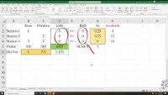

Slide 3


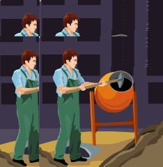
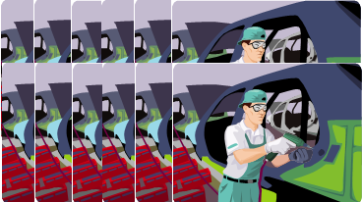
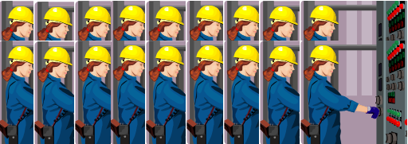
Door and Window
Two products (Product1 and Product2) and three resources (Resource1, Resource2, Resource3).
Contribution Margin of product 1 and Product2 are $300 and $500, respectively.
Product1 needs 1 hour of Resource1, nothing of Resource2, and 3 hours of resource3. Product2 needs nothing from Resource1, 2 hours of Resource2, and 2 hours of resource3.
Available hours of resources 1, 2, 3 are 4, 12, 18, respectively.
Formulate the Problem
Solve the problem using solver in excel

Slide 4










Slide 5
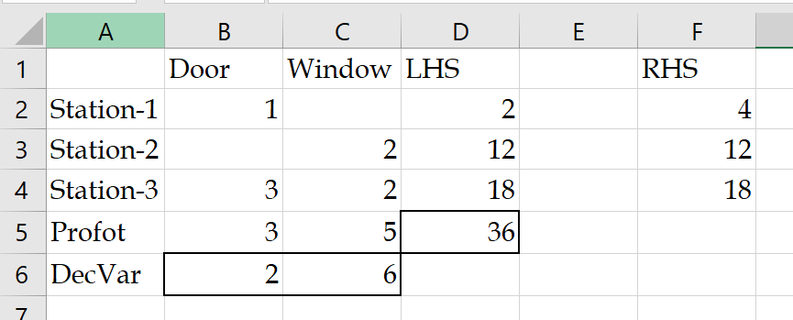
Formulation
Objective Function
Z = 300X1 +500X2
Constraints
Resource 1
X1 ≤ 4
Resource 2
2X2 ≤ 12
Resource 3
3X1+ 2X2 ≤ 18
Nonnegativity
X1≥ 0, X2≥ 0

Slide 6
Solver Optimal Solution
We can increase capacity of Sta-1 from 4 to 5 hours at a cost of $55. What is your decision?
We can increase either the capacity of Sta-2 from 12 to 13 hours, or the capacity of Sta-3 form 18 to 19 hours at a cost of $110. What is your decision?

Slide 7
Base Windoor n& Flexible Windoor

Slide 8
Base and Flexible 3-Products and 3-Resources

