Slide 1

Pipeline Inventory & Max-WIP
Ardavan Asef-Vaziri

Slide 2
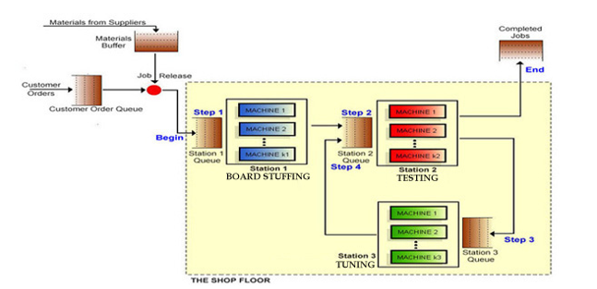
The Situation- Not the Same Numbers as in Your Game
c=1
Rp=8 /day
Tp=3 hrs
c=1
Rp=6 /day
Tp=4 hrs
c=1
Rp= 10 /day
Tp= 2.4
These commutations are not associated to any specific LittleField Technologies game.
They serve a prototype example. Please do your own computations for the game that you are playing.

Slide 3
One Machine Per Station; Pipeline Inventory and Theoretical Flow Time
Compute the Pipeline Inventory (Absolute Minimal Inventory).
Theoretical flow time in all cases is 3+4+2.4= 9.4 hours or 9.4/24 days
Capacity = 6, Assuming Capacity = Throughput, Rp=R=6/day and 24 hours per day.
Procedure 1- Little’s Law
Set R= 6/day and T=9.4/24 day ➔ RT=I=6(9.4/24)= 2.35 contracts
Set R= 6/24 =0.25/hour and T=9.4 hours➔ RT=I=0.25(9.4)= 2.35 contracts
Procedure 2- Utilizations
When R=6/day, Utilization of the three stations are 6/8=0.75, 6/6=1, and 6/10= 0.6, respectively. If there is only one machine at a station, and if U=0.6 what that means?
That means the station is busy 60% of time and Idle 40% of time.
That means there is on contract in the station for 60% of time, and no contract for 40%.
There are 0.60(1)+0.40(0) = 0.6 inventory.
Following this logic, the pipeline inventory I= U1+U2+U3= 0.75+ 1 + 0.6 = 2.35.

Slide 4
More Machine; Pipeline Inventory and Theoretical Flow Time
Compute Max-WIP for R=6/dy, T=3
RT=I=6(3)=18 ➔ Max-WIP= 18
Average WIP (Average Inventory) will be less than Max-WIP.
Average throughput will be less than capacity.
But in the games, we need to have an eye on it. Some time we may make it a little more than 18 (for example 19 or even more) and sometimes less than 18 (for example 17).
Compute the Pipeline Inventory and Max-WIP for the case when we have 3 machines in station-1, 3 machines in station-2, and 2 machines in Station-3, demand =16.
Theoretical flow time in all cases is 3+4+2.4= 9.4 hours or 9.4/24 days
Capacity = Sta-1=3(8)=24 Sta-2=3(6)=18, and Sta-3= 2(10)=20. Capacity of the process is 18, and demand is 16. Therefore R=16.
Procedure 1- Little’s Law
Set R= 16/dy and T=9.4/24 dy ➔ RT=I=16(9.4/24)= 6.267 contracts

Slide 5




More Machine; Pipeline Inventory and Theoretical Flow Time
Procedure 2- Utilizations
When R=16/dy, Utilization of the three stations are 16/24=0.67, 16/18=0.89, and 16/20= 0.8, respectively.
The pipeline inventory I= U1+U2+U3= 0.67+0.89+ 0.8 = 2.36.
2.36? vs. 6.27? Where did we go wrong?
The pipeline inventory I= c1U1+c2U2+c3U3= 3(16/24)+ 3(16/18)+ 2(16/20) = 6.267.
Suppose we need to deliver under 3 days.
What is the maximum allowable inventory? Here we use capacity not demand
R=18/dy, T=3 ➔ RT=I=18(3)=54 ➔ Max-WIP= 54
Suppose we need to deliver under 1 day.
R=18/dy, T=1 ➔ RT=I=18(1)=18 ➔ Max-WIP= 18
Suppose we need to deliver under 0.5 days.
R=18/dy, T=0.5 ➔ RT=I=18(0.5)=9 ➔ Max-WIP= 9
For Max-WIP. Also, check the average WIP. You do not want it to exceed the Max-WIP
But you do not want it to be much less than Max-WIP due to variability.
Also, check the lead time. You do not want it to be much less than minimal lead time.
If you are making full or close to full revenue per product
And if your lead time is << minimal lead time.
Due to high variability in demand, you may have R<<Rp
Increase Max-WIP step-by-step, but have an eye on it.
When WIP reaches close to what Max-WIP you have in mind, set it.

Slide 6
More Machine; Pipeline Inventory and Theoretical Flow Time
Theoretical flow time in all cases is 3+4+2.4= 9.4 hours or 9.4/24 days
Capacity of the process is 18.
Demand is 16 ➔ R=16.
Cycle Time. The minimal time interval when we can produce two consecutive products.
1 day 18 units
Xday 1 unit ➔ X= Cycle Time = 1/18 day or 24(1/18) = 1.33 hours
Takt Time. The minimal time interval when market needs two consecutive products.
1 day 16 units
X day 1 unit ➔ X= Takt Time = 1/16 day or 24(1/16) = 1.5 hours
Always TT>= CT
Always R<= Rp

Slide 7
Practice- Capacity and Cycle Time
  Compute the cycle time.
  Capacity is 6 per day.
  Cycle Time = 1/Capacity
  CT= 1/6 days.
  CT= 24(1/6) = 4 hrs.
  Capacity is 18 per day.
  Cycle Time = 1/Capacity
  CT= 1/18 days.
  CT 24(1/18) = 1.33 hrs.
  Capacity is 0.25 per hr.
  Cycle Time = 1/Capacity
  CT = 1/ 0.25 hrs.
  CT = 4 hrs.
  Capacity is 0.75 per hr.
  Cycle Time = 1/Capacity
  CT = 1/ 0.75 hrs.
  CT = 1.33 hrs.

Slide 8
Practice on Cycle Time & Takt Time
Demand is 5 per hour, Capacity is 6 per hour.
Cycle time = CT = 1/6 hour = 10 minutes.
Takt time = TT = 1/5 hour = 12 minutes.
Capacity of each machine in Sta-1 to Sta-3 in the Game are 4, 6 , and 10 products/day.
There are 4, 3, and 2 machines in these stations. The system works 24 hours per day.
Demand is 12 per day.
Compute cycle time
Capacity = Min (4*4,3*6, 2*10)= 14 per day
Cycle time = CT= 1/14 day = 24*(1/14) = 1.71 hour
Takt time = TT= 1/12 day = 24(1/12) = 2 hours.

