Slide 1
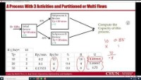
Multi-Flow Capacity

Slide 2
A Process With 3 Activities and Partitioned or Multi Flows
Subprocess A
Review
Tp = 20 mins.
c=2
40%
Compute the Capacity of this process.
R= 10/hr
Initial
Review
Tp=10 mins
c=2
Subprocess B
Review
Tp = 30 mins.
c=4
60%

Slide 3
A Process With 3 Activities- Relax The Bottleneck
Relax the bottleneck Resource Pool by one Resource Unit. Compute the new Capacity.
Relax the bottleneck Resource Pool by one Resource Unit. Compute the new Capacity.

Slide 4
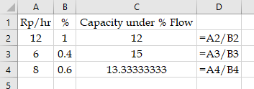
A Process With 3 Activities and Partitioned or Multi Flows
Subprocess A
Review
Tp = 20 mins.
c=2
40%
Compute the Capacity of this process.
R= 10/hr
Initial
Review
Tp=10 mins
c=2
Subprocess B
Review
Tp = 30 mins.
c=4
60%

