Slide 1

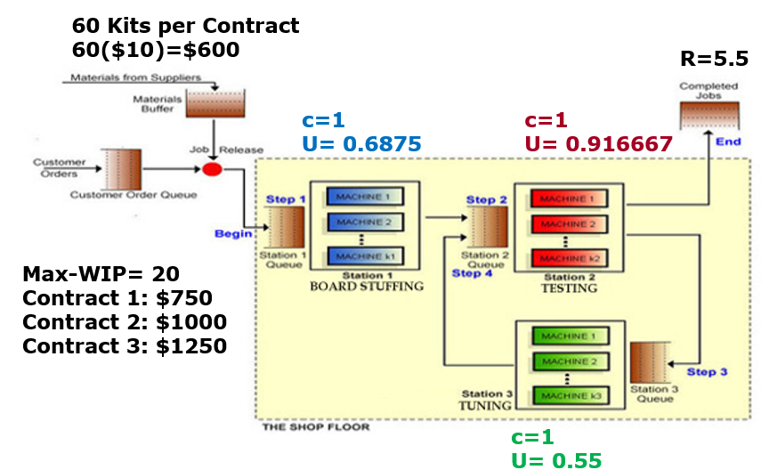

Capacity & Cycle Time LittleField Game
In Game, there is ONLY ONE CONTRACT for $1000 each. There are 3 contracts in Game-II for $750, $1000, and $1250. So do not worry when I say switch from contract 1 to contract 3. Just pay attention to how we can increase capacity.
These commutations are not associated to any specific LittleField Technologies game. Follow your own computations for the game that you are playing.
Ardavan Asef-Vaziri

Slide 2
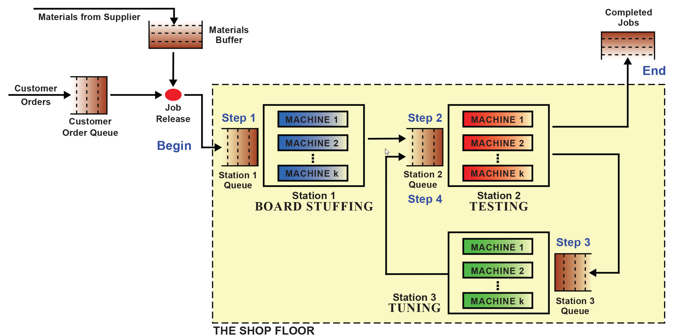
Compute Capacity- Not the Same Numbers as in Your Game
R=5.5
We have only one machine in each station
U=0.6875
U2=0.91666
U3=0.55

Slide 3
Capacity, Demand, and Binding Constraint (Bottleneck)
Let's assume the average throughput over the first 50 days was 5.5 orders per day. The average utilization of the three stations were U1=0.6875, U2=0.916667, and U3=0.55.
a) Estimate the capacity of the machines.
U=R/Rp ➔ Rp=R/U.
A machine in Station-1: Rp = 5.5/0.6875 = 8 contracts per day.
A machine in Station-2: Rp = 5.5/0.916667 = 6 contracts per day.
A machine in Station-2: Rp = 5.5/0.55 = 10 contracts per day.
b) Compute the Theoretical Flow Time. A day is 24 hours, and a month is 30 days.
The theoretical flow time is a time a flow unit spends on a resource or with a resource.
Flow Time = Theoretical Flow Time + Waiting times
Since the average capacities are 8, 6, 10 jobs per day.
Each job takes 1/8 days at Station-1, 1/6 day at Station-2, and 1/10 days at Station-3.
Since a day is 24 hours, therefore the average time for each job on each machine is
b)

Slide 4
Capacity, Contract, Loss of Revenue
Station Rp/day Tp(in days) Tp(in hrs)
Station-1 8 1/8 24(1/8)= 3
Station-2 6 1/6 24(1/6)= 4
Station-3 10 1/10 24(1/10) =2.4
Theoretical Flow Time = 3+4+2.4= 9.4 hours.
Process Capacity is min(8, 6, 10) = 6 contracts per day.
c) Suppose we are on contract-1 ($750). How much profit can we make?
Produced at throughput for our daily profit is 5.5(($750-$600) = $825.
Produced at capacity the ceiling for our daily profit is 6($750-$600) = $900.
During the past 50 days, the average demand per day was 16 contracts.
The current Binding Constraint (Bottleneck) is Internal and is our Capacity.
Due to low capacity, and also Max-WIP=20, we have accepted and processed 5.5 jobs per day, and have rejected 10.5 contracts per day.
We have passed the first 50 days. There are 7(24)+50 (the last 50 days) = 218 days left.

Slide 5
Capacity, Demand, and Binding Constraint (Bottleneck)
Suppose we buy enough capacity to match the demand and also switch to Contract-3.
Then our potential daily profit could reach 16($1250-$600) = $10,400
The difference in the daily profit is 10,400-900= $9500
Suppose the purchase price of each machine is 100,000. If we buy 6 additional machines (in harmony with all three stations) the Payback Period (PBP) is 600,000/9500 ≈ 64 days.
We are missing making 10,400 per day for 218 days (if everything remains the same). Total Profit = 218(10,400)= 2267200.
Since you start with about $1,000,000, by correct decision we may lift final cash to
1,000,000 (initial cash)+2,267,200 (profit)-600,000 (investment) = 2,667,200 plus interest.
A clever aggressive team whose members have watched all the lectures may make about 2 million dollars more compared to a team staying with the starting situation.

Slide 6
Capacity Expansion, Investment, and Utilization

Slide 7
100% Utilization is a High Risk
Imagine a freeway where all cars are driving exactly 65 and the distance between pairs of cars is 1”. As long as everyone has a speed of exactly 65 – no variability- that is fine.
What happens if one hits the break? How long does it take to clean the freeway. Do cars pass freeway easier when utilization is 1 and they are moving bumper to bumper, or when 50% of the freeway is empty, U = 0.5, or when U = 0.25. How long does it take to clean up accidents in these situations?
Never make U of all the sub-processes or activities, and not even a single sub-process = 1. If possible, consider cross taring and pooling.
7

