Slide 1
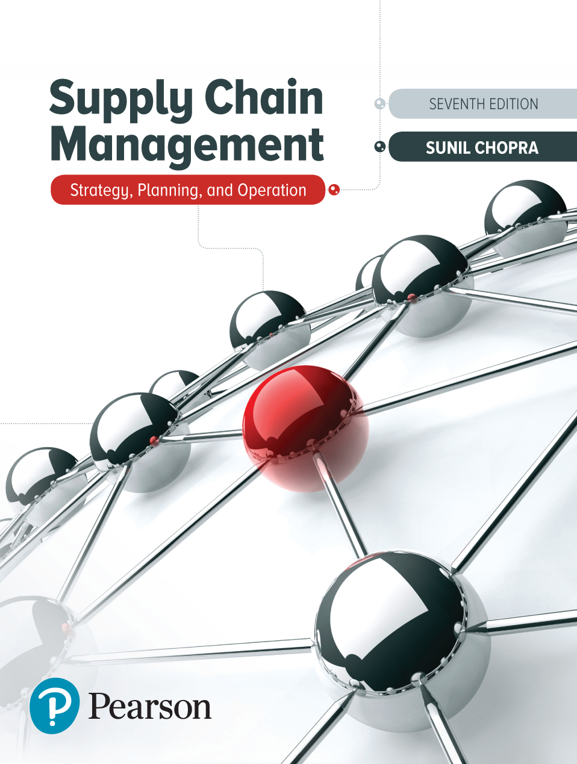
Supply Chain Management: Strategy, Planning, and Operation
Sunil Chopra, Pearson Education Inc. 7th Ed.
Chapter 8 Aggregate Planning in a Supply Chain
Parts of the slides of this lectures were prepared over my teaching lifetime based on the material that I have learned & benefited from this book
that I have learned from the following book
Ardavan Asef-Vaziri

Slide 2
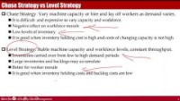
https://www.youtube.com/watch?v=3DPn4Bc39lw (36 mins)

Slide 3
Strategy or Design Decisions
Supply chain strategy decisions must support strategic objectives. To maximize supply chain surplus under competitive strategy constraints.
Long-term, less frequent, and expensive to reverse decisions– must consider market uncertainty
Strategic Decisions
  Outsource supply chain functions
  Capacity, location, capital intensity, and flexibility
  Production and storage nodes for the product mix
  Transportation nodes and links and modes of transportation
  Information infrastructure
Copyright © 2019, SCM, Sunil Chopra, Pearson Education, Inc

Slide 4
SC Decisions & Drivers of SC
Each driver affects the balance between responsiveness and efficiency and the resulting strategic fit.
It is important for supply chain designers to structure the six drivers appropriately to achieve strategic fit.
Copyright © 2019, SCM, Sunil Chopra, Pearson Education, Inc

Slide 5
Planning Decisions
Supply Chain Planning Decisions are under the constraints imposed by Supply Chain Strategy .
Maximize SC surplus under SC strategy constraints.
Starts with demand forecast for the coming year.
Consider demand uncertainty, exchange rates, and competition over the time horizon in planning decisions
Planning Decisions
  Which markets will be supplied from which locations
  Inventory policies- cycle, safety, seasonal, and pipeline inventory
  Subcontracting
  Timing and size of market promotions
Copyright © 2019, SCM, Sunil Chopra, Pearson Education, Inc

Slide 6
Aggregate Planning
Aggregate planning plans for an aggregate product which may even does not exist. It is a melt of all products. It is not at stock keeping unit (SKU) level.
The goal of aggregate planning is to satisfy demand in a way that minimizes the costs or maximizes profit.
Aggregate planning is a process by which a company determines levels of
  hiring and layoffs
  production in regular and over time
  subcontracting, inventory
  Stockouts
  and even pricing over a specified time horizon.
    The basic trade-offs in aggregate planning involve balancing the cost of capacity, inventory, and stockouts. Increasing any one of the three can lower the other two.

Slide 7
Aggregate Planning
The aggregate plan determines capacity, production, and inventory decisions over a time horizon of 3 to 18 months.
Aggregate Planning needs sensitivity analysis- since forecasts are always wrong.
That is why in forecasting, besides that forecast of the average demand, we also need the standard deviation and C.V. =StdDev/Ave.
Aggregate Planning is at aggregate level because forecast for aggregate items is more accurate than forecast for individual items.
Aggregate panning is usually updated on a rolling basis for 3-6 months periods, since the further the forecast in future, the lower the forecast accuracy.
Aggregate planning collects information from the enterprise as its breadth of scope, downstream partners to produce forecasts, and upstream partners to determine supply constraints.
The aggregate plan is shared with both customers (the aggregate plan determines planned supply) and suppliers (the aggregate plan determines anticipated orders).

Slide 8
Aggregate Planning Strategies: Chase, Level, and Flexible

Slide 9
Chase Strategy vs Level Strategy
Chase Strategy. Vary machine capacity or hire and lay off workers as demand varies.
  It is difficult and expensive to vary capacity and workforce.
  Negative effect on workforce morale
  Low levels of inventory
  It is good when inventory holding cost is high and costs of changing capacity is not high.
Level Strategy. Stable machine capacity and workforce levels, constant throughput.
  Inventories carried over from low to high demand periods
  Large inventories and backlogs may accumulate
  Better for worker morale
  It is good when inventory holding costs and backlog costs are low

Slide 10
Flexible Workforce (Utilization Flexibility) Strategy
Use excess machine capacity. While the workforce is stable, the number of hours worked varies
  Use overtime or a flexible work schedule
  Avoids morale problems
  Low levels of inventory
  It is good when inventory holding costs⇑ and costs of changing capacity ⇓

Slide 11
Aggregate Planning Summarized
Given the goal of maximizing profits (or minimizing costs) subject to supply chain constraints, the aggregate planning problem can be modeled as a linear program.
The first step is to identify a suitable aggregate unit of production and forecast demand in terms of the aggregate unit.
The next step is to identify the various costs (such as material, inventory, production, shortage) and constraints in the supply chain.
We then identify the set of decision variables and construct the objective function and constraints in terms of the decision variables.
Linear programming then allows us to optimize the objective function subject to the specified constraints.
Model and solve the aggregate planning problem as a linear program using Microsoft Excel.

Slide 12
Aggregate Product Parameters Computation
  Material cost per aggregate unit = (15 × 0.10) + (7 × 0.25) + (9 × 0.20) + (12 × 0.10) + (9 × 0.20) + (13 × 0.15) = $10

Slide 13
Demand and Costs
Demand Forecast -Highly seasonal demand
Options
  Adding workers during peak times
  Subcontract
  Build up inventory

Slide 14
Aggregate Planning Notations
Pt = # of units of the aggregate product produced in regular time in month t
Ot = # of units of the aggregate product produced in overtime hours in month t
Ct = # of units of the aggregate product outsourced in month t
It = Inventory at the end of month t
St = # of units stocked out at the end of month t
Wt = Workforce size (number of employees) in month t
Ht = # of employees hired at the beginning of month t
Lt = # of employees laid off at the beginning of month t

Slide 15
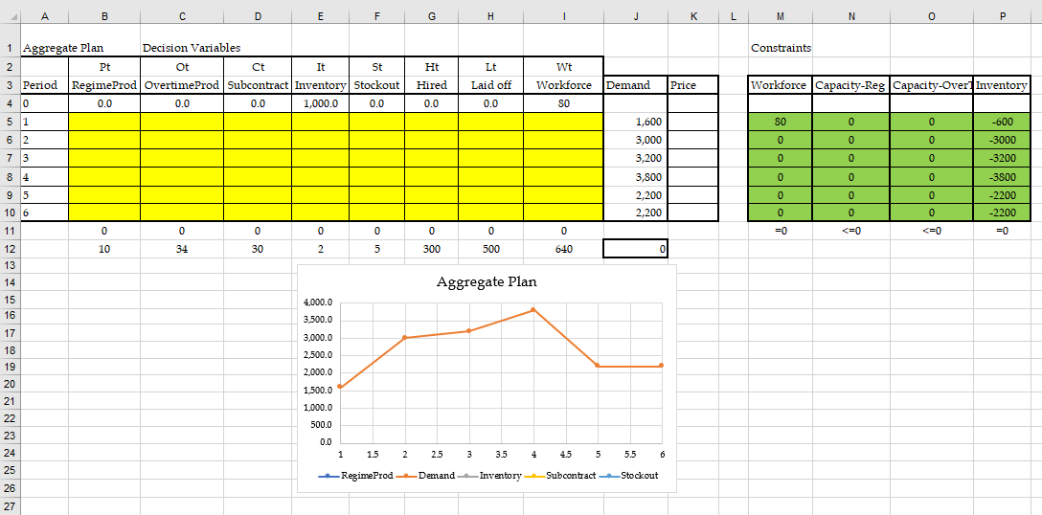
Aggregate Planning Excel Set-up

Slide 16
Aggregate Planning Excel Set-up
W0+H1-L1=W1 ➔ W0+H1-L1-W1=0 ➔ W1+H2-L2=W2
P1 ≤ 40W1 ➔ P1- 40W1 ≤ 0 ➔ P2- 40W2 ≤ 0
O1 ≤ 2.5W1 ➔ O1-2.5O1≤ 0 ➔ O2-2.5O2 ≤0
I0+P1+O1+C1 = S0+D1+I1-S1➔ I0+P1+O1+C1-(S0 +D1+I1-S1) =0 ➔
I1+P2+O2+C2-(S1+D2+I2-S2) =0

Slide 17
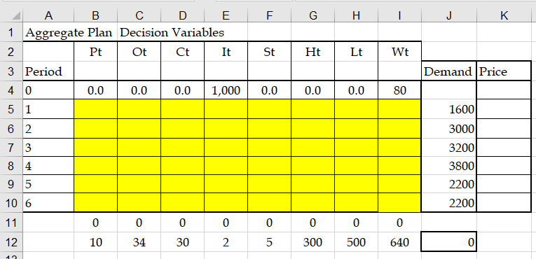
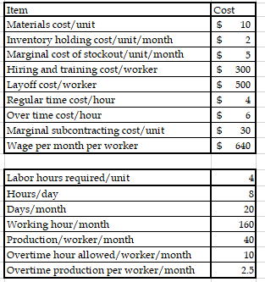
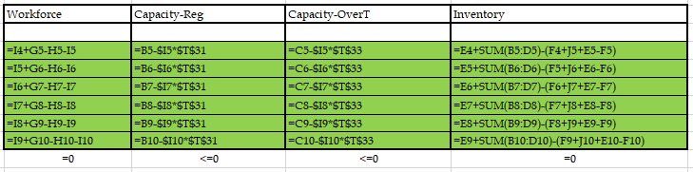
Constraints

Slide 18
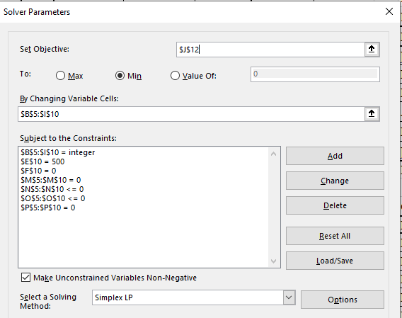
Optimal Solution

Slide 19
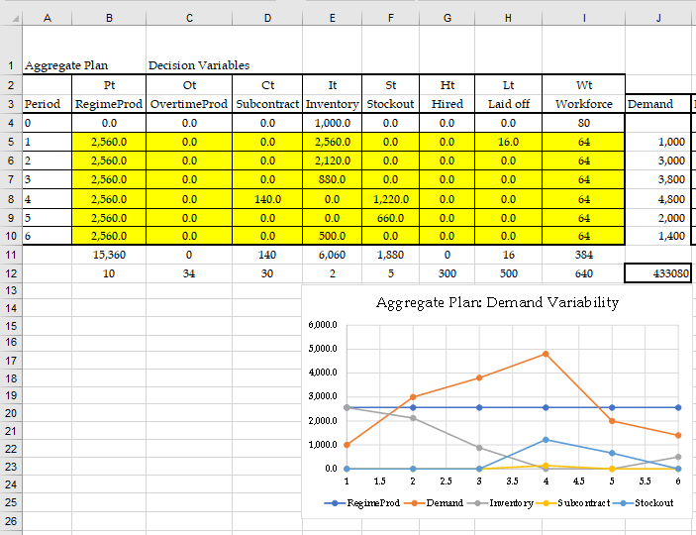
Sensitivity Analysis- More Variable Demand

Slide 20
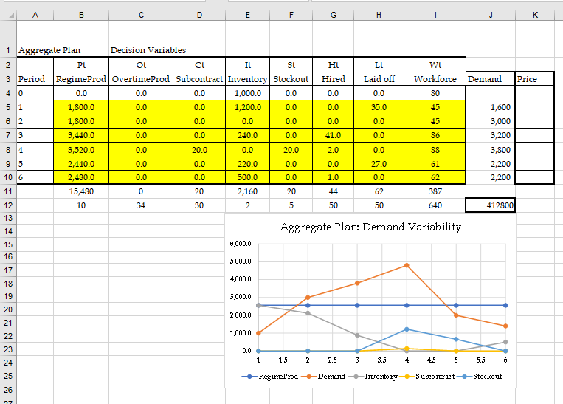
Sensitivity Analysis- Lower Hiring Layoff Costs

Slide 21
World is Not Deterministic
Forecast errors must be considered, flexibility must be built in
Safety inventory
  Build and carry extra inventories to satisfy higher than forecasted demand
Safety capacity
  Capacity used to satisfy higher than forecast demand
    Use overtime as a form of safety capacity
    Carry extra workforce permanently as a form of safety capacity
    Use subcontractors as a form of safety capacity
    Purchase capacity or product from an open or spot market as a form of safety capacity

Slide 22
Aggregate Planning ExcelSheet

Slide 23
C.AggregatePlanning-Project.xlsx

