Slide 1
Chapter 16 -Units and Conversions
ME101
Dr. Nhut Tan Ho

Slide 2
Lecture Objectives and Activities
Introduce you to systems of units
Teach you how to accurately use units and perform unit conversions
Activities: unit conversion exercises

Slide 3
16.1 History of Units
A common denomination of units is essential for the development of trade and economics around the world
Majority of nations (include US) in the world today operate on the International System (SI) of Units because of its simplicity
In the US, some sectors still use US Customary System (USCS)

Slide 4
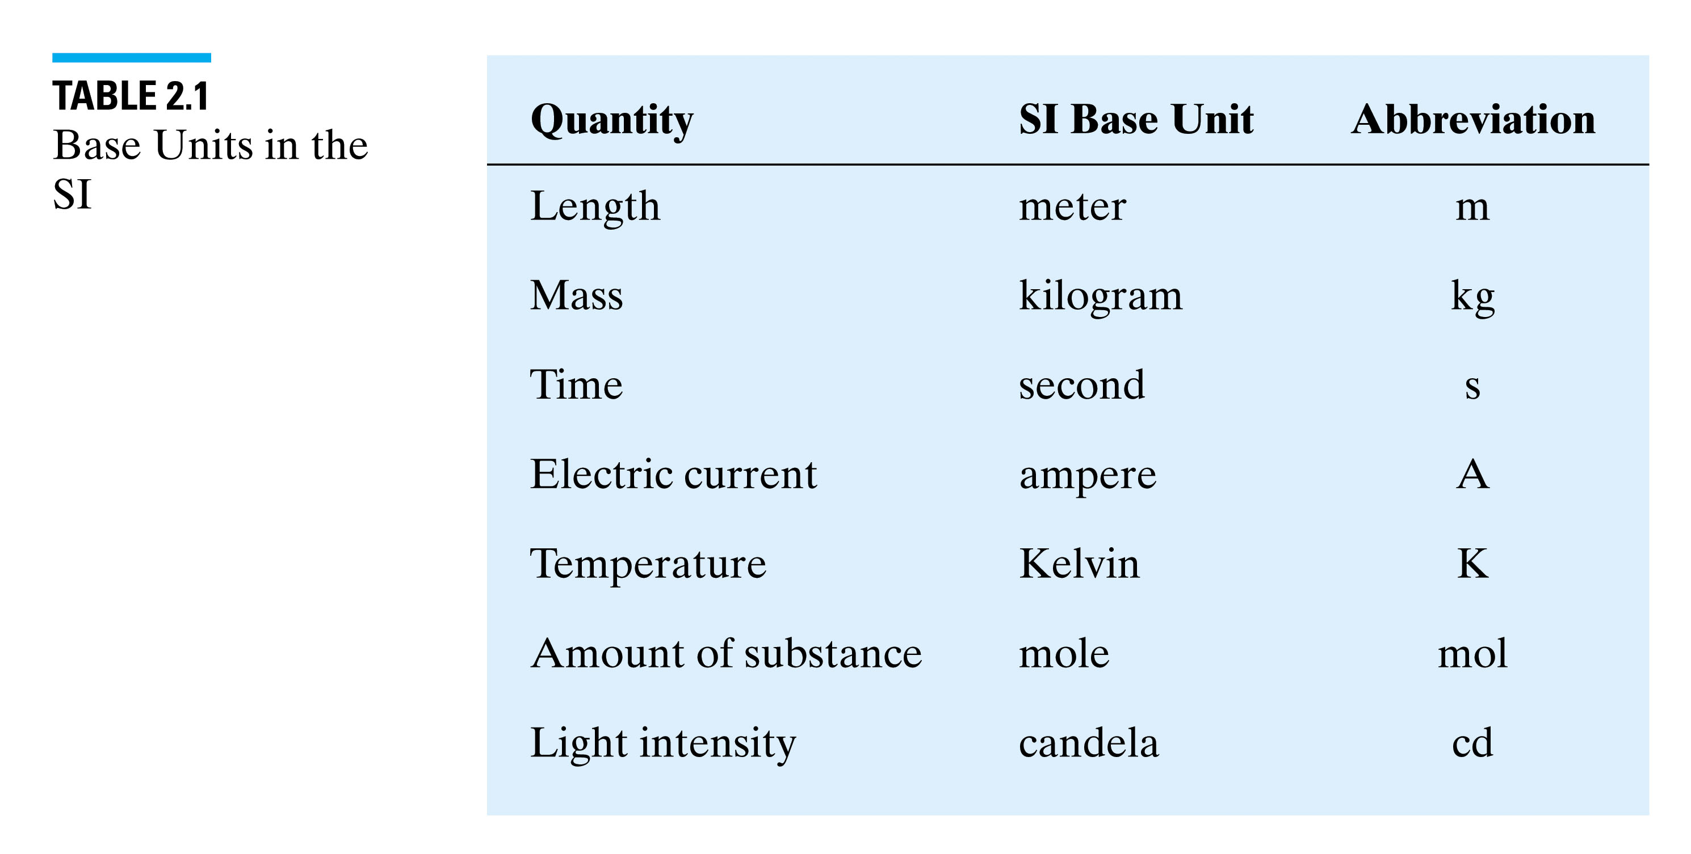
Base Units in the SI System

Slide 5
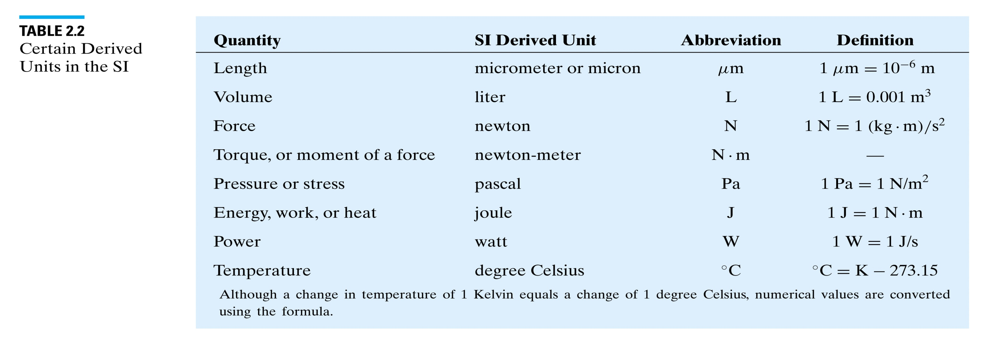
Derived Units in the SI System

Slide 6
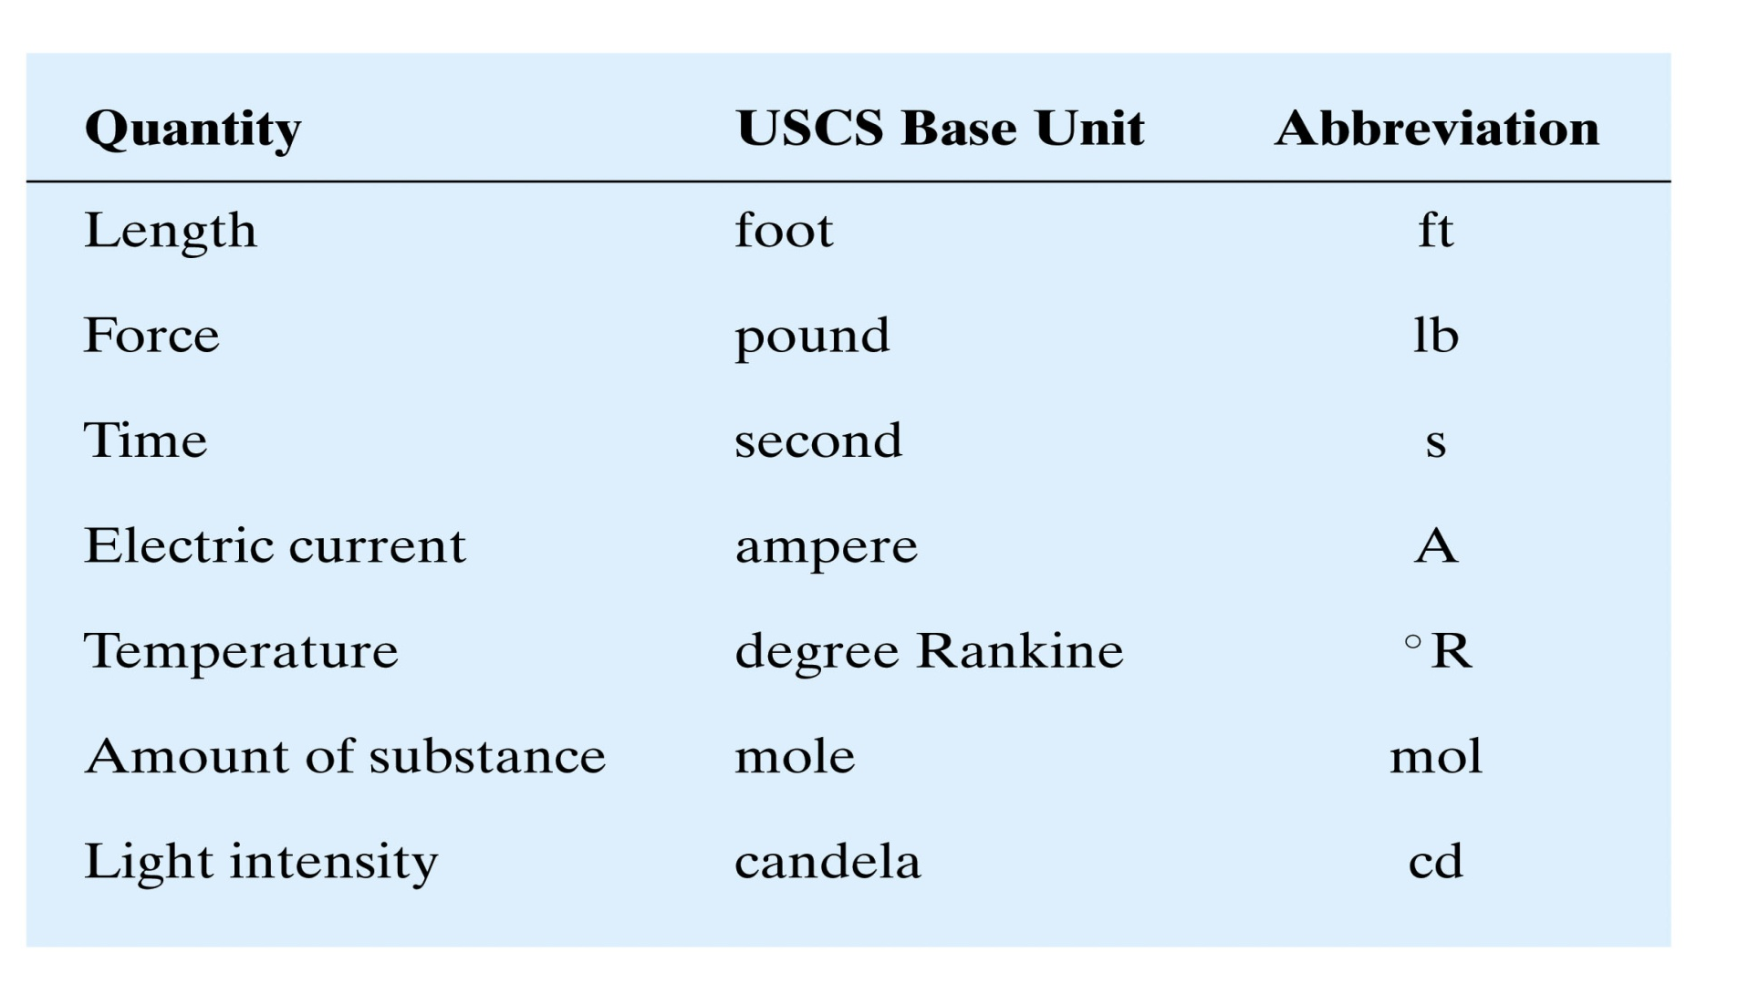
Base Units in the USCS

Slide 7
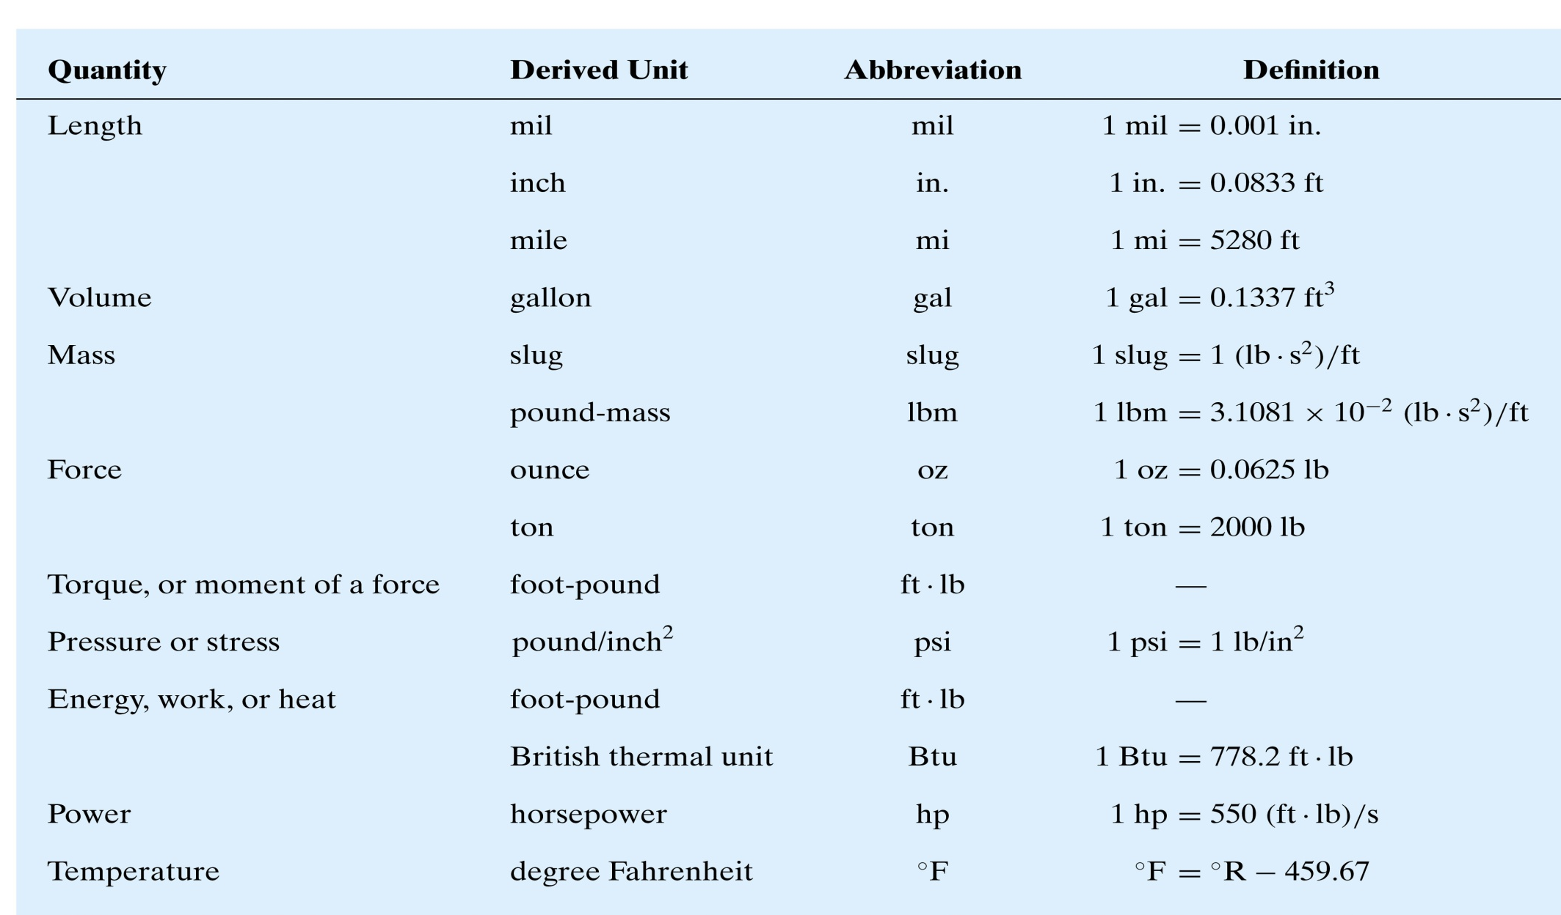
Derived Units in USCS

Slide 8
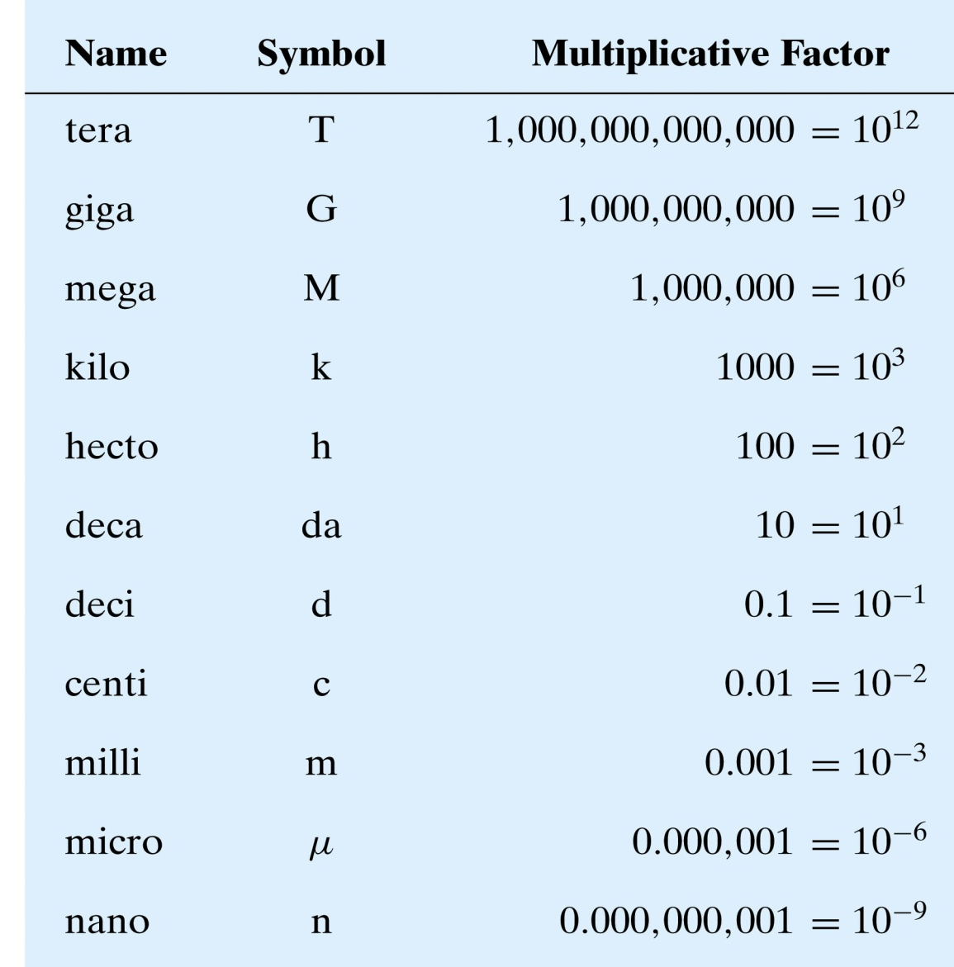
Prefixes for SI Units
Examples:
1 kW = 1000 W
  = 10³ W
1 kpsi = 1000 psi
2 GHz = 10⁹ Hz
=1,000,000,000 Hz

Slide 9
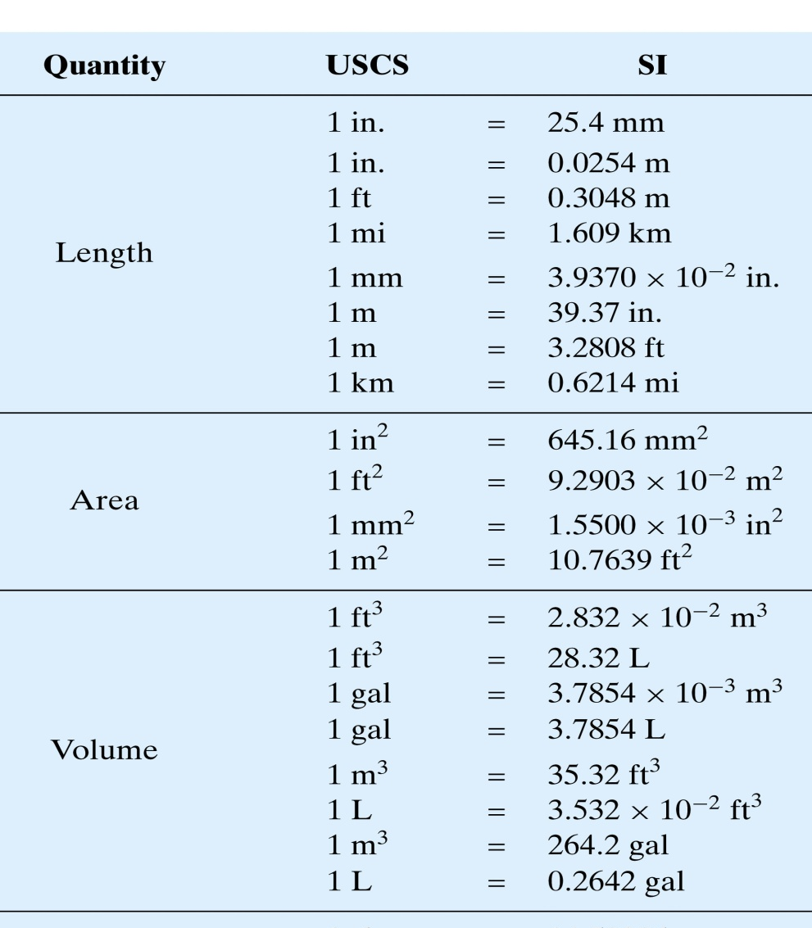
Conversion factors (1)
Example Conversion factors:

Slide 10
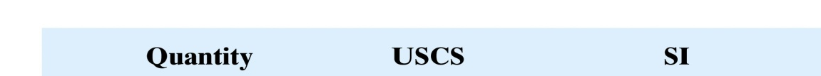
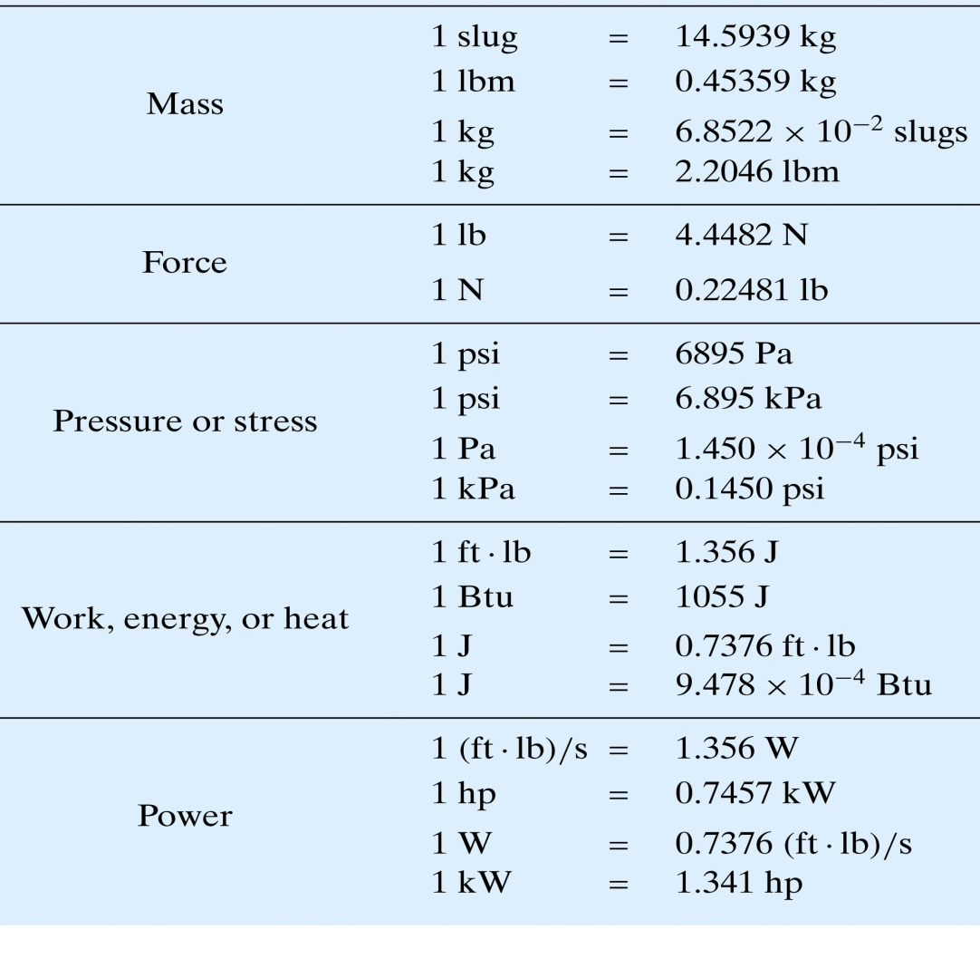
Conversion factors (2)
Example Conversion factors:
Conversion factors are also called unity factors

Slide 11
Unit Conversion
Accurately using units and converting them is an essential engineering skill
Accidents related to unit errors
  Total loss of $125-million NASA Mars Climate Orbiter spacecraft due to errors in impulse (I = Force * time) coding
  The spring constant (k = F/x) error that bankrupted a company

Slide 12
Unit Conversion Method
To convert from one unit to another
  Identify unity/conversion factors
  Write down starting information, and multiply by unity/conversion factors until the desired units are obtained

Slide 13
Unit Conversion Example 1
Convert 10 ft to inches
  Unity/conversion factor:

Slide 14
Unit Conversion Example 2
Convert 25 cents/minute to $/hour
  Unity factors: ,

Slide 15
Unit Conversion Example 3
Convert 25 lb/in² to kilogram/cm²
“lb” in this case is lbm: Must be very careful in clarifying the unit(s)

Slide 16
Unit Conversion Example 4
Convert 5 M ft-lb/s to KW

Slide 17
Pair and Share Exercises
Convert 2.5$/gal to cent/mL
Convert 5 m/s to ft/min
Convert 5 J to ft-lb
Convert 100 kW to ft-lb/s
Convert 200 horse powers to (N-m)/s
Convert 5 Btu to kg-m² / s²
Convert 1 kpsi to g/(m-s²)
Convert 10 gal/min to L/s

Slide 18
Lecture recap and assignment
Engineers work with SI and USCS units
Accurately using and converting units is an essential engineering skill
Assignments: 16.1,16.7,16.11,16.12,16.21,16.22

