Slide 1
Chapter 3 - Profile of and Investment for the Mechanical Engineering Profession
ME101
Dr. Nhut Tan Ho

Slide 2
Lecture Objectives and Activities
Provide information about the engineering profession
Introduce financial planning for your education investment
Active learning activities
Individual exercise: Analyze “my engineering education investment” with Excel Spreadsheet
Individual/Group-assignment: How my strengths and talents match employers’ requirements

Slide 3
4.2 College Enrollment Trends of Engineering Students
1950s-1960s: 60,000-80,000 engineering students
1970s marked the lowest number of students, at 43,000
Engineering peaked in 1980s, with around 118,000 students

Slide 4
4.3 College Majors of Recent Engineering Students
Of approximately 350,000 full-time undergrad engineering students, just less than 1/3 (124,000) were majoring in computer and electrical engineering
Just over 32,000 were “undecided”

Slide 5
4.4 Degrees in Engineering
Steady decline in Engineering degrees awarded between 1986 and 1995. Since then, there have been many fluctuations, but as of data of 2000, there were 63,300 engineering degrees awarded
For a long time, electrical awarded the highest number of degrees, but that was eventually replaced by mechanical engineering

Slide 6
4.5 Job Placement Trends
1999-2000 was the hottest year for engineering majors to find jobs
As the number of engineering students declines, employers must “fight” harder to get whatever students they can get their hands on to fill vacant positions. This has led to a very promising job placement ratio

Slide 7
4.6 Salaries of Engineers (in 2005)
On the whole, engineers make more money than any other graduate with another degree
Electrical, computer, and computer science recently have led the way, with average salaries from a Bachelor degree starting at around $52,000
Mechanical average starting salary is $44,000-$55,000

Slide 8
Income by Degree and Experience

Slide 9
Analyze “My Engineering Education Investment”
College Costs (Fees & Other Educational Expenses) - Expected Family Contribution (from the FAFSA) = Your Financial Need
How do you finance and pay back your Financial Need?
Analyze “My Engineering Education Investment” with Excel Spreadsheet Exercise

Slide 10
4.7 Diversity in the Profession
For a long time, white males dominated engineering
Recently, women, foreign nationals, and various minority students have entered colleges and universities with an engineering diploma in mind

Slide 11
4.8 Distribution of Engineers by Field of Study
Electrical engineering employs the highest number of engineers, nearly 25%, numbering close to 375,000
Mechanical employs almost 250,000
Civil is the next highest “populated”, with 200,000 workers

Slide 12
4.11 Words of Advice from Employers
Looking for graduates who possess:
Excellent communication skills
Teamwork
Leadership
Computer/Technical proficiency
Hard working attitude

Slide 13
Honing Your Resume and Skills, Knowledge, and Attitude

Slide 14
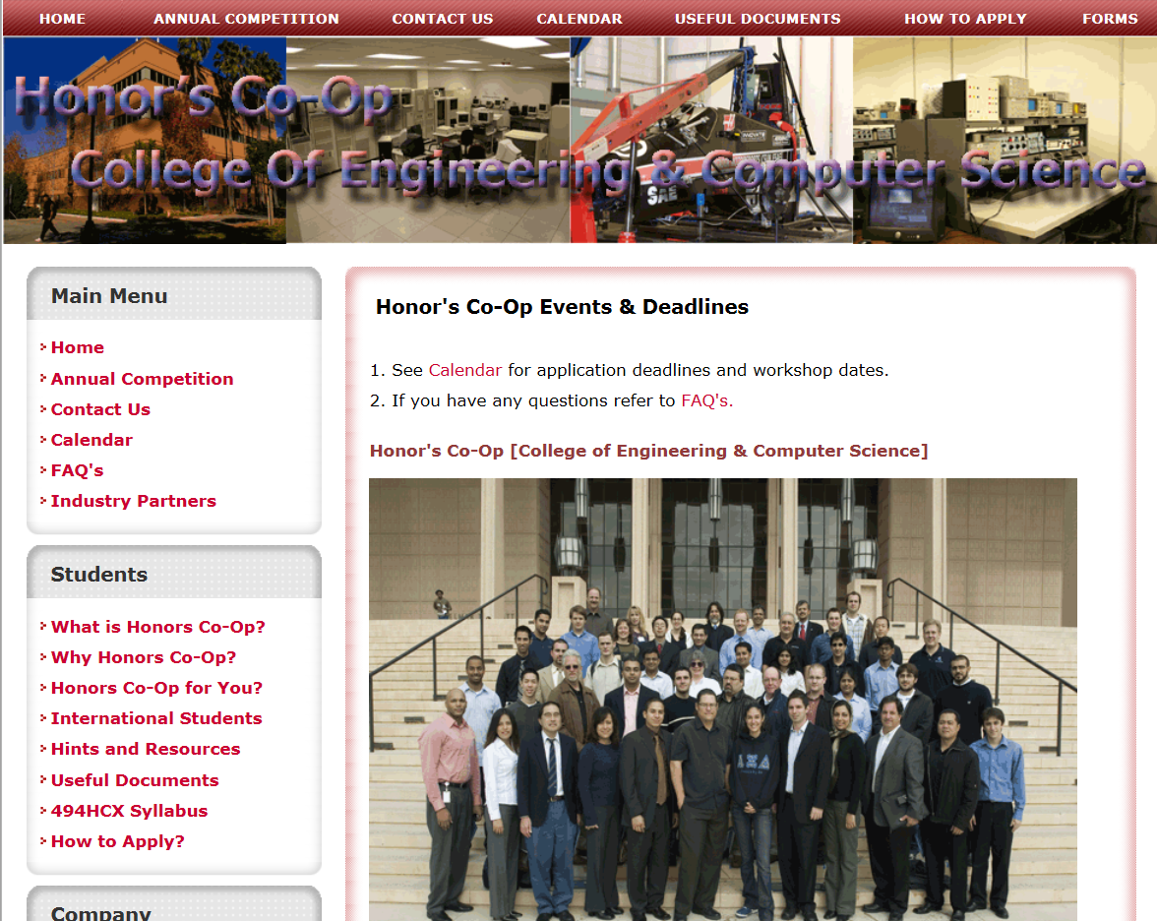
Honing Your Resume and Skills, Knowledge, and Attitude

Slide 15
Honing Your Resume and Skills, Knowledge, and Attitude
Undergraduate/Graduate Research with Professors
Student Societies: ASME, SWE, SHPE,
Volunteer for Senior Design Projects

Slide 16
Individual/Group Assignment: Strengths, Weaknesses, &Talents
Make a 3-column list of your
Strengths,
Weaknesses, and
How your talents match with what the employers are looking for in a mechanical engineering graduate? And how you can invest time and resources, and plan activities to further improve your strengths/talents
Form a group of 4, share your list with each person in your group and ask for suggestions for how you can improve your strengths, weaknesses, and talents

Slide 17
Lecture Recap: Profile of and Investment for ME Profession
Profile for engineering profession: people study engineering, majors, job market, salaries
Investment for profession
Financial planning
Time and activities
Next lecture: Global and international engineering
Homework reminder: Q & A

