Slide 1
Design is a Process with Passion
Professor Nhut Tan Ho
Department of Mechanical Engineering
California State University, Northridge
Notes:
Placed a distinctive header on all pages…Titles are short and sweet, helps students map what the presentation structure is, and where they are in it

Slide 2
Lecture Objectives and Activity
Introduce the Design process: Passion and systematic Organization of Ideas
Example: Case Study of Yoyo
Active-learning activity: Work with you team to develop an FR, DP, A, R, RC
Notes:
Constantly aligning outline text to the left, and limiting text on each slide. Using red for passion :)

Slide 3
Design is Passion
The Challenge
What does Passion have to do with design?
Control the Passion with Determinism
Systematic Organization of Ideas
Example and exercise
Notes:
Constantly aligning outline text to the left, and limiting text on each slide. Using red for passion :)

Slide 4

What does Passion have to do with design?*
Passion is Love, Focus, Perfection and Play
*slide are from Slocum’s Design Book
Notes:
An introduction or thesis slide…

Slide 5
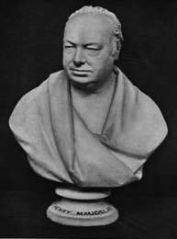
What does Passion have to do with design?*
Passion gives FOCUS so keep your eye on the prize :
“You can’t always get what you want
But if you try sometimes well you might find
You get what you need”
Mick Jagger & Keith Richards 1969
“Get a clear notion of what you desire to accomplish, then you will probably get it
Keep a sharp look-out upon your materials: get rid of every pound of material you can do without. Put yourself to the question, “What business has it there?”
Avoid complexities and make everything as simple as possible
Remember the get-ability of parts”
Henry Maudslay
(1700’s a father of modern machine tools)
from J. Roe English and American Tool Builders
1916 Yale Press
*slide are from Slocum’s Design Book
Notes:
Using font size and alignment to show different blocks of text. The image aligns with its corresponding quote text, and the images info text. This comes from the Gestalt Theory principles of Proximity and Closure/Continuation, some of the most effective organizers of a page.

Slide 6
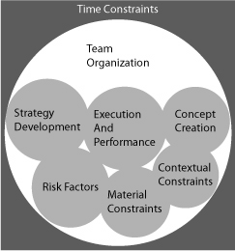
Control the Passion with Determinism*
What can a Deterministic Process do for me?
*slide are from Slocum’s Design Book
Notes:
See email…

Slide 7
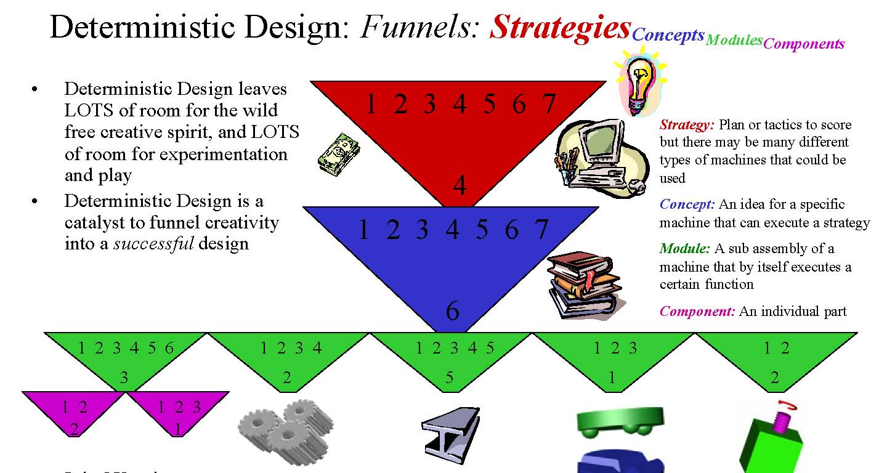
Deterministic Design Process*
*slide are from Slocum’s Design Book
Notes:
See email…

Slide 8
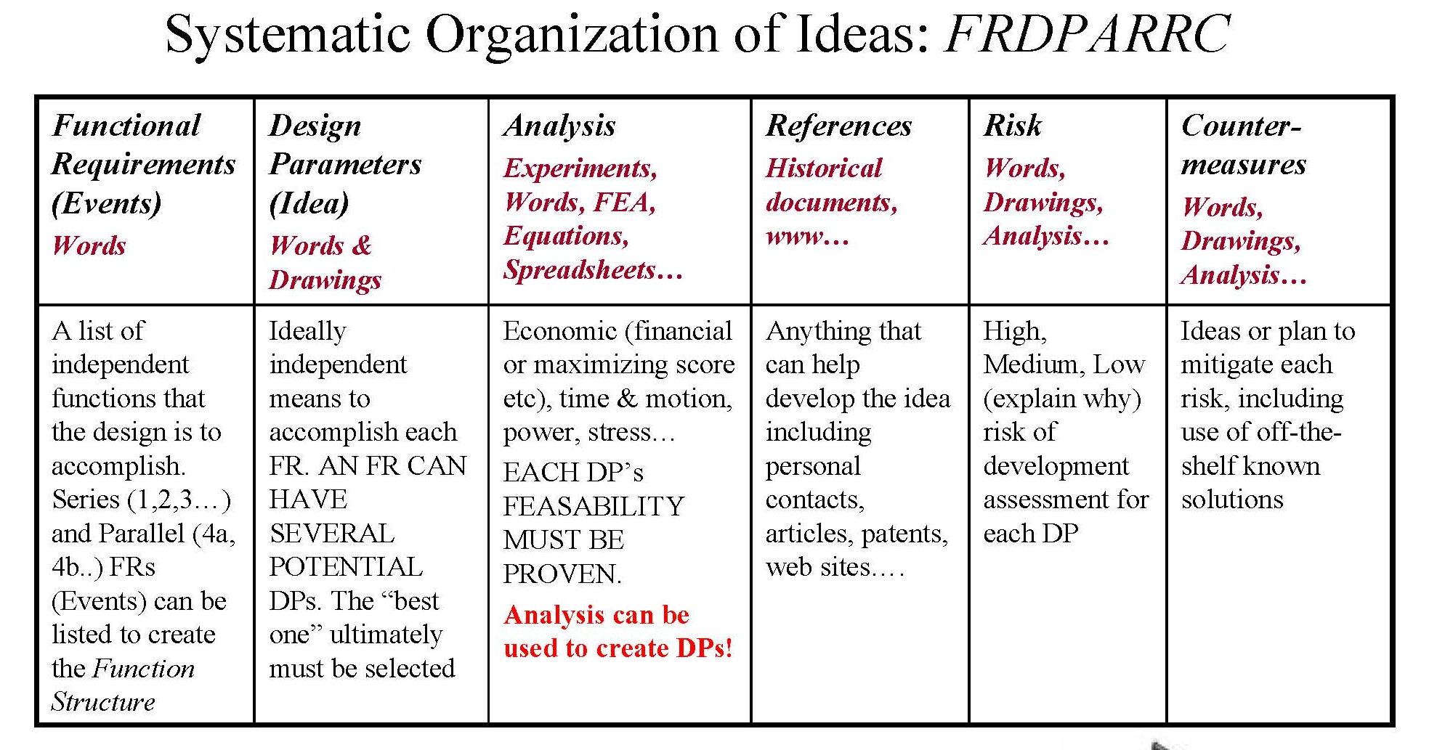
Deterministic Design*
*slide are from Slocum’s Design Book

Slide 9
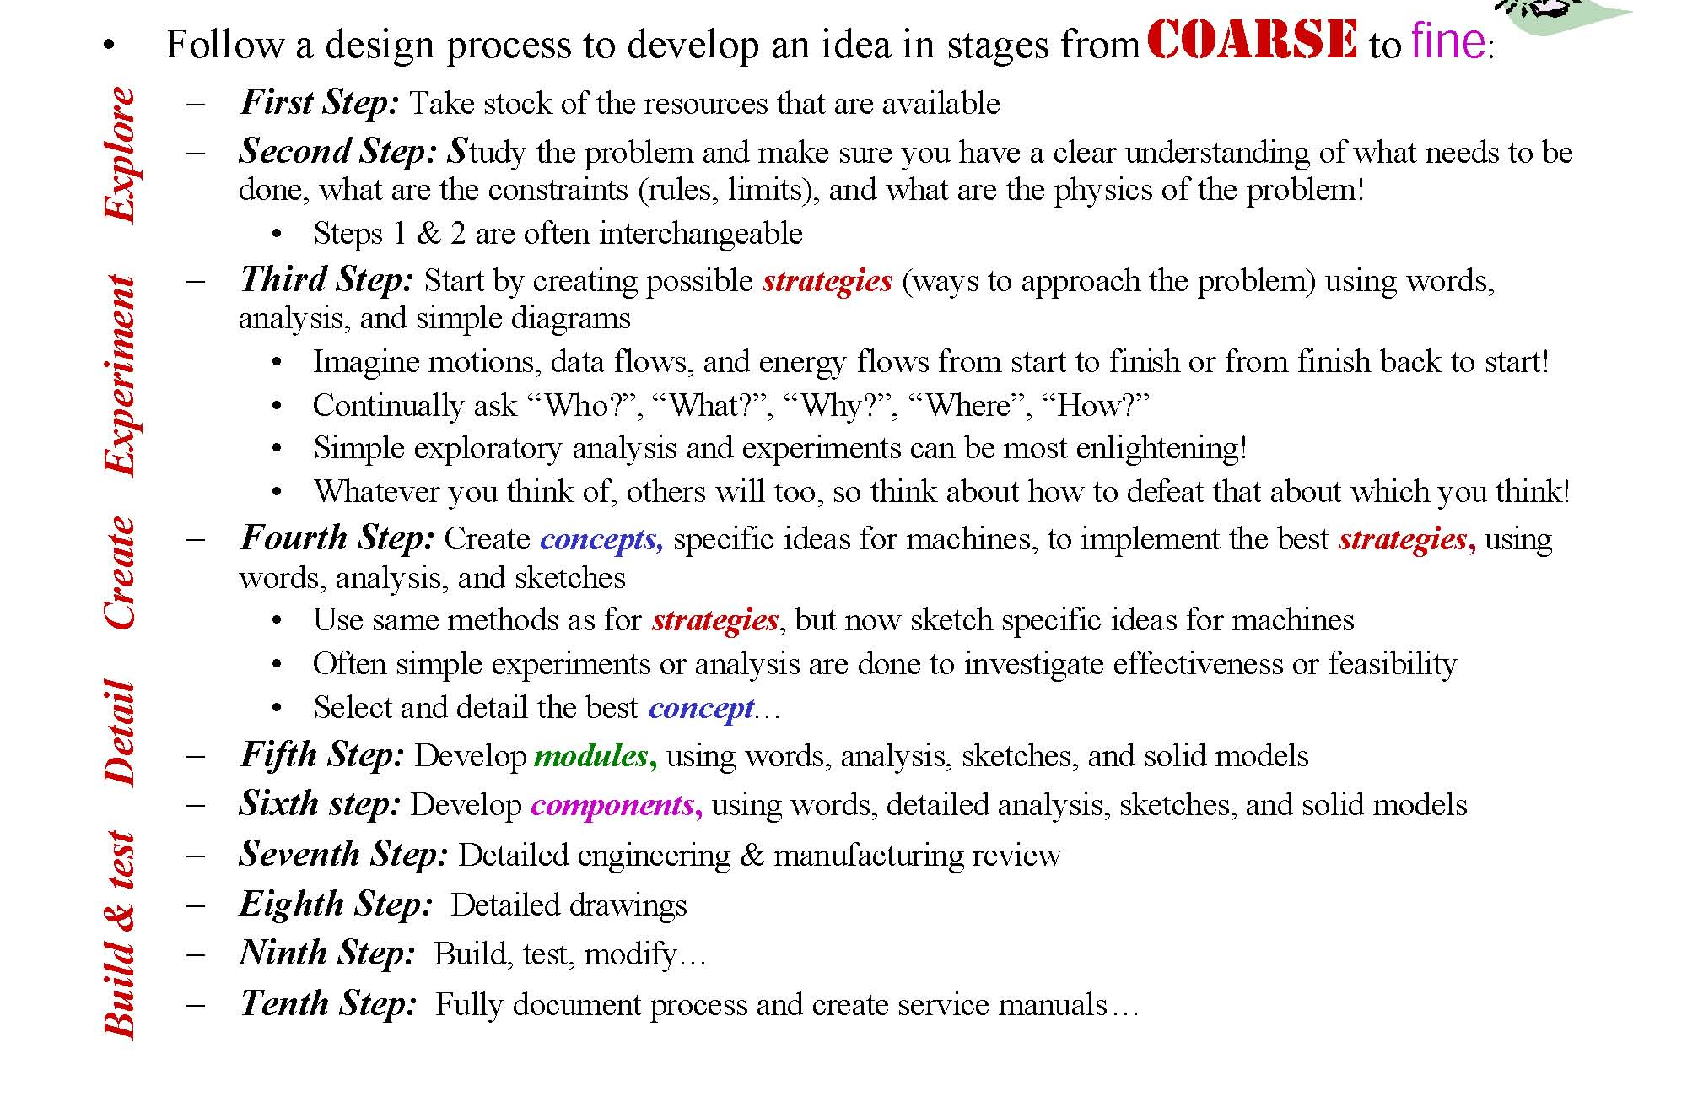
Design is a Series of Steps Blended Together

Slide 10
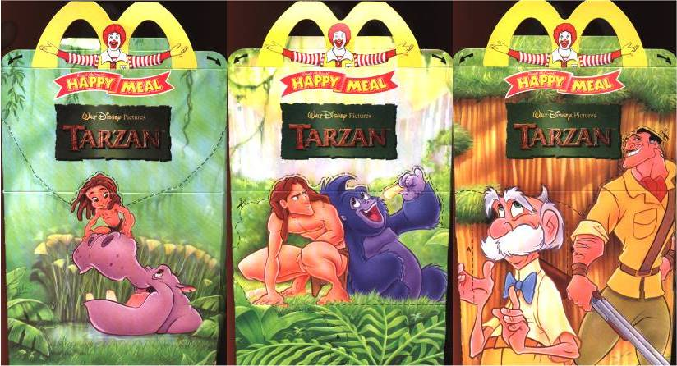
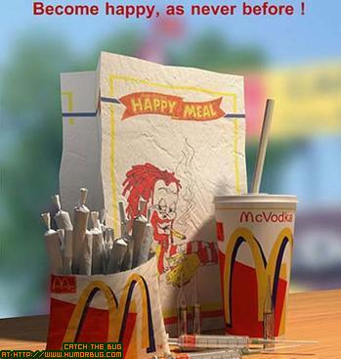
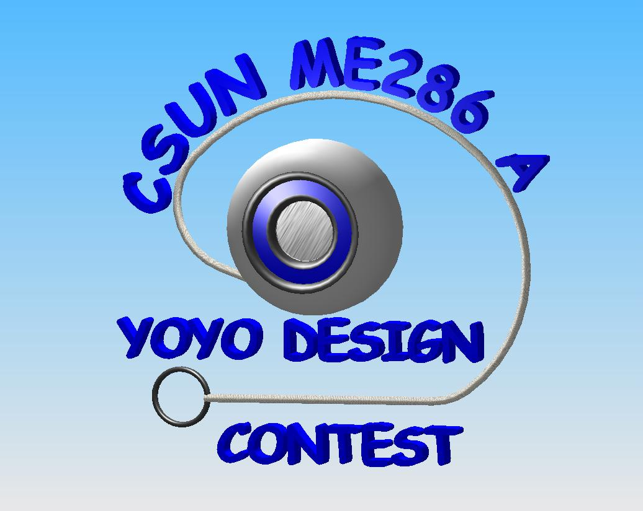
Case Study – Fall 2005 Yoyo Design Challenge
Your team is charged with the task of developing a new yoyo for fast food companies. The yoyo will be a toy in kid meals (e.g., McDonalds’ Happy Meal).

Slide 11
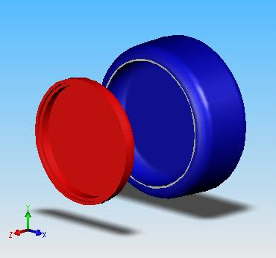
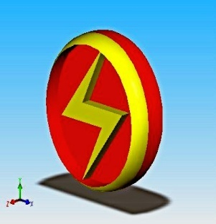
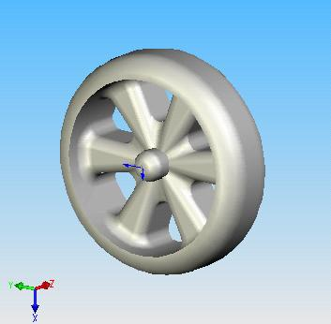
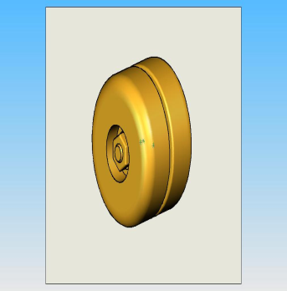
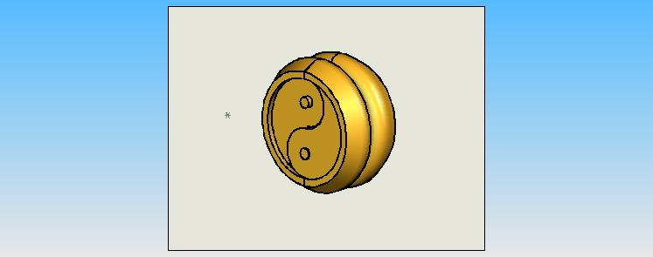
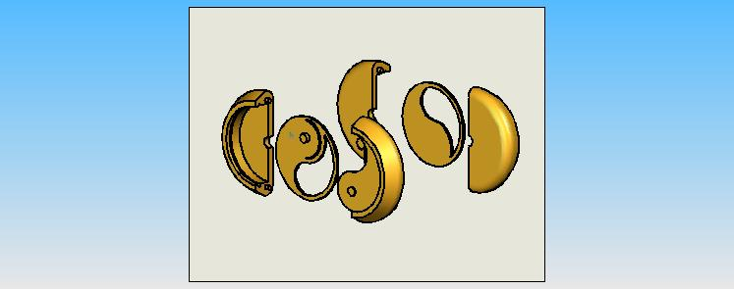
What does Passion have to do with design?
Passion is a LOVE for creating:
“Enthusiasm is one of the most powerful engines of success. When you do a thing, do it with all your might. Put your whole soul into it. Stamp it with your own personality. Be active, be energetic, be enthusiastic and faithful and you will accomplish your object. Nothing great was ever achieved without enthusiasm.”
Ralph Waldo Emerson

Slide 12
What does Passion have to do with design?
Passion drives perfection and creates PLAY

Slide 13
What does Passion have to do with design?
Passion drives perfection and creates PLAY

Slide 14
EXAMPLE – FRDPARRC Sheet (incomplete)
Functional Requirements | Design Parameters | Analysis | References | Risk | Counter Measures
Attractive Appearance | make it appealing to kids - glow in the dark; neat shapes… | Surveys and customer profiling | Research different types of yoyo designs | Mold becomes more complicated; harder to machine | Make the design as simple as possible; try various colors
Function Well | Must perform in a typical manner; Simple, standard design | a = g / (I/mr² + 1) ω = [2gx / (I/m+r²)]^{1/2} t = (2L/g)^{1/2} (1+I/mr²)^{1/2} v = [2gx / (1+I/mr²)]^{1/2} | Experimental Investigation of Yoyo Design by Alma Bardon; Physics and Dynamics books | improper application of equations; unbalanced design | Study references; Design a good symmetrical design; Bench-level experiments

Slide 15
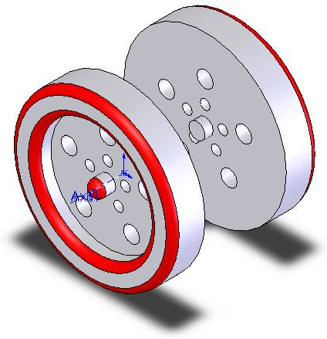
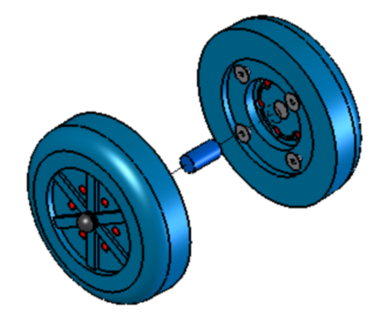
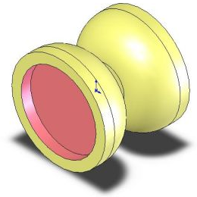
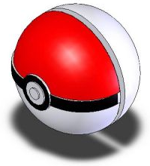
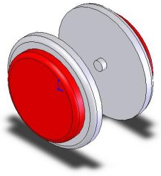
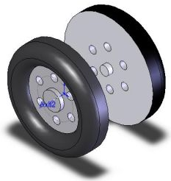
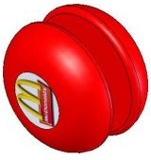
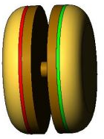
CHOOSING THE BEST DESIGN CONCEPTS
“5 Point Holes”
“Blades with Lights”
“Hourglass”
“Pokeball”
1
2
3
4
“Push Button”
“Tire”
“Basic”
“Hamburger”
5
6
7
8
CONCEPTS CONT…

Slide 16
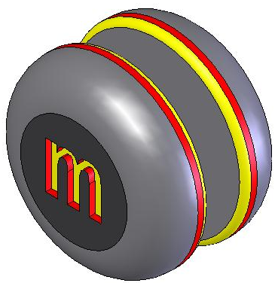
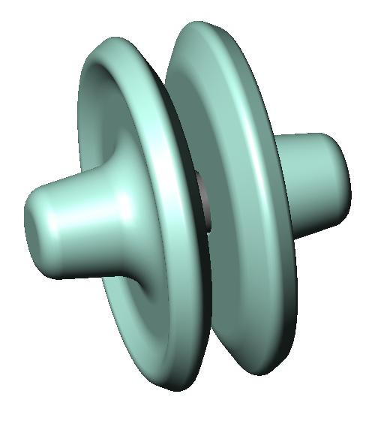
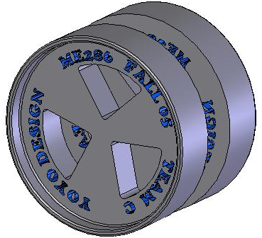
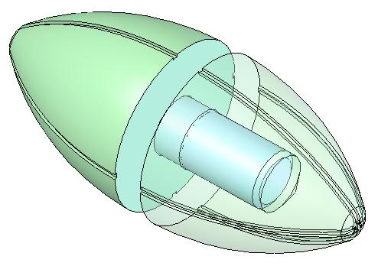
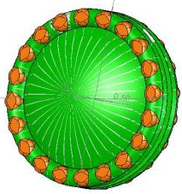
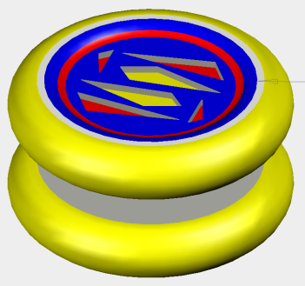
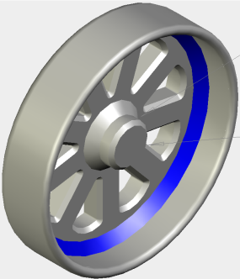
15 DESIGN CONCEPTS
“McD’s Logo”
“Team C”
“Football”
“Sombrero”
9
10
11
12
“Turtle Shell”
“Metroid”
“Rick’s Rim”
13
14
15

Slide 17
Design is a Process with Passion
Which one is the best concept?

Slide 19
EXAMPLE – FRDPARRC Sheet for Your Project
Functional Requirements | Design Parameters | Analysis | References | Risk | Counter Measures

Slide 20
Recap: Design Process
Design is
  A process with passion
  A series of steps blended together
Design success involves deterministic process with systematic organization of ideas
Homework: Teamwork assignment

