Slide 1
Calculating Potential Performance
How to use math
and physics to inform your
mousetrap car design

Slide 2
Engineering Calculations
Math and Physics are the backbone of mechanical engineering
Doing calculations before hand can;
Inform design decisions
Help to optimize parameters
Save time and money during prototyping

Slide 3
Alignment
Short-distance Speed Car
Long-Distance Endurance Car
tan(θ) = 5m / 5m
θ = arctan (5/5)
θ = arctan(1)
θ = 45 °
5
tan(θ) = 5m / 100m
θ = arctan (5/100)
θ = arctan(0.05)
θ = 2.86 °
5
5
100
θ
θ

Slide 4
String Length
Pulling Distance = Number of Turns x 2Πr_{wheel}
Number of Turns = Length of String / 2Πr_{axle}
Pulling Distance = Length of String x r_{wheel} / r_{axle}
String for a Car w/ Goal of 5m
Note
If you increase the wheel size to 10 cm (0.1m);
Pulling Distance = Length of String x r_{wheel} / r_{axle}
100m = Length of String x 0.1m / 0.005m
100m = Length of String x 20
100/20 = Length of String
5m = Length of String
So, the larger the wheels, the
shorter the string required!
String for a Car w/ Goal of 100m
Pulling Distance = Length of String x r_{wheel} / r_{axle}
5m = Length of String x 0.025m / 0.005 m
5m = Length of String x 5
5/5 = Length of String
1m = Length of String
Pulling Distance = Length of String x r_{wheel} / r_{axle}
100m = Length of String x 0.025m / 0.005m
100m = Length of String x 5
100/5 = Length of String
20m = Length of String

Slide 5
Wheel Radius
x_{f} = x_{o} + v_{o}t + ½ at ²
5m = ½ a (2)²
5 = 2 a
5/2 = a
2.5 = a
a = αr_{wheel}
a / r_{wheel} = α
So, angular acceleration can be increased or decreased according to the size of your wheel;
a / Large r_{wheel} = Small α
a / Small r_{wheel} = Large α
Note
Think about it second by second;
0 → 2.5 m/s → 5 m/s
0 → 1.25 m → 5 m

Slide 6
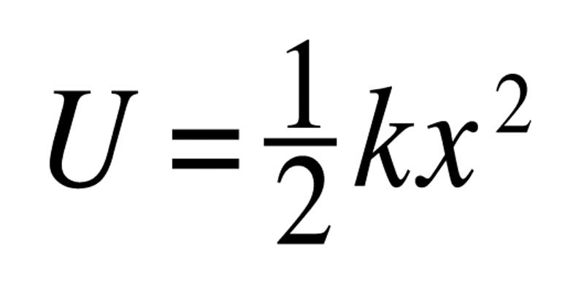
Potential and Kinetic Energy
U = ½ k θ²
U = ½ (3.5) (Π) ²
U = 17.3 J
The amount of Kinetic Energy (K) that an object is capable of exerting is the same as the amount of Potential Energy (U) stored in that object.
So if all of the mousetrap’s U is converted into K,
K = 17.3 J

Slide 7
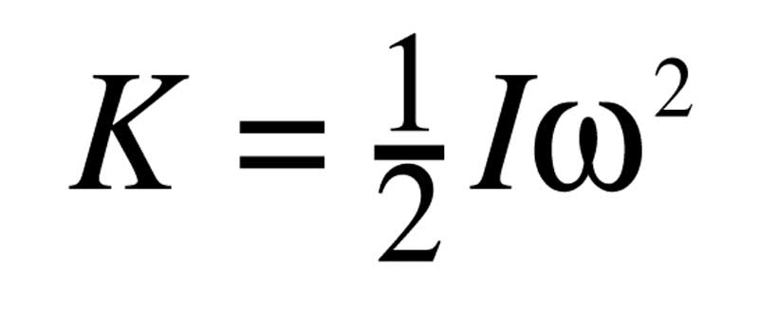
Inertia
K = ½ I ω²
17.3J x 2 = I ω²
34.6 = I ω²
34.6 / I = ω²
√(34.6 / I) = ω
So, the lower your wheel’s inertia, the higher its angular velocity.
√(34.6 / Low I) = High ω
√(34.6 / High I) = Low ω

