Slide 1
Improving PK-12 Education
Through Preparation
and Partnerships
Michael Spagna & Ford Roosevelt
Inaugural Volunteer Leadership Summit
December 3, 2011
Kurland Lecture Hall
Valley Performing Arts Center

Slide 2
Addressing Critical Areas of Need in the Community

Slide 3
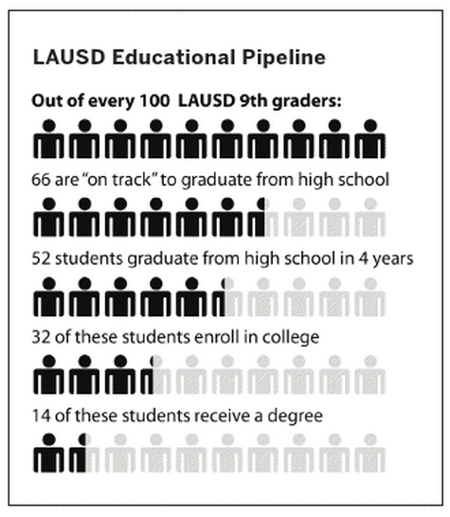
LAUSD Baseline Measurements

Slide 4
Where should we start?
“ACT researchers found in 2008 that the academic level students achieve by 8th grade has a bigger impact on college and career readiness and success than anything that happens academically in high school… Interventions are called for, particularly in middle school, when indicators show students are on a fast track to dropping out in high school.” (Education Week, November 29, 2011)

Slide 5
Where should we start?
Algebra success rate is low in LAUSD
Only 6% of 828 Algebra 1 students at one high school scored “Proficient” or above in the California Standards Test (CST)
Two thirds of those who fail Algebra in 8th or 9th grade fail to graduate on time

Slide 6
The Importance of Meaningful Partnerships

Slide 7

Partnership with Project GRAD
Increase A-G Completion: 21% (2003) to 40% (2010)
Project GRAD Scholars from CSUN tutor 6 - 12 students at Project GRAD Schools
1000+ Project GRAD Scholarships Awarded:
College Retention Program at CSUN
600+ Project GRAD Scholars enrolled at CSUN since 2003

Slide 8
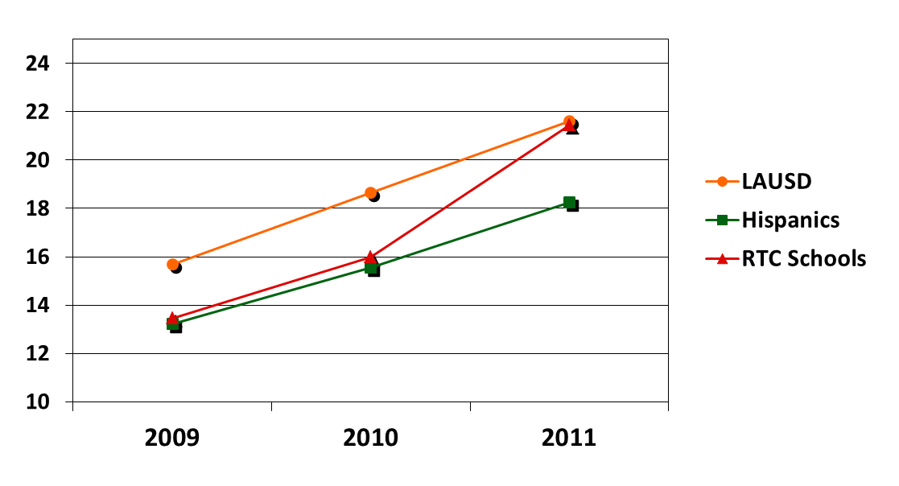
Initial Impact at Middle School
Schools closed the “achievement gap”
Percentage of 8th graders scoring Proficient or Advanced on Algebra 1 CST
Notes:
% of 8th graders who scored Proficient or Advanced in Algebra
Based on work at schools from CPEC grant.
2009 2010 2011
All LAUSD 15.7 18.6 21.6
Hispanics 13.2 15.5 18.2
RTC 13.4 16.0 21.5
RTC refers to the Responsive Teaching Cycle (Slide 17)

Slide 9
Continued Impact at High School
Comparisons for Algebra 1 CST Scores
Percentage of 9th graders scoring Proficient or Advanced on Algebra 1 CST
Notes:
Q1 CR Scores (Out of 4 Max.)
School 1.434854772
SITTE 2.237184116 (56% ⬆ over School)
Q2 CR Scores (Out of 4 Max.)
School 1.837953092
SITTE 2.439338235 (33% ⬆ over School)
Q3 CR Scores (Out of 4 Max.)
School 0.970235546
SITTE 1.502583026(55% ⬆ over School)

Slide 10
Increased Ability to Solve Complex Problems
The installation cost and monthly monitoring fee of a security system are listed below for two companies.
    Ace Systems charges $327 for installation and $204 per month for monitoring the system.
    Zero Entry charges $535 for installation and $188 per month for monitoring the system.
Write a variable expression for the total cost of a security system installed and monitored by Ace Systems. Write a variable expression for the total cost of a security system installed and monitored by Zero Entry. Define the variable.
Mrs. Clark will sign a contract to have a security system installed and monitored for 12 months. Calculate the total cost each company will charge for this service. Show all your work.
If Mrs. Clark signs a contract to have a security system installed and monitored for 18 months, which company has a lower total cost? Provide an explanation or show all your work.
Notes:
Students possessed the tools to solve complex problems.
Q1 CR Scores (Out of 4 Max.)
School 1.434854772
SITTE 2.237184116 (56% ⬆ over School)
Q2 CR Scores (Out of 4 Max.)
School 1.837953092
SITTE 2.439338235 (33% ⬆ over School)
Q3 CR Scores (Out of 4 Max.)
School 0.970235546
SITTE 1.502583026(55% ⬆ over School)

Slide 11
Implications
for Teacher
Preparation

Slide 12
How Was This Accomplished?
Traditional Model
Professional
Development
Teacher
Learning
Student
Achievement
Notes:
At the risk of oversimplifying a complex process, the traditional model for professional development is to change teacher practice in order to improve student achievement.
However, this model is not effective, as demonstrated by the Middle School Mathematics Professional Development Impact Study (Garet, et al. 2010).

Slide 13
How Was This Accomplished?
Student Centered Model
Professional
Development
Collaborative
Inquiry
Student
Achievement
Teacher
Learning
Designing
Lessons
Notes:
The authentic work of improving student achievement is the professional development. Teacher learning is an outcome of, not the lever for improving student achievement.

Slide 14
Responsive Teaching Cycle
Explore
Establish Experiment
Examine
Student Learning
Teacher
Learning
Notes:
The distinction of RTC is the frequency of its implementation.
Because the explicit product of RTC is the next day’s lesson, the focus is on student thinking as the starting point of collaboration (rather than completion of a checklist or protocol).
Many reform efforts using “data” fail to improve student achievement because the analysis only identifies what students know or don’t know. Teachers need opportunities to examine why their students are not understanding or struggling. Furthermore, they need opportunities to explore how to provide the necessary supports to help their students succeed. Samples of teacher produced lessons will illustrate this cycle.

Slide 15
Results from
Grant-Funded Partnership Projects:
ARCHES, CPEC, Project GRAD
With
Special Thanks to Ivan Cheng
Department of Secondary Education

