Slide 1

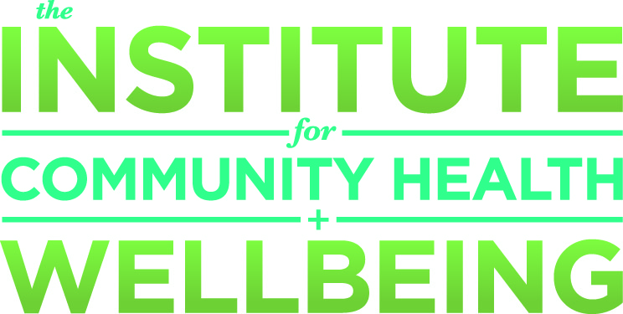

Creating Healthy Communities
College of Health
and Human Development
Where Community Matters
Presented by:
Dianne Philibosian, Director
Sylvia A. Alva, Dean
Building campus-community connections to promote healthy living and prepare the workforce of tomorrow.
Notes:
Welcome and thank you for coming.
Dianne, FYI: “summit goals and expected outcomes:
To build greater consensus that timing is right for university’s leading volunteers and key stakeholders to take greater collective responsibility for CSUN’s future
To empower leadership volunteers by sharing knowledge of what we do and what challenges we face
To acquaint volunteers with each other to build support for our common goals.
Summit co chairs are:
Linda Lingle, 6th Governor of Hawaii (current is Neil Abercrombie)
Earl Enzer, Managing director, private wealth management area of Goldman Sachs in LA and chair of rhe board of directors for the CSUN foundation and COBAE Dean’s Advisory Board member.

Slide 2
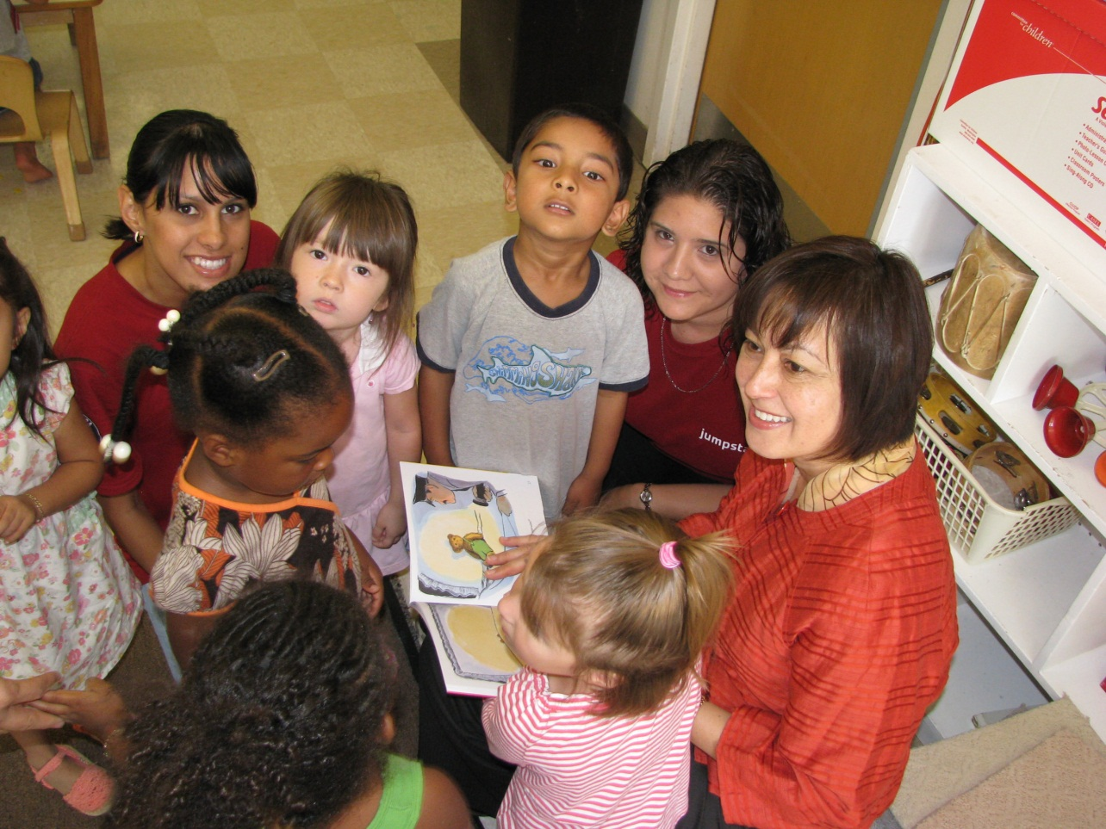
College of Health and Human Development
Where Community Matters
Notes:
The College of Health and Human Development is focused on improving the quality of life for others.
We graduate practice-ready professionals.
We have 11 undergraduate and 10 undergraduate programs and we’re growing.
We just initiated the Doctorate of Physical Therapy – this keeps us in step with changing requirements in the profession.
We just established a Department of Nursing – an outgrowth of a well established Bachelor of Science in Nursing program and a strong response to the shortage of nurses in California and the US.
Though our academic disciplines are diverse, what they all have in common is a drive to create better conditions for others - in health, the personal and public environment, and community and family life.
Here are a few glimpses of us in action:
[next slide]

Slide 3

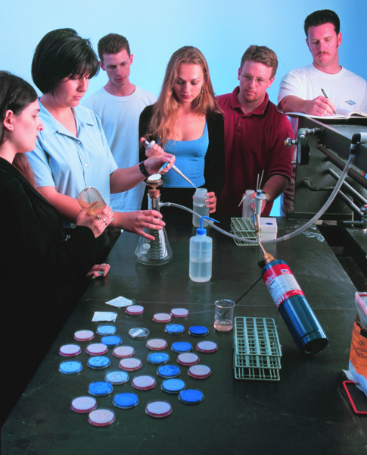
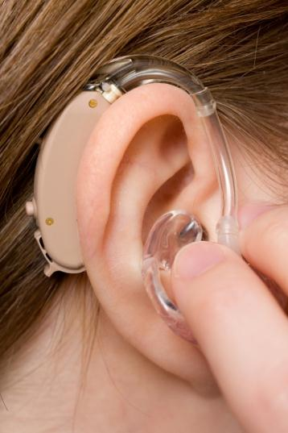
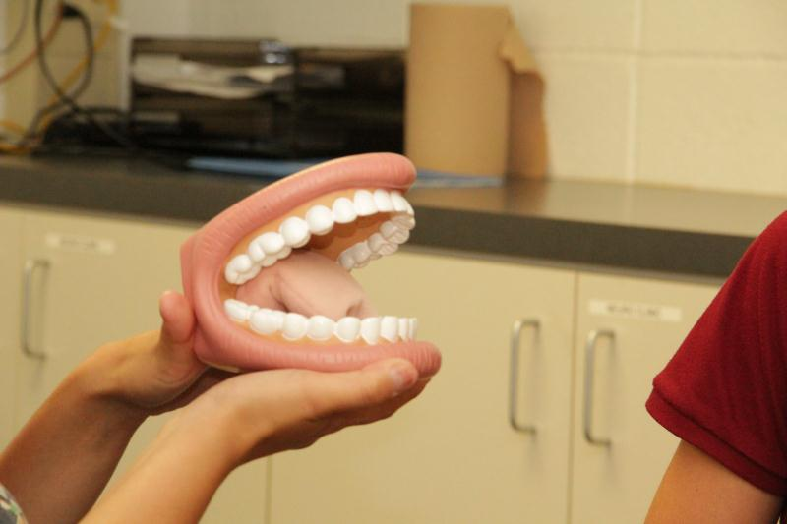
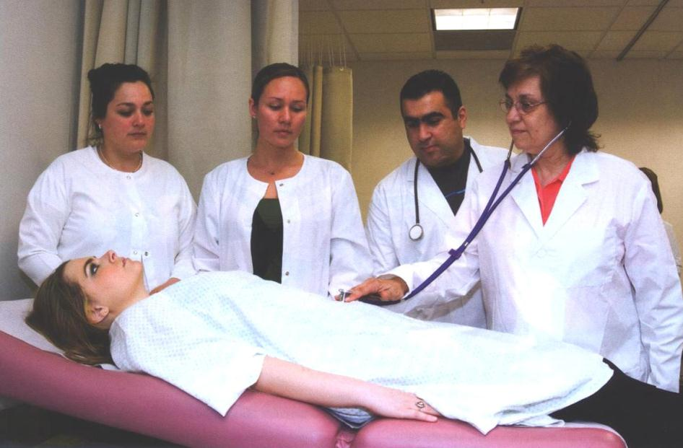
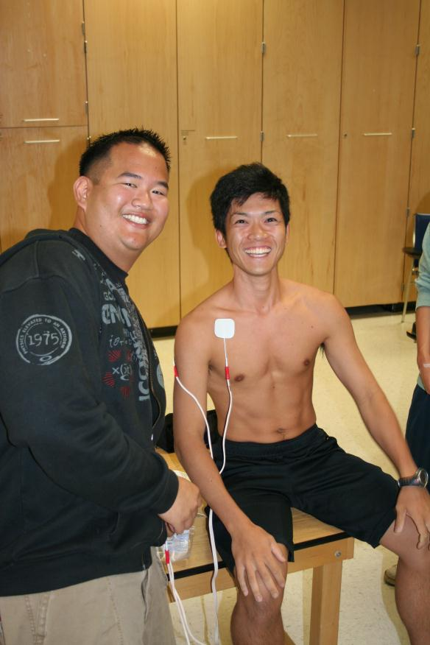
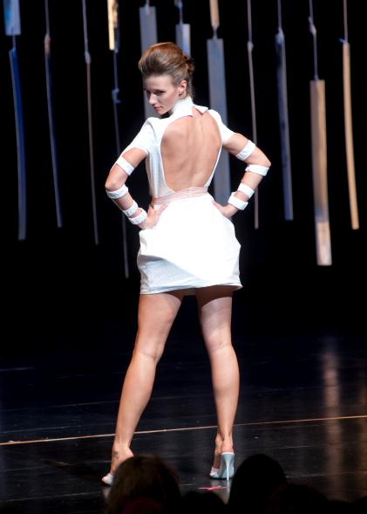
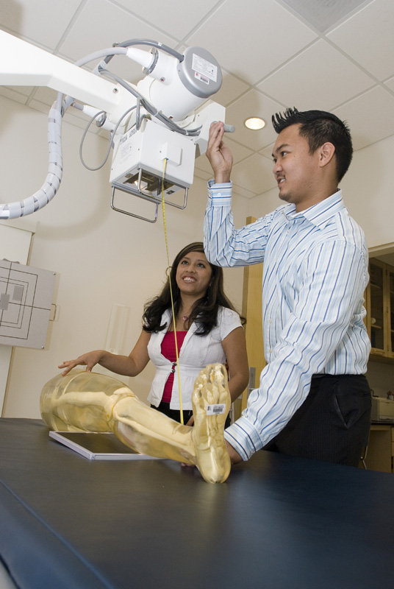
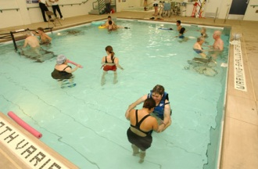
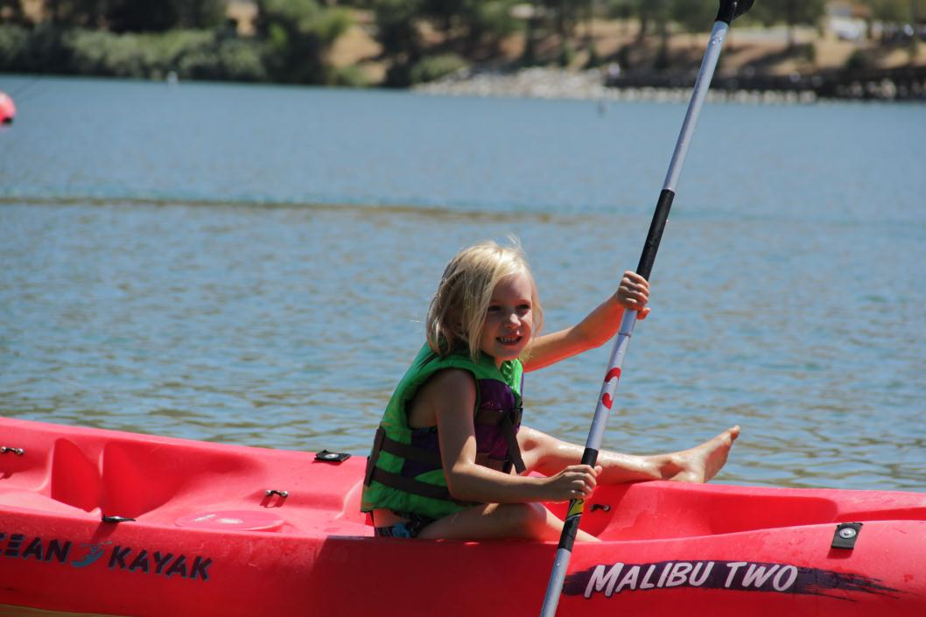
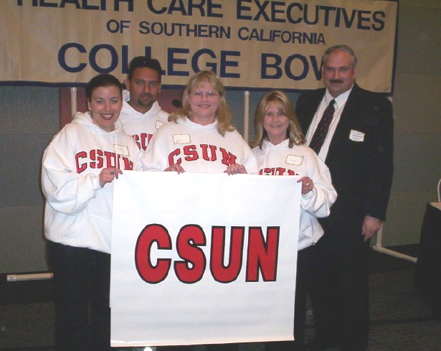
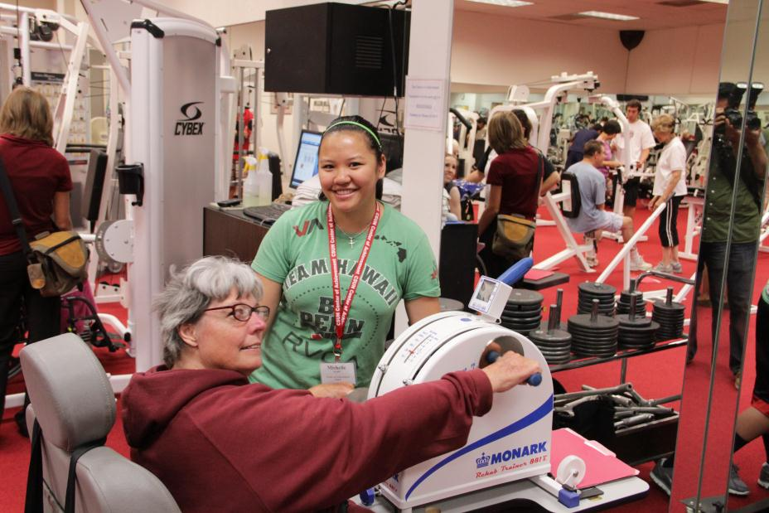
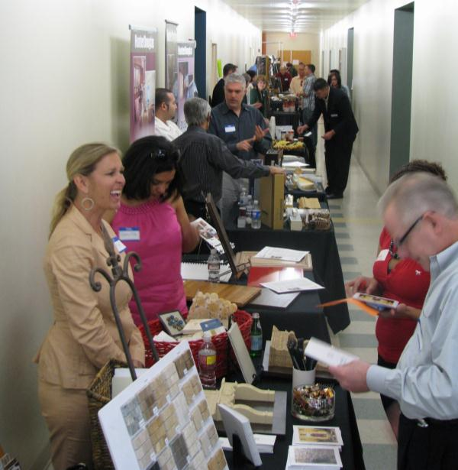
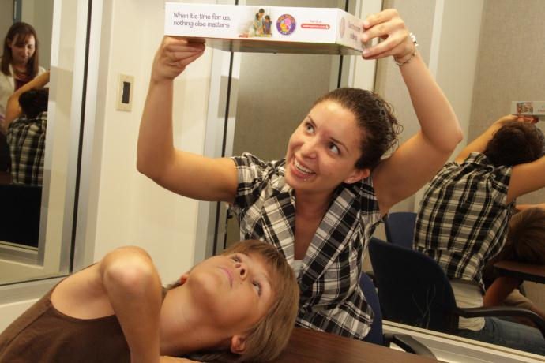
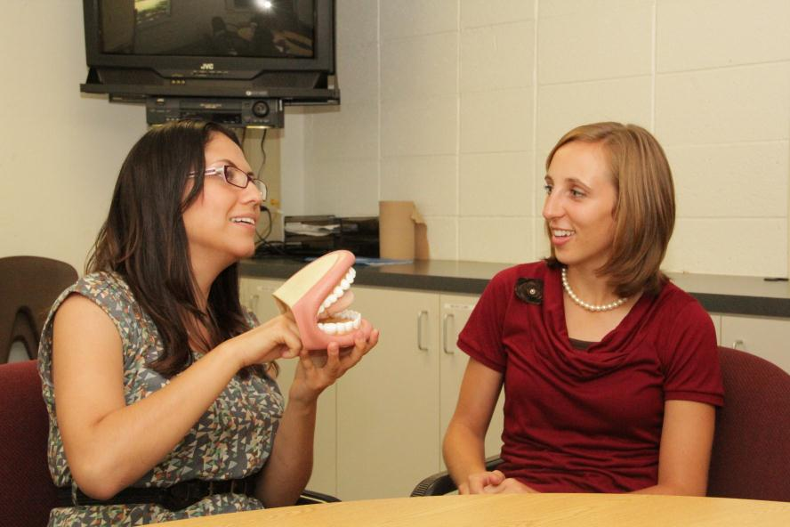
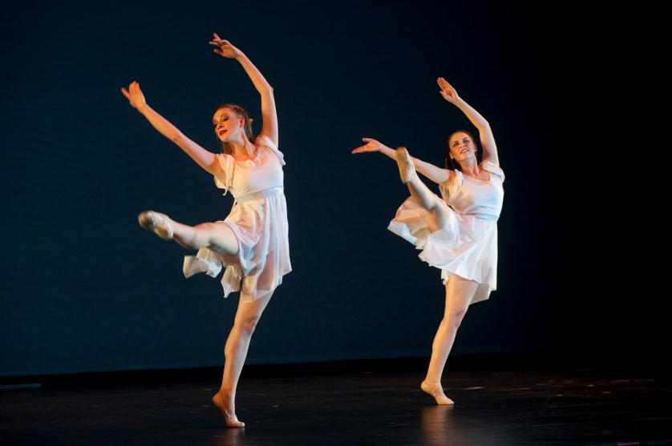
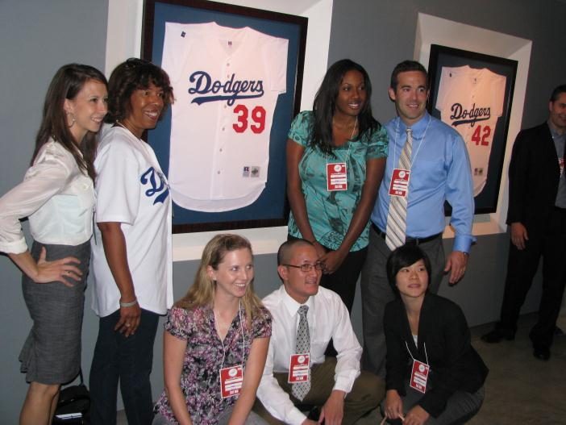
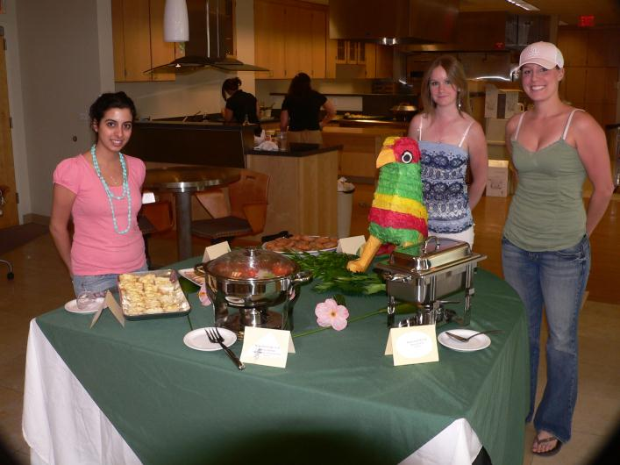
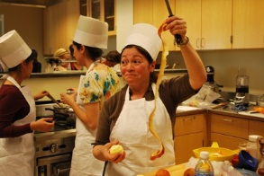

Slide 4
College of
Health and Human Development
Preparing the workforce of tomorrow
Doctorate of
Physical Therapy
at CSUN now!
1,600
Students graduated
in May
←from 21 Academic Programs
100%
Speech Language Pathology MS grads employment rate.
25% of the Speech Language Pathologists in California: CSUN Graduates
Largest accredited Environmental Health program in the US: CSUN EOH
100% of CSUN Nursing grads pass state licensure exam
Notes:
We’re preparing the workforce of tomorrow.
And when our students graduate they do very well!
Our nurses have a 100% pass rate on state exams required for licensure,
Our graduates are answering the call to improve our global environment – it’s most likely it is a CSUN graduate making sure the meal you get at your favorite restaurant is safe to eat!
There’s a 1 in 4 chance that any speech pathologist you might seek in California graduated from CSUN. We work with patients after injury or stroke, and help people with strong accents be more clearly understood. Right now we’re emphasizing the development of our voice lab where we provide services for illness recovery – or to help for professionals who use their voice every day – from singers to teachers.
[next slide]

Slide 5
“Health and wellbeing are at the very core of our quality of life, and so much affects our health: lifestyle choices, the economy, our environment, even public policy."
Notes:
Community outreach is at the heart of our work – it’s a way to give our students real-life experience, and of course it makes life better all around.
We value collaboration, because we know, as you do, we’re stronger together.
I’m here to tell you about the college, and I am going to talk about our work through (and with) the Institute for Community Health and Wellbeing.
[Refer to statement on slide, to wit:]
“Health and wellbeing are at the very core of our quality of life, and so much affects our health: lifestyle choices, the economy, our environment, even public policy."
[next slide]

Slide 6



Through the Institute we build campus community connections to promote healthy living.
Notes:
In Today’s presentation, we showcase the Institute for Community Health and Wellbeing as exemplar of how we use collaboration as a vehicle for action to create positive impact.

Slide 7
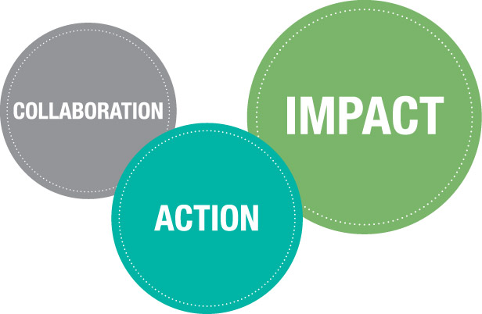
Today’s example: a critical community health issue:
Obesity.
Notes:
One of the primary causes we’re addressing is obesity and its negative effects on health and wellbeing – and we’ll look at solutions.
We’ll feature examples of how we are collaborating to take action and create impact.
We’re excited about the variety of services offered through the Institute for Community Health and Wellbeing
The Institute is not just about Health and Human Development, it’s a cross campus collaboration that features services from many areas of campus, anchored in our college and the College of Education, and the College of Social and Behavioral Sciences.
[a nod to Michael Spagna and Stella Theodoulou]
As an example I want to show you how we’re addressing the critical issue of obesity.
[next slide]

Slide 8
A few statistics:
Overweight children in California: 11.5%
Overweight children in LA County: 23%
Children diagnosed with diabetes in California 0.3%
(about 2000 in 780,000)
Overweight adults
in LA County: 22%
Overweight adults in California: 18-20%
Adults in California diagnosed with diabetes: 8.5%
Adults diagnosed with diabetes in LA County: 10.0%
Notes:
I used the word “critical” but perhaps I should have said “urgent.”
[You may want to let the weights fall with a little silence for a backdrop.]
You can see overweight is a problem that we’re handing down to our next generation.
[next slide]

Slide 9
Five-years of overweight: as much as $24,000 per person
Weight to lose for improvements to start: only 5% to 7%
What works: nutrition and exercise, as always.
Today: obese adults in the US: 34%
20 years from now: 50%
Overweight children>>> overweight adults >>>
diabetes, hypertension, atherosclerosis
Notes:
Overweight and obesity make life more expensive financially and personally, and it’s taking a bite out of our longevity and overall health.
It seems to me that it’s worse than it used to be. The Centers for Disease Control agrees:
[next slide]

Slide 10

Obesity Risk Factor Trends
1990
2000
2010
No No Data <10% 10%–14% 15%–19% 20%–24% 25%–29% ≥30%
Notes:
Long term studies show a dramatic rise in obesity and the risk factors associated with it.
Take a look – you see that shift from blue in 1990 to mostly red in 2010.
Remember: this isn’t a political map!
In 1990, the percentage of risk factors balances somewhat between less than 10 to 19 %.
Within ten years, the west is generally creeping up, leaving that 10% behind - and the east and south are up in the 20 – 24% range.
And today? The dark red represents equal to or greater than 30%.
Clearly we need help.
[next slide]

Slide 11
What are we doing about it?
Notes:
[self explanatory]
[next slide]

Slide 12
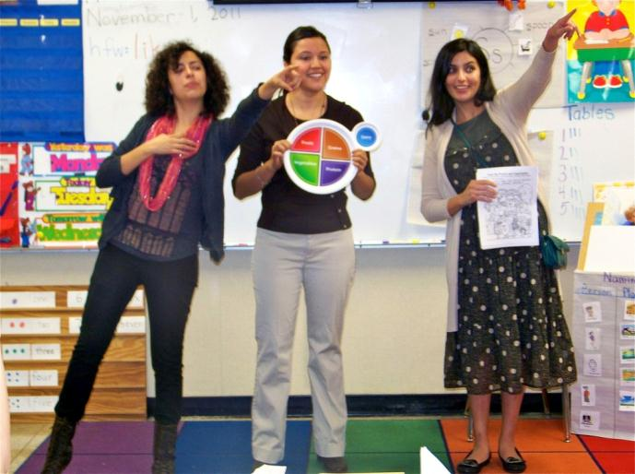
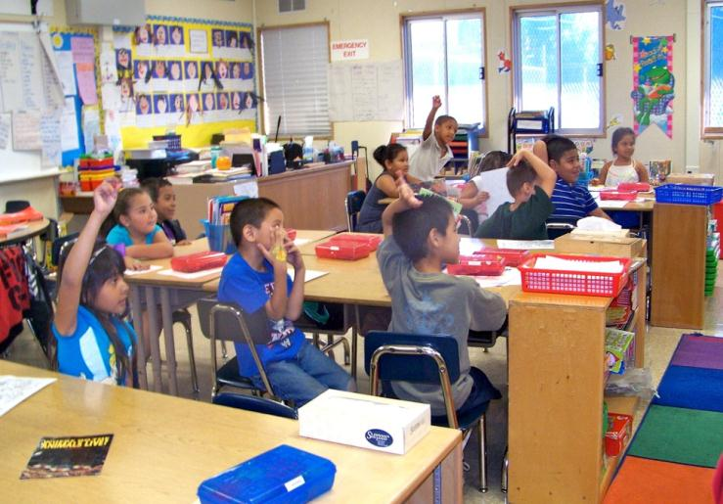
Community Partners
+
Northridge Hospital Medical Center
LAUSD
Local schools: Cohasset, Anatola, Gault
USDA & HUD Grant
Notes:
What works? Nutrition and exercise, as always.
We work with community partners.
We’ve teamed up our Kinesiology and Nutrition faculty with the LAUSD and Northridge Hospital Medical Center to bring nutrition education to three local schools.
In this photo you can see our student interns from the Marilyn Magaram Center for Food Science Nutrition and Dietetics with the school teacher and obviously the children are engaged.
They make it fun for kids...
[next slide]

Slide 13
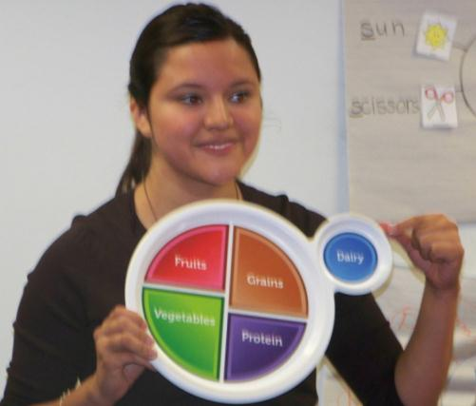
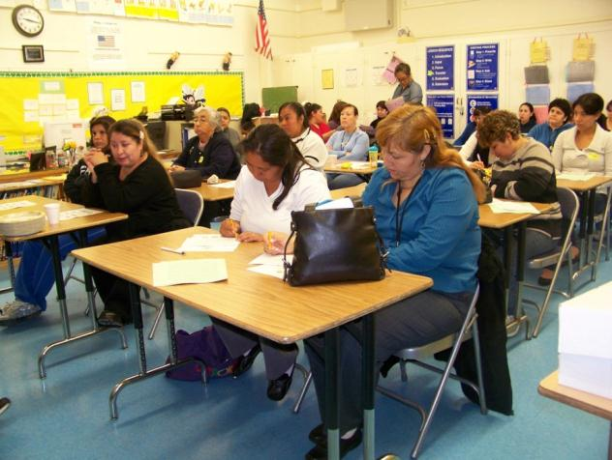
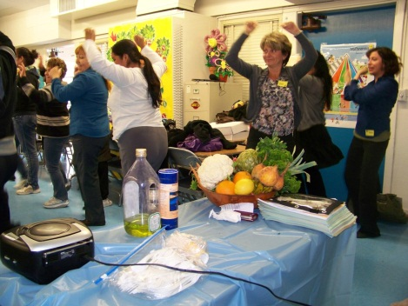
My Plate:
portion control
Nutrient balance
Parent
education
Nutrition and fitness celebration!
Notes:
…and they make it worthwhile for the parents, too!
“My Plate” replaces the old “four food groups” and the more recently used, “food pyramid.”
This new approach shows portion relationships on the plate – a section for fruits, one for vegetables, a portion for protein and another for grains.
As a reminder to drink your milk – but also to consume dairy in small quantities - a small circle at the side of the plate suggests a proper portion of dairy products.
[next slide]

Slide 14
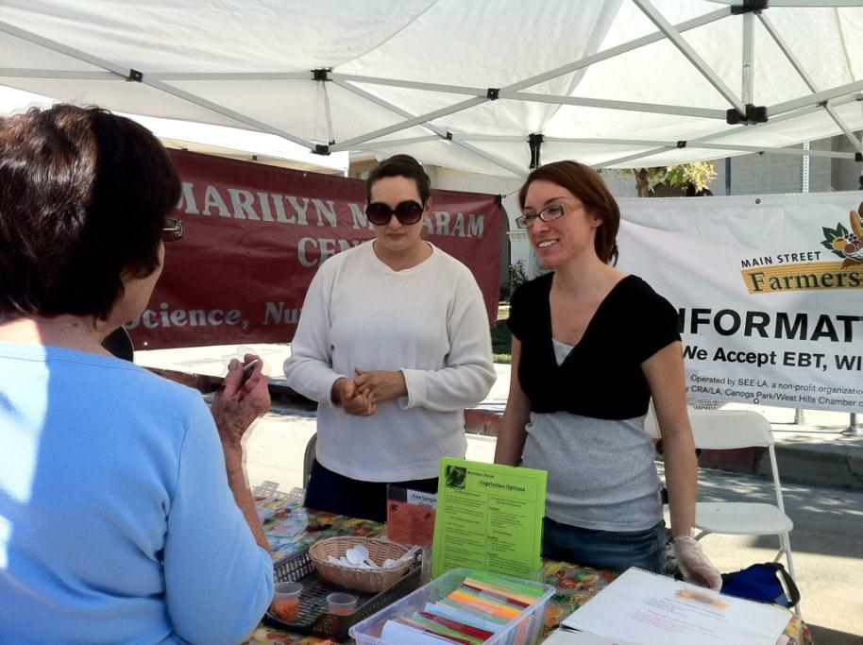
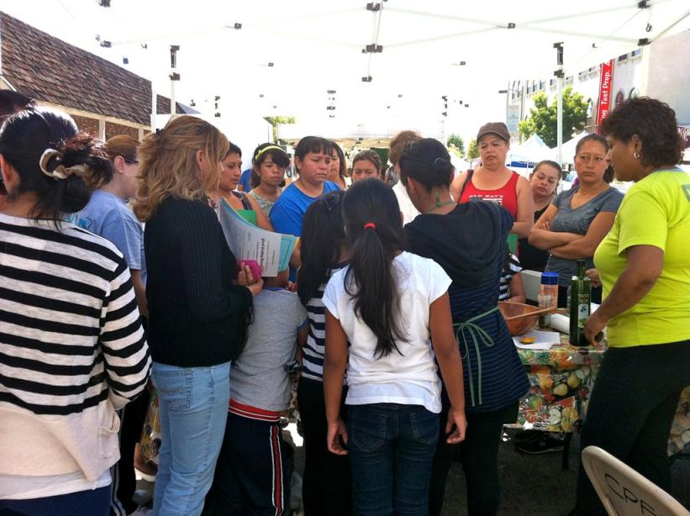
Ask the Dietitian
Farmers Market
Canoga Park
Marilyn Magaram Center + LA Public Health
Notes:
Magaram Center interns also go to the Farmers Market to work in our “Ask the Dietician” booth.
This is every 4th Saturday of the month in Canoga Park.
Our students create and share materials about food safety and portion control, suggest recipes and conduct on the spot nutrition education needs assessments with parents.
[next slide]

Slide 15
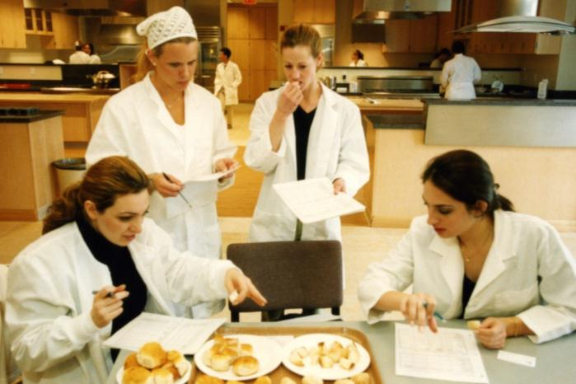
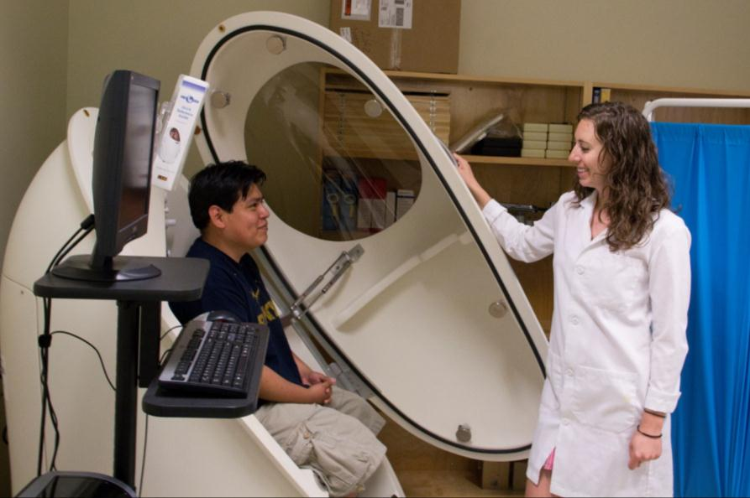
Nutrition Assessment
The
BodPod
  Measures
  body fat %
Accuracy: 99%
Notes:
We also do nutrition assessments on campus.
These are more intensive, and it’s also possible to get a body fat analysis if you want.
In the old days you had to be willing to be dunked completely under water to get an accurate reading – and that involved blowing as much air out of your lungs as possible so it wasn’t very comfortable.
But with the Bod Pod, you just step in, sit down, and relax.
The subject in this photo is wearing loose clothing, but since the Bod Pod displaces air to measure ratios, you’ll want to wear your skinny jeans or jeggings so no air can get trapped in your clothes!
[next slide]
[you know what jeggings are, right? They’re leggings that are supposed to look like jeans. Terrible invention, and the butt of many jokes.]

Slide 16
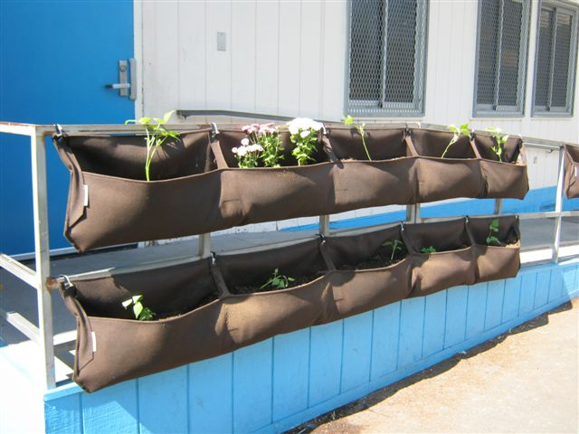
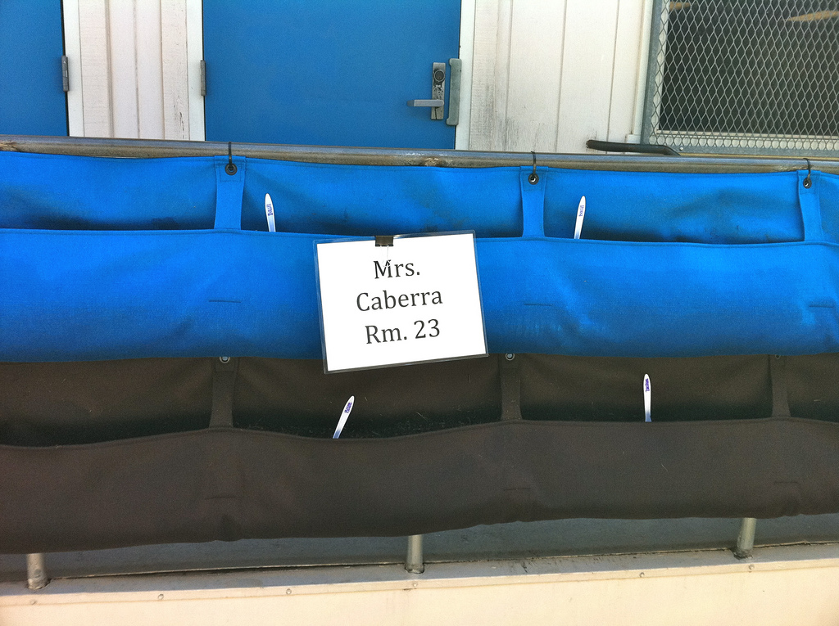
A Woolly Garden:
Grow food on the schoolyard!
Notes:
It’s one thing to explain to kids how food grows from seeds and dirt.
It’s another to show a video or a head of broccoli and explain how it got its start.
But there’s nothing like growing a plant from seed to engage the imagination.
Woolly Gardens (that’s not a misspelling, it’s a name) are designed to hang over a fence, or in this case a railing. They drain properly and can be used in small spaces, like apartment balconies or in this case, the railing outside the classroom door.
[next slide]

Slide 17
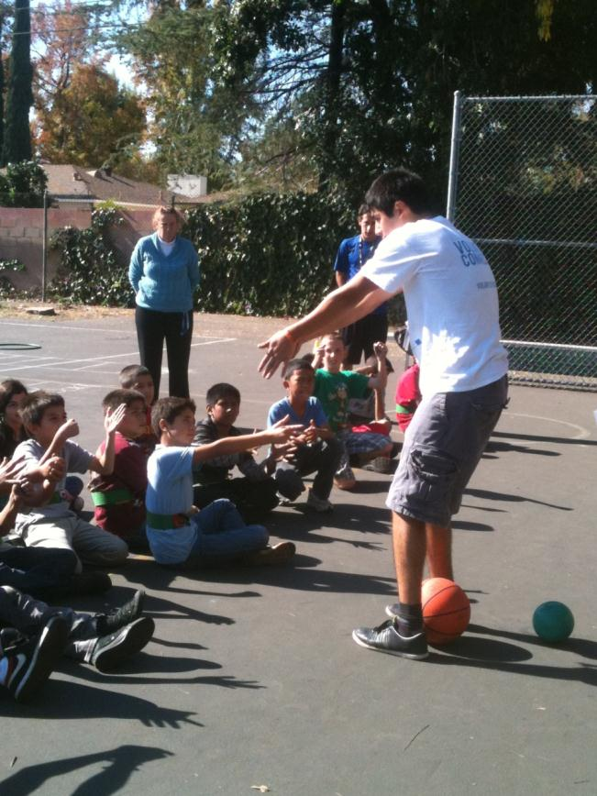
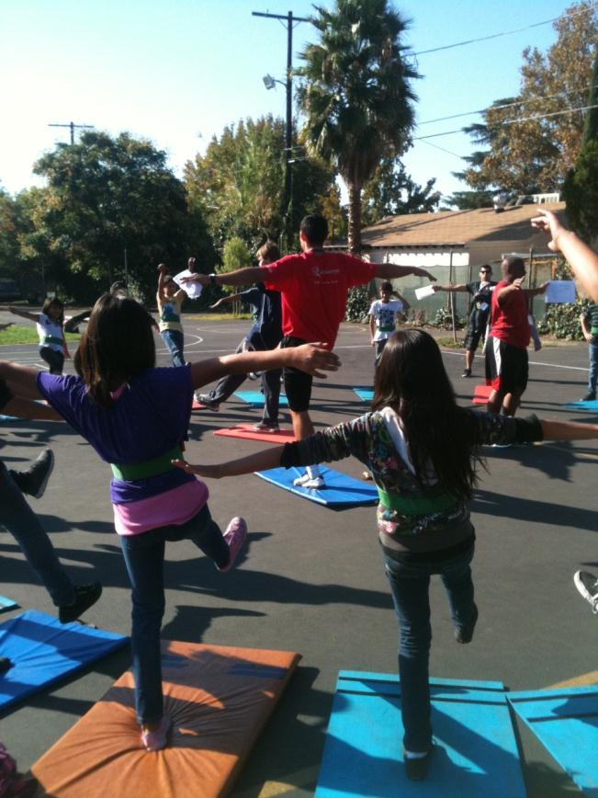
Fitness returns to the schools
with Kinesiology students and faculty.
HUD grant
Notes:
Financial cutbacks have not been kind to Physical Education programs in the schools. We are bringing it back!
As we teach the children how to make fitness a part of every day life, we are also performing research to document the positive results to support PE in school curricula.
[next slide]

Slide 18
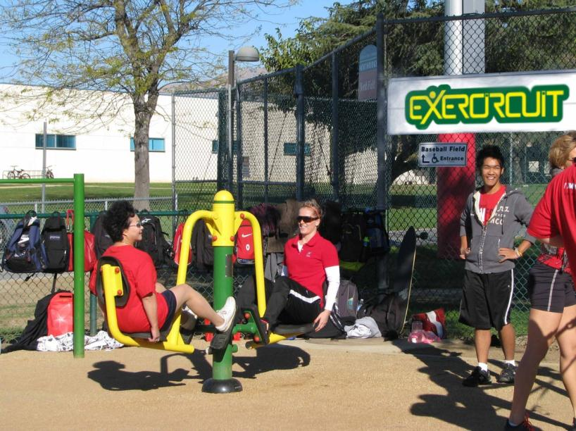
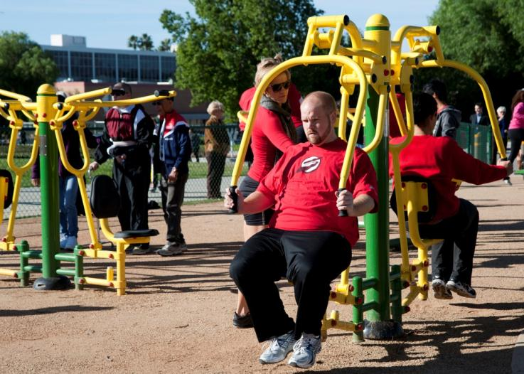
New CSUN ExerCircuit
Available 24 hours a day!
Support:
Alumnus Shlomi Golan
Kaiser Permanente
CSUN community
Notes:
The newest development, here on campus, students, faculty and staff, as well as members of the community, are all welcome to use the new “ExerCircuit.”
This is a full fitness par-course.
It includes resistance machines that use your own weight for strength training, and you can also get your cardio on one of the gliders.
Just outside the fenced area there is also an established walking path.
By the way, the gate is always open, so potentially none of us have an excuse not to use it!
Some of the machines are also accessible to people with disabilities.
It’s on campus at the corner of Lindley and Plummer on campus, next to the Brown Center.
[next slide]
[if Shlomi Golan is in the audience or if anyone from Kaiser is, (Jennifer Lopez – yes really) give a nod. Also this was supported by campus initiatives so you might want to mention that.]

Slide 19
And – there is more yet…
Notes:
This is setting you up to tell about how to access the institute through the website.
[next slide]

Slide 20
Teaching, Learning and Counseling Consortium
Berke Assessment Clinic and Library
Educational Therapy Program
Family Focus Resource Empowerment Center
LA Times Literacy Center
Mitchell Family Counseling Clinic
Special Education Literacy Lab
The Aquatic Center at Castaic Lake
Center of Achievement
Center for Cancer and Developmental Biology
Center for Educational Intervention and Therapy
Center in Educational Psychology and Counseling
Center for Health Promotion, Research, and Ethics
Center for Recreation and Tourism
Consumer Resource Center
Valley Trauma Center
Center for Teaching and Learning
CSUN Autism Center
Klotz Student Health Center
The Child and Family Studies Center
Language, Speech and Hearing Center
Marilyn Magaram Center
for Food Science, Nutrition and Dietetics
Music Therapy Wellness Center
Physical Therapy Center
for Advanced Clinical Practice
Notes:
We talked about overweight and obesity and the roles the Magaram Center and Kinesiolgy department play in creating an impact.
But the Institute has a variety of solutions available to many conditions and situations.
The names of the centers are showing up pretty quickly on the screen so please pick up one of our brochures to learn more – we want you to find us easily to get what you need!
[next slide]

Slide 21
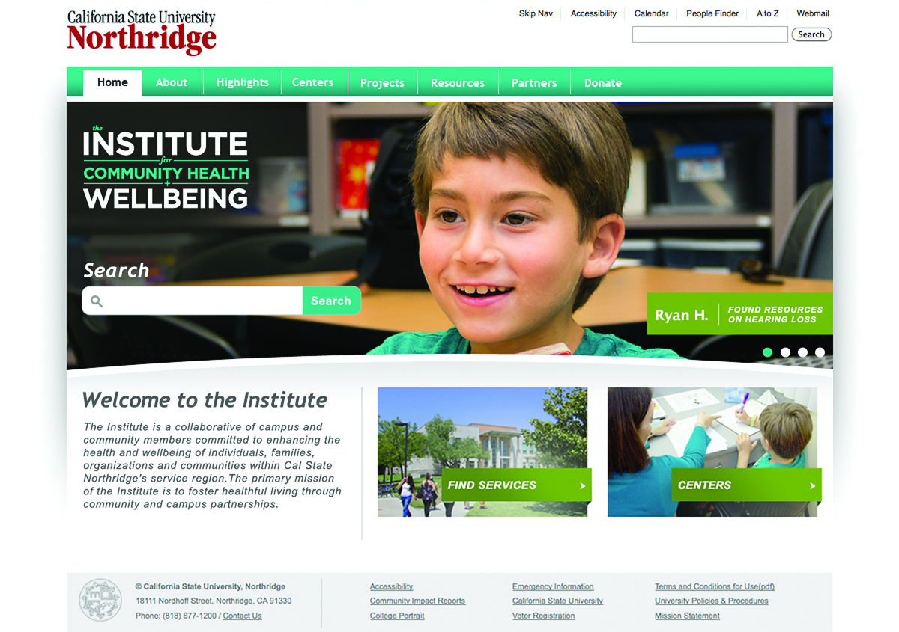
www.csun.edu >>> Institute for Community Health and Wellbeing
Notes:
Search for services by typing in your need, or you can browse through our centers.
You can find us at www.csun.edu, se
Search “Institute for Community Health and Wellbeing”
[next slide]

Slide 22
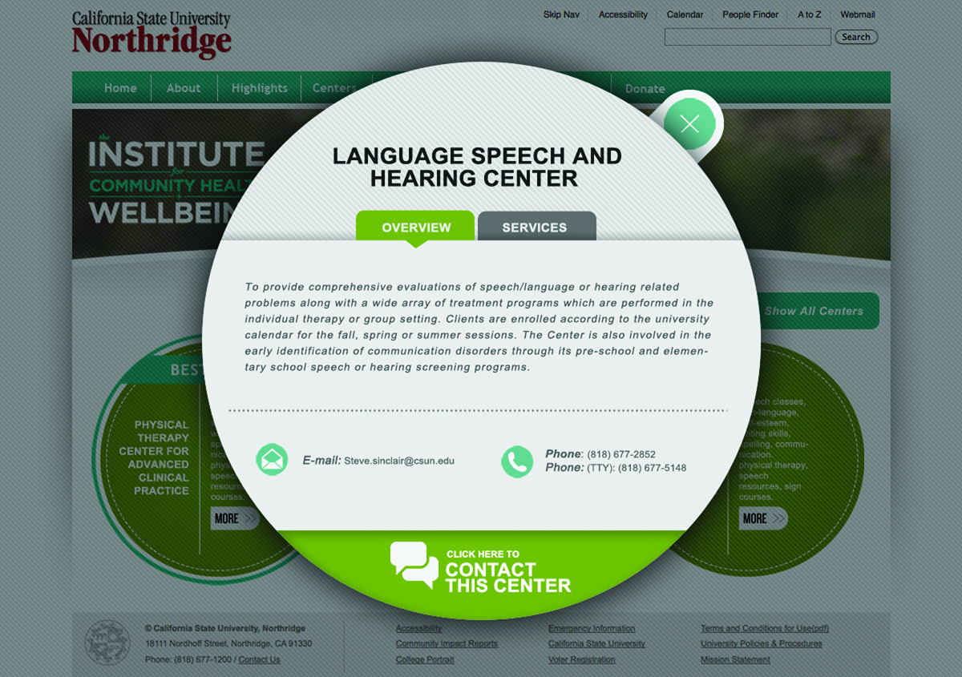
Notes:
When you select a Center, you get quick info that is of course linked to greater detail.
[next slide]

Slide 23
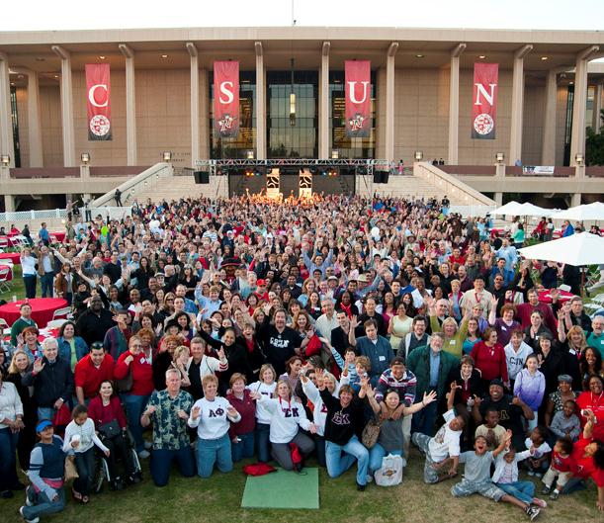
Where Community Matters:
The College of Health and Human Development and the Institute build campus-community connections
to promote healthy living – with you!
Notes:
Thank you again for coming today.
We want to engage you in this joint endeavor, and we want to hear what you have to say.
Please join us for the breakout session after the presentations today.
[You can close with the next slide or stop here.]

Slide 24
Creating Healthy Communities
College of Health
and Human Development
Sylvia A. Alva, Dean
Dianne Philibosian, Director
Presentation by
Jean O’Sullivan
HHD Public Affairs/ Communications
2011
Notes:
Thank you

