Slide 1
Accessible PDF Creation using Adobe Acrobat Professional 11

Slide 2
Agenda-PDF
Why use PDFs?
Text Recognition
Accessibility Checker
Accessibility Full Check
Order Pane
Tags Pane
Touch Up Reading Order (TURO)
Headings
Table Editor
Images
Lists
Links
Read Out Loud

Slide 3
Why Use PDF? (Portable Document Format)
Presents itself like a printed document
You can lock your authored material from end user changes
Can be opened across multiple platforms
Can be marked up to be accessible to multiple assistive technologies
Notes:
A PDF is a file format that presents itself like a printed document, and can be viewed, printed, and electronically submitted. Using PDFs allows authors to lock their material as well as have users electronically sign documents. There are many different types of assistive technology so structuring a PDF properly will ensure accessibility across multiple platforms.

Slide 4
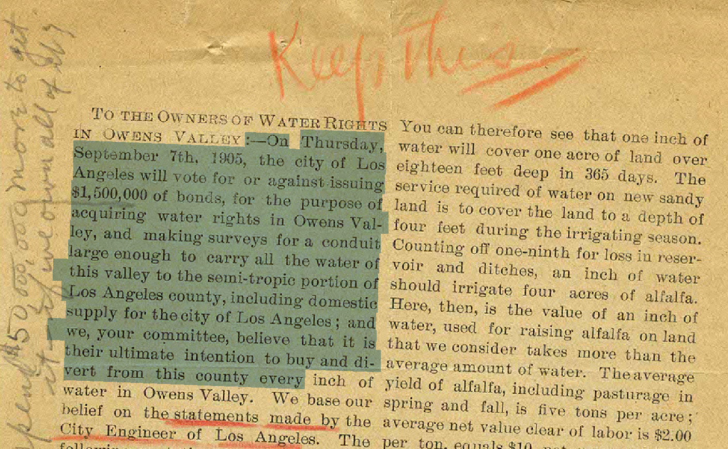
Text Recognition
Also known as Optical Character Recognition (OCR)
The first step in making the document accessible
Scans the document and provides selectable text
Notes:
When a scanned document is received it may not read correctly. To correct the wording you need to convert your document back into a Word file, retype the information and clear up any jumbled text.

Slide 5
Accessibility Full Check
Use the Accessibility Full Check
When first receiving a PDF file
While you are editing
As a final step
Scans document based on different accessibility standards
Generates a report for the user
If assistance is needed contact the UDC
Notes:
It is recommended to use the Full Check to quickly diagnose any accessibility errors within a document.

Slide 6
Accessibility Full Check
Follows the WCAG 2.0 guidelines and PDF/Universal Accessibility (UA) standards
Document
Accessibility permission flag is set
Document is not image-only PDF
Document is tagged PDF
Document structure provides a logical reading order
Text language is specified
Document title is showing in title bar
Bookmarks are present in large documents
Document has appropriate color contrast
Page Content
All page content is tagged
All annotations are tagged
Tab order is consistent with structure order
Reliable character encoding is provided
All multimedia objects are tagged
Page will not cause screen to flicker
No inaccessible scripts
Navigation links are not repetitive
Page does not require timed responses
Adobe Acrobat XI Accessibility
Using the PDF Accessibility Checker
Notes:
The Accessibility Full Check allows users to validate their document using four options.

Slide 7
Accessibility Full Check Cont.
Forms, Tables and Lists
All form fields are tagged
All form fields have description
TR must be a child of Table, THead, TBody, or TFoot
TH and TD must be children of TR
Tables must have headers
Tables must contain the same number of columns in each row and
rows in each column
Tables must have a summary
LI must be a child of L
Lbl and LBody must be children of LI
Alternate Text and Headings
Figures require alternate text
Alternate text that will never be read
Alternate text must be associated with some content
Alternate text should not hide annotation
Elements require alternate text
Appropriate heading nesting

Slide 8
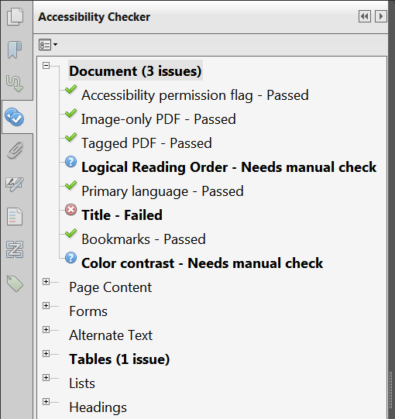
Accessibility Checker
Notes:
The checker first displays result in an expandable list. The results of each item will be marked as one of the following:
Passed: The item passed this accessible check.
Passed Manually: The item was marked passed by manual inspect.
Skipped By User: The rule was not selected in the Accessibility Checker Options dialog box.
Needs Manual Check: The Full Check feature could not check the item automatically. Verify the item manually.
Failed: The item did not pass the accessibility check.

Slide 9
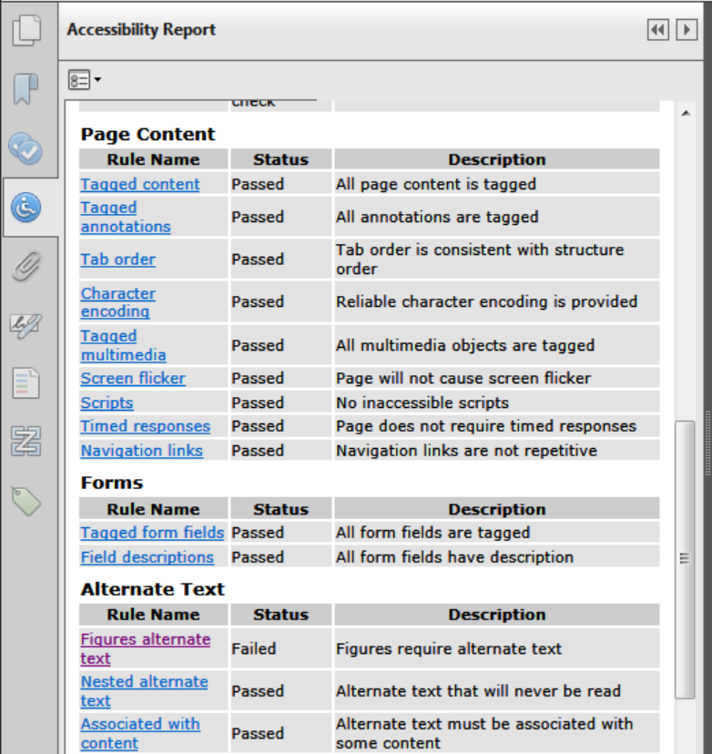
Accessibility Full Check Cont.
Notes:
This report allows you to see the names of all the accessibility rules Adobe checks, provides documentation about each rule, and suggests ways to fix the document. This report also lets the author know whether or not the document passes the accessibility check and provides a description on why changes are necessary.

Slide 10
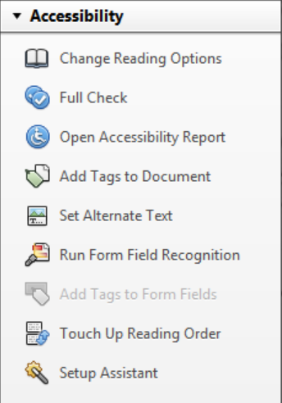
Accessibility Options
A tool panel where most accessibility options are located.
Notes:
Change Reading Options: Changes the reading settings for people using screen readers.
Full Check: Runs the Adobe Acrobat Accessibility Checker and presents a report to authors to check a PDF’s accessibility.
Open Accessibility Report: Opens a saved accessibility report previously ran on your document.
Add Tags to Document: Opens the tags section of the PDF allowing authors to assign tags to important landmarks in a document.
Set Alternate Text: Allows authors to attach alternate text to meaningful images giving users with Assistive Technology information about an image.
Run Form Field Recognition: Runs a sweep through your PDF checking for any possible places where users will have to enter text.
Add Tags to Form Fields: Allows authors to assign tags to important landmarks on a PDF form.
Touch Up Reading Order: Allows authors to move the order in which a PDF will be read using Assistive Technology.
Setup Assistant: Gives users assistance with setting accessibility preferences.

Slide 11
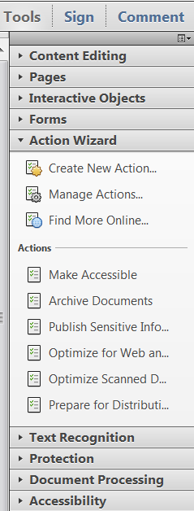
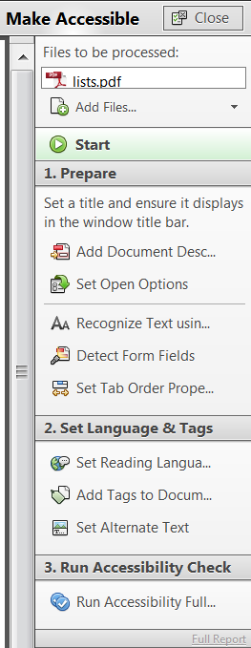
Action Wizard - Make Accessible
It prompts to address accessibility issues:
such as document description
document title
scanned text
form fields
tables
images without alternative text
Notes:
The Make Accessible action wizard walks users through the steps required to make a PDF accessible. The wizard checks the document description, runs the OCR if necessary, detecting form fields, setting tab order, assigning the reading language, add tags to a document, setting the alternative text for images. The last step of the Make Accessible action wizard is to run the Acrobat Pro Accessibility Checker (Full Check).

Slide 12
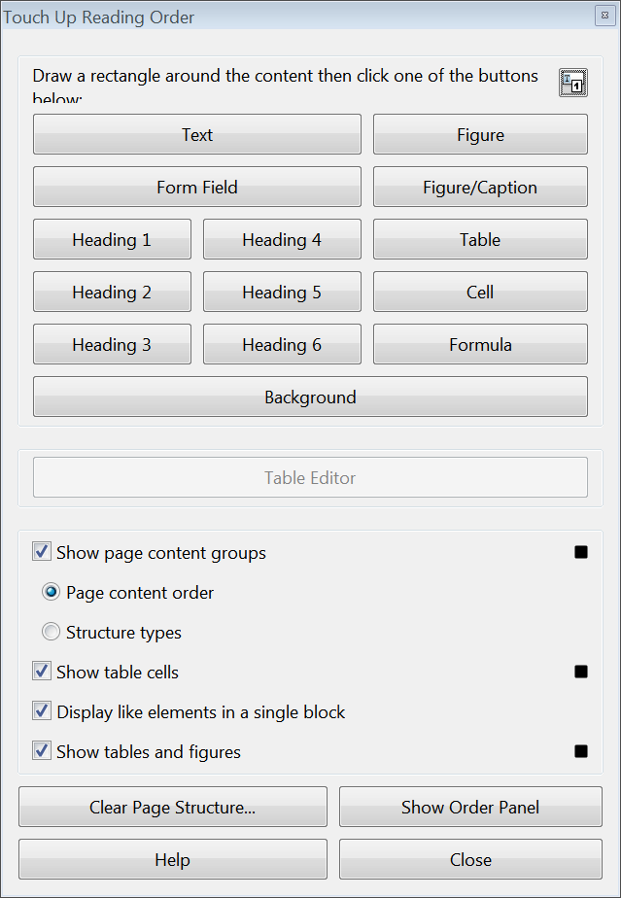
Touch Up Reading Order (TURO) Tool
Allows users to select an element in the document and assign a tag to it.
This tool provides many tagging and table mark up options.
This tool also gives users the ability to clear all of the page structure and start fresh.
Notes:
The Touch Up Reading Order (TURO) Tool is used for correcting the reading order and assists with some of the basic tags of the document. To access the Touch Up Reading Order Tool go to the main menu on and select the View menu → Tools → Accessibility→ Touch Up Reading Order. This will open up a dialog box with 12 different buttons for you to choose from while tagging your document. Use the Text option for regular body text within your PDF. Use the Figure option for all images. Use the Form Field option when tagging a form. Use the Figure/Caption option for images when you would like to include your caption with the image in a single tag. However, you still will have to provide an alternative text description for the image as well. Heading 1, Heading 2, Heading 3 are used for tagging the different levels of headers. Use the Table option for tagging a table. Use the Cell option for merged cells that were incorrectly split or for marking table or header cells. Background is used for removing any items like span boxes and decorative images that does not need to be read by assistive technology.

Slide 13
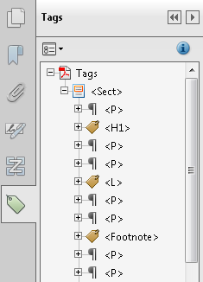
Tags Pane
Visual representation of tags applied to the document.
Allows authors to attach tags to important landmarks and content in the document.
Allows authors to edit existing tags
To open your Tags pane select the View menu and under Show/hide > Navigation Panes, select Tags.
Notes:
The Tag pane will allow authors to open up all of the tags that were assigned to the document. It also gives authors the option to remove a tag or relocate it to a different section of the document. The Tags pane is where authors can change the tag type if the touch up reading order tool does not offer that selection.

Slide 14
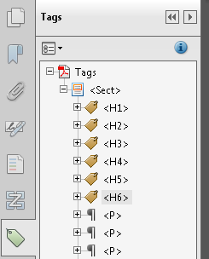
Headings
Headings are tags used for each section
Headings are announced to screen readers
Helps keep users of assistive technology organized

Slide 15
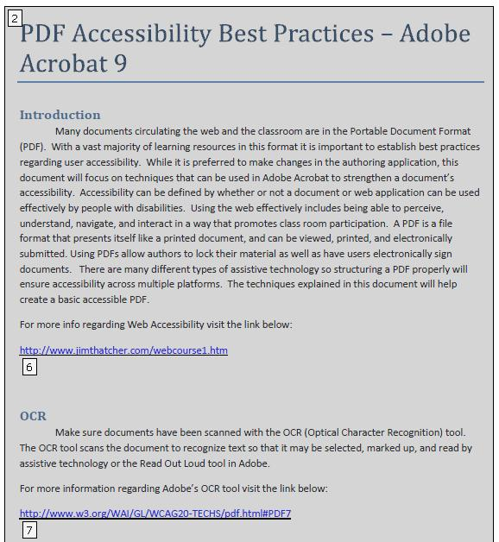
Bad Example of Headings
Notes:
In this example, “PDF Accessibility Best Practices – Adobe Acrobat 9”, “Introduction”, and “OCR” are not tagged as Headings. The all of the content on this page (paragraphs and headings) appears to be tagged the same.

Slide 16
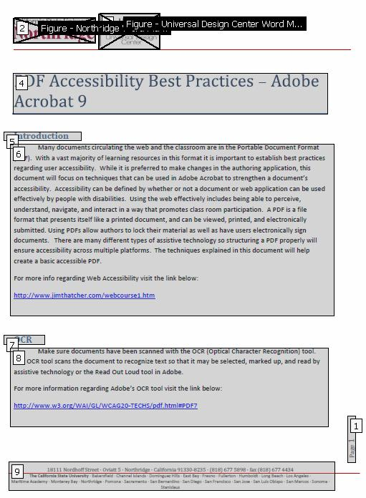
Good Example of Headings
Notes:
In this example, “PDF Accessibility Best Practices – Adobe Acrobat 9”, “Introduction”, and “OCR” are tagged as Headings. Each heading is separate from the surrounding text and contained in its own box.

Slide 17
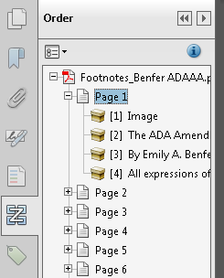
Order Pane
Visual representation of the reading order in the document.
Drag and Drop style of re-ordering content.
To open your Order pane select the View menu and under Show/hide > Navigation Panes, select Order.
Notes:
The Order button allows you to see the reading order of the document. When the pane is selected authors see the different boxes and what has been tagged. The numbers inside of these boxes correspond with the reading order of the document.

Slide 18
Bad Example of Reading Order
Notes:
Notice how the reading order jumps around. Assistive technology would read this in a way that would not make sense to the user. Reading

Slide 19
Good Example of Reading Order
Notice how the reading order starts at the Page number and then starts at the top of the page.
Starting the reading order with the page number lets users with assistive technology know what page they are on before they start reading the page.
Notes:
This is a good example of a PDF with Proper Reading Order. Notice how all the numbers are in chronological reading order. Be sure to look over the reading order before submitting a document.

Slide 20
Table Structure
Providing proper table structure helps end users with:
Cell navigation
Cell Announcement
Header Announcement
Notes:
Having good table structure allows assistive technology to alert the user of what cell they are in and also announces the header column and row before reading a cell.

Slide 21
Bad Example
Notes:
Column and Row headers are not there. Assistive technology would just read this line by line making this table confusing to the user.

Slide 22
Good Example
Notes:
Column and Row headers are there giving this table structure and the ability to be navigated easily by users with assistive technology.

Slide 23
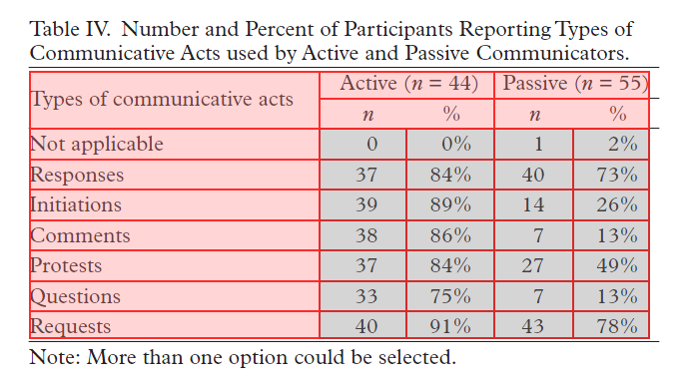
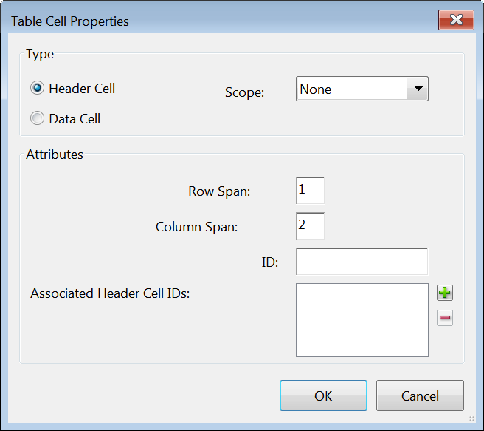
Table Editor
The Table editor allows authors more control over the structure of the table.
Associates and assigns data cells to header cells within a table.
Notes:
The Table Editor option can be used after a table is already tagged. This feature allows authors more control over their table and the ability to apply the appropriate properties to each cell, making the table more navigable and understandable by assistive technology users.

Slide 24
Alternative Text
Text Alternative
Captions
Or link to additional complex information as needed (from authoring tool)
Notes:
Alt text is a text alternative for visuals in your document. If you have a caption on your picture, you can have alt text that is null. Also, if the information explaining the image is in the text surrounding the image it is ok.
Alt text is necessary because if someone has an old version that does not support images, or if images are turned off, the user will not get the same information.

Slide 25
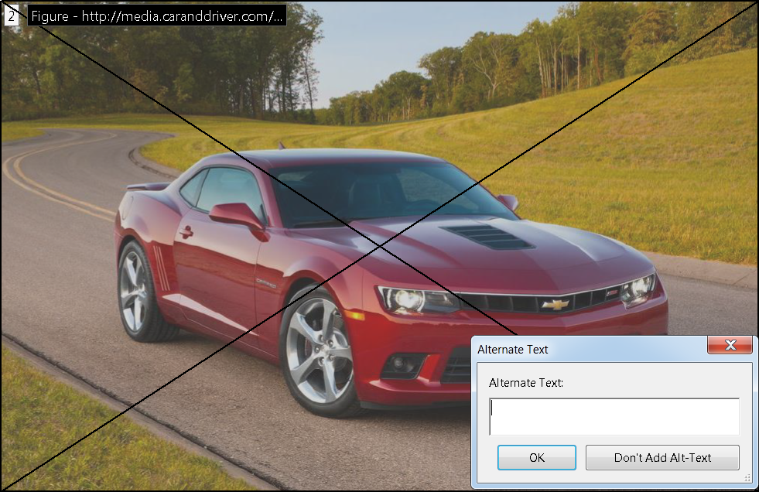
Bad Example of Alternative Text
There is no alternative text for the picture to the right. Users of assistive technology such as screen readers will not get any information from this image. When the screen reader selects the image it will just say “Image”.
Notes:
As we will see in this example of alternative text there is nothing filled out in the box, offering no information to users with assistive technology.

Slide 26
Good Example of Alternative Text
There is alternative text for the image to the right. Users with assistive technology such as screen readers will hear “Image – Red 2014 Chevy Camero”.
Notes:
As we see in this example the alternative text is filled in, giving users with assistive technology information about the image.

Slide 27
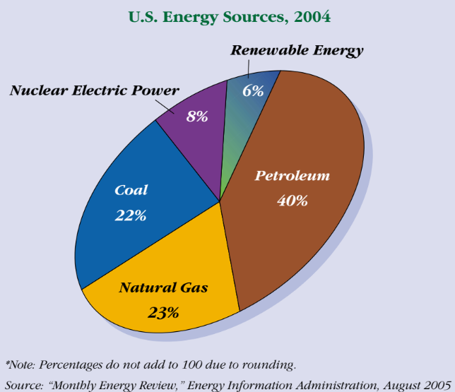
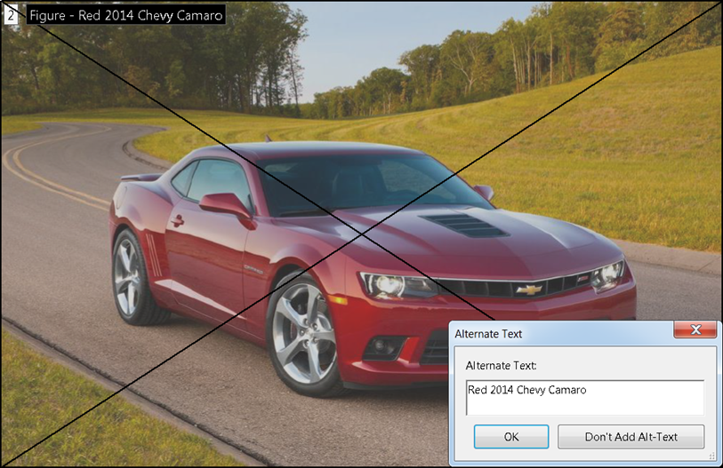
Images
Use the Touch Up Reading Order Tool to select the Figure/ Caption button when tagging an image with a caption.
If the image does not have a caption use the Figure button.
Add alternative text to highlight the salient points of the graph.
Notes:
Include a caption with supporting text around graphs. Use the Touch Up Reading Order Tool to select the Figure/ Caption button when marking graphs. When captioning a graph authors do not have to state every specific detail within the graph, but be sure that the importance of what the graph is representing is presented in the surrounding text. Important text includes the graph labels and the distinction between colors on the graph. Besides having a caption for the graph it is recommended that you also include a brief description in the paragraph text before the graph to introduce the graph coming up. If there is no explanation of the graph in the surrounding text, alternative text is required.

Slide 28
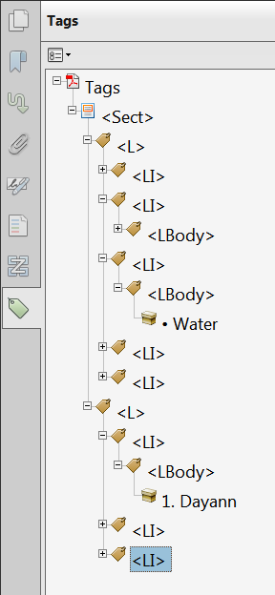
Lists
Allows authors to tag a list appropriately
Gives visual hierarchy

Slide 29
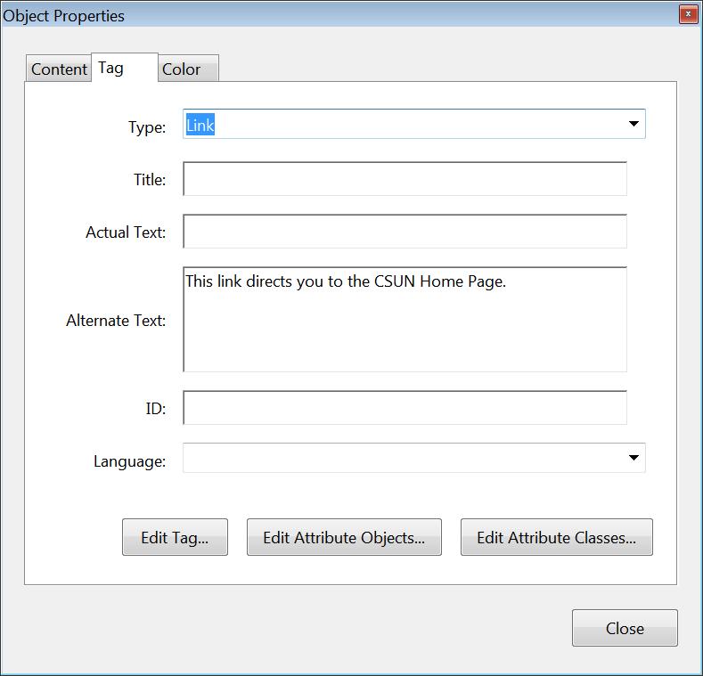
Links
When a link is not meaningful within it’s immediate context, provide alternative text to it to help readers understand where the link will go.
Notes:
When adding a link remember that the alternative text should still be descriptive. To add alternative text to a link select the correct tags within the Tags pane, select the options menu at the top of the Tags pane, select the Properties option, and insert your alternative text in the space provided.

Slide 30
Read Out Loud
Read Out Loud will read the document to you.
Read Out Loud is a text to speech tool.
Make sure you test your completed documents using the Adobe Read Out Loud once you are finished with adding your accessibility tags.
You can find this feature under View→ Read Out Loud → Activate Read Out Loud
Notes:
The read out loud function offers authors a chance to hear their document out loud illustrating the importance of reading order.

Slide 31
Recap
Why use PDFs?
Text Recognition
Accessibility Checker
Accessibility Full Check
Order Pane
Tags Pane
Touch Up Reading Order (TURO)
Headings
Table Editor
Images
Lists
Links
Read Out Loud

Slide 32
Contact Us
For further assistance please contact the UDC:
Phone: 1(818) 677-5898
Email: universaldesigncenter@csun.edu
Website: http://www.csun.edu/universaldesigncenter

