Slide 1
SPSS
Statistical Package for Social Sciences
Selecting Cases
Department of Psychology
California State University Northridge
www.csun.edu/plunk

Slide 2
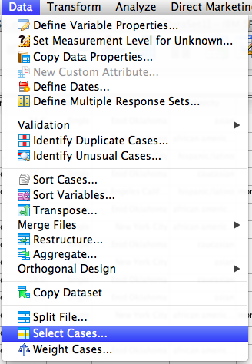
Selecting Cases in SPSS
A researcher may want to only include certain data in an analyses (e.g., only female participants), and exclude other data (e.g., male
participants)
Go to “Data” and then
“Select Cases”

Slide 3
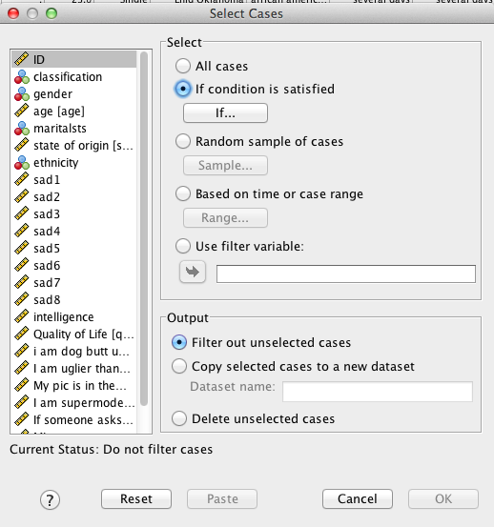
Selecting Cases in SPSS
Click where it says “If condition is satisfied”, and then “If…”.

Slide 4
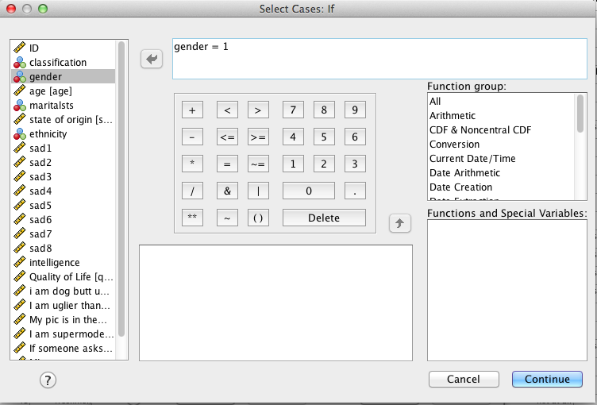
Selecting Cases in SPSS
In this example, the researcher is going to limit the data to just women (coded as “1” in the data).
Move “gender” into the box, and then type “= 1” (or just type “gender = 1”)
Click “Continue”

Slide 5
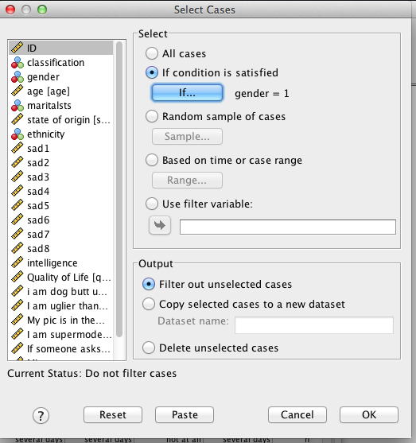
Selecting Cases in SPSS
This window provides three options for the output. In the last option, it just deletes the unselected cases.
In this example, used the
default “Filter out
unselected cases”
Click “OK”

Slide 6
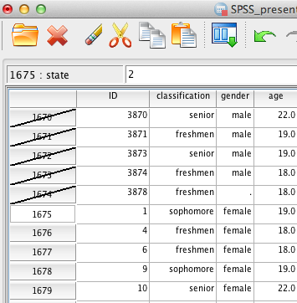
Selecting Cases in SPSS
As shown in the screen shot of the data, missing data and “males” are now selected out (notice the dash through the cases),
while “female” is still
included in the data.
Any analyses will only
include “female”
participants unless the
researcher goes back to
the window and selects
“all cases”

Slide 7
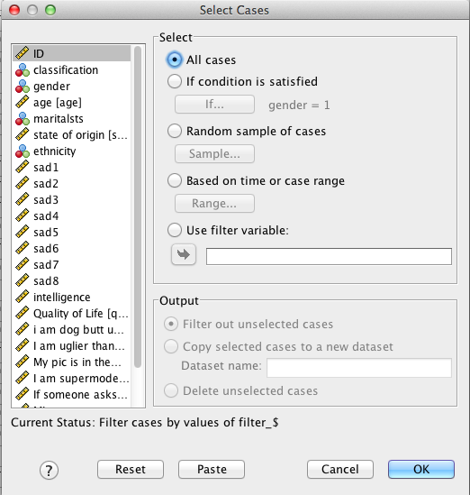
Selecting Cases in SPSS
Click “all cases” and “OK” and all the cases will be selected again.

