Slide 1
SPSS
Statistical Package for Social Sciences
Computing Alpha Reliability in SPSS
Department of Psychology
California State University Northridge
www.csun.edu/plunk

Slide 2
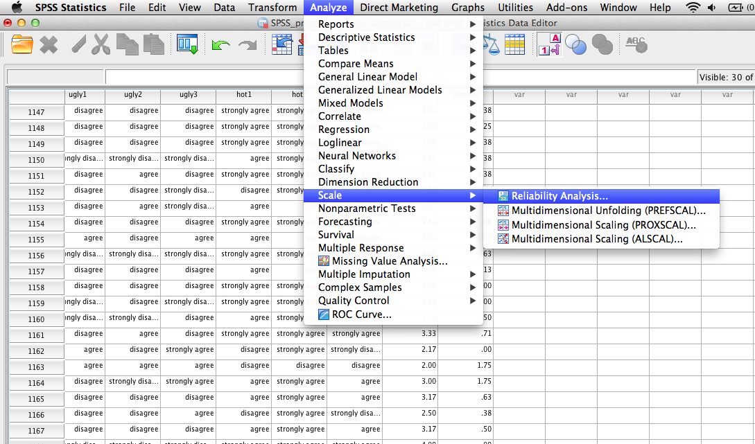
Computing Alpha Reliability
Step 1 – select Analyze -> Scale -> Reliability Analysis

Slide 3
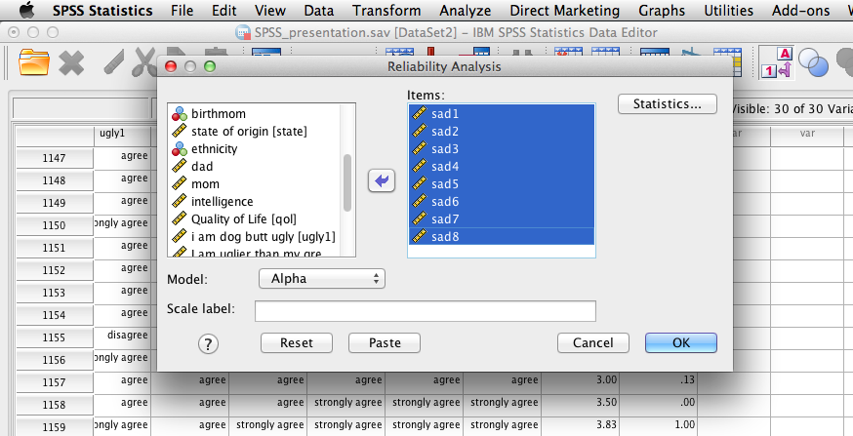
Computing Alpha Reliability
Select the items that make up the scale
Then click “statistics”

Slide 4
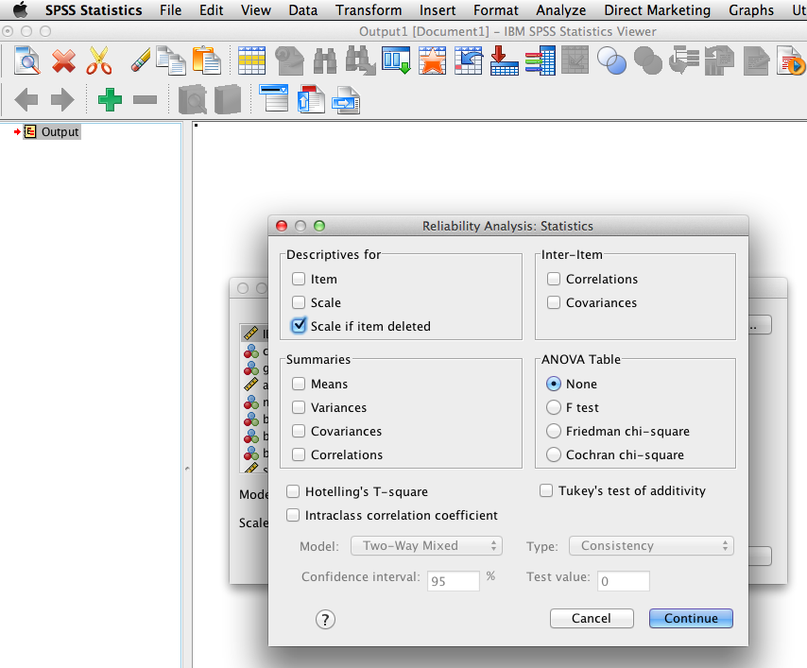
Computing Alpha Reliability
Select “scale if item deleted”

Slide 5
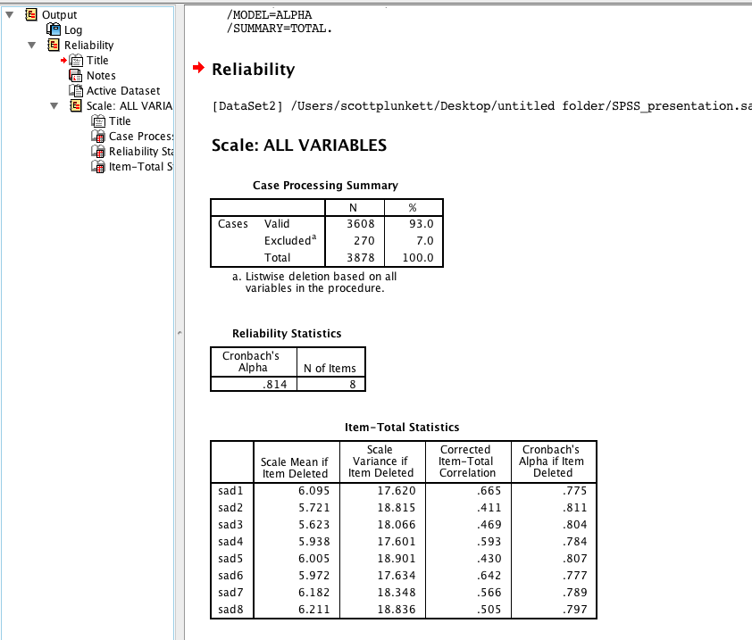
Computing Alpha Reliability
The alpha is shown in the 2nd box.
The 3rd box shows what the alpha would be if an item were deleted (see last column)
In this case, the alpha is not substantially lower or higher than the overall scale if an item is deleted.

Slide 6
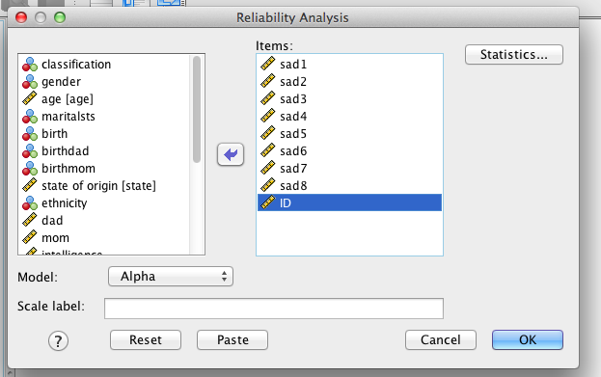
Computing Alpha Reliability
Now add an item that should not theoretically be related to the items in the scale. In this case, “ID” is added.

Slide 7
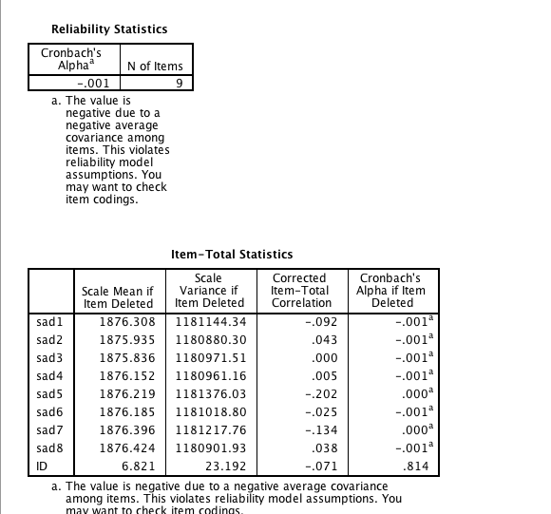
Computing Alpha Reliability
The 3rd box shows what the alpha would be if an item were deleted (see last column)
Notice that the alpha dropped from .81 to -.001 by adding “ID”
This table shows that if “ID” were dropped, the alpha would go back up to .81

