Slide 1
SPSS
Statistical Package for Social Sciences
Recoding in SPSS
Department of Psychology
California State University Northridge
www.csun.edu/plunk

Slide 2
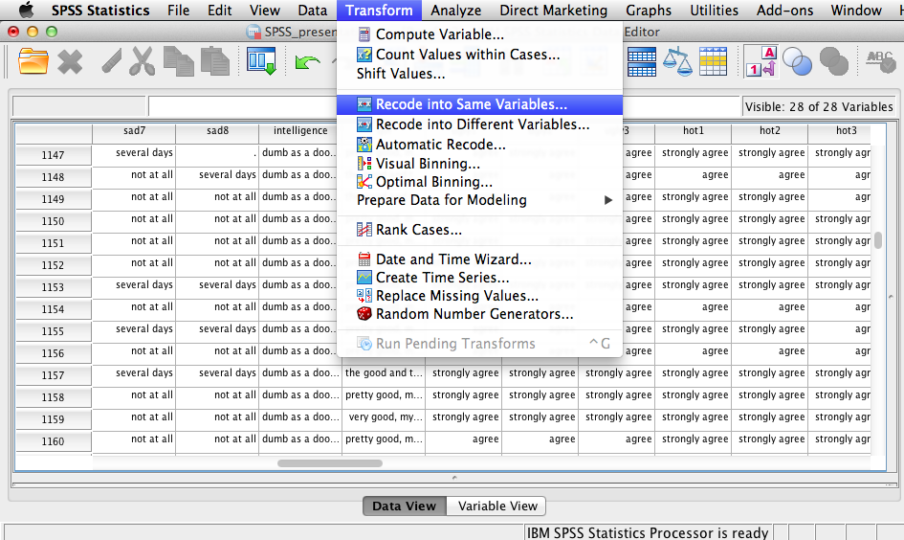
Recoding in SPSS
Sometimes a researcher may want to recode a variable
  “Recode into same variable” (which will overwrite your data)
  “Recode into different variable” (which will create new variables based on the recoded values)

Slide 3
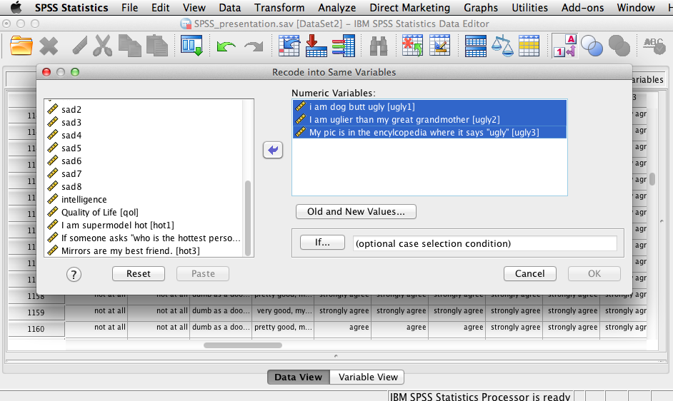
Recoding in SPSS
Lower scores on “ugly” variables will be coded as higher scores (e.g., on a “hotness” scale).
  Thus, if a person has a low score on “ugly”, it is like saying they have a high score on “hotness”

Slide 4
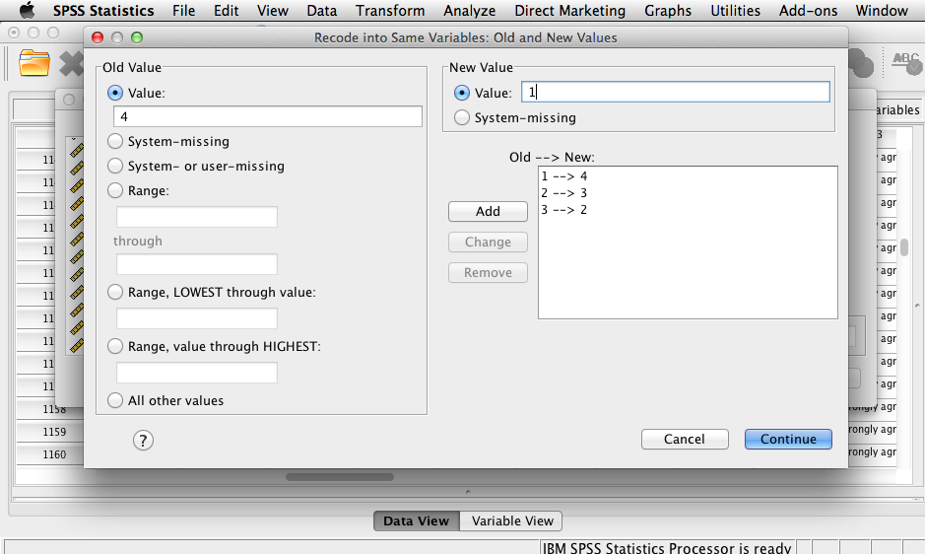
Recoding in SPSS
A score of 4 on an “ugly” variable will be coded as score of 1 on the “hot” scale; while, a score of 1 on an “ugly” variable will be recoded as a 4, and so on.

Slide 5
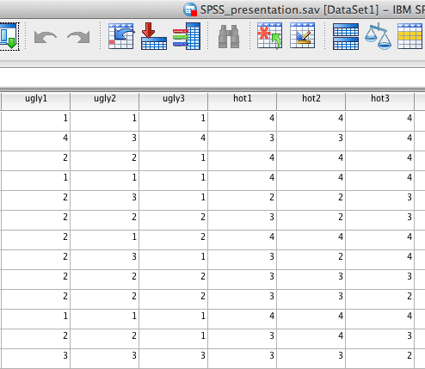
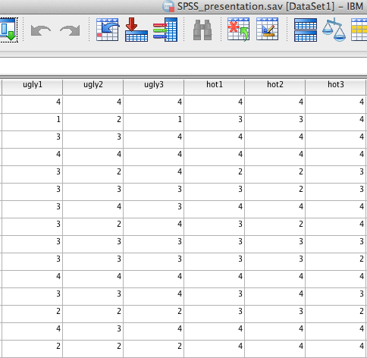
Recoding in SPSS
Examination of the data file shows the numbers have now been recoded.
Original Data
Recoded Data

