Slide 1
SPSS
Statistical Package for Social Sciences
Paired Samples t-test
Department of Psychology
California State University Northridge
www.csun.edu/plunk

Slide 2
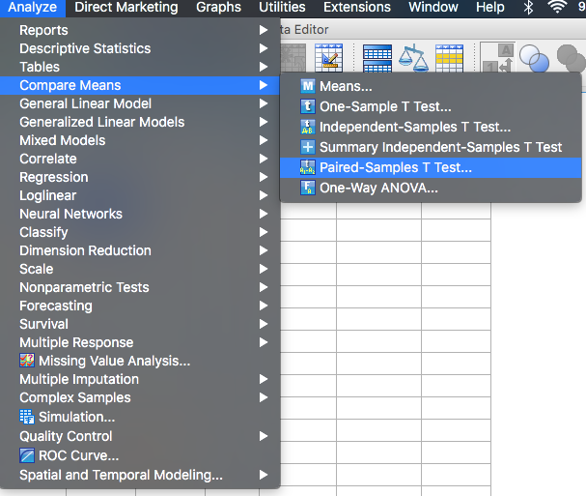
Paired samples t-test
Paired samples t-test examines differences between two dependent measures (e.g., pretest/posttest, time 1 / time 2).

Slide 3
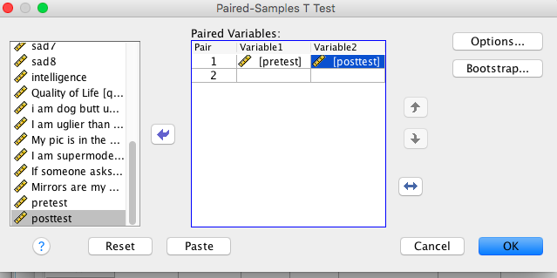
Paired samples t-test
Move over the pretest and posttest into “variable1 and variable2.
  Click on “OK”

Slide 4
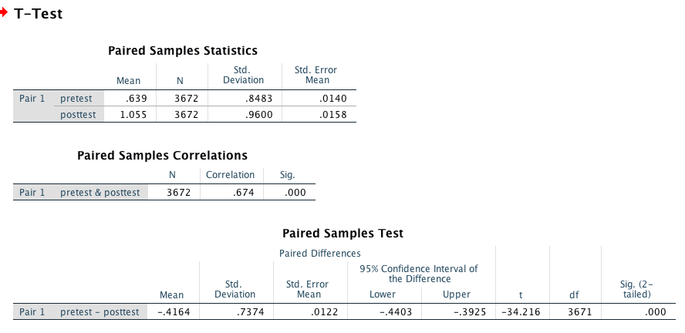
Paired samples t-test
Paired samples t-test indicated the posttest knowledge score (M = 1.06, SD = 0.96) was significantly higher than the pretest knowledge score (M = 0.64, SD = 0.85); t(3671) = -34.21, p < .001.

