Slide 1
SPSS
Statistical Package for Social Sciences
Multiple Regression
Department of Psychology
California State University Northridge
www.csun.edu/plunk

Slide 2
Multiple Regression
Multiple regression predicts/explains variance in a criterion (dependent) variable from the values of the predictor (independent) variables.
Regressions also explain the strength and direction of the relationship between each IV and the DV (taking into consideration the shared variance between the IVs).

Slide 3
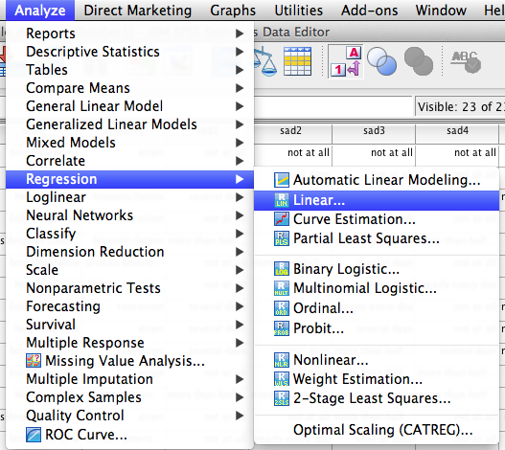
Multiple Regression
Go to “Analyze”, then “Regression”, and then
“Linear”

Slide 4
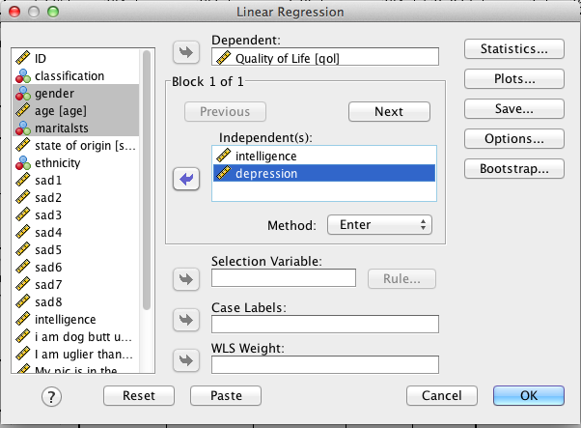
Multiple Regression
Move “Quality of Life” into the “Dependent” box, and move “Intelligence” and “Depression” into the “Block 1 of 1” box. Then click “OK”.

Slide 5
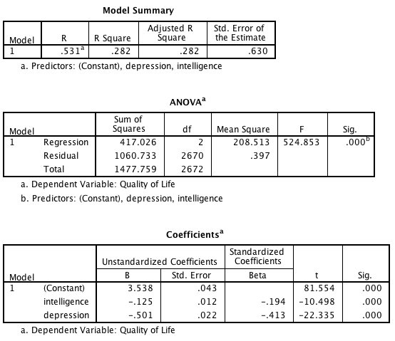
Multiple Regression
Intelligence and depression accounted for significant variance in quality of life, R² = .28, F(2,2670) = 524.85, p < .001. The standardized beta coefficients indicated that intelligence (Beta = -.19, p < .001) and depression (Beta = -.41, p < .001) were significantly and negatively related to quality of life.
Note: Another way this could have been reported is that intelligence and depression accounted for 28% of the variance in quality of life, F(2,2670) = 524.85, p < .001

Slide 6
Hierarchical Multiple Regression
A form of multiple regression in which the contribution toward prediction of each IV is assessed in some predetermined hierarchical order.
Researchers may put in ‘control variables’ first to determine if a set of variables account for significant variance in the DV after controlling for the ‘control variables’.
Or the researchers may have a theoretical or methodological reason to determine the order entry.
In this example, the researcher is going to assess whether intelligence and depression account for significant change in quality of life after controlling for certain demographic variables.

Slide 7
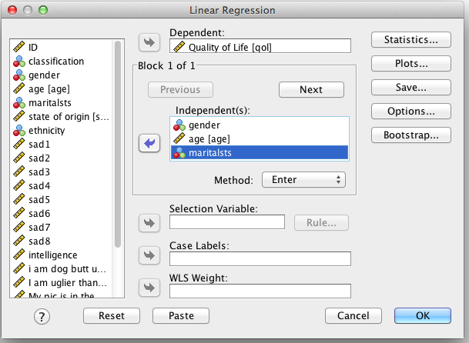
Hierarchical Multiple Regression
Move “Quality of Life” into the “Dependent” box, and move “gender”, “age”, and “maritalsts” into the “Block 1 of 1” box. Then click “Next”.

Slide 8
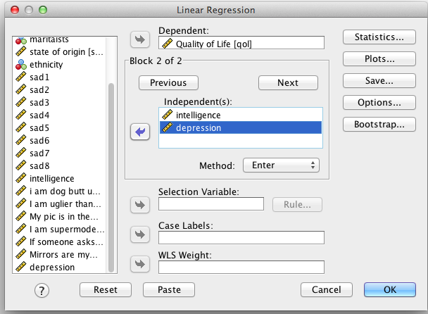
Hierarchical Multiple Regression
Move “Intelligence” and “Depression” into the “Block 2 of 2” box. Then click “Statistics”.

Slide 9
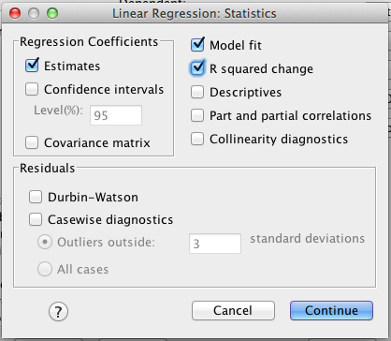
Hierarchical Multiple Regression
Select “R squared change”, then “Continue” and then “OK”

Slide 10
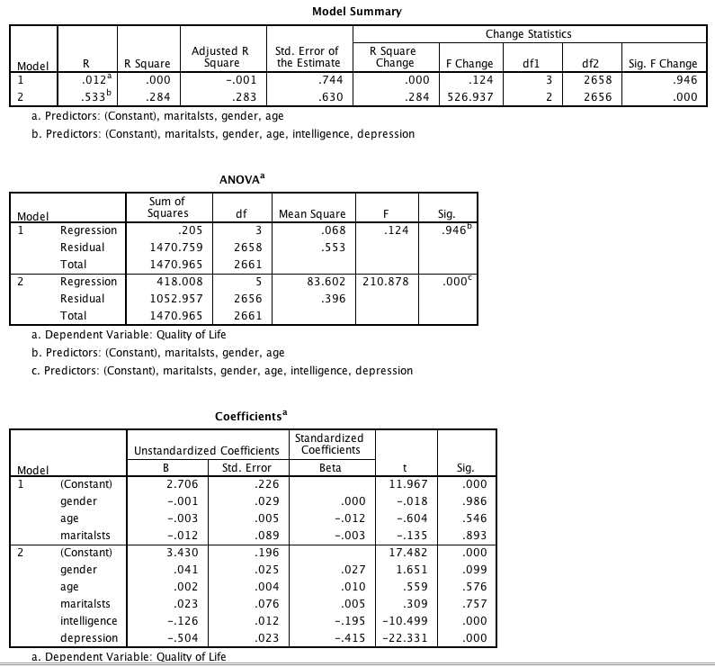
Hierarchical Multiple Regression
In the first step, the demographic variables did not account for significant variance in quality of life R² = .00 F(3,2658) = .12, p = .95. In step 2, intelligence and depression accounted for significant variance in quality of life, R² = .28, F(2,2656) = 526.94, p < .001. The standardized beta coefficients indicated that intelligence (Beta = -.20, p < .001) and depression (Beta = -.42, p < .001) were significantly and negatively related to quality of life.

