Slide 1
SPSS
Statistical Package for Social Sciences
Independent Samples t-test
Department of Psychology
California State University Northridge
www.csun.edu/plunk

Slide 2
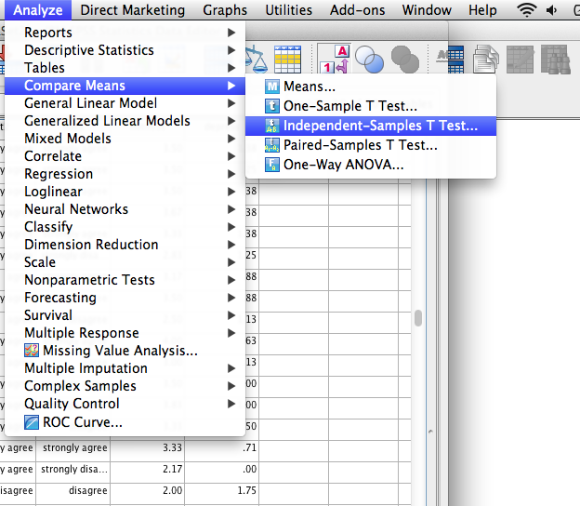
Independent samples t-test
Independent samples t-test examines differences between two groups on a dependent variable.

Slide 3
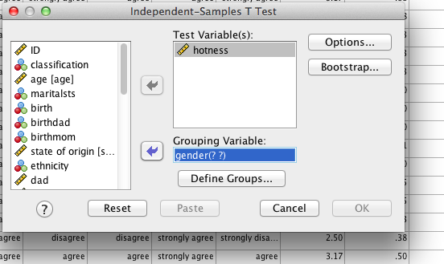
Independent samples t-test
The test variable is the dependent variable.
The grouping variable is the independent variable.
Click on “define groups”

Slide 4
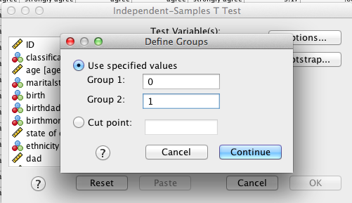
Independent samples t-test
To define the groups, insert the values for the two groups that are to be compared.
Men were coded as 0 while women were coded as 1.

Slide 5
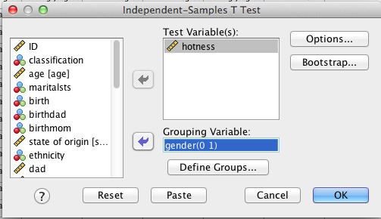
Independent samples t-test
The values now show in the group variable box

Slide 6
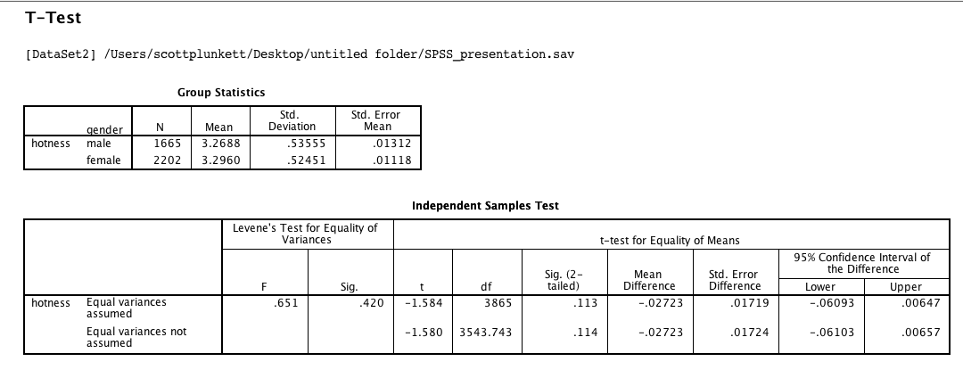
Independent samples t-test
If the Levene’s test is not significant (such as this example), then interpret the top t value.
If the Leven’s test is significant (p < .05), then interpret the bottom t value
Independent samples t-test indicated no significant difference between women (M = 3.27, SD = 0.54) and men (M = 3.30, SD = 0.53) on hotness, t(3865) = -1.58, p = .11, d = .05.
Note 1: I calculated cohen’s d using an online calculator such as the one found here http://www.uccs.edu/~lbecker
Note 2: The reason the value for SD has a “0” in front of decimal point is that the value could be above 1.00. In the case of p value and d value, they can’t be above 1.00, so no need to put a “0” before the decimal point.

Slide 7
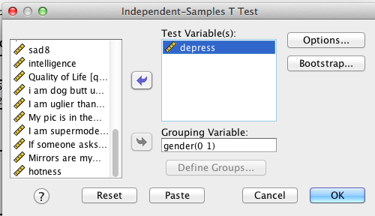
Independent samples t-test
This time, put in “depress” as the test variable; keep gender as the grouping variable.

Slide 8
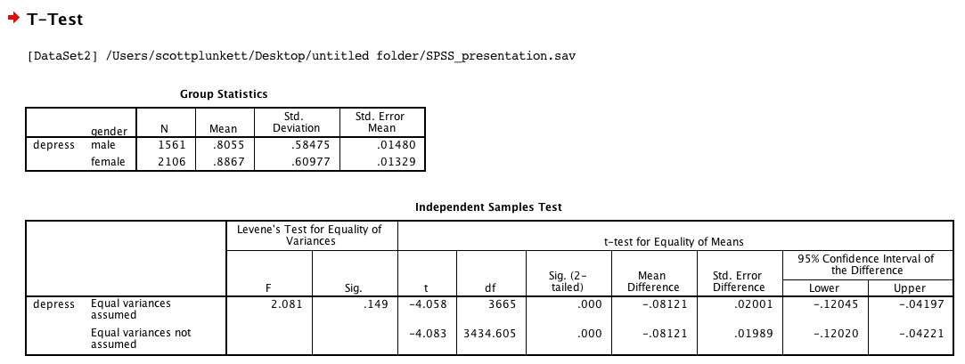
Independent samples t-test
If the Levene’s test is not significant (such as this example), then interpret the top t value..
Independent samples t-test indicated women (M = 0.89, SD = 0.61) reported significantly higher depressive symptoms than men (M = 0.81, SD = 0.58), t(3665) = -4.06, p < .001, d = 14.
Note: When “p < .001,” it is okay to say “p < .001” instead of the actual p value (as recommended by APA). If it was greater than .001, then I would have reported the actual p value (e.g., p < .002 or p < .013)

