Slide 1
SPSS
Statistical Package for Social Sciences
Computing Variables in SPSS
Department of Psychology
California State University Northridge
www.csun.edu/plunk

Slide 2
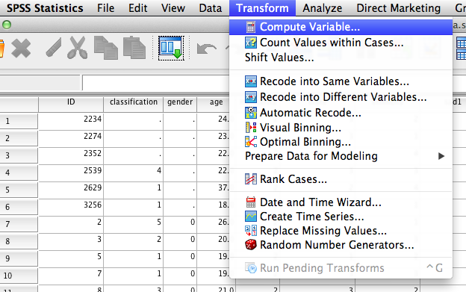
Computing Variables in SPSS
There are many reasons a research may want to compute a variable.
A common reason is to create a scale score based on scores from individual items.

Slide 3
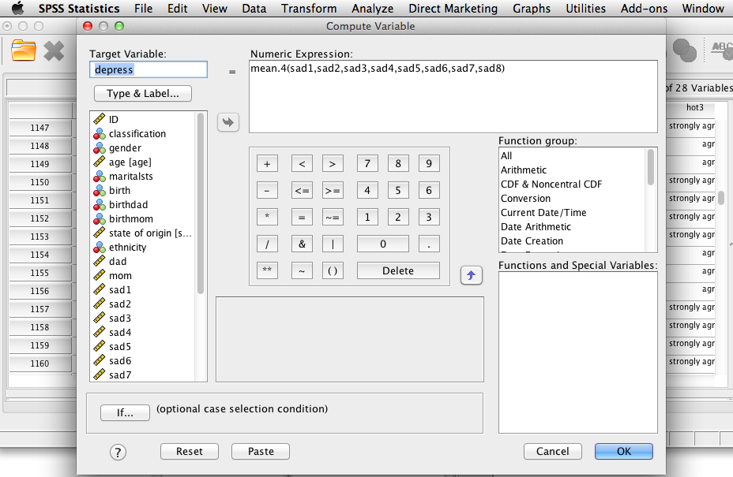
Computing Variables in SPSS
The researcher is computing a depression score by averaging 8 items in the depression scale (sad1…sad8).
  Note: “mean.4” indicates the items will be averaged as long as at least 4 items are answered. “Mean.6” would indicate 6 items need to have values before the scale is computed, and so on.

Slide 4
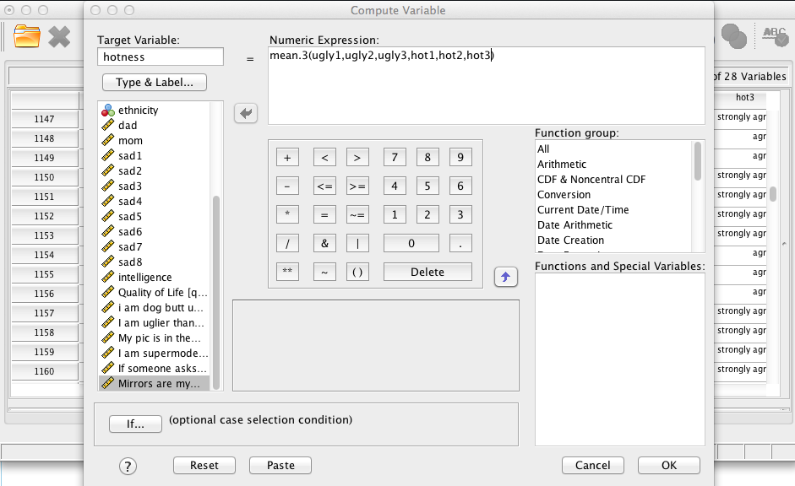
Computing Variables in SPSS
The researcher is computing a hotness score by averaging 6 items (3 reversed coded “ugly” items, and 3 “hotness” items).
  Note: To add the items, substitute “sum” in place of “mean”

Slide 5
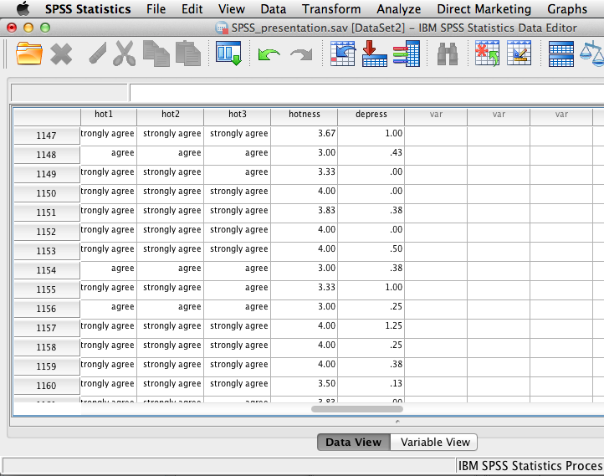
Computing Variables in SPSS
When computing a new variable, it puts the scores at the end of the SPSS data file.

