Slide 1
SPSS
Statistical Package for Social Sciences
Bivariate Correlations
Department of Psychology
California State University Northridge
www.csun.edu/plunk

Slide 2
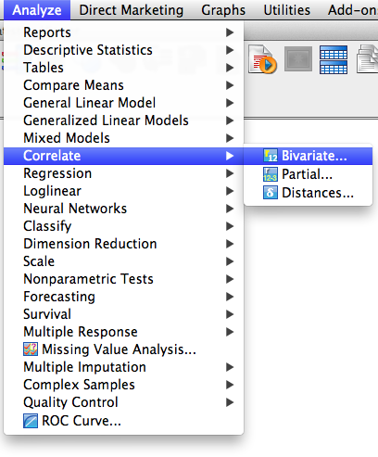
Bivariate Correlations
Bivariate correlations examines the strength and direction of the relationship between two variables.
They are also called zero-order correlations.
Go to “Analyze”,
then “Correlate”, and then
“Bivariate”

Slide 3
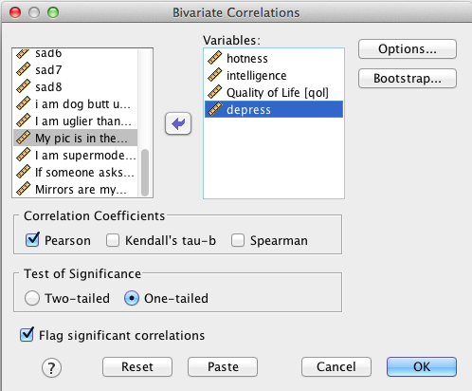
Bivariate Correlations
Move over the following variables
Click “One-tailed” (when you are hypothesizing a relationship between variables) and “Two-tailed” when you not hypothesized a
specific relationship
between the variables.
If you want the means
and standard deviations,
then click on “Options.”
Click “OK”

Slide 4
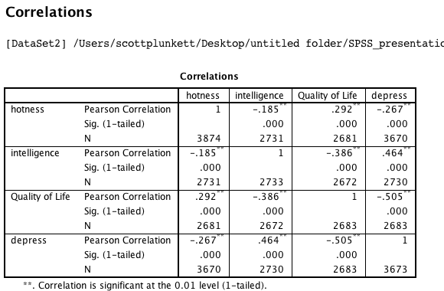
Bivariate Correlations
Hotness was significantly and negatively related to intelligence, r(2731) = -.19, p < .001, and depressive symptoms r(3670) = -.27, p < .001. Hotness was significantly and positively related to quality of life, r(2681) = .29, p < .001.

