Slide 1
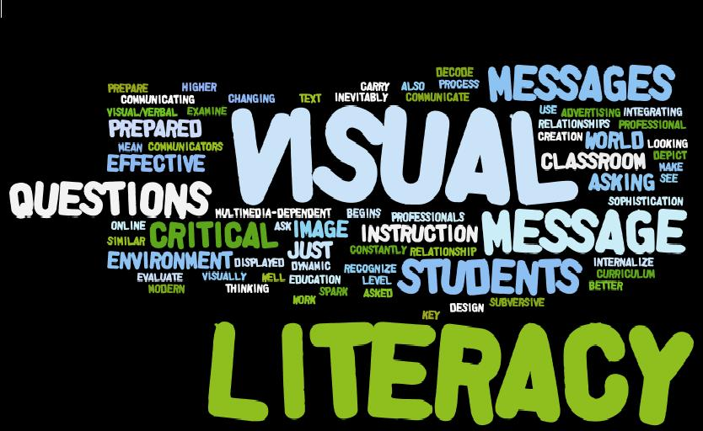
Visual Rhetoric

Slide 2
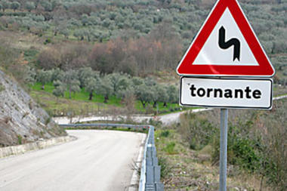
What is an Image Text?

Slide 3

Images as Symbols
Like written words, images are symbols that represent an object, action, idea, or concept.

Slide 4

De-coding Images
Because image texts are not always an explicit photographic representation of something, we must learn to “read” them, the same way we learn to read a written text. This is often called “de-coding.”

Slide 5
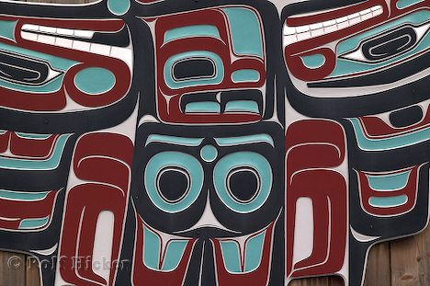
Images as Language
And, just like word-only texts, images exist as a kind of “language,” which often must be learned within the context of a certain culture.

Slide 6
Definition of Visual Literacy
The ability to interpret, evaluate, and make meaning from information presented in the form of an image.
The ability to communicate by the use of images within a textual form.

Slide 7

Images in Context
What are all the things
you’d have to know to
“de-code” the “language”
in this image?

Slide 8
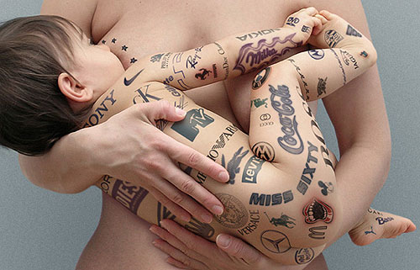
How could this image be interpreted?

Slide 9
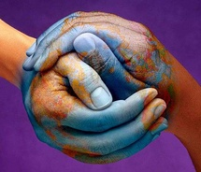
What does this image seem to say?

Slide 10
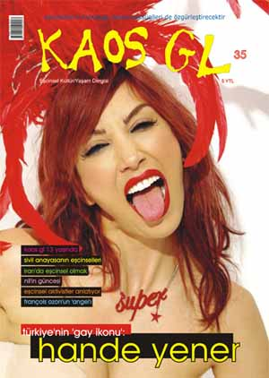
What cultural context do you think this image belongs to?

Slide 11
Why are Images so Powerful?
Images are evocative – they elicit strong emotions
Images are processed cognitively more quickly than written text
Images are open to interpretation
They can appeal to many different viewers
They can be used in many contexts

Slide 12
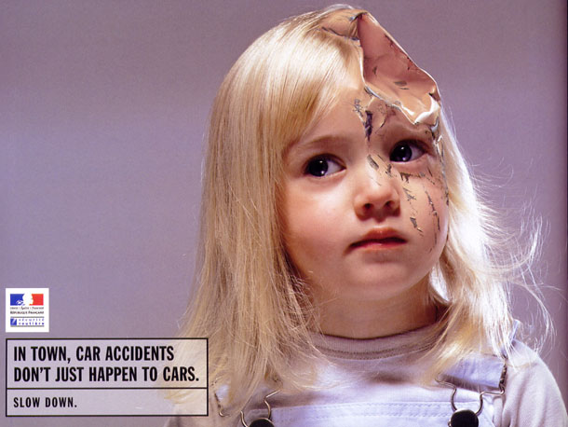
What makes this image evocative?

Slide 13

What are some of the ways this image could be interpreted?

Slide 14

What are some of the contexts in which this image could be used?

