Slide 1
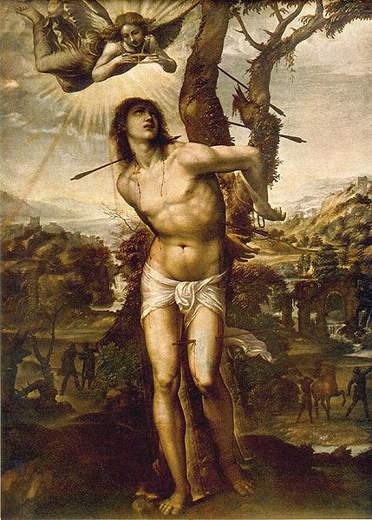
hurts so good
Notes:
Messed with

Slide 2
François Jacob writes that the pleasure center has been located, somewhere in the brain or in the spinal cord. A miracle: it is immediately juxtaposed with the center of displeasure….What marvelous naïveté. And where would one locate masochism, in pleasure or displeasure?
⎯Jean Baudrillard

Slide 3
hurts so good
François Jacob writes that the pleasure center has been located, somewhere in the brain or in the spinal cord.
A miracle: it is immediately juxtaposed with the center of displeasure….What marvelous naïveté. And where would one locate masochism, in pleasure or displeasure?
⎯Jean Baudrillard

Slide 4
François Jacob writes that the pleasure center has been located, somewhere in the brain or in the spinal cord.
A miracle: it is immediately juxtaposed with the center of displeasure….What marvelous naïveté. And where would one locate masochism, in pleasure or displeasure?
⎯Jean Baudrillard

Slide 5
Freud
He who experiences pleasure by causing pain to others in sexual relations is also capable of experiencing pain in sexual relations as pleasure.

Slide 6
Seligman
Cases of masochism do indeed exemplify pleasant pains.
Masochism: Pleasure, particularly sexual pleasure in suffering physical pain.

Slide 7
Townsend
Everything within an SM exchange is done with the intent of producing physical or emotional pleasure.

Slide 8
Mains
To leathermen pain is no second-rate substitute; pain is enjoyable because it is pleasure.

Slide 9
Approach

Slide 10
Terms and Concepts

Slide 11
Scene: An interaction involving the causation of masochistic pain.
Top: The person providing the pain
Bottom: The person receiving the pain

Slide 12
Masochistic pains
The sought after pains that occur in sexual or quasi-sexual contexts.
Masochists
Those who seek to experience masochistic pains.

Slide 13
What Pains Are

Slide 14
Stories Set Boundaries

Slide 15
Rough sufficient condition
If mental state x affects the value of a pain per se, then x is part of that pain.

Slide 16
Story principle
If the presence, absence, or change in mental state x figures in a good story of the pain’s valence or degree of value, then x is part of that pain.

Slide 17
Authority

Slide 18
Authority principle
If the sufferer of pain x says that x has value_{n}, then x has value_{n}.

Slide 19
Scarry
For the person in pain, so incontestably and unnegotiably present it is that ‘having pain’ may come to be thought of as the most vibrant example of what it is to ‘have certainty,’ while for the other person it is so elusive that ‘hearing about pain’ may exist as the primary model of what it is ‘to have doubt.’

Slide 20
Virginia Woolf
The merest schoolgirl when she falls in love has Shakespeare or Keats to speak her mind for her, but let a suffer try to describe a pain in his head to a doctor and language at once runs dry.

Slide 21
Sources

Slide 22
Romanticizing Pain

Slide 23
Summary
We need a way of identifying what makes up a pain.
The answer: If there’s a good story about how something affects a pain’s value per se, then that thing is part of the pain.
We start looking for such stories from certainty about the pain’s value.

Slide 24
Algolagnic pains
Pains that are good per se partly in virtue of their connection to pleasures.

Slide 26
Economic masochism
A person is willing to endure the pain in order to get the much greater pleasure afterwards.

Slide 27
The pain-pleasure barrier could be thought of as that maximum level in intensity of a stimulus that still remains pleasurable. Towards and at the barrier…small twinges of pain are far outweighed by the pleasure. On passing through the barrier pain overrides the pleasure.
Notes:
[Mains 58]

Slide 28
In SM, we also seek pain/pleasure settings precisely because they give us intense rewards. The kiss of the whip stings but gives such a delicious glow to the back. It exhilarates yet calms us.

Slide 29
Pain as contrast
Pain… functions in contrast to other sensations the top applies during the scene. A prolonged bout of pain can make subsequent pleasure…that much more intense.
Even the absence of stimulation can be pleasurable when the pain fades.

Slide 30
Punishment

Slide 31
Could There Be Algolagnic Pains?

Slide 32
Freud
If the mental processes are governed by the pleasure principle in such a way that their first aim is the avoidance of unpleasure and the obtaining of pleasure, masochism is incomprehensible.

Slide 33
Evaluative use

Slide 34
Taxonomic use

Slide 35
First interpretation

Slide 36
Second interpretation

Slide 37
Third interpretation

Slide 38
Algolagnic pain
x is an algolagnic pain only if x is good and some pleasure-related mental state y figures in x’s story.

Slide 39
Three Structures

Slide 40
Shared Root Cases

Slide 41
Concomitant cases

Slide 42
Fusion cases

Slide 43
Shared Root Cases

Slide 44
Given involuntarily, and in an atmosphere of distrust, pain is torture, whatever the motive….But given consensually, between equals, pain can be a most incredible form of love….If we were tied down against our wills by some asshole we didn’t trust… that whip would feel very unpleasant.

Slide 45
Concomitant cases

Slide 46
Concomitant case example
The context in which a pain is applied has a lot to do with how it’s felt. [If] I slap you suddenly when I meet you in the street, as a stranger… you probably won’t like it. But [if] I start slapping your ass when you’re sexually worked up…you might really get off on it.
Notes:
Con

Slide 47
Fusion cases

Slide 48
Ecstasy
1. The state of being ‘beside oneself’, thrown into a frenzy or a stupor, with anxiety, astonishment, fear, or passion.
4. An exalted state of feeling which engrosses the mind to the exclusion of thought; rapture, transport…the expressions ecstasy of woe, sorrow, despair, etc., still occur

Slide 49
Agony
1.b. Intensity or paroxysm of pleasure.
4.a. Extreme bodily suffering, such as to produce writhing or throes of the body.

Slide 50
Ecstasy and Fusion
I'd always thought that ecstasy was just extreme pleasure, but it's pain too. I remember during one scene, after a really heavy work-out, floating off in ecstasy while getting flicked and drifting back to reality while laughing at the irreconcilability of it all. Of the freedom to get such pleasure from punishments that once had hurt me.

Slide 51
Ecstasy and Fusion
There comes a point…when anything goes. Pain of any form becomes sheer ecstasy. Needles through the flesh. Hot candle wax dribbled over alligator clips. The most extraordinary pressure on muscles or connective tissue. The frontier between pain and pleasure has been crossed.

Slide 52
Shared Root cases
There is some non-affective mental state x which causes or explains the presence and/or value of the pleasure, and x is part of the pain’s story.

Slide 53
Fusion cases
There is some mental state x such that x is part of pleasure p and x is part of pain q, and p and q occur at the same time.

Slide 54
Sam whimpers some, but it is as much contentment as pain. Moments of resistance, the tautness of muscles; these soon give way. The intensity continues to rise….Against the raw bark of the whip, Sam now screams out his pain….[His] mind is beyond hiding the pain. It lives and it is ineffable; each scream helps to relieve it. If there is any moment of doubt in a scene, of wanting to turn back, it is now, just when the reality of the pain has emerged, and grins, but has not yet blossomed into ecstasy. One wants to go on, but the urge to retreat is great….[Soon] Sam no longer screams to relieve the pain: he has crossed that barrier that separates fantasy and reality. Each stroke of the whip no longer sears but bursts into waves of ecstasy to which he can only abandon himself: And as his mind rolls outwards into those wonderful vaulted heavens, his body moves to receive and caress each stroke as it comes down. “Oh please Sir” he whimpers. “Oh thank you Sir.” Once again, God is speaking with Sam. In this bloody reward, David senses catharsis and a mind spun free. And once liberated, Sam is now free to reinhabit himself on his own terms….[47-8]

Slide 55
Concomitant cases
some attitudes and states which are often concomitants of pleasure ⎯for example, excitement, happiness, contentment⎯ are parts of the pain but are not parts of the pleasure itself. In these cases

