Slide 1
The sea-breeze circulation
Part II: Effect of Earth’s rotation
Reference: Rotunno (1983, J. Atmos. Sci.)

Slide 2
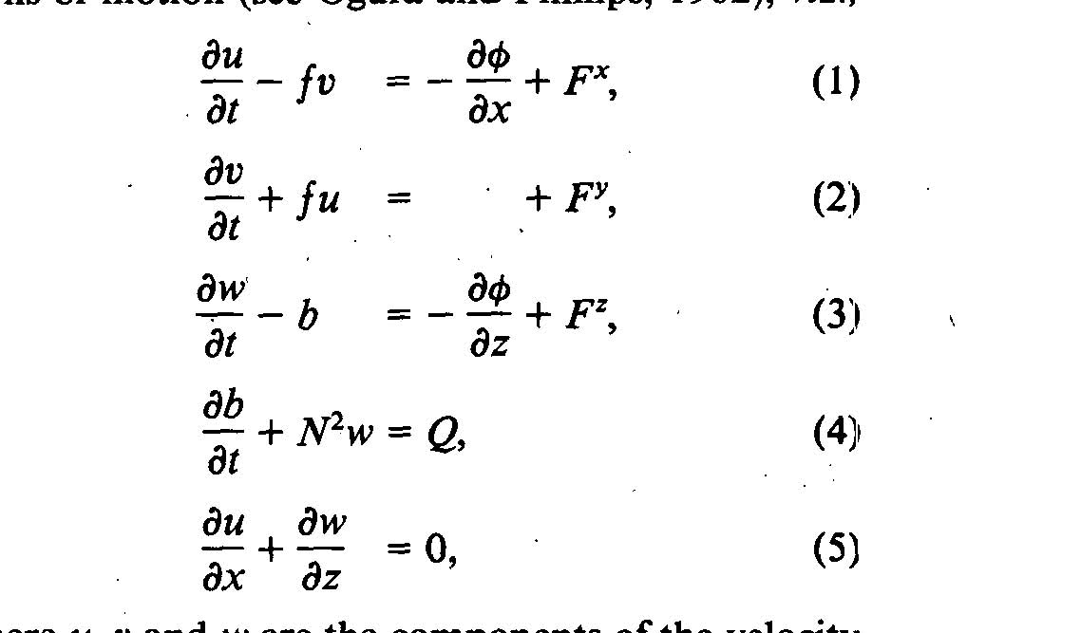

Slide 3
Rotunno (1983)
Quasi-2D analytic linear model
Heating function specified over land
  Becomes cooling function after sunset
Cross-shore flow u, along-shore v
Two crucial frequencies
  Heating Ω= ω = 2π/day (period 24h)
  Coriolis f=2 ω sin(λ) (inertial period 17h @ 45˚N)
One special latitude… where f = ω (30˚N)

Slide 4

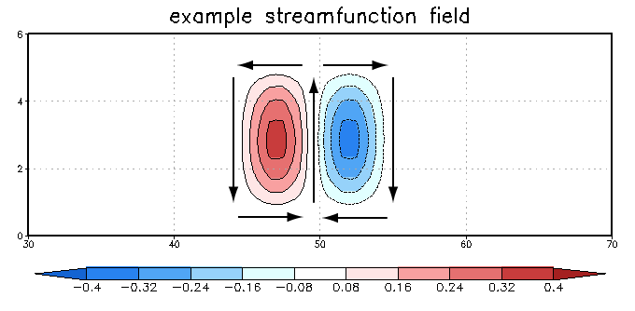
Streamfunction ψ

Slide 5

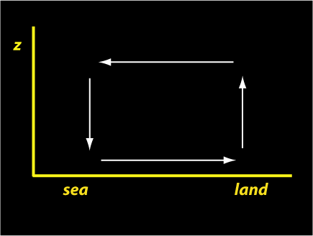


Circulation C
Integrate CCW as shown
Take w ~ 0; u_{top} ~ 0
Integrate from ±infinity,
from sfc to top of atmosphere

Slide 6

Rotunno chooses, w(x,0,t)=0, Fx=0, Fy=0, and defines
the heating function Q analytically. Its time dependence
is assumed to be the daily periodic signal
Q $≈ e^{iωt}$
The equations can be written in terms of ψ, following the following
steps:
- Take time derivative of Eq 1 and call the result Eq 6
- Use Eq. 2 to eliminate v from Eq 6, and call the result Eq 7
- Take the partial with respect to z of Eq 7 and call it Eq 8
- Take time derivative of Eq 3 and call the result Eq 9
- Use Eq. 4 to eliminate b from Eq 9, and call the result Eq 10
- Take the partial with respect to x of Eq 10 and call it Eq 11
- Take the difference between equations 8 and 11

Slide 7
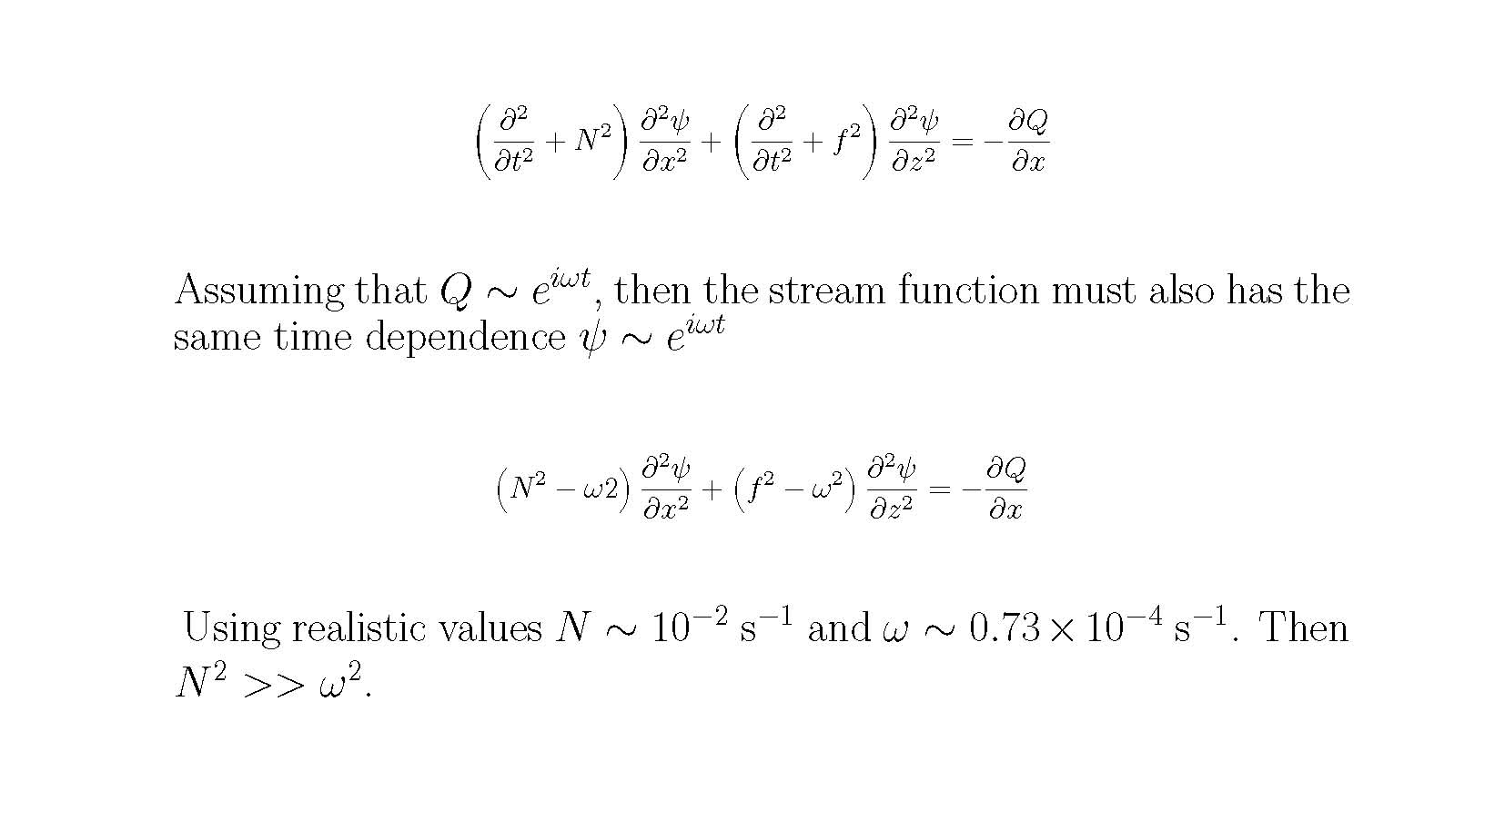
Rotunno’s Equations in terms of the Stream Function

Slide 8
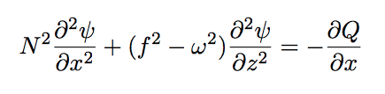
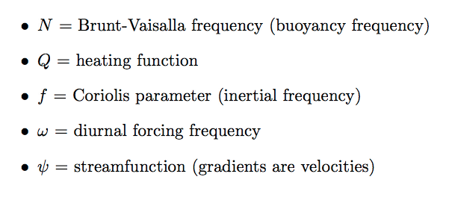
Rotunno’s analytic solution

Slide 9
Rotunno’s analytic solution
If f > ω (poleward of 30˚) equation is elliptic
• sea-breeze circulation spatially confined
• circulation in phase with heating
• circulation, onshore flow strongest at noon
• circulation amplitude decreases poleward
If f < ω (equatorward of 30˚) equation is hyperbolic
• sea-breeze circulation is extensive
• circulation, heating out of phase
• f = 0 onshore flow strongest at sunset
• f = 0 circulation strongest at midnight
Notes:
F < omega circ strongest at midnight but onshore flow strongest at SUNSET

Slide 10
Rotunno’s analytic solution
If f = ω (30˚N) equation is singular
• some friction or diffusion is needed
• circulation max at sunset
• onshore flow strongest at noon
Notes:
F < omega circ strongest at midnight but onshore flow strongest at SUNSET

Slide 11
Summary
Latitude | Onshore max | Circulation max
φ > 30˚ | Noon | Noon
φ = 30˚ | Noon | Sunset
φ = 0˚ | Sunset | Midnight

Slide 12
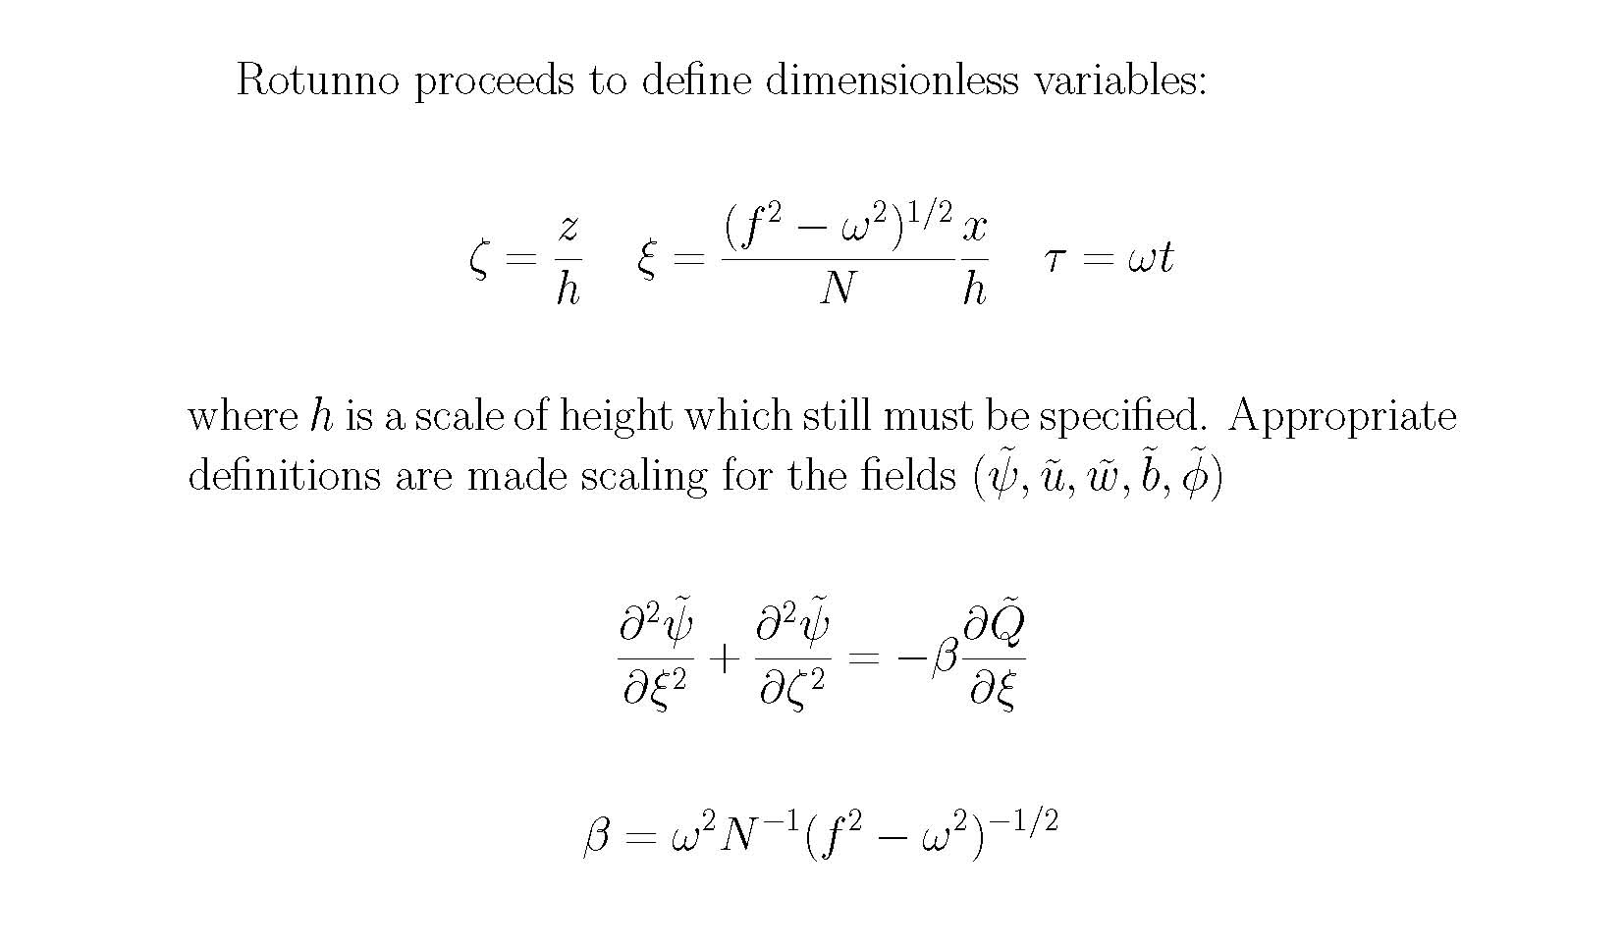
For the case f > ω (latitudes greater than 30 degrees)

Slide 13
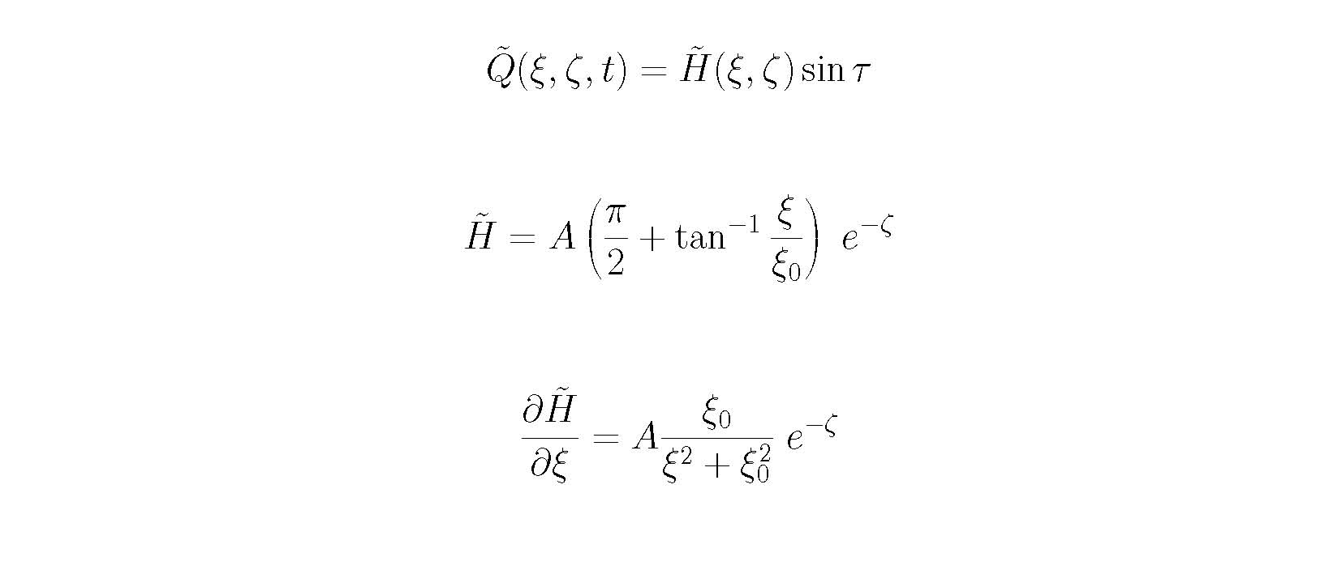

Slide 14
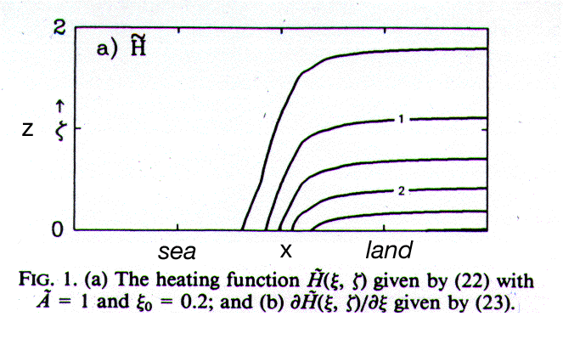
Heating function
Rotunno’s analytic model lacks diffusion
so horizontal, vertical spreading built into function

Slide 15
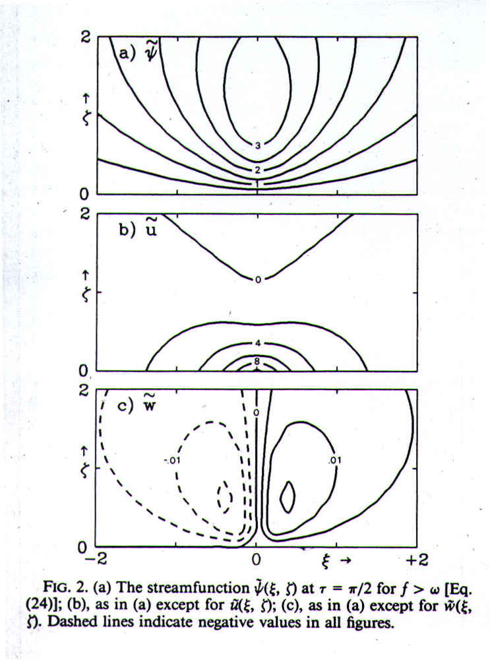
f > ω (poleward of 30˚) at noon
Note onshore flow
strongest at coastline
(x = 0);
this is day’s max
coast

Slide 16
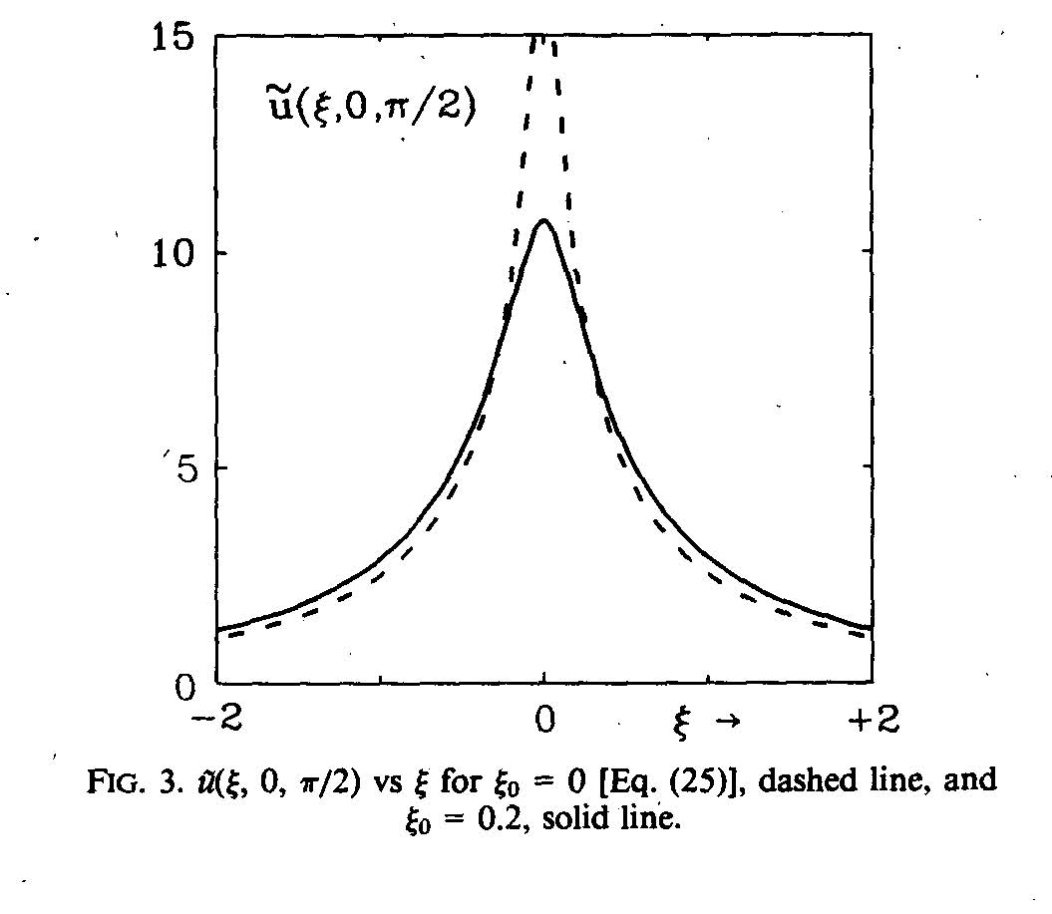

Slide 17
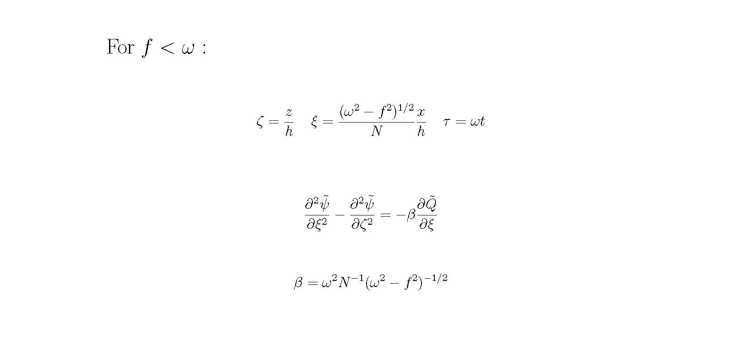

Slide 18
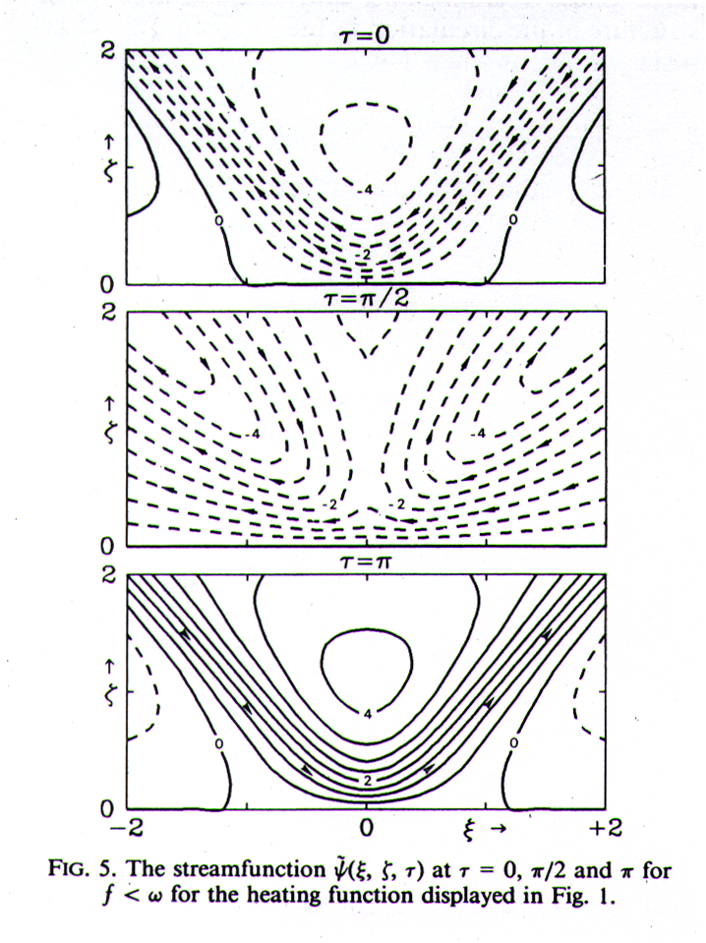
f < ω (equatorward of 30˚) ψ at three times
sunrise
noon (reverse sign for midnight)
sunset
Note coastline onshore flow
max at sunset

Slide 19
Paradox?
Max |C| noon & midnight
Why is onshore max wind at sunset and circulation max at midnight/noon?
  While wind speed at coast strongest at sunset/sunrise, wind integrated along surface larger at midnight/noon

Slide 20
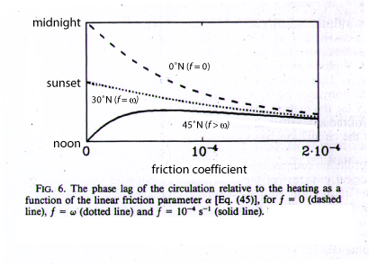
In order to treat the case f=ω (30 degrees) effects of linear friction are included (α is the linear friction parameter)
Fx= -α u Fy = -α v Fz =0 Q=H(x,z) sin(ωt) – α b
Time of circulation maximum
180 deg
midnight
90 deg
sunset
0 deg
noon
friction coefficient
As friction increases, tropical circulation max becomes earlier,
poleward circulation max becomes later
Notes:
As friction increases, the tropical seabreeze circ max becomes much earlier, the 30N circ becomes slightly earlier, the poleward circ becomes later

Slide 21
Dynamics and Thermodynamics Demonstration Model (DTDM):
The DTDM is a simple, two-dimensional, script-driven package that can be used to demonstrate concepts relating to:
gravity waves produced by heat and momentum sources
sea-breeze circulations generated by differential heating
lifting over cold pools
Kelvin-Helmholtz instability
The entire package, was written by Rob Fovell in Fortran 77 and produces GrADS output
DTDM has been tested on Linux, Mac OS X and other Unix or Unix-like systems, and MS Windows with the g77, g95, IBM (xlf), Portland Group (pgf77) and Intel (ifort) Fortran compilers.
http://www.atmos.ucla.edu/~fovell/DTDM/
The Grid Analysis and Display System (GrADS) is an interactive desktop tool that is used for easy access, manipulation, and visualization of earth science data.
http://grads.iges.org/grads/head.html

Slide 22
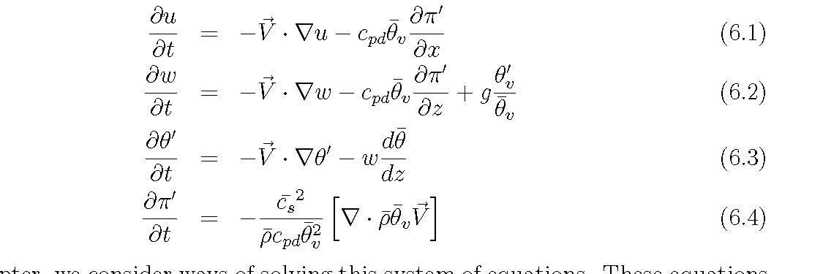
Before going into the details on how to run the program a few considerations
on the numerical scheme.
In Chapter 6 Fovell summarizes the equations in 2-dimensions without
Coriolis
NOTE: The final form of the equations going into DTDM, including diffusion
and moisture are in Fovell’s notes 8.13-8.19.
The Coriolis terms must still be added

Slide 23
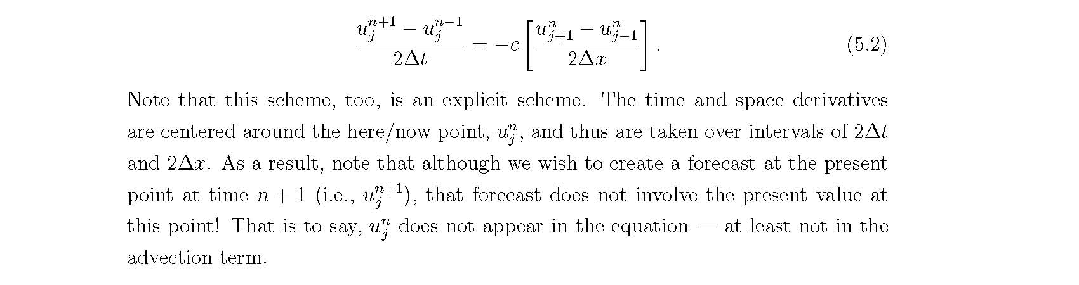

There are a variety of approaches to discretization each with different numerical
problems.
DTDM uses the leapfrog scheme in which space and time derivatives are replaced
with centered approximations.
For the heat equations (hyperbolic PDE)
$u_{t}$ + c $u_{x}$=0

Slide 24
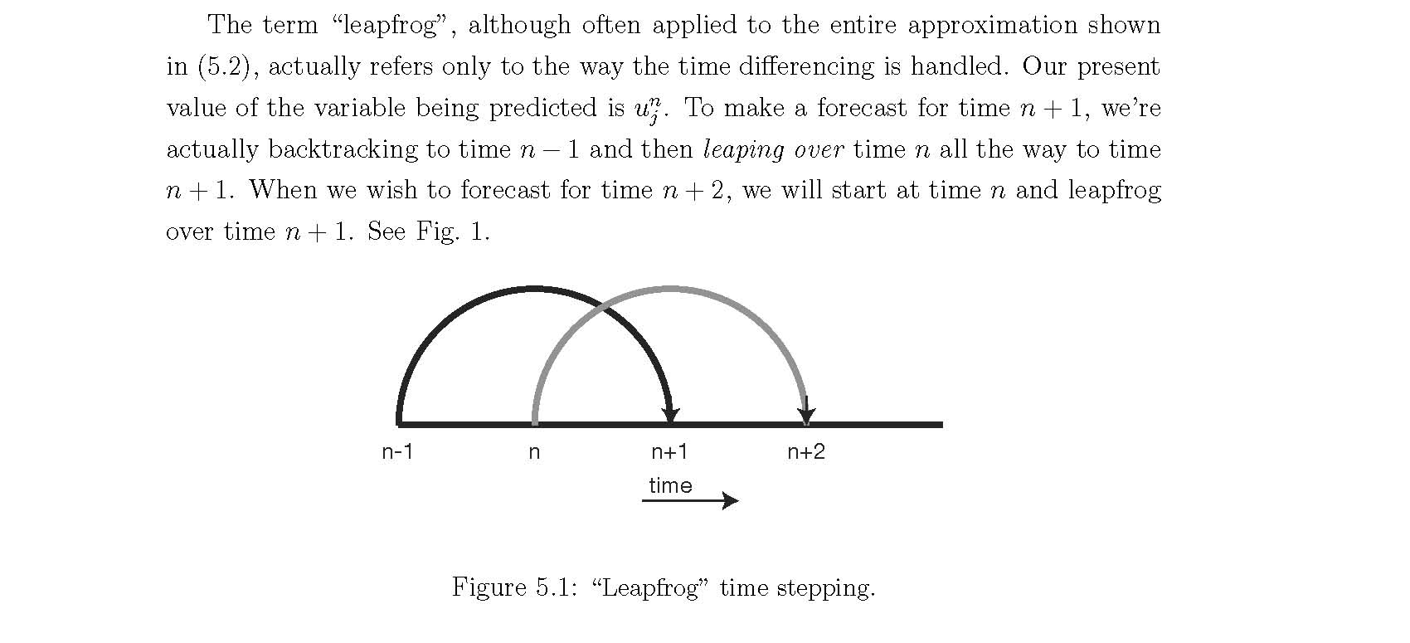

Slide 25
Sound Waves are always present but it can be shown that they imperil
the efficient solution of the equations.
The need to maintain stability places limits on how large we can choose
the model time step to be.
For the leapfrog scheme the time step (grid spacing/ speed) is limited by
the speed of the fastest moving signal in the model. So for cases with
sound speed of ~300 m/s, the great computational expense is caused
by the least important aspect of the physical model.

Slide 26
Techniques:
Adopt time splitting in which acoustically active and inactive parts are
Identified and are solved with different time steps.
Relatively economical but difficult to implement
2) Quasi-compressible approach. Artificially slow down the sound waves
by treating the sound speed as a free parameter and discounting it.
Efficient and easy to code but does violence to the model physics
3) Anaelastic Approximation. Consists on artificially speeding up the waves
all the way to infinity.
Eliminates the wave contribution and leads to a simple continuity equation
It is difficult to implement.

Slide 27
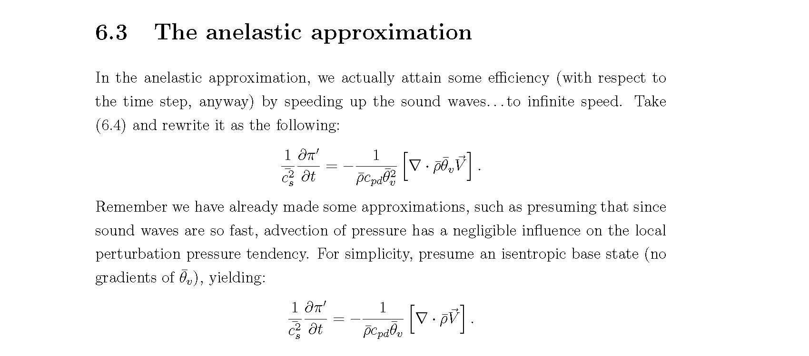

Slide 28
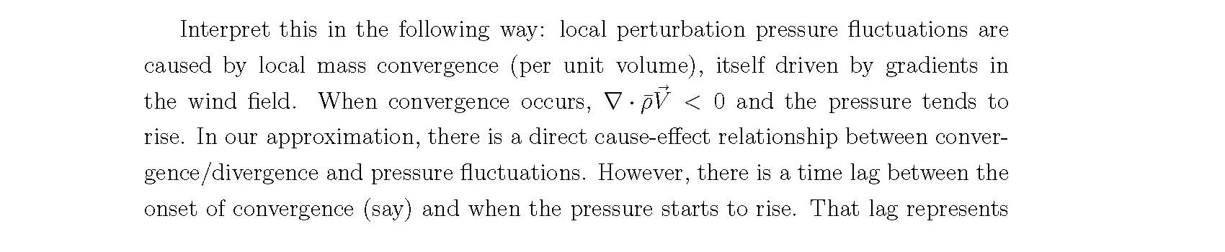
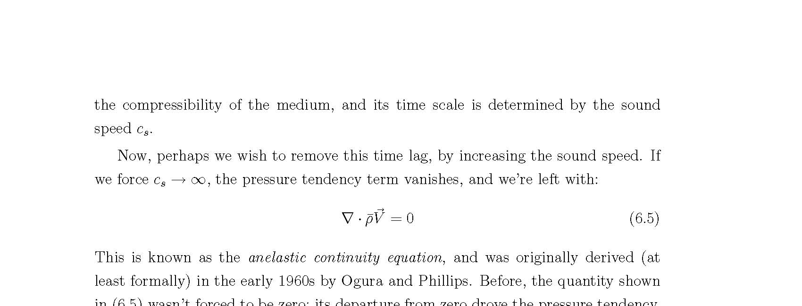

Slide 29
DTDM long-term sea-breeze strategy
Incorporate Rotunno’s heat source, mimicking effect of surface heating + vertical mixing
Make model linear
Dramatically reduce vertical diffusion
Simulations start at sunrise
One use: to investigate effect of latitude and/or linearity on onshore flow, timing and circulation strength

Slide 30
input_seabreeze.txt
&rotunno_seabreeze section
The choices for a particular run are determined in the input control files. Example:
c===================================================================
c
c The rotunno_seabreeze namelist implements a lower tropospheric
c heat source following Rotunno (1983), useful for long-term
c integrations of the sea-land-breeze circulation
c
c iseabreeze (1 = turn Rotunno heat source on; default is 0)
c sb_ampl - amplitude of heat source (K/s; default = 0.000175)
c sb_x0 - controls heat source shape at coastline (m; default = 1000.)
c sb_z0 - controls heat source shape at coastline (m; default = 1000.)
c sb_period - period of heating, in days (default = 1.0)
c sb_latitude - latitude for experiment (degrees; default = 60.)
c sb_linear (1 = linearize model; default = 1)
c
c===================================================================
Notes:
* Integration can be lengthy

Slide 31
input_seabreeze.txt
&rotunno_seabreeze section
&rotunno_seabreeze
iseabreeze = 1,
sb_ampl = 0.000175,
sb_x0 = 1000.,
sb_z0 = 1000.,
sb_period = 1.0,
sb_latitude = 30.,
sb_linear = 1,
$
sb_latitude ≠ 0 activates Coriolis
sb_linear = 1 linearizes the model
Other settings include:
timend = 86400 sec
dx = 2000 m, dz = 250 m, dt = 1 sec
dkx = dkz = 5 m²/s (since linear)
Notes:
* Integration can be lengthy

Slide 32
input_seabreeze.txt
&rotunno_seabreeze section
&rotunno_seabreeze
iseabreeze = 1,
sb_ampl = 0.000175,
sb_x0 = 1000.,
sb_z0 = 1000.,
sb_period = 1.0,
sb_latitude = 30.,
sb_linear = 1,
$
sb_latitude ≠ 0 activates Coriolis
sb_linear = 1 linearizes the model
Other settings include:
timend = 86400 sec
dx = 2000 m, dz = 250 m, dt = 1 sec
dkx = dkz = 5 m²/s (since linear)
Notes:
* Integration can be lengthy

Slide 33
Caution
Don’t make model anelastic for now
  Make sure ianelastic = 0 and ipressure = 0
  Didn’t finish the code for anelastic linear model
  iseabreeze = 1 should be used alone (I.e., no thermal, surface flux, etc., activated)

Slide 34
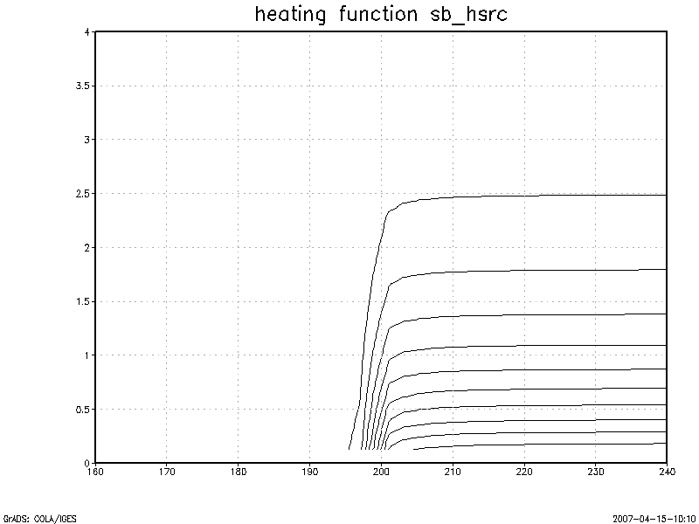
Heat source sb_hsrc
set mproj off
set lev 0 4
set lon 160 240 [or set x 80 120]
d sb_hsrc

Slide 35
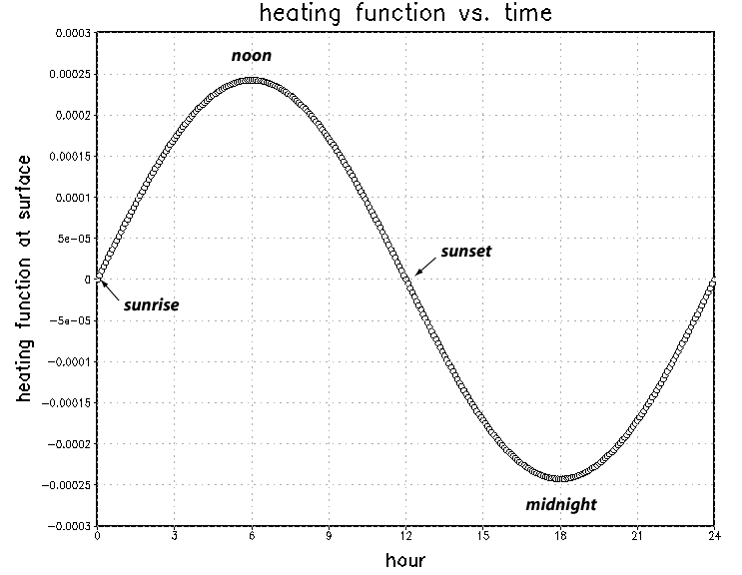
Heating function vs. time
Notes:
Model starts at sunrise - 12 hour day

