Slide 1
The sea/land-breeze circulation
Part I: Development w/o Earth rotation

Slide 2
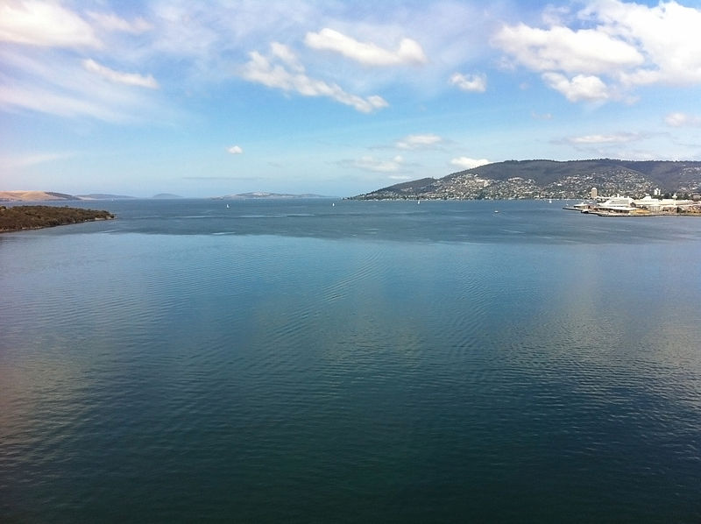
A sea-breeze (or onshore breeze) is a wind from the sea that develops over land
near coasts.
It is formed by increasing temperature differences between the land and water;
these create a pressure minimum over the land due to its relative warmth,
and forces higher pressure, cooler air from the sea to move inland.

Slide 3
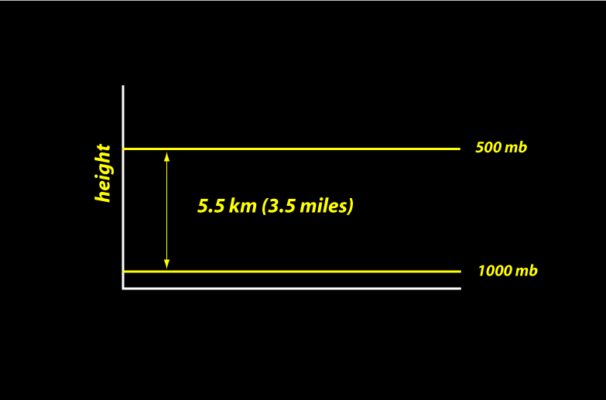
Pressure
Same mass of water would only
be 18.5 feet deep

Slide 4
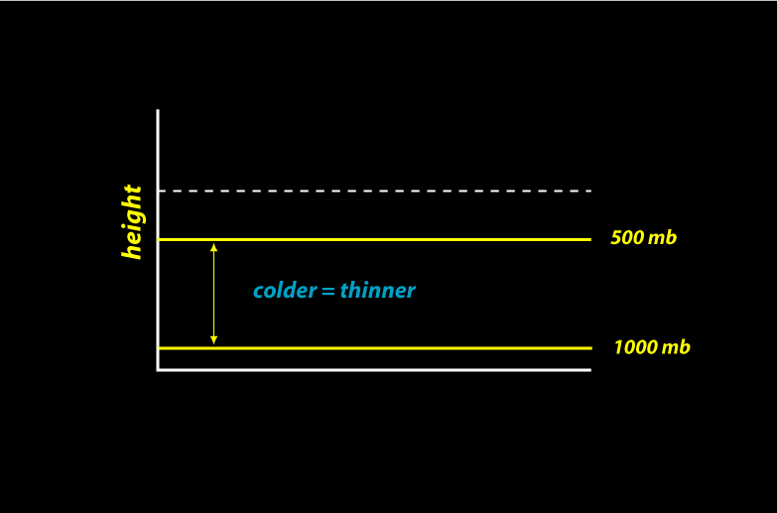
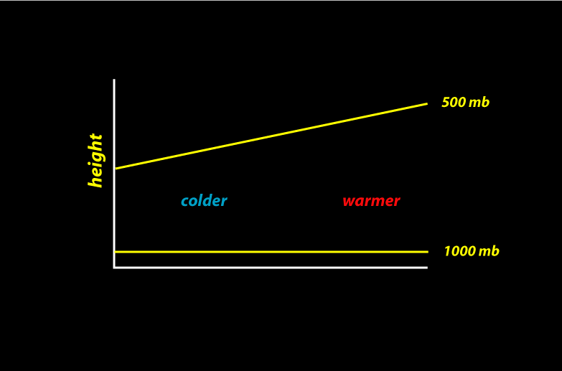
Temperature affects thickness

Slide 5
Temperature differences make pressure differences

Slide 6
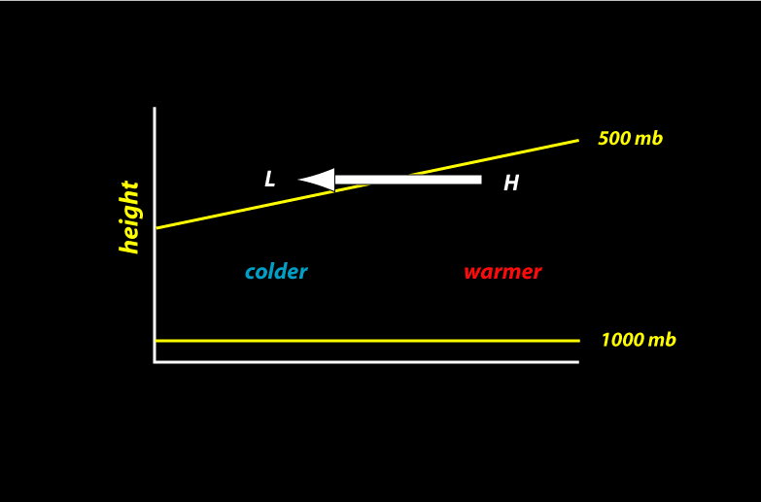
Pressure differences make winds

Slide 7
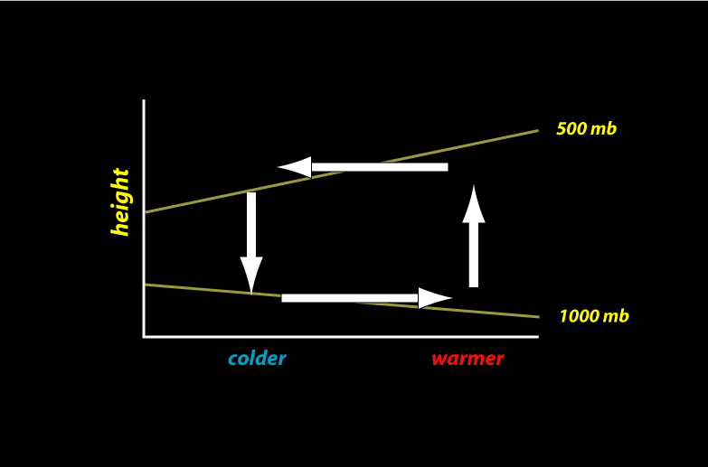
Pressure differences make winds
Sea-breeze is not this deep…

Slide 8
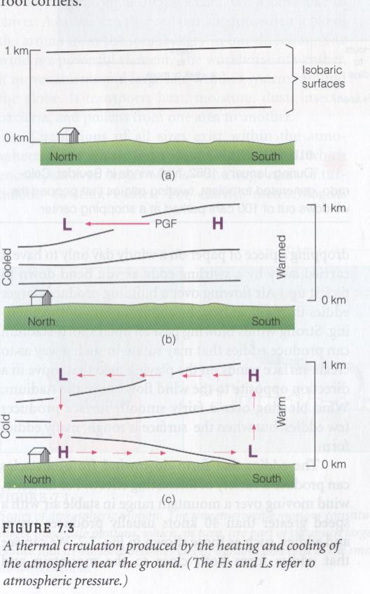

Slide 9
Land breeze: At night, the land cools off faster than the ocean due to differences
in their heat capacity, which forces the daytime sea breeze to dye.
If the land cools below that of the adjacent sea surface temperature, the pressure
over the water will be lower than that of the land, setting up a land breeze as
long as the environmental surface wind pattern is not strong enough to oppose it.
Movie
http://www.classzone.com/books/earth_science/terc/content/visualizations/es1903/es1903page01.cfm

Slide 10
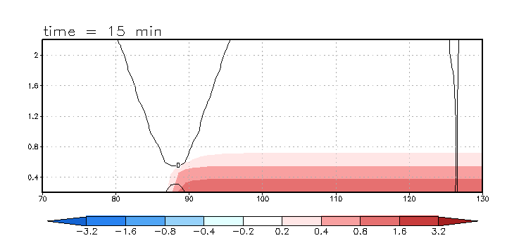
Simulation using the Dynamics and Thermodynamics Demonstration Model (dtdm) code:
Perturbation potential temperature (colored); cross-shore horizontal velocity (contour)
coastline

Slide 11
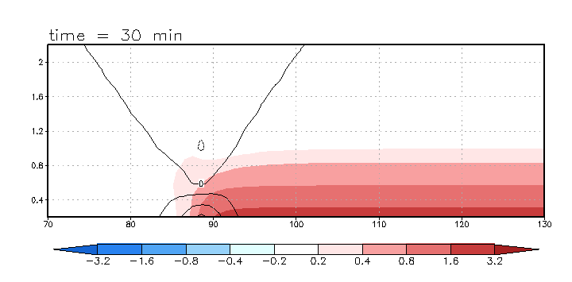
The horizontal wind is not blowing first…

Slide 12
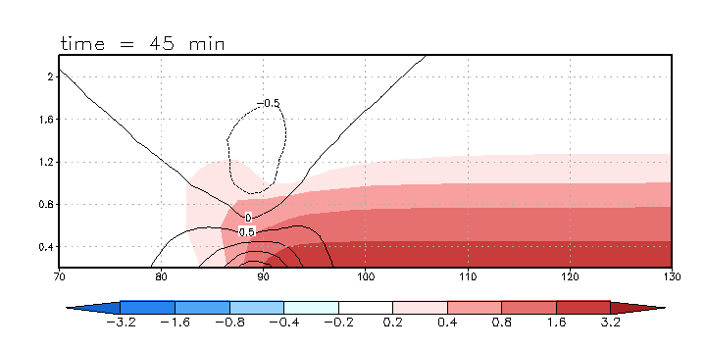

Slide 13
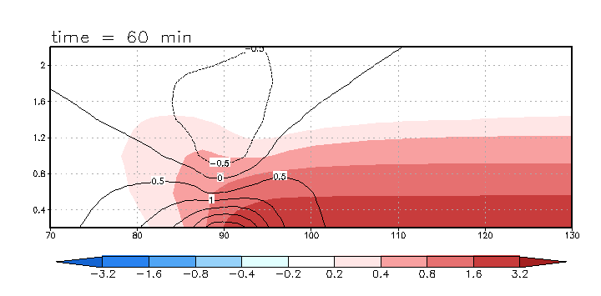

Slide 14
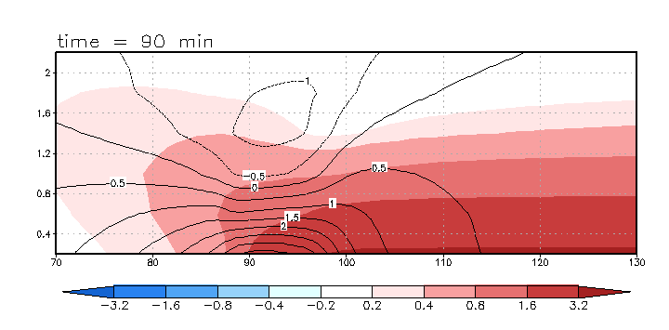

Slide 15
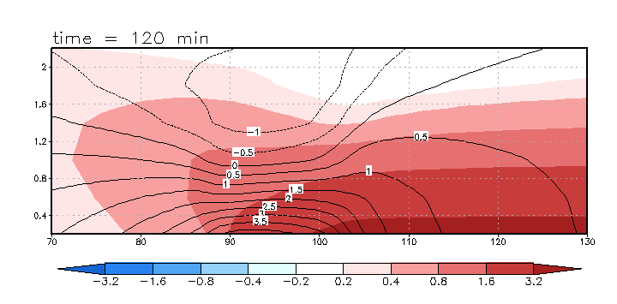
Onshore flow always stronger;
Vertical scale grows with mixed layer

Slide 16
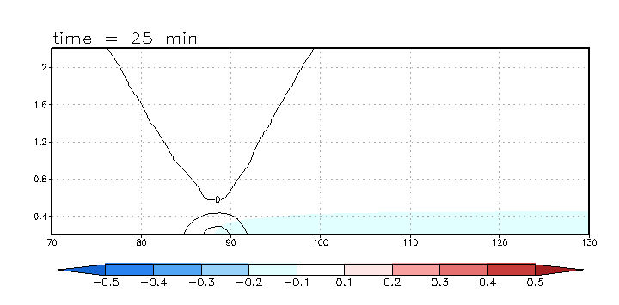
Perturbation pressure (colored); cross-shore horizontal velocity (contour)

Slide 17
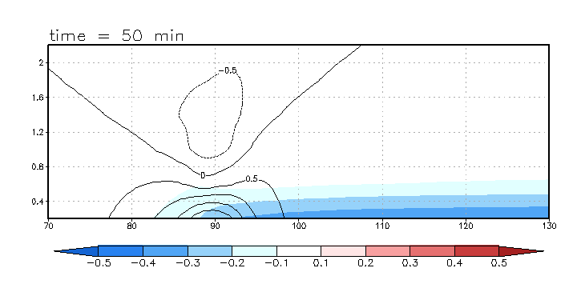

Slide 18
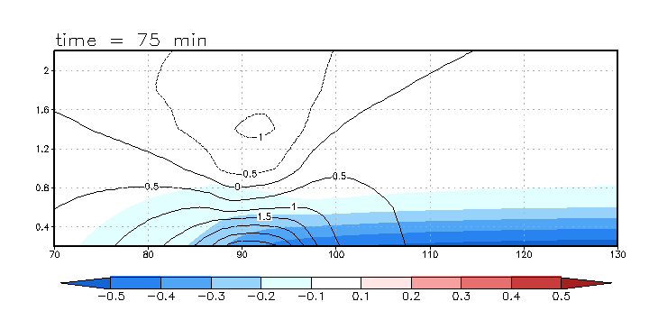

Slide 19
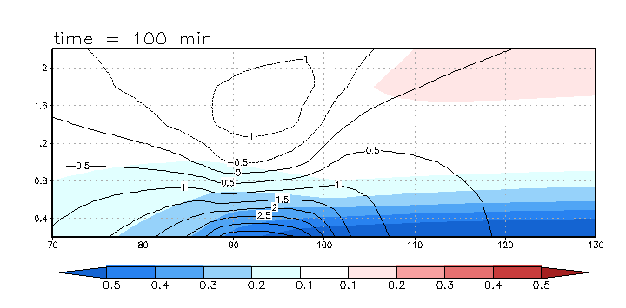

Slide 20
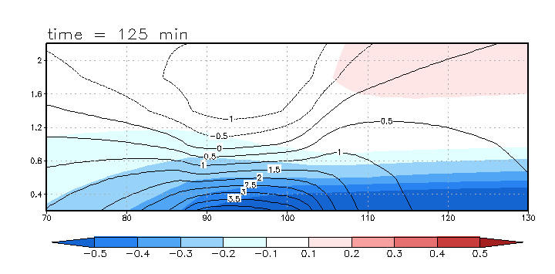

Slide 21
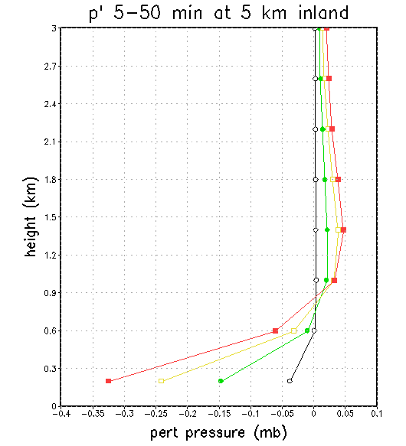
Pressure perturbation 5 km inland
H
t=50 min
L
t=5 min
L at surface; local H above,
decreasing farther aloft

Slide 22


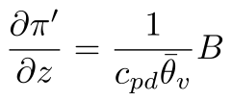

Analysis
where
At the rigid surface dw/dt = 0, therefore
B > 0 for the heated surface, therefore perturbation pressure increases with height

Slide 23
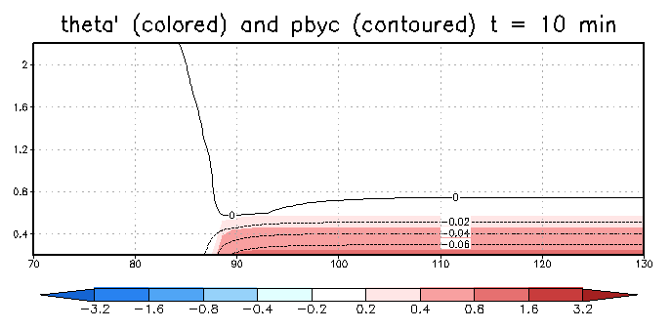
Analysis, continued
Why low perturbation pressure at surface?
-- Far above heated surface, atmosphere
undisturbed, thus π’ ~ 0 there
-- If π’ increases with height and approaches zero, surface π’ must be negative

