Slide 1
Rayleigh Bernard Convection and the Lorenz System
During the last century there were three revolutions in Physics:
General Relativity, Quantum Mechanics and Chaos.
Low dimensional chaos applications range from atmospheric physics, to astronomy,
engineering, biology, medicine, economy and the social sciences.
Saltzman (1962, Journal of the Atmospheric Sciences, 19, 329)
Model describing idealized thermal convection in the Earth’s atmosphere
Edward Lorenz (1963, Journal of the Atmospheric Sciences 20, 130)
Set of simple nonlinear ordinary differential equations from the Saltzman (1962) model
Studies weather prediction

Slide 2
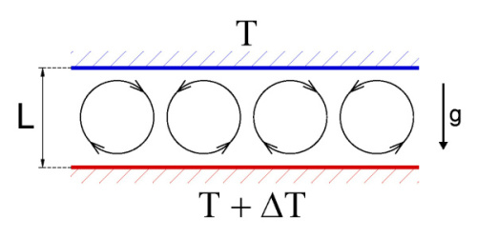
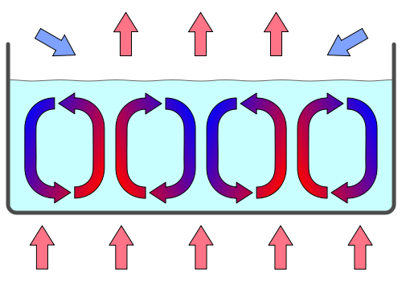
Warm low density fluid rises
Cool high density fluid sinks
Fluid cools by loosing heat from the surface
h
a

Slide 3
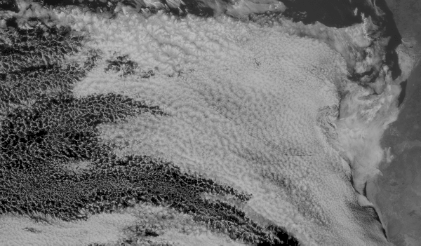
Bénard Cells as seen by Meteosat-7 off the West Coast of Africa

Slide 4

Experiment - Cells-rolls in Rayleigh-Bénard convection

Slide 5
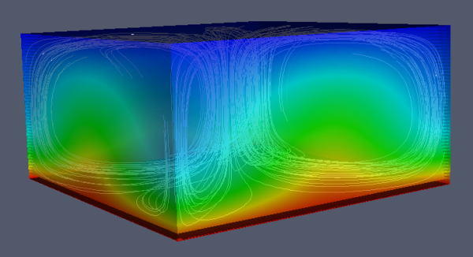
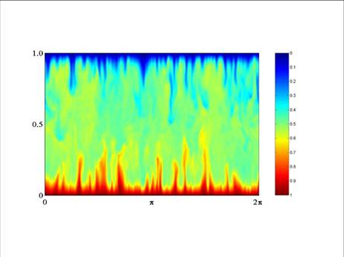
Simulation

Slide 6
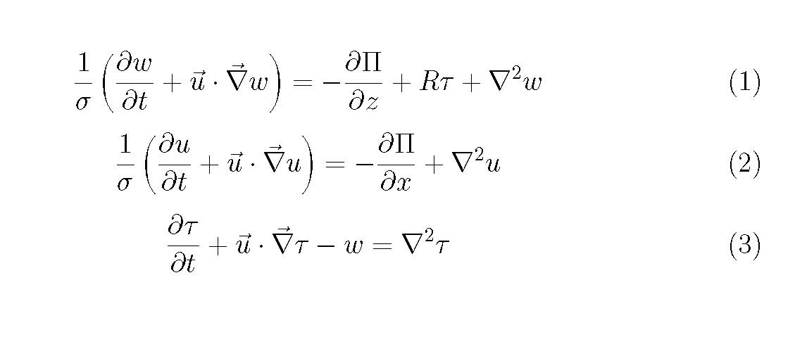
Equations for Rayleigh Bernard convection after:
Boussinesque approximation (ρ = constant except in gravity term)
Writing in terms of dimensionless variables
Π is the dimensionless pressure
τ is the deviation of the temperature from linear behavior

Slide 7
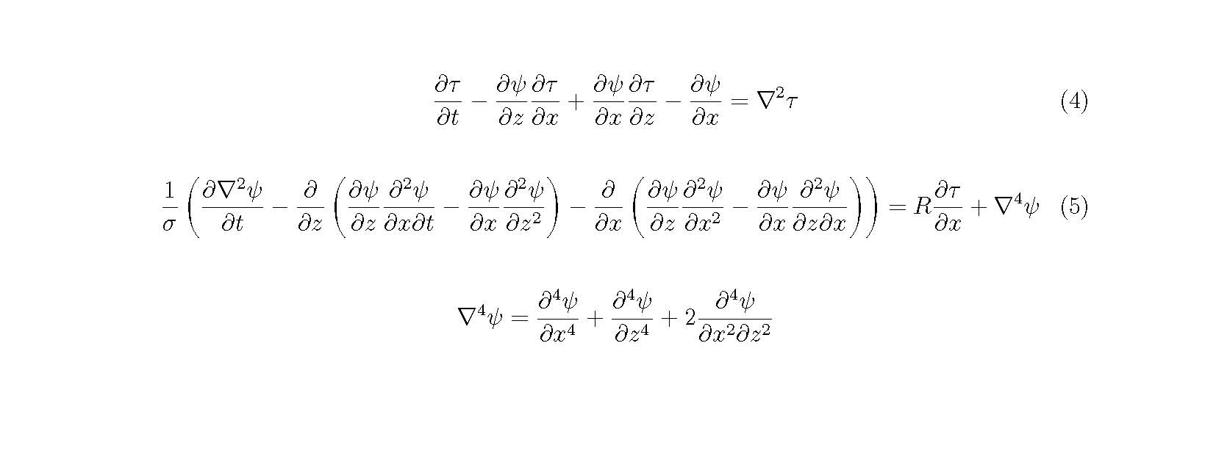
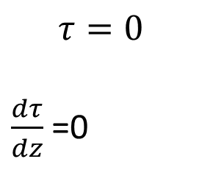
After introducing the stream function ψ and combining equations (1) and (2) the pressure term is eliminated
$$τ=0$$
$\frac{dτ}{dz}$ =0
z=0 z=h
Ψ=0 at the boundary
x=0 and x=a/h

Slide 8
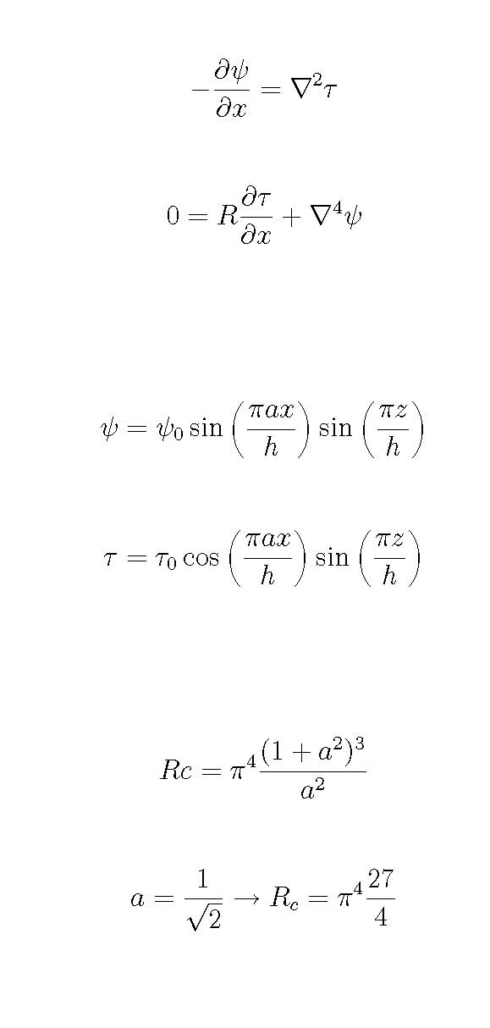
Equations (4) and (5) without time dependence
and non-linear terms
Rayleigh conjectures a steady solution with this
form where
h is the height difference between the plates
a is the horizontal width of the convections rolls
The steady solutions satisfy the equations if the
Rayleigh number has a critical vale

Slide 9
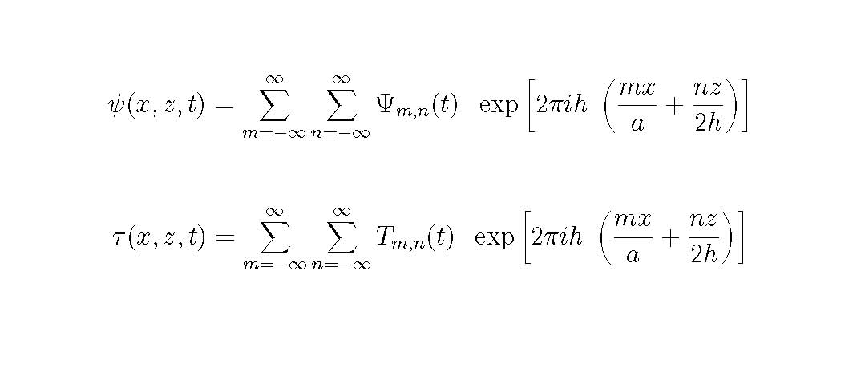
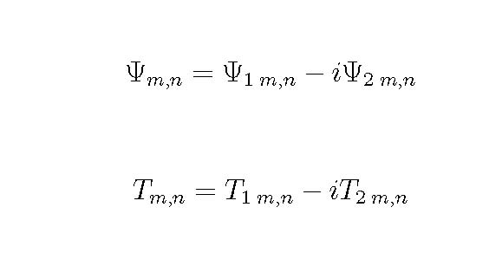
Salzman (1962) assumes a Lorenz transform to solve Equations 4 and 5.
The time dependent coefficients Ψ and T are complex quantities

Slide 10
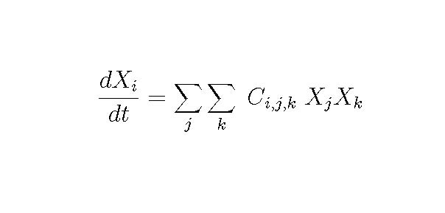
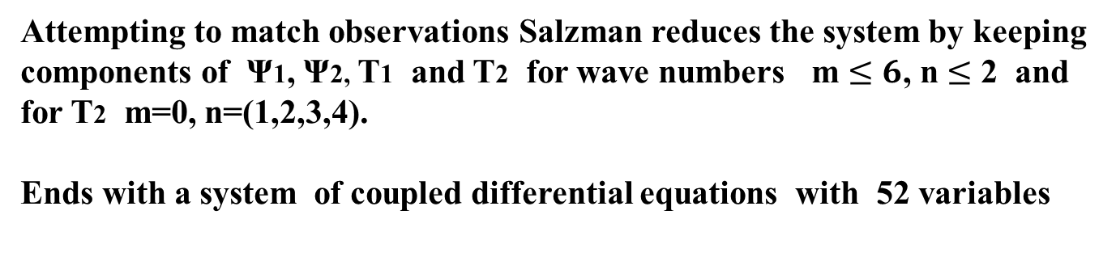
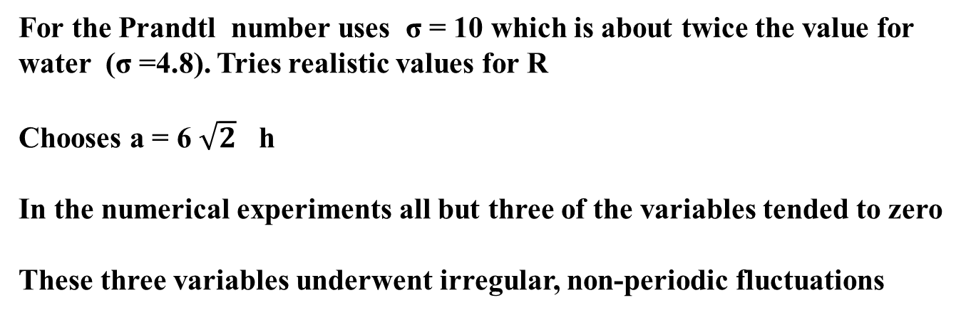
Attempting to match observations Salzman reduces the system by keeping
components of Ψ1, Ψ2, T1 and T2 for wave numbers m $≤6$, n $≤$ 2 and
for T2 m=0, n=(1,2,3,4).
Ends with a system of coupled differential equations with 52 variables
For the Prandtl number uses σ = 10 which is about twice the value for
water (σ =4.8). Tries realistic values for R
Chooses a = 6 $\sqrt{2}$ h
In the numerical experiments all but three of the variables tended to zero
These three variables underwent irregular, non-periodic fluctuations

Slide 11
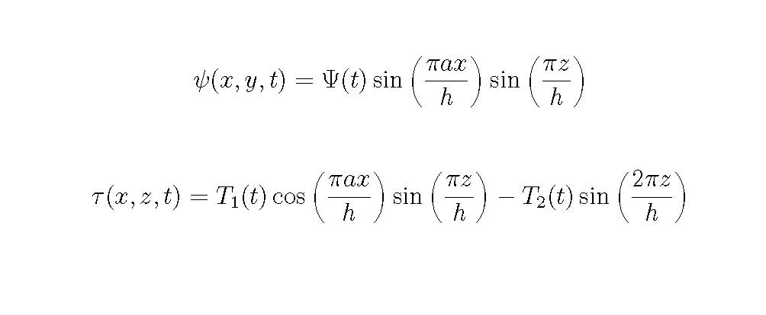
Inspired by Salzman, Lorenz (1963) makes the radical assumption that the
solutions can be obtained if the series is truncated to include only 3 variables.
Selects m=1, n=1 for the real parts of Ψ and T,
and m=0, n=2 for the imaginary part of T:

Slide 12
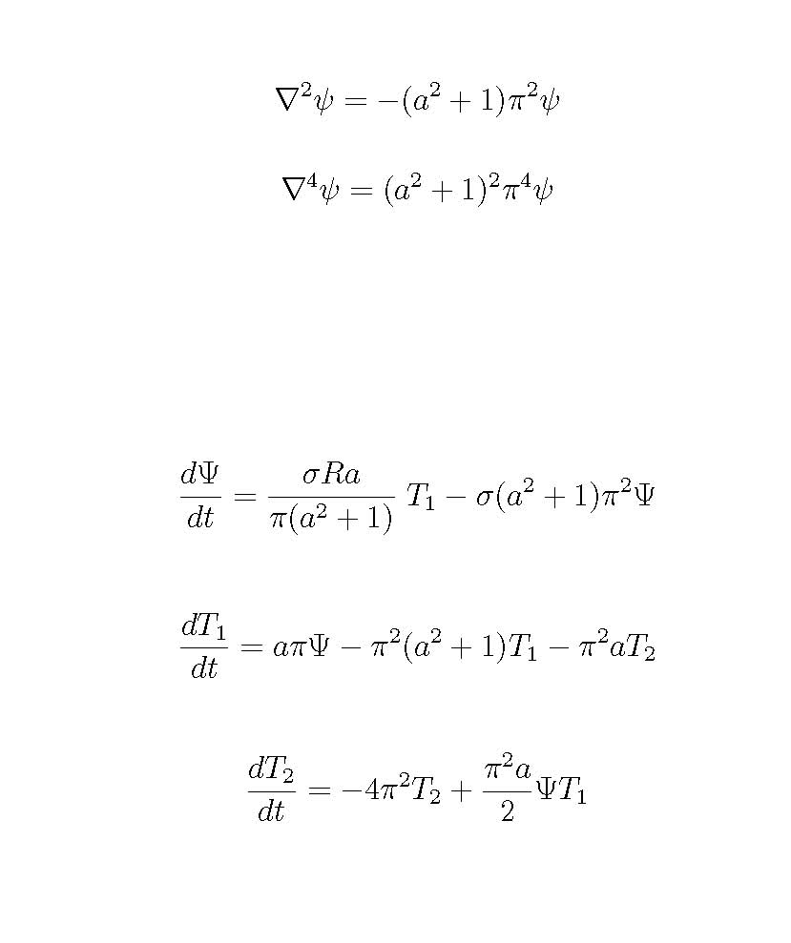
With Lorenz’s assumption equations 4 and 5 radically simplify
The non-linear terms in equation 5 all cancel and we are left with the simple system of three equations
< --- From equation 5
< --- Two equations
result from equation 4

Slide 13
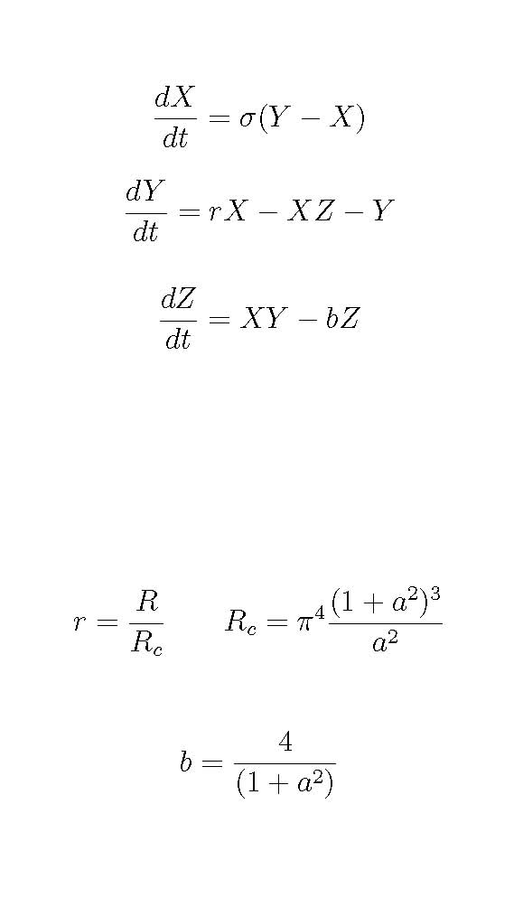
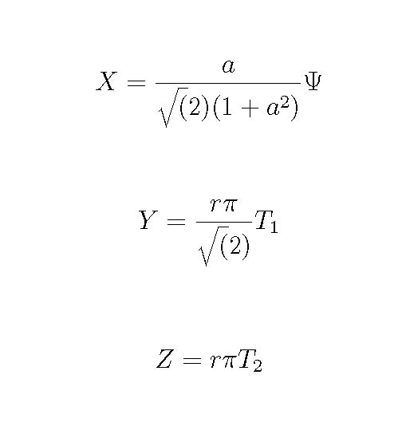
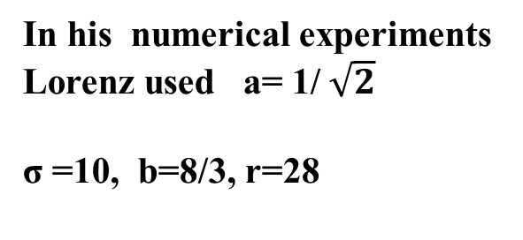
Lorenz System:
In addition to the Prandtl number σ, the factor r is the normalized
Rayleigh number and b is a geometrical factor
In his numerical experiments
Lorenz used a= 1/ $\sqrt{2}$
σ =10, b=8/3, r=28

Slide 14
