Slide 1
Launch Meeting
Department Orientation for Program Review
Office of Academic Assessment & Program Review
Bonnie Paller Bonnie.Paller@csun.edu
Eli Bartle ebartle@csun.edu
Roxi Diaz mayra.diaz.222@my.csun.edu
(818) 677-2969
August
28,
2013
10 a.m. -12 p.m.
PROGRAM REVIEW ORIENTATION

Slide 2
Agenda
Introductions
Program Review Policy and Procedures
Program Review Video
Steps of Process
  Writing & Reviewing the Self Study
    Overview of the Information to Include: Eli Bartle
    Obtaining the Institutional Research Data: Bettina Huber
    Campus Climate: Dianah Wynter
    Using Assessment Data & Results: Bonnie Paller
  External Reviewer Visit
    Planning & Scheduling: Roxi Diaz
  Constructing the 5-Year Plan: MOU
Review Calendar and Timeline
Small Group work on your department’s timeline
Wrap up, website, questions

Slide 3
The big picture: Program Review
Why is program review required?
What does the process document?
  History/Reflection
  Goals/Objectives/Planning (since last review)
  Commendations & Recommendations: Improvement
Shared responsibility
  Who are the key players?
  How will you get support?
Evaluation: How does it tie into assessment?

Slide 4
Steps of Process
Review the New FLOWCHART*
http://www.csun.edu/assessment/program_review.html
Thanks to Jody Myers (Religious Studies & Jewish Studies Program Coordinator), Anita Slechta (Chair, Health Sciences & Director of BS, Radiologic Sciences), and Cheryl Spector (English Department & Director, Academic First Year Experiences) for their feedback in creating the flowchart.

Slide 5
Steps of process
  Step 1: Launch Meeting
  Step 2: Self Study
  Step 3: External Review
  Step 4: MOU – Creation
  Step 5: MOU Distribution
  Step 6: Implementation of MOU

Slide 6
Steps of process
Step 2. Self Study
  What’s the point?
  What’s involved in compiling the information?
  Who writes it?
  What information needs to be included?
  What to do when it is done?

Slide 7
Self-study sections
Overview of the Program
Campus Climate Actions*
Assessment and Strategic Planning
Key Strengths and Challenges
Discussion of MOU
Appendices
See Self-Study Guidelines:
http://www.csun.edu/assessment/pr_resources.html
* New section as of Fall 2013

Slide 8
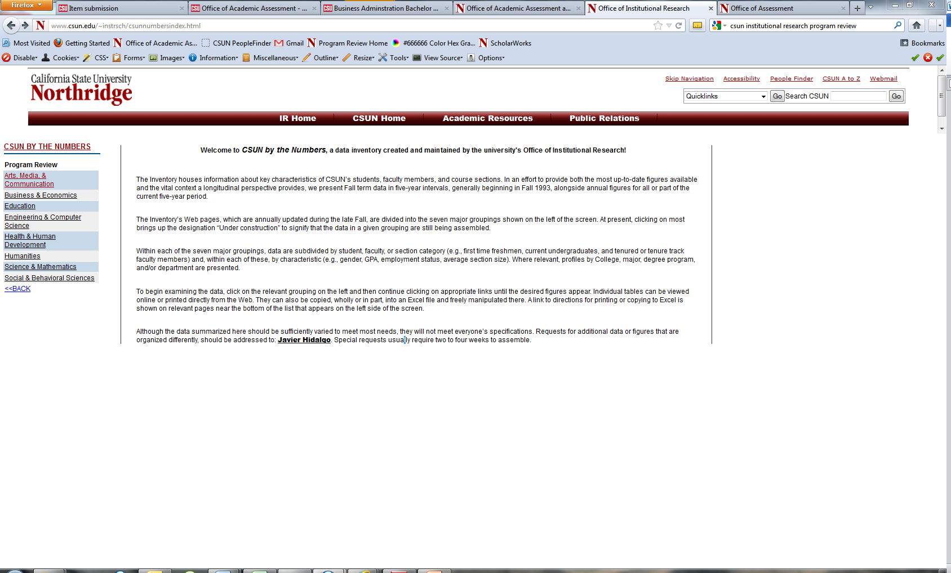
Institutional RESEARCH Data
Bettina Huber, Director, Office of Institutional Research
http://www.csun.edu/~instrsch/

Slide 9
Campus Climate
Campus Climate Survey Results and Recommendations
Program Review and Student Learning Outcomes Practice Changes
Dianah Wynter (Associate Professor, Media Theory & Criticism Option; Arts, Media, & Communication)

Slide 10
Assessment and Strategic Planning
Assessment in the Self-Study (Part 3)
  Summarizes assessment results since your last program review
  Serves as a foundation for curriculum planning
Assessment Matrix at the end of the Self-Study Guidelines Document,
      @ http://www.csun.edu/assessment/program_review.html
    Bonnie Paller, Director of Office of Academic Assessment & Program Review

Slide 11
Steps of process
Step 3 External Reviewer Visit & Report
  Selection of Reviewers
  Visit to Campus
  Report and MOU
Roxi Diaz, Graduate Assistant

Slide 12
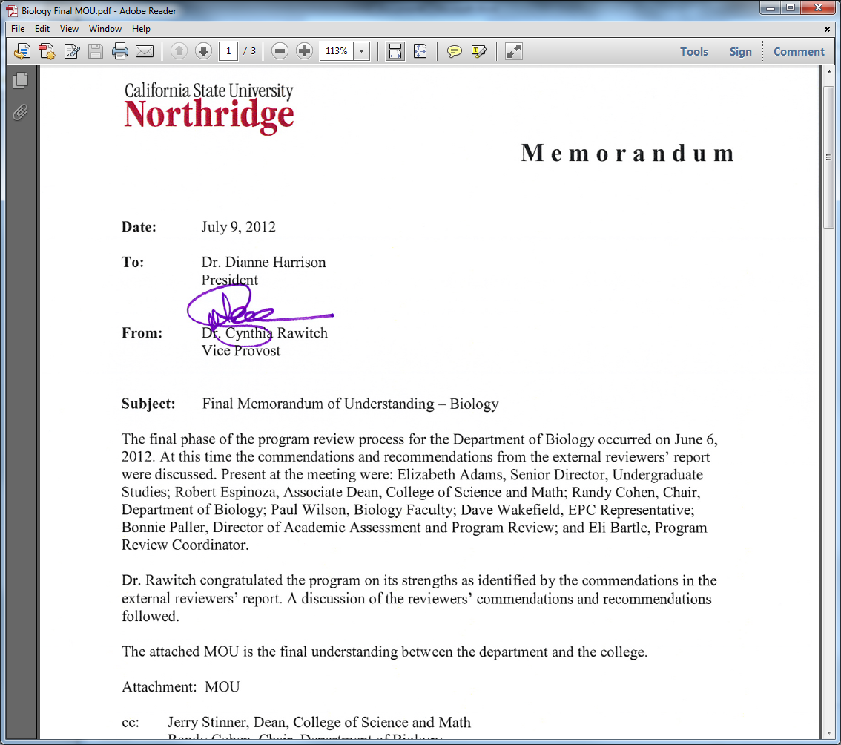
Steps of process
Step 4 MOU – Creation
  Who creates it?
  What does the meeting involve?
  Recommendations and Commendations

Slide 13
Steps of process
Step 5 – MOU Distribution
  Who sees it?
  Creating understandings

Slide 14
Steps of process
Step 6: Implementation of MOU
  What’s the point?
  What is to be done with it after program review is done?

Slide 15
Program Review Video
Video

Slide 16
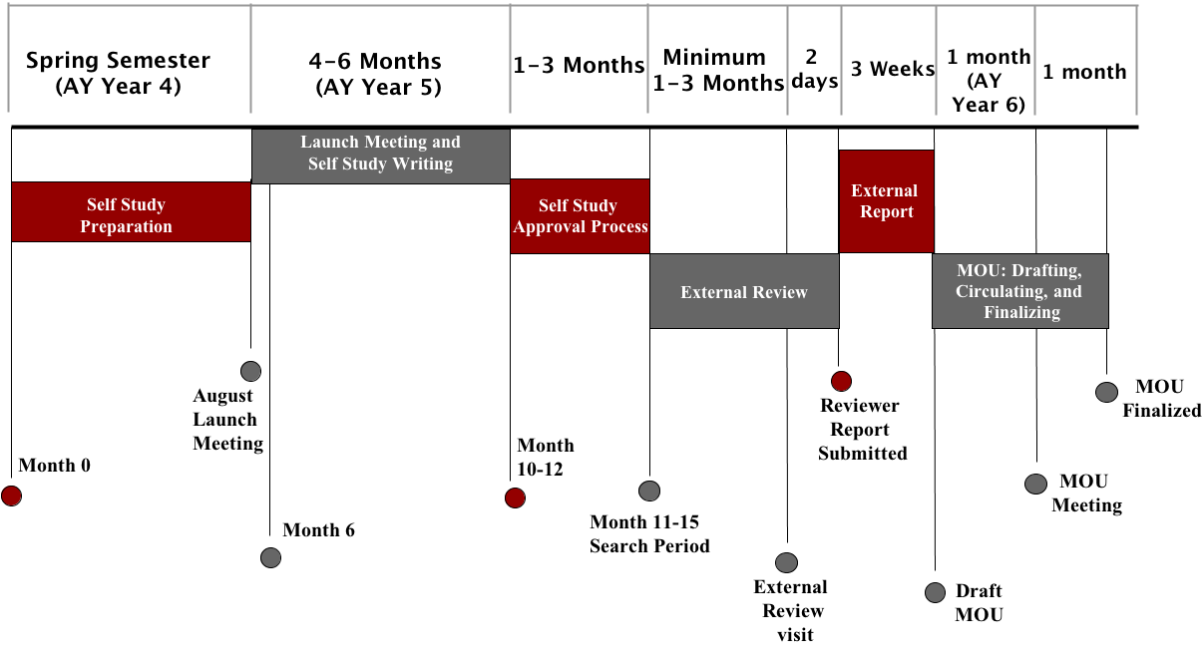
Calendar and timeline

Slide 17
Wrap up
Questions? Consultation? Assistance? Examples? Delays?
Contact us at:
Website: http://www.csun.edu/assessment/program_review.html
Or Phone: 818 677 2969
Or Email:
Eli Bartle, Program Review Coordinator
  Email: ebartle@csun.edu
Roxi Diaz, Student Assistant
  Email: mayra.diaz.222@my.csun.edu
Bonnie Paller, Assessment and Program Review
  Email: bonnie.paller@csun.edu
Good luck!

