Slide 1
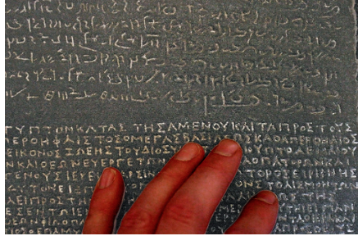
Freshmen and Academic English: What's Language Got to Do with It?
making clear to students what we want them to know, learn, and do;
tapping in to students' existing language resources to support their learning;
addressing some of the questions and issues that faculty ask about language, and;
considering the language we use with students in pursuit of their—as well as our—goals.
BCFS/AFYE and WRAD

Slide 2
Notes:
So, (…) where have we been and where might we “head”?

Slide 3
U
G
R
L
A
M
M
A
R
O
Notes:
magos "one of the members of the learned and priestly class," from O.Pers. magush, possibly from PIE *magh- "to be able, to have power” We might observe that it was only the members of the learned or priestly class who learned to write, early on.

Slide 4
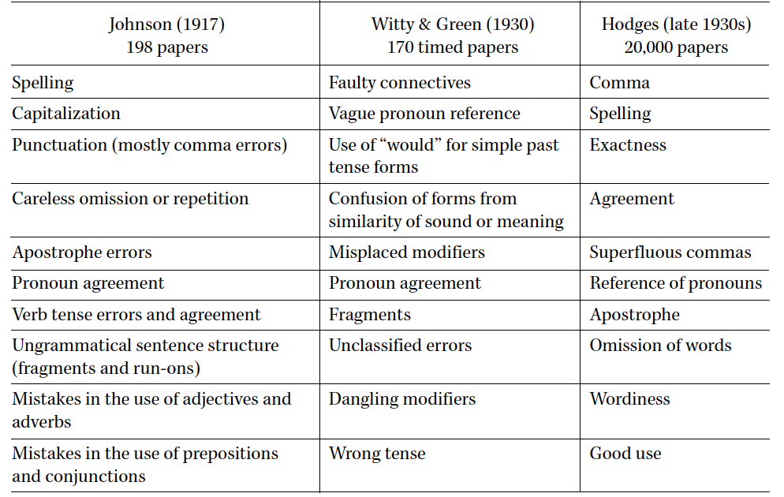
A History of Errors: The Top Ten
Andrea A. Lunsford and Karen J. Lunsford. Mistakes are a fact of life: A national comparative study. CCC 59:4. 2008.

Slide 5
JoAnn painted JoAnn painted the barn The barn was painted (by JoAnn)
JoAnn walked John walked the dog ?The dog was walked (by JoAnn)
The book fell JoAnn dropped the book The book was dropped (by JoAnn)
The water boiled JoAnn boiled the water The water was boiled (by JoAnn)
JoAnn arrived
JoAnn was arrived
?

Slide 6
(1)
a. *Without the effective control of public emotion… , a civil fight was occurred inevitably.
b. *Of course these methods weren’t fallen down from the sky.
c. *Since these violent TV shows are on, that [polite] manner has been disappeared.
d. ?For pregnant women over 35, the risk of having a Down syndrome child is increased.
Patricia Balcom. An application of second language acquisition research to ESL grammar teaching:
What to do with novel passives. RCLA/CJAL Vol. 4. Nos 1-2.
Notes:
Revue Canadienne de Linguistique Appliquée/Canadian Journal of Applied Linguistics

Slide 7
(10)
a….concentrated population could occur these kind of problem.
b. …he falls a piece of note into dough by mistake.
c. The TV appear all kinds of animals. (Oshita, 1998)
Patricia Balcom. An application of second language acquisition research to ESL grammar teaching:
What to do with novel passives. RCLA/CJAL Vol. 4. Nos 1-2.

Slide 8
Some Groupings
occur
Seem
happen
fall
arrive
disappear
increase
break
open
boil
freeze
walk
run
swim
cry
laugh
drink
hit
kiss
drop
expect
receive

Slide 9
Feeling Tense? Let’s look at some other aspects of verbs
Matt leaves at 2:00(every day/?*now) Matt is leaving at 2:00 (?*every day/now)
Matt be leaving at 2:00
Matt leaving at 2:00
Matt been leaving at 2:00
Matt s’en va

Slide 10
So, a dog walks in a telegraph office and he says, "I want to send a message." And the operator says, "Sure, what would you like to send?" And the dog says, "Woof woof. Woof woof woof. Woof woof woof woof." And the operator pauses a second, and goes, "You know, that's only nine. You can send a 10th woof for free."
And the dog replies, "But that would make no sense."
http://www.npr.org/2014/03/15/289946192/whyd-the-scientist-cross-the-road-to-figure-out-why-youre-laughing
Notes:
Making grammatical explanations accessible and understandable. And being sensitive to the systematicity of (a) whatever language(s) students come CSUN with, and (b) that they’re different from—but not less than—English (not even academic written English), and that we must build a bridge—a three-way bridge: Between their language(s) and English, and between the academic written English that they’ll be expected to navigate—and at least drive, if not fully control—and the systems of English they’re developing.

Slide 11
The ability to provide written response that serves assessment for learning functions appears to be a powerful component of teacher practice that develops student writing. [This]paper suggests that considerable teacher pedagogical content knowledge is required to provide such feedback.
(Abstract, Feedback to writing, assessment for teaching and learning and student progress. Judy M. Parr and Helen S. Timperlay. Assessing Writing, Vol. 15, Issue 2. 2010.
In other words… Effective feedback from writing instructors(written response that serves assessment for learning functions) seems crucial (a powerful component) for the development of student writing, that is for student writing to achieve the goals we have for it. [This] paper suggests that we need a strong knowledge foundation (considerable teacher pedagogical content knowledge) if we are to achieve this goal (is required to provide such feedback).

Slide 12
READING
http://www.csun.edu/afye/When-Students-Do-Not-Do-the-Reading.html
http://www.csun.edu/undergraduate-studies/reading-initiative

Slide 13
Comprehending Text
“It seems very pretty,” she said when she had finished it, “but it’s
rather hard to understand!” (You see she didn’t like to confess, even to herself, that
she couldn’t make it out at all.) “Somehow it seems to fill my head with ideas—only
I don’t exactly know what they are!”
p. 175, The Annotated Alice: Alice’s adventures in wonderland & Through the looking glass.
Lewis Carroll, Introduction and notes by Martin Gardner. Meridian. 1960.

Slide 14
In ways that appear to be little understood, even by literacy experts, the language used in complex texts of the type students should be reading in school is different in numerous ways from the language of ordinary talk. Differences in vocabulary, the easiest to see, make up only a part of it. Linguists and language analysts who have studied the language of academic texts have identified grammatical structures and devices for framing ideas, indicating relationships, and structuring arguments, that create substantial differences between spoken and written language. (p. 1)
To further complicate matters, we would argue that academic language
cannot be “taught” as a separate school subject, either, at least not in the way one might teach a language like English, Spanish or French. So where and how are students to learn this kind of language? (p. 2)
What Does Text Complexity Mean for English Learners and Language
Minority Students? (2012)
Lily Wong Fillmore, University of California, Berkeley
Charles J. Fillmore, University of California, Berkeley
http://ell.stanford.edu/
Notes:
“Text Complexity” = Common Core language

Slide 15
A text is never fully explicit. A second claim is that schemata provide the basis
for filling gaps, the basis for inferential elaboration, the basis for positing states
of affairs, not expressly mentioned, that must hold if a passage is to permit a
coherent interpretation. Comprehension involves going beyond the givens in a
message, so to speak "reading between the lines." Readers must make logical
inferences, pragmatic inferences, coordinate reference, and supply suppositions
about an author's intentions. They must make inferences about the motives and
mental states of characters, antecedent and consequent events, instrumentality,
and illocutionary force as well as propositional content.
Richard C. Anderson, Ralph E. Reynolds, Diane L. Schallert, and Ernest Goetz. 1977.
Frameworks for comprehending discourse. American Educational Research Journal
Fall 1977, Vol. 14, No. 4, Pp. 367-381

Slide 16
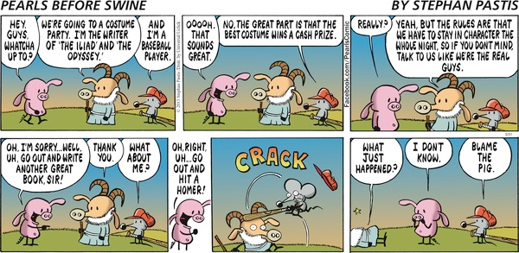
http://www.gocomics.com/pearlsbeforeswine/2013/03/31

Slide 17
What does kick mean?
The baby kicked the ball.
The punter kicked the ball.
The golfer kicked the ball
Imagine the statement The bull is in the field in each of the
following circumstances:
(1) You are driving past the field in your car.
(2) You are sitting in the field having a picnic.
(3) You have brought your pure-bred cow to be inseminated.
(4) The sentence comes up on a screen in a memory
experiment in which you are participating.
Ibid.
Notes:
See also the schema piece about the “misunderstood photographer.”

Slide 18
Rocky slowly got up from the mat, planning his escape. He hesitated a
moment and thought. Things were not going well. What bothered him
most was being held, especially since the charge against him had been
weak. He considered his present situation. The lock that held him was
strong but he thought he could break it. He knew, however, that his timing
would have to be perfect. Rocky was aware that it was because of his early
roughness that he had been penalized so severely-much too severely
from his point of view. The situation was becoming frustrating; the
pressure had been grinding on him for too long. He was being ridden
unmercifully. Rocky was getting angry now. He felt he was ready to make
his move. He knew that his success or failure would depend on what he did
in the next few seconds.
Ibid

Slide 19
Every Saturday night, four good friends get together. When Jerry, Mike,
and Pat arrived, Karen was sitting in her living room writing some notes.
She quickly gathered the cards and stood up to greet her friends at the
door. They followed her into the living room but as usual they couldn't
agree on exactly what to play. Jerry eventually took a stand and set things
up. Finally, they began to play. Karen's recorder filled the room with soft
and pleasant music. Early in the evening, Mike noticed Pat's hand and the
many diamonds. As the night progressed the tempo of play increased.
Finally, a lull in the activities occurred. Taking advantage of this, Jerry
pondered the arrangement in front of him. Mike interrupted Jerry's
reverie and said, "Let's hear the score." They listened carefully and
commented on their performance. When the comments were all heard,
exhausted but happy, Karen's friends went home.
Ibid

Slide 20
So, these passages each evoked one of two interpretations, depending on “where our heads were”—which schema we were triggered to “use.” What pieces engaged one or the other schema?
What’s going on here? Vocabulary? Context?

Slide 21
Notes:
Sometimes context trumps vocabulary—and using different terminology makes us think explicitly about what we’re addressing—what we’re talking about.

Slide 22
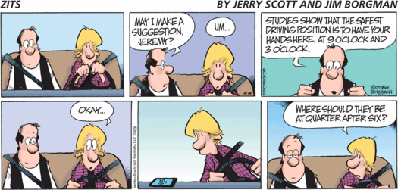

Slide 24
So, schemata, vocabulary, and sentence structure—to name just a few elements—affect comprehension. And all of these factors are components of language—contributing to—our interactions with the world, and—crucially—with one another… A lot at stake. Especially since

Slide 25
Language is
a club

Slide 26
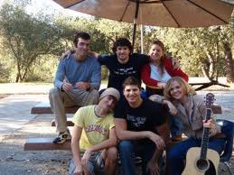

Slide 27
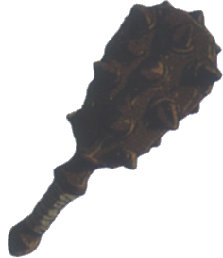
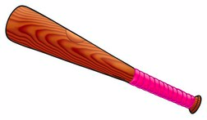

Slide 28
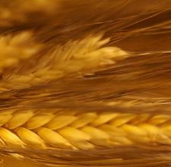
Gen 41:5 ff.; Ruth 2:2; Zach 4:12
שבלת
סבלת
ʃɪbolɛθ
sɪbolɛθ
Psalms 69:3,16; Isa. 27:12
http://www.balashon.com/2010/01/shibolet.html and sources cited there.
Notes:
There are a number of lessons to learn from this shibboleth episode.

Slide 29
From the Online OED: Greek βαρβαρισμός ‘foreign mode of speech,’ βαρβαρίζ-ειν to (behave or) speak like a foreigner. The extension from language to social condition (= French barbarie, Latin barbaria, -ies) is exclusively English. "barbarism, n.". OED Online. June 2011. Oxford University Press. http://www.oed.com.libproxy.csun.edu/viewdictionaryentry/Entry/15389

Slide 30
Spanglish in the News
http://www.washingtonpost.com/blogs/wonkblog/wp/2014/01/13/obamacares-spanish-language-web-site-is-written-in-spanglish/
http://thehill.com/blogs/pundits-blog/healthcare/195538-ap-wrongly-says-obamacare-site-written-in-spanglish
http://www.latinorebels.com/2014/01/16/ap-defends-obamacare-spanglish-story-while-using-same-mistakes-in-other-ap-articles/

Slide 31
Alternatively….
And… “Do You Speak American?”
http://www.pbs.org/speak/education/
And there’s no “one” American…
http://www.ncsu.edu/linguistics/research_dialecteducation.php
Notes:
Inculcating dialect and language awareness and acknowledging the public issues that need to be addressed.

Slide 32
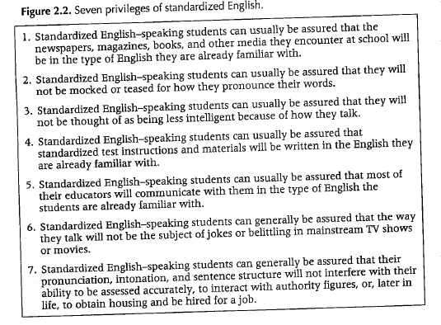
Understanding English Language Variation in U.S. Schools. Anne H. Charity Hudley and
Christine Mallinson. Teachers College Press. 2011

Slide 33
Micro-aggression
http://www.fordham.edu/academics/office_of_research/research_centers__in/center_for_teaching_/the_art_of_teaching/microaggressions_89343.asp
http://www.apa.org/monitor/2009/02/microaggression.aspx

Slide 34
Hyland (2000, 147) argues that writing teachers ‘are not
correcting a deficit in students’ writing weaknesses, but helping them to unpack the requirements of their discipline’. This may be complicated by students having to develop some level of understanding of and familiarity with several disciplines.
Judith Reynolds. 2010. Writing in the discipline of anthropology – theoretical, thematic and
geographical spaces. Studies in Higher Education. Vol. 35, No. 1
http://www.carnegiefoundation.org/publications/disciplinary-styles-scholarship-teaching-and-learning-exploring-common-ground
http://decodingthedisciplines.org/index.html

Slide 35
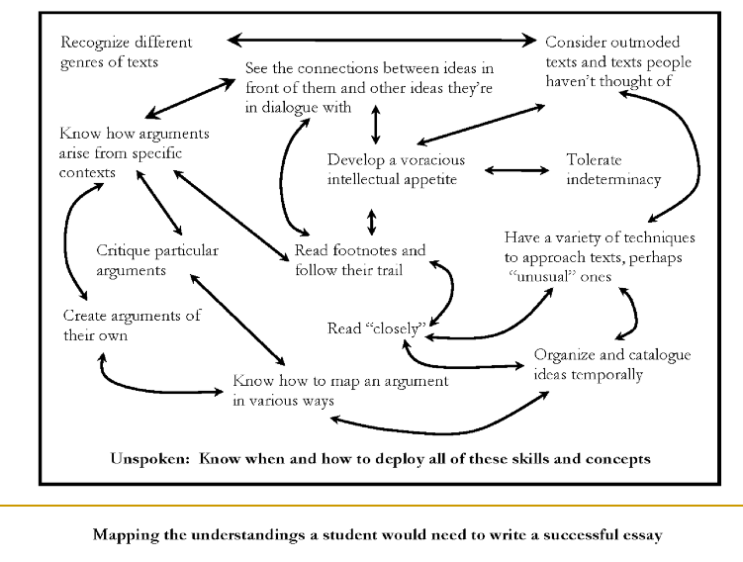
Notes:
And what do we expect students to do?

Slide 36
http://decodingthedisciplines.org/
Notes:
This is the basic cycle that the “Decoding the Disciplines” folks have constructed. Some of the pieces make more sense than the others, but the map on the previous slide speaks volumes about the complexity of the territory we want students to navigate.

Slide 37
BICS and CALP: What is it? Does it highlight a useful distinction?
BICS: Basic Interpersonal Communication Skills
CALP: Cognitive Academic Language Proficiency
http://vimeo.com/56112120
http://www.wce.wwu.edu/Resources/CIRCLE/Articles/Jim%20Cummins.pdf
Embedded in this response, an implicit critique: http://www.tolerance.org/tdsi/sites/tolerance.org.tdsi/files/assets/general/Putting_Language_Proficiency_in_Its_Place_Jim_Cummins.pdf
But….
Notes:
But the territory of language is not all that simple in an setting. Despite the Cummins definition of BICS and CALP

Slide 38
How “B” is BICS?

Slide 39
More that we can do….
Sentence by Sentence? How do we get from one to the other?
Transitions
https://www.msu.edu/~jdowell/135/transw.html
https://owl.english.purdue.edu/owl/resource/574/02/

Slide 40
Essay Structure by essay structure….

Slide 41
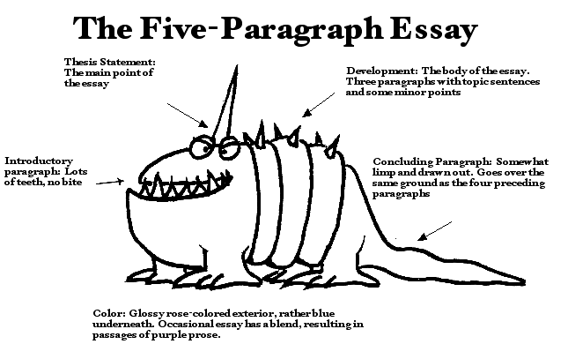

Slide 42
Where do these five parts come from?
http://iws.collin.edu/grooms/cr2sp13quintq.pdf
http://www.public.coe.edu/wac/classicalessay.htm
--with some exercises
Could we not let students in on this history?

Slide 43
And assignment design by assignment design…for writing and for reading
http://writing.colostate.edu/guides/teaching/wassign/
http://writing.umn.edu/tww/assignments/designing.html
https://www.dartmouth.edu/~acskills/success/reading.html
http://www.eecs.harvard.edu/~michaelm/postscripts/ReadPaper.pdf
Essay terms for students—at least one of the resources
http://www2.le.ac.uk/offices/ld/resources/writing/writing-resources/essay-terms

Slide 44
(Virtually) Hot off the Press:
A pre-print version of Terry Myers Zawacki and Michelle Cox’s new edited collection is now available on the Clearinghouse at http://wac.colostate.edu/books/l2/.
The collection carries the title:
WAC and Second-Language Writers: Research Towards Linguistically and Culturally Inclusive Programs and Practices

