Slide 1
The University Corporation
Executive Committee
September 12, 2008

Slide 2
Geronimo's

Slide 3
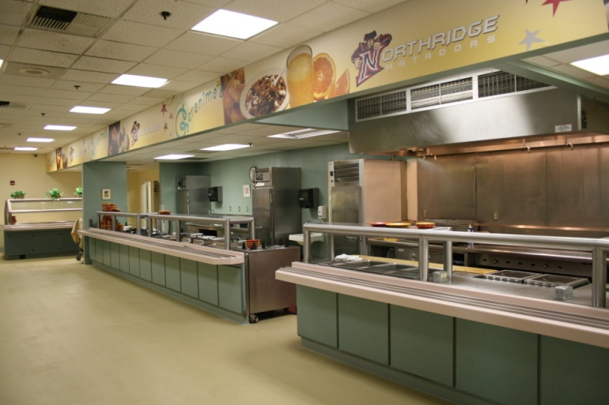
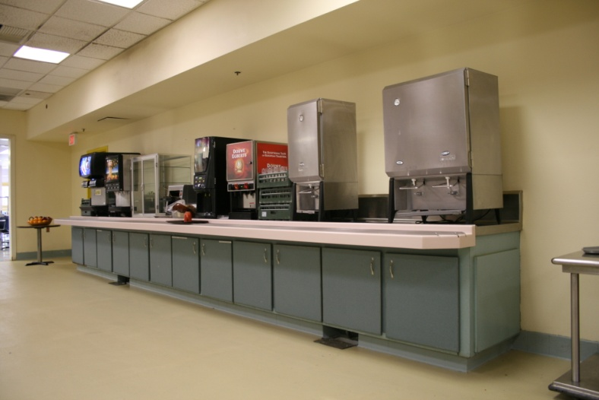
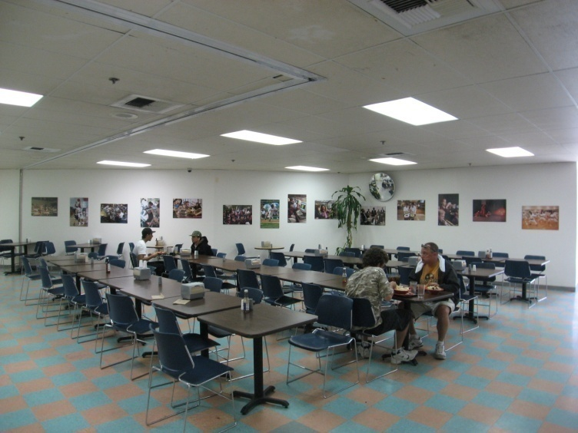
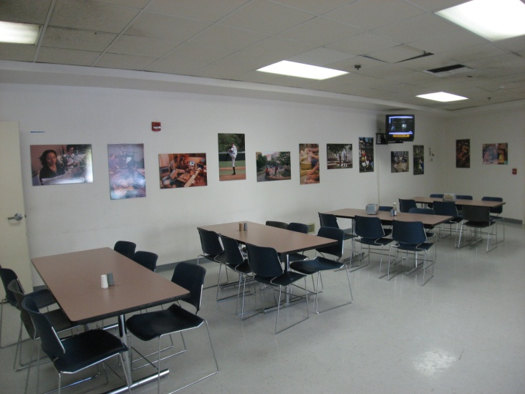
Geronimo‘s 2008
Serving Area
Dining Area
Notes:
Thank you Rick,
Geronimo's is 18 years old.
Judging from these photos you would think it dates back to the San Fernando Valley State College days.
The primary objective of this project is to create an exciting and inviting dining facility. A facility we can be proud to show our prospective students.
.

Slide 4
Feasibility Study
Add additional seating
Expand Food Program
Maintain “all you care to eat” program
No need to modify existing kitchen
Notes:
At the conclusion of our Feasibility Study we were able to determine a number of primary goals.
We will need to add seating to accommodate the additional students who will be coming on line in the Fall of ‘09.
We will expand our food program .
We will maintain our current “all you care to eat” program.
The existing kitchen will be sufficient to service the added students.
This last point is critical because it allows us to focus the bulk of our efforts (and funds) on the front of the house and on a the student’s positive dining experience

Slide 5
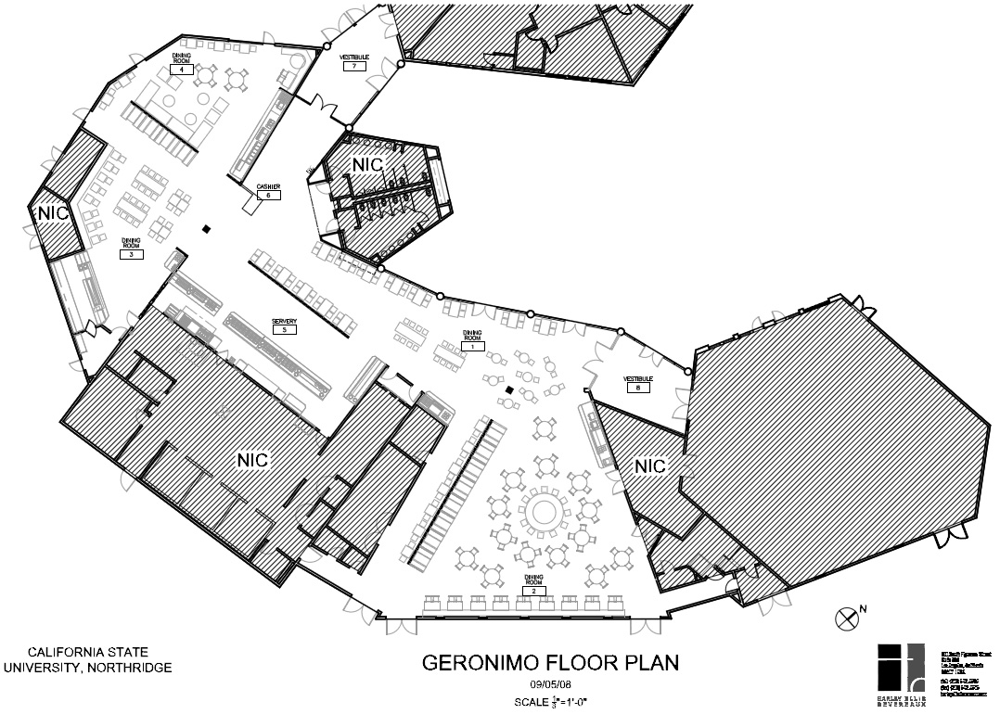
Geronimo’s
Notes:
What you are looking at here is the redesigned Geronimo's floor plan.
Our current facility is the kitchen, the servery, and the Gabrielino Room.
Working closely with the USU we have added the concourse area and the Fernandino Room giving us the 350 seats that are necessary to feed the anticipated number of additional students.
One of our early requests of the architect was to open up the space if possible.
They have accomplished this by removing and or modifying a number of walls.
The wall into the Gabrielino Room has been removed. The wall inside the Gabrielino Room has been shortened.
The wall dividing the concourse from the servery has been shortened and opened up.
The walls into the Fernandino Room have been removed.
The western wall of the Fernandino Room has been shortened and opened up.
We also requested the designers make each dining room vibrant and somewhat unique unto itself.
The Gabrielino Room is to be our most lively room. Pub like, if you will, or themed, with flat screen TV’s, a limited amount of soft seating, and a variety of as yet to be determined wall treatments. Possibly shadow boxes with spirit type contents.
Possibly photo collages of campus life.

Slide 6
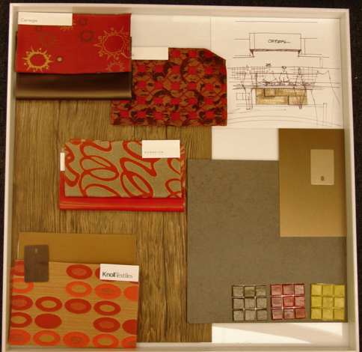
Geronimo’s
Notes:
Here are some of the proposed materials for the Gabrielino Room.
Wood flooring.
Vibrant patterns for the upholstery.
Colorful accent tile.

Slide 7
Geronimo’s
Notes:
We will add seating in the concourse area. This area will be bright and airy due to the patio windows.
From there we move over to the Fernandino Room.
We will remove the walls leading into the room creating a continuous flow from the concourse.

Slide 8
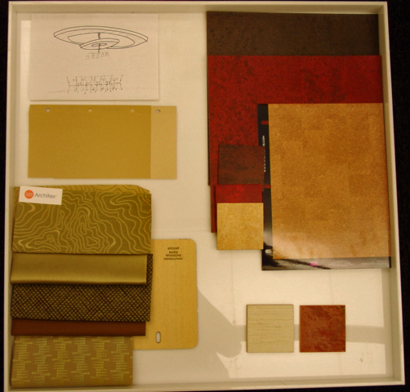
Geronimo’s
Notes:
Here we have a sampling of the proposed materials for the Fernandino Room.
This room will be somewhat more classy than the Gabrielino Room.
Slightly less energetic with more subdued colors and fabrics.

Slide 9
Geronimo’s
Notes:
I would like to bring the table layout to your attention.
We would love to see the students interact with one another and feel this circular seating pattern in the Fernandino Room will encourage that.
The focal point of this room will be the ceiling treatment.

Slide 10
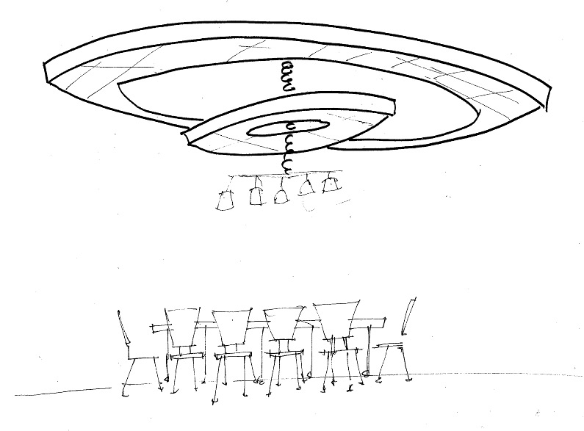
Geronimo’s
Notes:
The bulls eye shape above will match the seating below, promoting communal dining and social interaction.

Slide 11
Geronimo’s
Notes:
That brings us back to the servery and our straight line cafeteria.
Originally our hope was to break up this counter and construct separate “pods”
where the different types of food would be served.
Unfortunately funding and available space precluded us from designing the facility this way.
However, the designers came up with a very clever compromise to break up this straight counter.

Slide 12
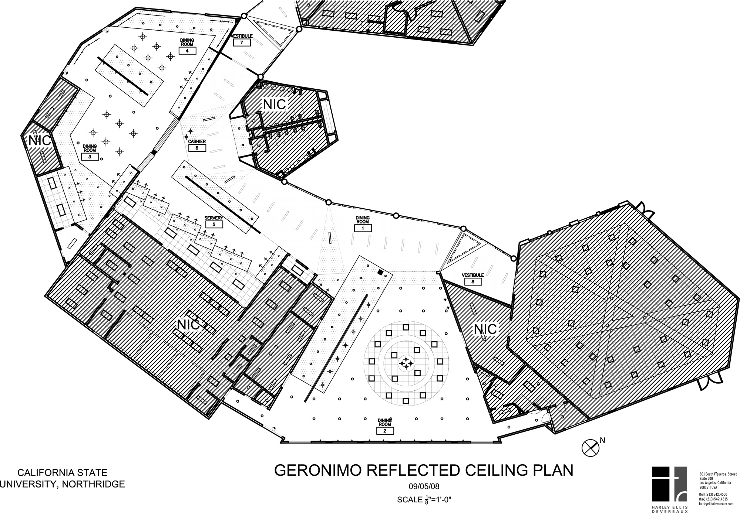
Geronimo’s
Notes:
What we will do is create a saw tooth soffit with various elevations above the straight counter breaking up the straight line directly below.

Slide 13
Servery
Notes:
Here you can see the different elevations.
We will also delineate the different stations with unique treatments on the counter fronts.

Slide 14
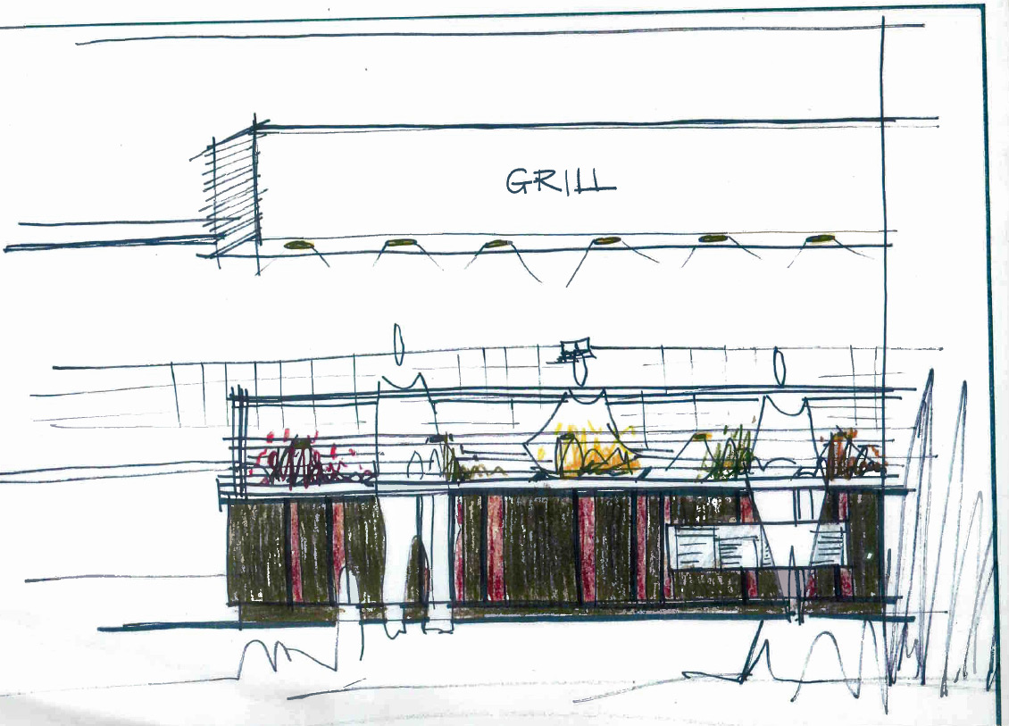
Geronimo’s
Notes:
We will incorporate our already established campus “brands” at each station.
Here we will have “Grill & Greens” serving burgers, fries, chicken strips, and specialty sandwiches. This area will be our late night station.

Slide 15
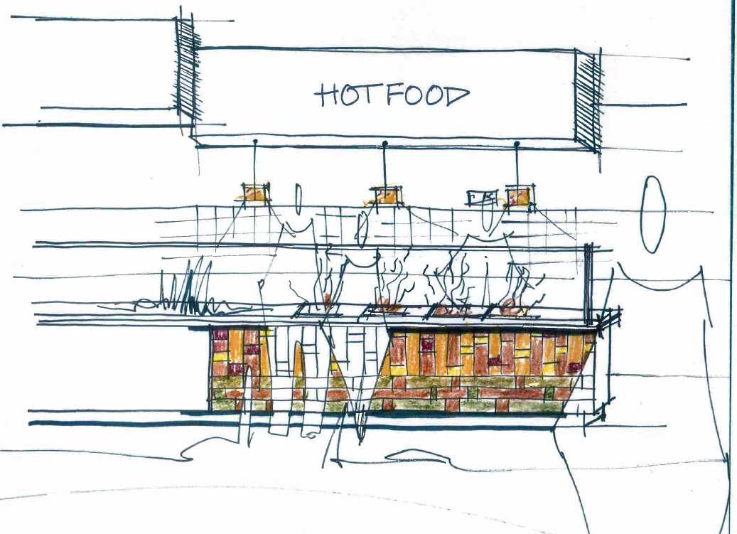
Geronimo’s
Notes:
Here we will serve our entre options. The breakfast faire will also be served in this area.
Notice in this image how the various elements I’ve described create a unique station that the student will be inclined to “walk up to” as opposed to “sliding down” like an old school cafeteria line.

Slide 16
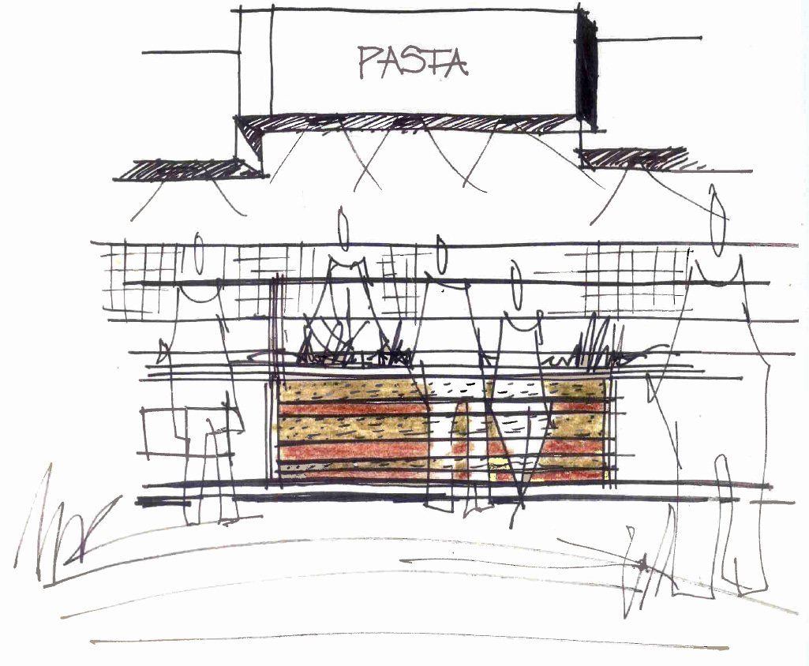
Geronimo’s
Notes:
Here we have Pizzazz serving our Mediterranean faire.

Slide 17
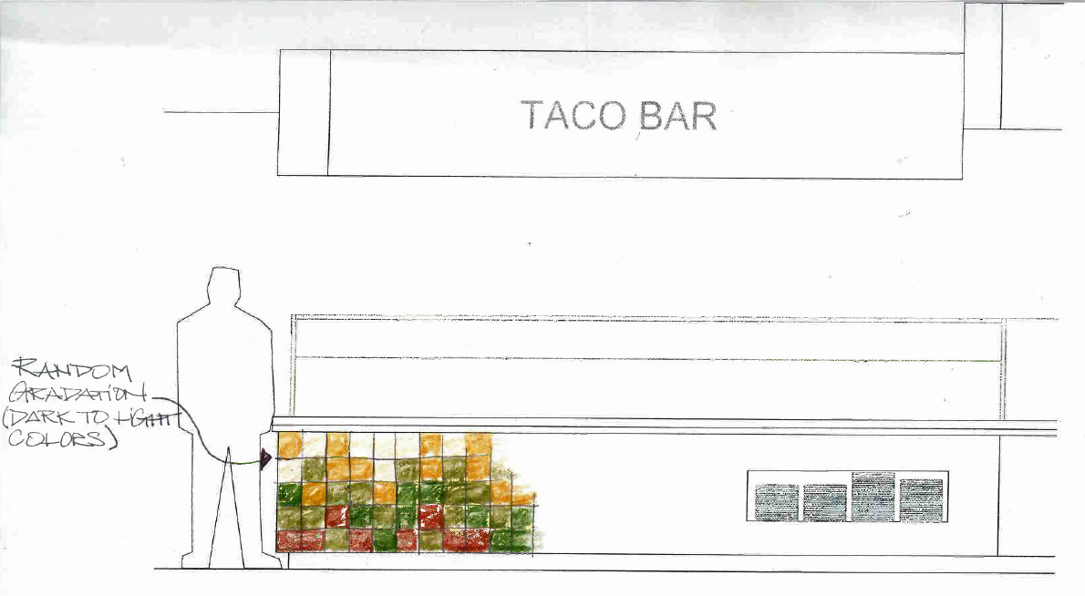
Geronimo’s
Notes:
Our as yet to be named taco bar serving Mexican food.
We used to have a Burrito Norte on campus. Possibly Taco Norte?

Slide 18
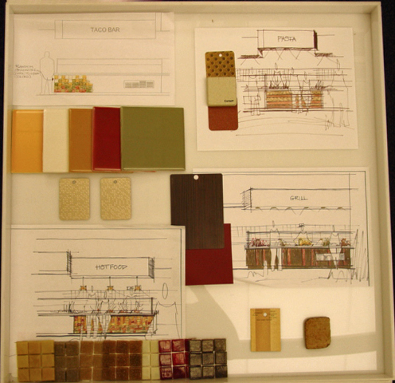
Geronimo’s
Notes:
Here is a sampling of some of the materials we will use in the servery.
A lot of vibrant tile for ease of cleanability but also some different textures to add variety.

Slide 19
Geronimo‘s 2008
Notes:
So in conclusion, given what we have to work with…….

Slide 20
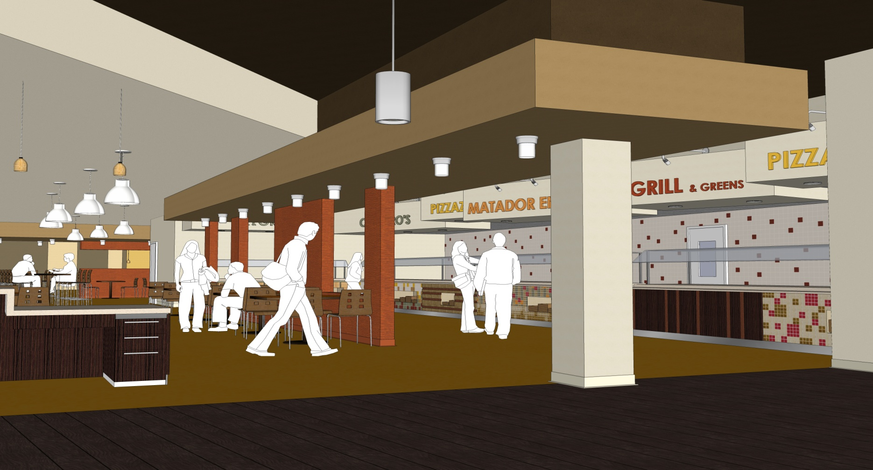
Geronimo’s 2009
Notes:
We feel we are well on our way to providing a fun, vibrant, comfortable dining environment offering a wide variety of freshly prepared, nutritional foods in an inviting space that promotes a sense of community.
A positive gateway to the campus for our incoming freshmen.
Any questions?

