Slide 1
Soc 680 Final Review
Output Recognition
These slides will stay on for 2:00 minutes each. Use that time to identify the table and interpret the results in written form. We will discuss them after we are through.

Slide 2
 |  | Age of Respondent | Highest Year of School Completed | Number of Brothers and Sisters
Age of Respondent | Pearson Correlation | 1 | -.254** | .117**
 | Sig. (2-tailed) |  | .000 | .000
 | N | 1514 | 1508 | 1502
Highest Year of School Completed | Pearson Correlation | -.254** | 1 | -.264**
 | Sig. (2-tailed) | .000 |  | .000
 | N | 1508 | 1510 | 1501
Number of Brothers and Sisters | Pearson Correlation | .117** | -.264** | 1
 | Sig. (2-tailed) | .000 | .000
 | N | 1502 | 1501 | 1505

Slide 3
Highest Year of School Completed
 | Sum of Squares | df | Mean Square | F | Sig.
Between Groups | 240.725 | 2 | 120.362 | 13.746 | .000
Within Groups | 13195.994 | 1507 | 8.756
Total | 13436.719 | 1509

Slide 4
Control Variables |  |  | Number of Brothers and Sisters | Highest Year of School Completed
Highest Year School Completed, Mother | Number of Brothers and Sisters | Correlation | 1.000 | -.131
 |  | Significance (2-tailed) | . | .000
 |  | df | 0 | 1228
 | Highest Year of School Completed | Correlation | -.131 | 1.000
 |  | Significance (2-tailed) | .000 | .
 |  | df | 1228 | 0

Slide 5
 | Component
 | 1 | 2
Number of Brothers and Sisters | -.318 | -.321
Age of Respondent | -.423 | .698
Highest Year of School Completed | .777 | .310
Highest Year School Completed, Father | .758 | -.311
Highest Year School Completed, Mother | .769 | -.333
Highest Year School Completed, Spouse | .728 | .177
R's Occupational Prestige Score (1980) | .552 | .574

Slide 6
Model |  | Unstandardized Coefficients |  | Standardized Coefficients | t | Sig.
 |  | B | Std. Error | Beta
1 | (Constant) | 9.694 | .494 |  | 19.624 | .000
 | Age of Respondent | .002 | .005 | .013 | .415 | .678
 | Highest Year School Completed, Father | .191 | .026 | .281 | 7.240 | .000
 | Highest Year School Completed, Mother | .182 | .032 | .222 | 5.686 | .000
 | Number of Brothers and Sisters | -.099 | .028 | -.102 | -3.494 | .000
Dependent Variable Highest Years of Education Completed

Slide 7
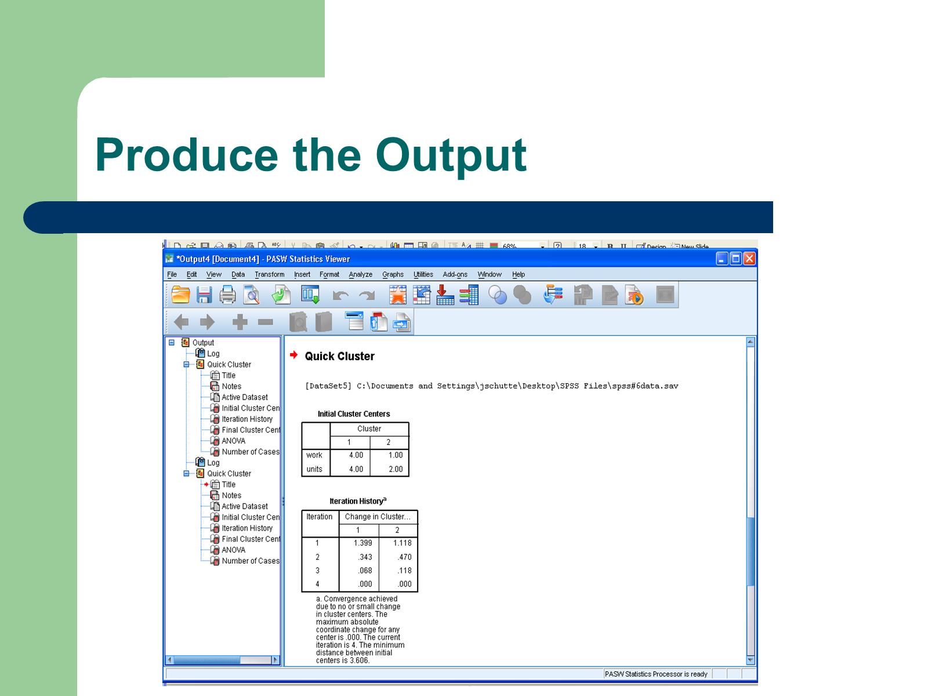

Slide 8
 | Function
 | 1
Highest Year of School Completed | -.863
Age of Respondent | .589
Number of Brothers and Sisters | .553

Slide 9
Dependent Variable: R's Occupational Prestige Score (1980)
Source | Type III Sum of Squares | df | Mean Square | F | Sig.
Corrected Model | 8886.142ª | 5 | 1777.228 | 10.766 | .000
Intercept | 479147.035 | 1 | 479147.035 | 2902.680 | .000
sex | 54.460 | 1 | 54.460 | .330 | .566
race | 7632.679 | 2 | 3816.340 | 23.119 | .000
sex * race | 1255.778 | 2 | 627.889 | 3.804 | .023
Error | 233079.627 | 1412 | 165.071
Total | 2855770.000 | 1418
Corrected Total | 241965.769 | 1417

Slide 10
Variables in the Equation
 |  | B | S.E. | Wald | df | Sig. | Exp(B)
Step 1ª | age | -.011 | .004 | 7.808 | 1 | .005 | .989
 | educ | -.080 | .025 | 10.245 | 1 | .001 | .923
 | thnkself | -.073 | .056 | 1.699 | 1 | .192 | .930
 | Constant | 2.486 | .452 | 30.260 | 1 | .000 | 12.012
a. Variable(s) entered on step 1: age, educ, thnkself.

