Slide 1
The Effects of Age, gender and Ethnicity on Higher Education and Opportunities for latinos
Siobhan Goldberg
SOC 680
Fall 2012

Slide 2
Population Stats
US Census (2011)
Hispanic Population
  Individuals identified as Hispanic or Latino in origin
      California: 38.1%
      Los Angeles: 48.1%
  In Los Angeles County, the concentration of Latino is even higher than the state average [with] half (42.9%) of the students enrolled in the Los Angeles Community College District are Latino” (Hagedorn et al. 2007:89)

Slide 3
Literature Review
Young Adults and Higher Education: Barriers and Breakthroughs to Success
  Brock Thomas, 2010
    Government aid has not kept up with the rising cost of college
    California struggles financially with meeting students’ needs
        “In California, for example, community colleges receive less than half the funding per full-time enrolled student than the state universities receive, and only about one-fifth as much as the University of California” (Brock 2010: 119)

Slide 4
Literature Review
College-Level Choice of Latino High School Students: A Social-Cognitive Approach
  Laura Gonzalez (2012) adds that Latino students are more likely to enter community colleges rather than four year universities after high school. It has been a long standing trend that students who go to community college first tend to have low degree completion rates.
  Some of the influences for choosing community college is:
    Cultural and family obligations
    Lack of counselor support
    Poor academic preparation in high school
    Access to financial aid

Slide 5
Data Set
Immigration and Intergenerational Mobility in Metropolitan Los Angeles (IIMMLA)
  2,512 Participants
  Location: Focused on 5 counties
    Ventura
    Orange
    San Bernardino
    Los Angeles
    Riverside

Slide 6
Background of Data Set
Funded by a grant from the Russell Sage Foundation
Conducted by the Field Research Corp. for the University of California, Irvine
Conducted in 2004
2,512 Participants ages 20-40 years old
Method of Data Collection
  Random Digit Dialing (RDD)

Slide 7
Methodology
Population Total: 2,512
Independent Variables
  Age
  Gender
  Ethnicity (Hispanic or White)
Dependent Variable
  Bachelor’s Degree Attainment
Technique Chosen
  Logistic Regression

Slide 8
Recoding of Variables
Independent Variable
  Ethnicity
    Hispanic
      Combined all Hispanic/Latin America/Latino countries into general category of Hispanic
Dependent Variable
  Degree attainment
    1=no degree (no high school to some college)
    2=bachelor’s degree (bachelor’s degree and beyond)

Slide 9
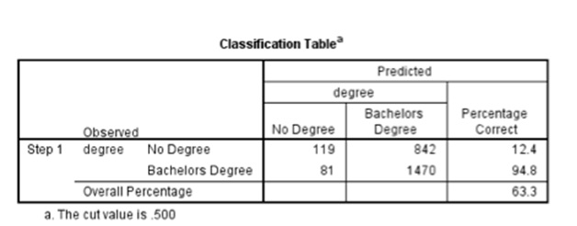
Results
63.3% of cases correctly predicted
36.7% of cases incorrectly predicted

Slide 10
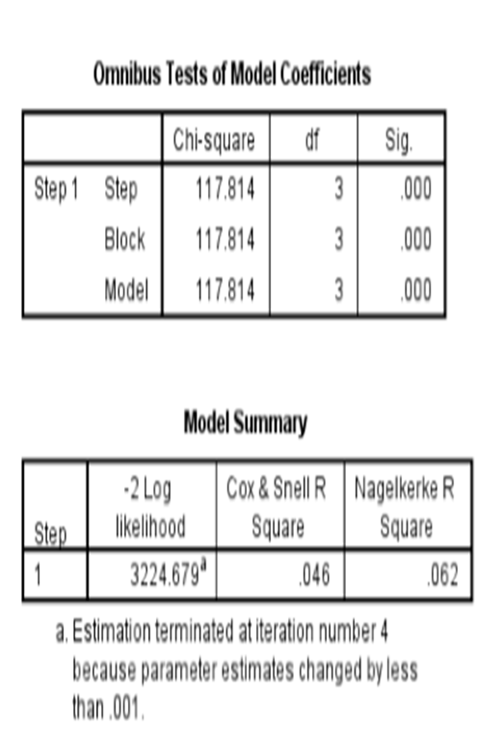
Results
Statistically significant so the model with only the constant is a poor fit, so the predictors have a significant effect and essentially a different model.
Cox & Snell: 4.6% of the variation of degree attainment is explained by the logistic regression model.
Nagelkerke R Square Test: A relatively weak relationship of 6.2% between the predictors and the prediction.

Slide 11

Results
The Hosmer and Lemeshow Test is not significant so the model is a good fit for the data.
So since the model doesn’t statistically differ from the observed, it therefore fits the model at an acceptable level.

Slide 12
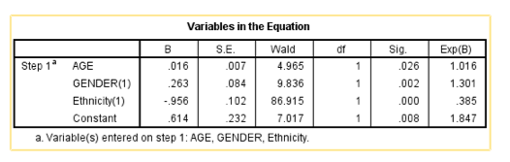
Results
Age: Significant
-As age increases the proportion of people who get degrees increases.
Gender: Significant
-As the ratio of females to males increases the proportion of degrees obtained increases.
Ethnicity: Significant
- An increase in the proportion of Hispanics relative to whites in the sample, has a dramatic negative effect on the proportion of people getting a bachelor’s degree.

Slide 13
Limitations
Calls were only made to landlines so any households without one could not be included in the data collection process.
Focus was on the Greater Los Angeles Area so not generalizable to other populations due to the unique population of the area.

Slide 14
Further Research
Look at schools in the Los Angeles area especially in the high schools to see how students are being encouraged to go to school and see what information is available to them.
See how counselors are able to help students out
  Accuracy of information
    Are there bilingual pamphlets or is information only available in English?
  Availability (urban vs suburban high schools and colleges)

Slide 15
References
Brock, Thomas. 2010. “Young Adults and Higher Education: Barriers and Breakthroughs to Success.” The Future of Children 20(1):109-32.
Gonzalez, Laura M. 2012. “College-Level Choice of Latino High School Students: A Social-Cognitive Approach.” Journal of Multicultural Counseling and Development 40(3):144-55.
Hagedorn, Linda S., Winny Chi, Rita M. Cepeda, and Melissa McLain. 2007. “An Investigation of Critical Mass: The Role of Latino Representation in the Success of Urban Community College Students.” Research in Higher Education 48(1):73-91.
US Census Bureau. (2011). State and County Quick-Facts: California. Retrieved November 5, 2012 from http://quickfacts.census.gov/qfd/states/06000.html

