Slide 1
What Affects Sports Attendance?
by
Kevin Gragg

Slide 2
Introduction
Why study sports? It seems very mundane
Literature Review
Methodology
Results
Limitations and Future Research

Slide 3
Importance of Sports in Society
67% of Americans are sports fans or have some knowledge about sports
the dynamics that are present in other phenomenon that Sociology studies are inherent in sports i.e. stratification, conflict, gender & race issues, solidarity and group cohesion
Notes:
Race: Jackie Robinson, Title IV allowed women to participate in college athletics
In ALL newspapers, on ALL news shows, athletes are famous & widely recognized, schools fund sports programs, mass revenue spent on them by companies

Slide 4
Literature Review
Fan Identity
What Affects Attendance?

Slide 5
Fan Identity
sense of obligation to the team leads fans to show their loyalty
explains why fans feel compelled to attend games or purchase merchandise
the stronger a person identifies with a team, the more likely they will outwardly express their fandom through attending games or purchasing merchandise
males are more likely to identify as a sports fan

Slide 6
What Affects Attendance?
social aspect
gender
age
demographic factors correlate with attendance
social class and the status of the sport
Notes:
need to interact & feel a common bond/solidarity with other sports fans
escape from real life
women prefer the environment: safety, family friendly, socializing
Men: want to support their team & that's their primary motive for attending games
younger fans more likely to attend games

Slide 7
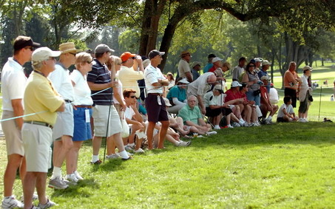
High Status Sports
Notes:
golf or tennis are associated with the upper class

Slide 8
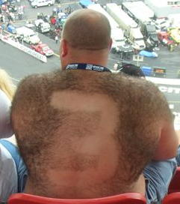
Prole Sports
Notes:
NASCAR, boxing, UFC...all associated with having low status

Slide 9
Methodology
1993 GSS Survey
Binary Logistic Regression
Cross Tabulation
Notes:
DV= sports attendance, attend game or didn't attend game (nonquantitative variable)
IVs= age, race, income, sex, marital status (race, marital status & sex are categorical)
cross tab to examine income
cross tab to further examine income on attendance

Slide 10
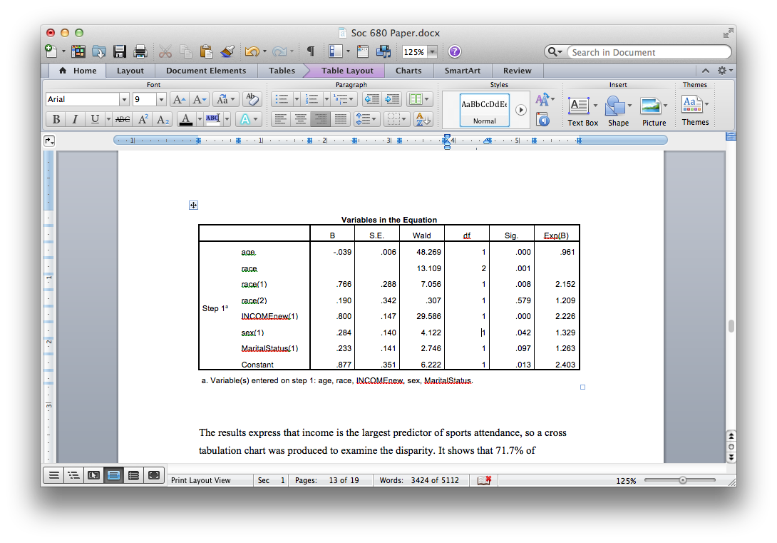
Results from Logistic Regression
Notes:
Correctly classified 66.4% overall correct & 86.6% of those that attended a game correct
Wald’s statistic shows that marital status is not significant in predicting the probability of attending a game & sex was barely significant; being black overall wasn’t significant either, but race itself is
as age increases, the likelihood/probability of attending a game decreases
whites significantly & very largely more likely to attend games than blacks
as income increases, the probability of attending a game increases dramatically
males are more likely to attend games than females
married people are more likely to attend games than non married people

Slide 11
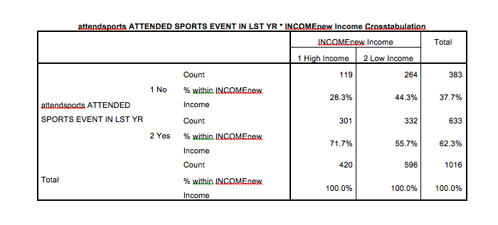
Results from Cross Tabulation chart
Notes:
71.7% of those with an income greater than $25,000 attended a game in the last year, compared to 55% of those that made less than $24,999

Slide 12
Limitations and Future Research
Compare fans within a sport ex. Los Angeles Dodgers fans vs Los Angeles Angels fans
Region: small markets tend to be heterogeneous communities (i.e. New Orleans and Indiana) while large markets tend to have diverse fans (i.e. New York and Los Angeles)

