Slide 1
A Forbidden Fruit? The Effect of Age, Nervousness, and Parental Supervision on Adolescent Alcohol Use
By Karen Sabbah
SOC 680 – Fall 2012

Slide 2
Introduction
Purpose: To explore how an adolescents age, how often they felt nervous and the amount of parent supervision effects their alcohol use
Logistic Regression used since I’m predicting adolescents partaking in risky behavior (alcohol use)

Slide 3
Literature Review:
Adolescents and Risky Behaviors
Nationwide teenage drinking increases the older the kids are. The highest being reported in 12th grade. (Grunbaum et al. 2004:313)
Teens surveyed by CASA on Substance Abuse identified the top 5 sources of stress as (2012:20):
Academic Pressure – “twice as likely to have used alcohol [except when coupled with high levels of stress, they’re] more than three times likelier to have used alcohol”
Family or Problems at home
Drama with Friends
Bullying
Being Popular

Slide 4
Literature Review:
Parental Knowledge of Teen Activities
Parental monitoring is not enough to reduce adolescent alcohol use. Teens also need to talk to their parents about alcohol and find out their parent’s opinions on alcohol use (Beck, Boyle, Boekeloo 2003:109).
National Center on Addiction and Substance Abuse report teens whose parents have little to no knowledge on their activities are “one and a half times likelier to have used alcohol” (Family Dinner 2012:2)
According to the American Medical Association “one out of four American parents support [underage drinking as long as it is done in the parent’s presence]” (Alcoholism 2005).

Slide 5
Hypotheses
H₁: The older the adolescent is the more likely they are to have consumed more than a few sips of alcohol.
H₂: The more often the adolescent felt nervous in the last 30 days, the more likely they are to have consumed more than a few sips of alcohol
H₃:The more the parents know of the adolescent’s evening activities, the less likely they are to have consumed more than a few sips of alcohol.

Slide 6
Dataset Used
Using data from the California Health Interview Survey, 2009 Adolescent Questionnaire
  Funded by UCLA Center for Health Policy
  Done every 2 years since 2001
  Random Digit Dialing sampling method across 56 counties in California
  3,379 adolescents aged 12-17 participated

Slide 7
Methodology
Population: 3,379 adolescents aged 12-17
Independent Variables:
  Age
  Sex (not included in logistic regression, used as a comparison tool only)
  About how often during the past 30 days did you feel nervous?
  How much do you parents really know about where you go out at night?
Dependent Variable:
  Did you ever have more than a few sips of any alcoholic drink, like beer, wine, mixed drinks, or liquor?
Logistic Regression performed to predict the risky behavior

Slide 8
Results: Adolescent Nervousness
Comparison By Age
Comparison By Sex
Males had the highest reporting being nervous a little of the time (52.8%) or none (59.4%)
Females had the highest reporting being nervous all of the time (54.5%), most of the time, (65.5%) or some of the time (53.3%)
Age | All-Some | Little-None
12 | 19.6% | 80.4%
13 | 23.3% | 76.7%
14 | 25.1% | 74.9%
15 | 28.2% | 71.8%
16 | 27.8% | 72.2%
17 | 32.6% | 67.4%
Overall Results of Adolescent Nervousness
0.65% of teenagers reported All of the Time
4.29% of teenagers reported Most of the Time
21.19% of teenagers reported Some of the Time
49.7% of teenagers reported A Little of the Time
24.12% of teenagers reported None
As Age increases, so does reports of feeling nervous

Slide 9
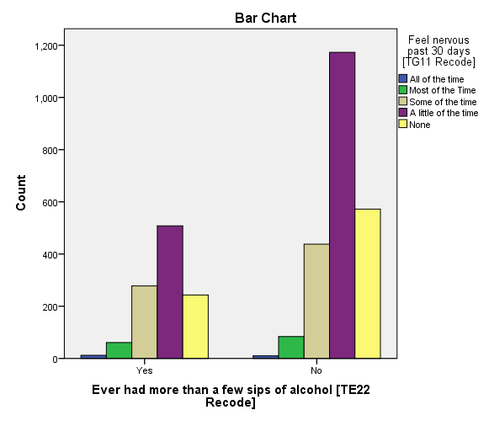
Results: Adolescent Nervousness and Alcohol Use
Nervous | Yes | No
All | 54.5% | 45.5%
Most | 42.1% | 57.9%
Some | 38.8% | 61.2%
A Little | 30.2% | 69.8%
None | 29.8% | 70.2%
Increase in nervousness leads to an increase in alcohol use
43% of teens who felt nervous all or most of the time reported having more than a few sips of alcohol

Slide 10
Results: Adult Knowledge on Teen Evening Activities
Comparison By Age
Comparison By Sex
Age | A Lot | Little | None | Stay In
12 | 75.5% | 3.04% | 0.95% | 20.4%
13 | 77.7% | 5.27% | 2.04% | 14.9%
14 | 80.2% | 8.9% | 1.93% | 8.95%
15 | 79.4% | 10.5% | 2.05% | 8.03%
16 | 79.9% | 15.3% | 1.66% | 3.16%
17 | 77.5% | 17.5% | 1.97% | 3.04%
Sex | A Lot | Little | None | Stay In
M | 77.1% | 10.9% | 1.81% | 10.1%
F | 79.7% | 9.36% | 1.74% | 9.12%
Overall Results of Adult Knowing Where Teen is at Night
78.4% of teenagers reported A Lot
10.18% of teenagers reported A Little
1.78% of teenagers reported Nothing
9.65% of teenagers reported they Stay In at Night
Age 14 is the turning point for parental knowledge on evening activities

Slide 11
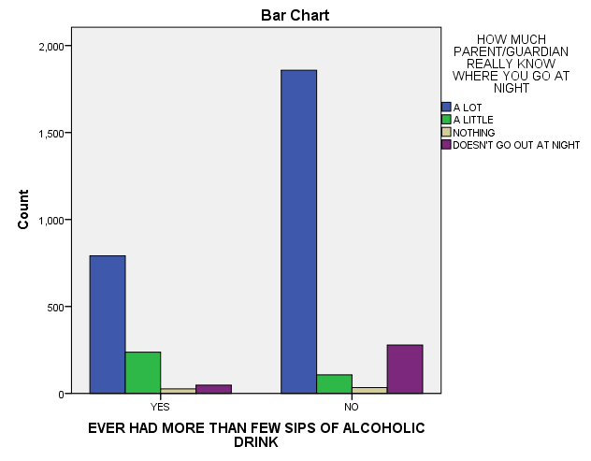
Results: Adult Knowledge on Teen Evening Activities and Alcohol Use
Adult Knows | Yes | No
A Lot | 29.8% | 70.2%
A Little | 68.9% | 31.1%
Nothing | 43.3% | 56.7%
Stays In | 14.7% | 85.3%
The more parent/adults know where the teens are at night, the less likely they are to drink.
65% of teens whose parents know little to nothing of their evening activities reported drinking more than a few sips of alcohol

Slide 12
Results: Alcohol Use
Comparison By Age
8.36% of 12 year olds reported Yes
15.82% of 13 year olds reported Yes
28.07% of 14 year olds reported Yes
37.76% of 15 year olds reported Yes
46.92% of 16 year olds reported Yes
57.42% of 17 year olds reported Yes
Comparison By Sex
33.38% of Males reported Yes
31.76% of Females reported Yes
Overall Results of Alcohol Use
32.6% of teenagers surveyed reported having had more than a few sips of alcohol
67.4% of teenagers surveyed reported not having had more than a few sips of alcohol
As Age increases, so does Alcohol Use

Slide 13
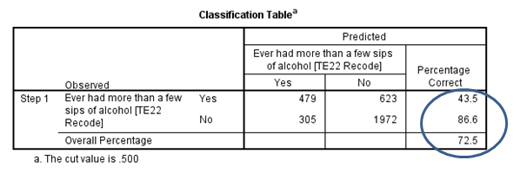
Logistic Regression
72.5 % of cases were correctly predicted
27.5 % of cases were incorrectly predicted

Slide 14
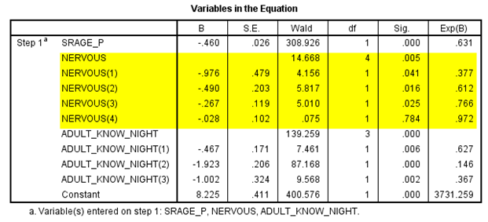
Results: Logistic Regression
For each year the adolescent ages, the more likely they are to have had more than a few sips of alcohol
For each one unit of nervousness (felt all the time, most of the time, some of the time, a little of the time) the more likely the adolescent is to have had more than a few sips of alcohol.
For each one unit of adult knowledge of their evening activities (a lot, a little, nothing) the more likely the adolescent is to have had more than a few sips of alcohol

Slide 15
Results: Logistic Regression (cont.)
SPSS calculated the dependent variable as a No/Yes ratio so proportion of No is relative to Yes goes down.
Age, Nervousness, and Adult Supervision are significant predictor independent variables. The only exception is Teens who reported feeling nervous A little of the time. This is not a significant predictor independent variable (0.784)

Slide 16
Discussion
Reject the null hypothesis on Adolescent Age – as they age, the more likely they are to have more than a few sips of alcohol
Reject the null hypothesis on Adolescent Nervousness – the more nervous they are, the more likely they are to have had more than a few sips of alcohol
Reject the null hypothesis on Adult Supervision because there is an effect, just not as it is initially stated in the hypothesis.

Slide 17
Limitations
Cross Sectional Survey
No logical sequence to see which came first, Adolescent Nervousness, Adult Knowledge of their evening activities, or Alcohol use.
No descriptor to factors contributing to feelings of nervousness (peer, family, school, etc.)
No explanation for occasion/location alcohol was consumed or if parents had knowledge or provided alcohol
Majority of teenagers surveyed reported they had not had more than a few sips of alcohol
Phrasing of the alcohol question including “sips” may not resonate with older adolescents who don’t “sip” but chug or swig.
Limited variance in parental knowledge of adolescent evening activities (80/20)

Slide 18
Further Research Suggested
Have teens identify:
  a sequence of events → Nervousness caused Drinking or Drinking caused increase in Nervousness
  factors contributing to feelings of nervousness
  Identify occasion/location of alcohol consumption
  Identify if parents provided alcohol or knew it would be provided
Expand on alcohol consumption definition or provide a time frame of consumption relative to other variables.

Slide 19
References
Alcoholism and Drug Abuse Weekly . 2005. “AMA Polls Find Parents Give Alcohol to Teens and Their Friends.” August. Retrieved November 26, 2012 doi: 10.1002/adaw.20006.
Beck, Kenneth H., Jennifer R. Boyle and Bradley O. Boekeloo. 2003. "Parental Monitoring and Adolescent Alcohol Risk in a Clinic Population." American Journal of Health Behavior 27(2):108-15.
California Health Interview Survey. 2009. “Adolescent Public Use File.” Los Angeles, CA: UCLA Center for Health Policy Research, November 2011.
National Center on Addiction and Substance Abuse. 2012, "The Importance of Family Dinners VIII", 633 Third Avenue, New York, NY 10017-6706: Columbia University. Retrieved November 21, 2012(http://www.casacolumbia.org/templates/publications_reports.aspx).
National Center on Addiction and Substance Abuse. 2012, "The National Survey of American Attitudes on Substance Abuse XVII: Teens", 633 Third Avenue, New York, NY 10017-6706: Columbia University. Retrieved November 26, 2012 (http://www.casacolumbia.org/templates/publications_reports.aspx).

