Slide 1
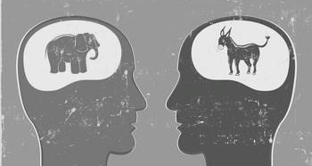
The Effects of Party System on voter attitudes and behavior

Slide 2
Research Question
Does type of party system affect voter attitudes and behavior?
Specifically, confidence in government, leaders, the democratic process, voter participation, etc.

Slide 3
Previous Research/theory
Schofer and Fourcade-Gourinchas (2001)
Looked at how structural contexts affect voter behavior
Heath (2007)
Voter decline in Britain compared to other countries
Miller and Listhaug (1990)
Political Parties and Confidence in Government
Discontent in Two-party systems was much more likely to turn into cynicism and distrust
Where voter identification is high, voter turnout will be high, where low, turnout will be low
Looked specifically at associational membership

Slide 4
Data set- World Values Survey 1995
Coordinated by the World Values Survey Association, located in Stockholm
A worldwide investigation of sociocultural and political change
Conducted by social scientists at universities in over 100 countries

Slide 5
Party Systems
Two-Party System
Two main parties
One wins the majority of votes
Ex: U.S. Republicans and Democrats- alternate
Multi-Party System
Three or more main parties (often with supporting parties
No party has a chance of winning majority of votes, thus must form coalitions to put over 50% threshold
Ex: Sweden 9 parties represented in parliament

Slide 6
Variables
IV
Party System
1= Two-Party 2=Multi-Party
DV1
Political Participation Scale (from 0-10)
DV2
Confidence Scale (from 0-12)
CV1
Rating of Political System Scale (from 0-20)

Slide 7
Tests of Univariate Normality
 |  | Rating of Politic. System | Confidence Scale | Political Participation
Two-Party
 | Skewness | -0.046 | 0.051 | 0.214
 | Kurtosis | -0.507 | -0.045 | -0.516
Multi-Party
 | Skewness | -0.242 | -0.224 | -0.013
 | Kurtosis | -.405 | -0.219 | -0.543

Slide 8
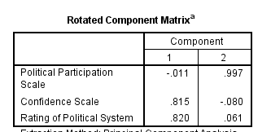
Principle Component Analysis

Slide 9
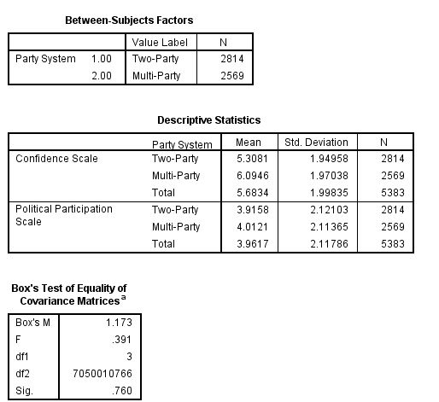
Results

Slide 10
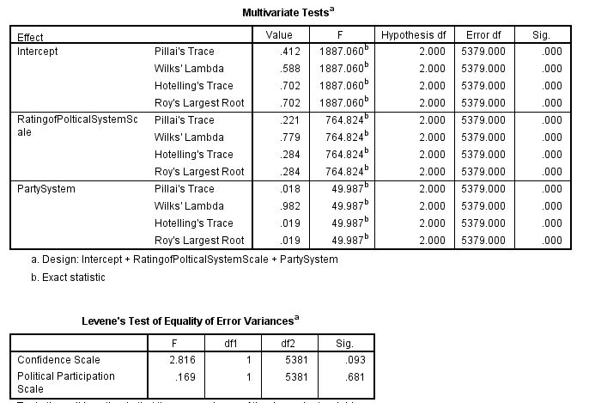

Slide 11
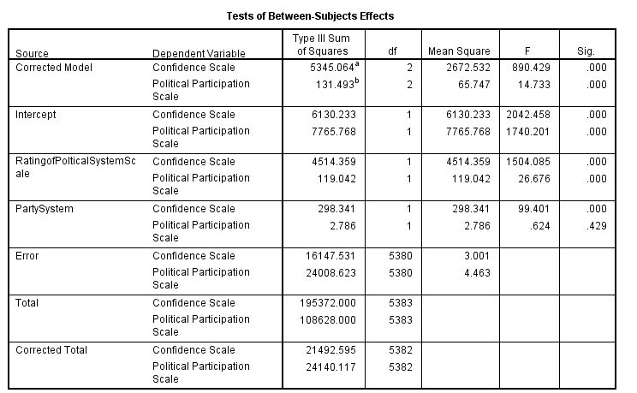

Slide 12
Post- Analysis

