Slide 1
Walkability
The Effect of Walkability on Quality of Life

Slide 2
A simple Overview
Introduce concepts and why you should care
Address data and method of analysis
Discuss analysis

Slide 3
Literature Review:
Quality of Life
Quality of Life:*
  I am appropriating the definition of quality of life from Harjiran “as the product of interactions between an individuals personality and the continuous episodes of life events as influenced by a multidimensional set of domains that constitute life…a community’s quality of life is the sum of its members” (2006:33)*
  No universally agreed upon definition
  Research into this areas of study has been spurred by:
    Urban gentrification and revitalization (Das 2007:500)
    Changing living conditions (298)
    Individuals need to be happy within society (Gerson 1976:794)
Operationalized: The Community Satisfaction Index:
  Dependent variable
  Measurement from the data by which I will be gauging quality of life
Notes:
*Two perspectives are economic (economic influences on social life) and hedonistic (concerned with pleasure, enjoyment satisfaction and concerned with functioning and the realization of our potential (Clark :303)
* Within this paper, the domains I will be examine quality of life through are those of the independent variables

Slide 4
Literature Review:
Walkability
Walkability:
  The ability to access necessary and pleasurable destinations within a community while considering the variables listed below
  Often measured as a component variable and represented as an aggregate of the following variables (Gallimore et al 2011:188) :*
    Traffic Safety
    Accessibility
    Pleasurability
    Crime Safety
    Density
    Diversity
    Routes
  “Walkability enhances social capital by providing the means and locations for individuals to connect, share information and interact with those that they might not otherwise meet” (Rogers et al 2010:212)
  “Patterns of joint participation in multiple settings are…at the heart of any conception of quality of life” (Gerson 1976:799)
Operationalized: Walking Behavior for Leisure and Walking Behavior Overall:
  Independent variables
  Measurements from the data by which I will be gauging walkability
  Going against the popular method of creating a component variable and using a non-quantitative approach
Notes:
I couldn’t find a good definition of walkability.
Walkscore.com – check it out whether for additional research or to look up your neighborhood. Next time I do research I think I’ll try to get a hold of their data

Slide 5
Literature Review:
Additional Research
Prevalent Research:
  Quality of life research pertaining to health (well-being)
  Urban planning, transportation (not much in walking as transportation)
  Use of leisure time and physical activity pertaining to general leisure activities (not explicitly walking) and type of community*
Very Minimal Research:
  Measuring walkability within communities
  Examining quantitative vs. qualitative perceptions and measurements of walkability*
  Walking for leisure vs. walking for necessity*
Notes:
Most of this research focuses on the health of elderly individuals who engage in walking, particular cities that have been examined are Bogota, Columbia, cities in Sweden and a few cities in Germany.
Research done in Belgium, Australia and USA. Primarily focuses on use of parks, health in relation to physical activity, types of activity, community centers, urban vs rural communities, male vs female and racial differences
How is walkability most effectively measured? Quantitatively – distances to certain places (schools, parks, grocery, work) or qualitatively – how an individual perceives their community as walking friendly (safety, sidewalks, trees / shade, closeness or interaction with neighbors)
Mostly walking for leisure is lumped in with health and well-being research and walking for necessity is only occasionally found as a variable in transportation research. Haven’t been able to locate any comparative studies

Slide 6
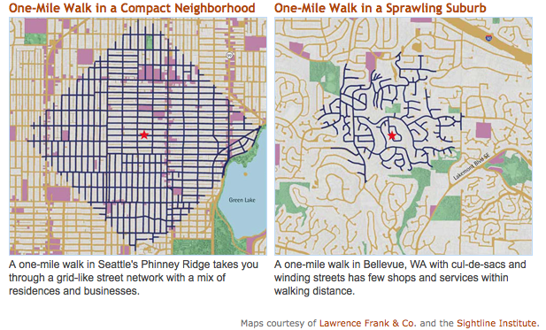
Why Walkability and Quality of Life Matter
The developing causes of durable networks within communities are created by communal activities, socializing (Kim and Kim 2008, Robinson and Martin 2008:596) and leisure activities engaged within a community atmosphere (Clark et al 2002, Rogers et al 2010 and Stalker 2011)*
Depending on the infrastructure that supports the interaction of the community, residents may increase their interaction through walking which leads to an increased degree of social capital, community integration and quality of life (Rogers et al 2010)
The structural dimensions of a community, which allow for walkability, can greatly influence that community’s quality of life and thus should be taken into consideration by urban planners
Notes:
*walking for leisure is a community activity and walking for necessity becomes communal when social ties are developed (such as between people you pass regularly on the street)
Picture: One mile of walking in an urban neighborhood on the left and one mile of walking in a suburban neighborhood on the right.
More walkability = more social interaction = increased quality of life

Slide 7
Hypothesis
The perceived walkability of a community
by its residents
has an influence on how those residents
perceive their quality of life.

Slide 8
The Dataset
Detroit Area Study, 2001: Quality of Life in the Metro-Detroit Area
Who:
  Funded: 300-400 face-to-face interviews are funded by the University of Michigan. The city, state, regional and county governments fund the surveys distributed in the mail
  Research and Analysis : Through the DAS research and training facility at University of Michigan
Why the survey was initially created:
  Established in 1951 to provide data on the Detroit metropolitan area
  Distributed annually*
Notes:
The same questionnaire is used for interviews as for mail distribution
I used the 2001 survey because its feature topic was quality of life and thus it was more applicable than resent surveys
I also used this one because it is difficult to find datasets that fully address all dimensions of walkability that this one does while also having a variable that could work as an operationalization for quality of life

Slide 9
The Methods
Method of Sampling:
  Multi-stage probability sample
Survey Instrument:
  Questionnaire
Population:
  Face-to-face Interviews: Randomly conducted on 300 to 400 individuals within 60 minutes of the University of Michigan
  Mail surveys: 7 counties in southeast Michigan, often referred to as the metro Detroit area.
Sample:
  4,392 individuals
Analysis:
  The method most appropriate for this data set was an analysis of variance (ANOVA) and analysis of covariance (ANACOVA)*
Notes:
Additional ANOVAS and factorial ANOVAS were ran on walkability, but were not included in this project for the sake of brevity

Slide 10
Analysis: The Original variables
Dependent Variable:
  Community Satisfaction Index (COMM1):*
    Scale
    Values ranging from 1-7 in.25 increment attributes
Independent Variables:
  Walking Behavior for Leisure (WALKLEIS):
    Ordinal
    3 values ranging from .00 to 1 in .5 increments
  Walking Behavior Overall (WALKOVER)
    Ordinal
    Values ranging from 0 to 1 in .20 increments
Control Variables:
  Neighborhood conveniently located within walking distance of stores, parks, etc. (V162M)
    Ordinal
    Likert Scale
Notes:
Breeze through this slide
*this scale was created by the original survey developers based on an aggregate of factors measured in the survey

Slide 11
Analysis: Recoded Variables
COMM1 -> LGCOMM1:
  How: I used the inverse transform function to normalize the data*
  Why: The index was negatively skewed, most of the answers were high community satisfaction. This continually threw off the Levine’s test for homogeneity of variance
Walkover -> REWALK:
  How: Minimized from 6 attributes into 3 ordinal attributes
  Why: To better fit the ANOVA model
V162M -> RV162M:
  How: Minimized from 5 attributes into 3 ordinal attributes
  Why: To better fit the ANOVA model
Notes:
Part that I had the most trouble on
*The Community Satisfaction Index gave me the most trouble. I tried just about every sort of correction including using the log and square route functions to transform the data but they were not as effective as the inverse function.

Slide 12
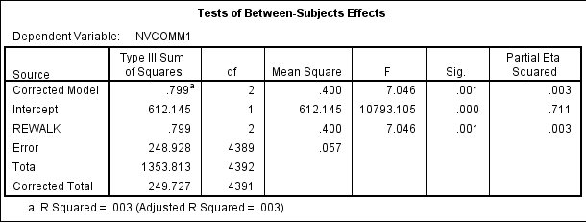
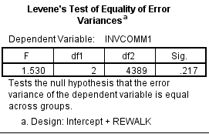
Analysis: The Results
The effect that Walking Behavior Overall has on the Community Satisfaction Index
Method: One-Way ANOVA
Hypothesis Supported: Yes, minimally
P Value: Significant
F Ratio: The means of the 3 groups are close together
Effect Size: Under .5 but Walking Behavior Overall still has an effect on Community Satisfaction
Notes:
Hypothesis: The perceived walkability of a community by its residents has an influence on how those residents perceive their quality of life.
ANOVA

Slide 13
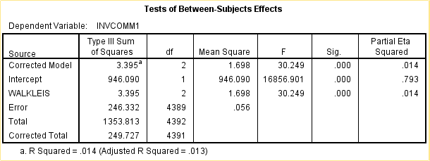
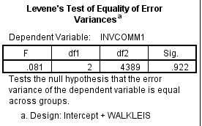
Analysis: The Results
The effect that Walking Behavior for Leisure has on the Community Satisfaction Index
Method: One-Way ANOVA
Hypothesis Supported: Yes, on a greater scale
P Value: Significant
F Ratio: Means of the 3 groups are farther apart
Effect Size: Under .5 but Walking Behavior for Leisure has a greater effect on Community Satisfaction than Walking Behavior Overall
Notes:
Hypothesis: The perceived walkability of a community by its residents has an influence on how those residents perceive their quality of life.
ANOVA

Slide 14
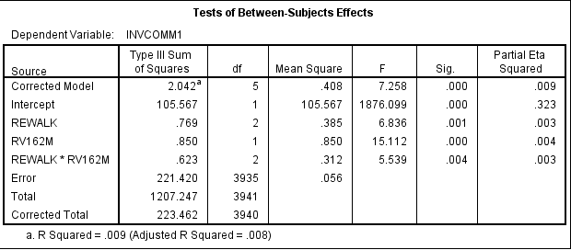
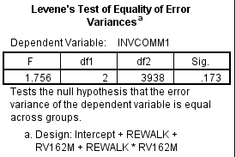
Analysis: The Results
The effect that Overall Walking Behavior has on the Community Satisfaction Index, with the covariate of the neighborhood being conveniently located within walking distance of stores, parks, etc.
Method: ANACOVA
Hypothesis Supported: Yes, minimally
P Value: Significant
F Ratio: The means of the groups, when accounting for the control variable, are close
Effect Size: Under .5 but Overall Walking Behavior, when controlling for the neighborhood being conveniently located within walking distance of stores, parks, etc., still has an effect on Community Satisfaction
Notes:
Hypothesis: The perceived walkability of a community by its residents has an influence on how those residents perceive their quality of life.
ANACOVA

Slide 15
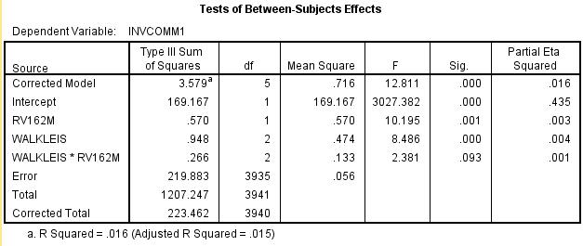
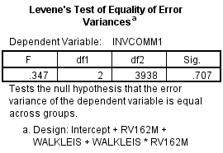
Analysis: The Results
The effect that Walking Behavior for Leisure has on the Community Satisfaction Index, with the covariate of the neighborhood being conveniently located within walking distance of stores, parks, etc.
Method: ANACOVA
Hypothesis Supported: No
P Value: Insignificant
F Ratio: The means of the groups, when accounting
for the control variable, are very close
Effect Size: Doesn’t really matter since the results are not statistically significant
Notes:
Hypothesis: The perceived walkability of a community by its residents has an influence on how those residents perceive their quality of life.
ANACOVA

Slide 16
Discussion
Was my hypothesis correct?
  Overall, yes, except for when using the covariate with Walking Behavior for Leisure.
Limitations:
  Sample:
    The sample was skewed towards suburban single family dwellings in the metro Detroit area*
    There were a very limited number of quantitative variables
  Procedure:
    It would have been nice if the dependent variable, Community Satisfaction Index, were normally distributed and thus would not have required as much manipulation as it did to fulfill the necessary assumptions of analysis
  Analysis:
    More in depth analysis could be done if additional quantitative variables were available from the survey results
    May be interesting to examine combinations of independent variables or other possible covariations
Suggestions for further data collection and research:
  Smaller, more thorough samples of community enclaves, within the city and enclosed communities
  If a regional survey is done again, a larger, more representative sample would be beneficial
  This survey could be beneficial for use in other communities to examine their walkability
Notes:
*possible reason for the skew in the Community Satisfaction Index

Slide 17
Perhaps walking is best imagined as an ‘indicator species,’ to use an ecologist’s term. An indicator species signifies the health of an ecosystem and its endangerment or diminishment can be an early warning sign of systemic trouble. Walking is an indicator species for various kinds of freedom and pleasures: free time, free and alluring space, and unhindered bodies.
Rebecca Solnit,
Wanderlust: A History of Walking
Notes:
Why the results matter and why the relationships between Quality of life and Walking should be further examined.

Slide 18
References
Clark, Terry Nichols, Richard Lloyd, Kenneth K. Wong and Pushpam Jain. 2002. “Amenities Drive Urban Growth.” Journal of Urban Affairs 24:493-515.
Das, Daisy. 2007. “Urban Quality of Life: A Case Study of Guwahati.” Social Indicators Research 88:297-310.
Detroit Area Study, 2001: Quality of Life in the Metro-Detroit Area. 2001. Detroit Area Study. Ann Arbor, MI: University of Michigan [producer]. Ann Arbor, MI: Inter-university Consortium for Political and Social Research [distributor].
Gallimore, Jonathan, Barbara Brown and Carol Werner. 2011. “Walking Routs to School in New Urban and Suburban Neighborhoods.” Journal of Environmental Psychology 31:184-191.
Gerson, Elihu M. 1976. “On ‘Quality of Life’.” American Sociological Review 41:793-806.
Hajiran, Homayoun. 2006. “Toward a Quality of Life Theory: Net Domestic Product of Happiness.” Social Indicators Research 75:31-43.
Kim, Seoyong and Hyesun Kim. 2008. “Does Cultural Capital Matter?: Cultural Capital Divide and Quality of Life.” Social Indicators Research 93:295-313.
Robinson, John P. and Steven Martin. 2008. “What Do Happy People Do?” Social Indicators Research 89:565-71.
Rogers, Shannon H., John M. Halstead, Kevin H. Gardner and Cynthia H. Carlson. 2010. “Examining Walkability and Social Capital as Indicators of Quality of Life at the Municipal and Neighborhood Scales.” Applied Research in Quality of Life 6:201-13.
Stalker, Glenn John. 2011. “Leisure Diversity as an Indicator of Cultural Capital.” Leisure Sciences 33:81-102.

