Slide 1
The effects of gender and online forums on time spent playing video games
By Danny Shnorhokian

Slide 2
Overview
Introduction
  Previous research
Hypotheses
Method
  Factorial ANOVA
Findings
Final Discussion

Slide 3
Introduction
Take a look to see if gender and time spent surfing online forums have a direct effect on how much time adolescents play video games
I used a factorial ANAOVA
  Independent variables = non-quantitative
  Dependent variable = quantitative

Slide 4
Previous research
Video games have been center of controversy
  Many recent crimes such as the Columbine shooting were blamed on violent video games (Gaudiosi, 2011).
Christopher Ferguson, a clinical psychologist who is a leading expert on video game violence and mass killings, states that video games aren’t to blame for these tragedies
  Believes that the shootings would have happened regardless of them playing video games and that other factors are to blame

Slide 5

Previous research
Some researchers believe that video games can be used in a positive light such as education
  “Edutainment” – using video games in classrooms to help students learn (Squire, 2003)

Slide 6

Previous research
Jeanne Funk (1993) found that
  66% of girls and 90% boys spent time each week playing videogames at home. Estimated average time played per week - 2 hours for girls, 4.2 hours for boys. 20% girls and 50% boys played in arcades during the week. Approximately 50% of favorite games were either fantasy or human violence games, 2% were educational.

Slide 7
Hypotheses
H₁ – Gender does have a direct effect on the amount of times per week video games are played
H₂ – Visiting online forums have a direct effect on the amount of times per week video games are played
H₃ – The interaction of both gender and visiting online forums have a direct effect on the amount of times per week video games are played
H₀ – Gender and visiting online forums do not have a direct effect on the amount of times per week video games are played

Slide 8
Method: Factorial ANOVA
Overview of study
  Conducted by The Parent and Teen Survey on Gaming and Civic Engagement which was sponsored by Pew Internet and American Life Project
Study was done
  Phone interviews with 1,102 teenagers between the ages of 12-17
  Had consent of parents
  4 month span from Nov. 2007 to Feb. 2008

Slide 9
Method: Factorial ANOVA
All phone calls were dialed at random
All participants were located in the continental US
All teenagers interviewed in the study played video games
All data was weighted using sample balancing (done by researchers)

Slide 10
Method: Factorial ANOVA
Independent variables
  Gender
  Whether or not they browsed online forums on the internet
Dependent variable
  Number of days spent playing video games a week
Controls
  All children in analysis did play video games

Slide 11
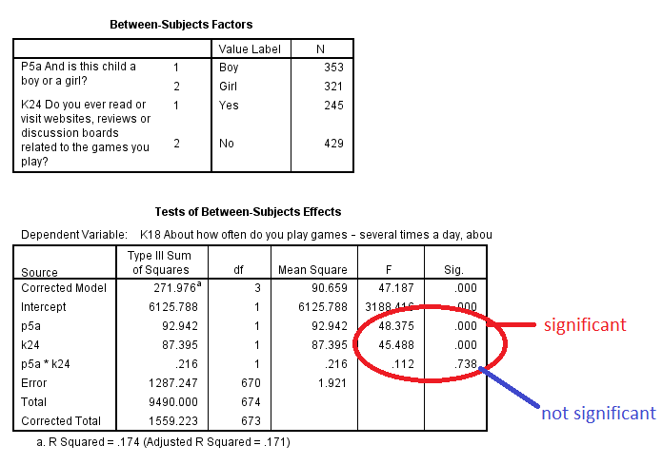
Findings

Slide 12
Findings
The results show that both my independent variables gender and whether or not the respondent visits online forums INDIVIDUALLY have a direct effect on the number of times per week they play video games
However, the interaction between the two independent variables had a significant value of 0.738 which means that 73.8%, this would have happened by random, therefore having no direct effect on the dependent variable

Slide 13
Findings
I accept my H₁ and H₂ that gender and whether the teenagers visit online forums do have a direct effect on how many times a week they play video games
BUT
I cannot accept my H₃ that the interaction of these two independent variables have a direct effect the number of times they play video games per week

Slide 14
Final Discussion
Limitations
  The teenagers conducted the interview over the phone after the researcher spoke to the parents
    Kids may lie if they feel nervous or uncomfortable in front of parents
  No face-to-face interviews were done which might have resulted in more truthful answers

Slide 15
Final Discussion
  More questions regarding other aspects of gaming could be asked for the further studying of video games and how they affect adolescence
  Do not ask if household has internet
  For modern day video games, internet is required to play online which might increase the amount of time kids play video games
They do not specify what is considered a “video game”
  Video games range from solitaire or games on the cell phone to arcades and current generation consoles (Xbox & Playstation)

Slide 16
Final Discussion
For future research
  Do the study with a broader age range
    Do not start at 12 and do not cap it at 17
      Both younger and older people play video games
  Specify what is considered a video game and branch the research in different categories
  Conduct face-to-face interviews and online surveys to get a bigger sample size

Slide 17
References
Funk, Jeanne. 1993. “Reevaluating the Impact of Video Games” Electronic Journal of Clinical Pediatrics 32:2, 86-90. Retrieved on November 29, 2012 (http://www.cmch.tv/research/fullRecord.asp?id=2545)
Gaudiosi, John. 2011. “Expert Calls Blaming Video Games On Tragic Massacres Like Oslo And Columbine Racist” Retrieved November 30, 2012 (http://www.forbes.com/sites/johngaudiosi/2011/07/28/expert-calls- blaming-video-games-on-tragic-massacres-like-oslo-and-columbine- racist/)
Lucas, Kristen and Sherry, J. L. 2004. “Sex differences in video game play:. A communication-based explanation” Communication Research, 31(5), 499-523. (http://search.proquest.com.libproxy.csun.edu/socabs/docview/81197148 4/13ABAE8683A54F013C9/1?accountid=7285)
Squire, Kurt. 2003. “Video Games in Education” Electronic Journal of Int. J. Intell. Games & Simulation, 2:1, 49-62. Retrieved November 29, 2012 (http://www.skatekidsonline.com/parents_teachers/Video_games_in_edu cation_Updated.pdf)
Steinkuehler, Constance and Dmitri Williams. 2006. “Where Everybody Knows Your (Screen) Name: Online games as "Third Places.”" Journal of Computer-Mediated Communication,11:4 Retrieved on December 1, 2012 (http://jcmc.indiana.edu/vol11/issue4/steinkuehler.html)

