Slide 1
Hubbard Elementary
September 10, 2013
Susan Belgrad
Steve Holle
As You Teach… Ignite Students’ Interests in Science Careers (and Science!) The Motivation

Slide 2
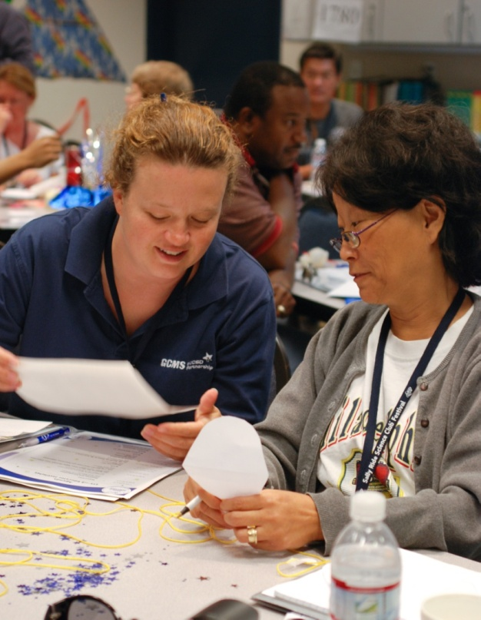
Purpose of this Workshop
The purpose of this workshop is to help educators raise students’ interest in science and science careers based on research that shows introducing young students to
fuels their interest in science and makes the study of science more meaningful to them.
the wide variety of science careers available
the many paths to becoming a scientist
the vibrant women and men working in science today

Slide 3
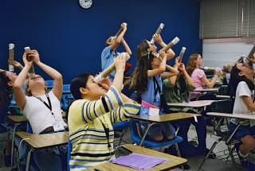
Goals of Workshop
Understand
current knowledge of boys’ and girls’ interest, achievement, and aptitude in math and science.
reasons students lose interest in science, and girls in greater numbers than boys.
the crucial role educators play in shaping students’ attitudes and beliefs about science and science careers.

Slide 4
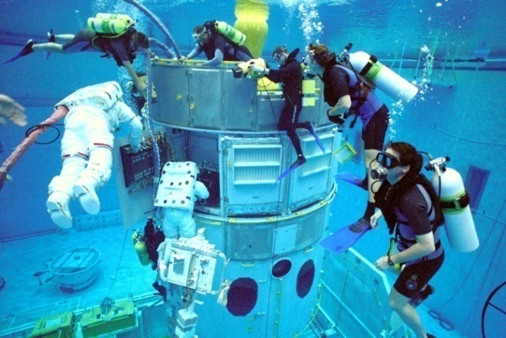
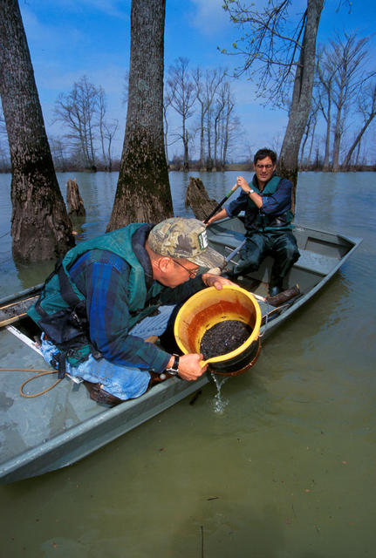
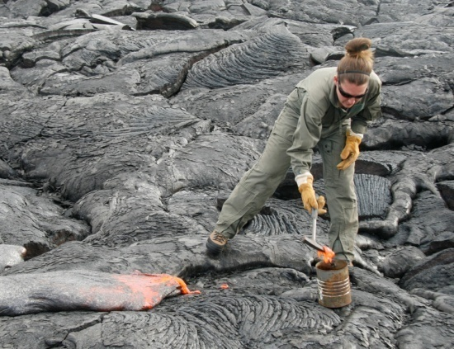
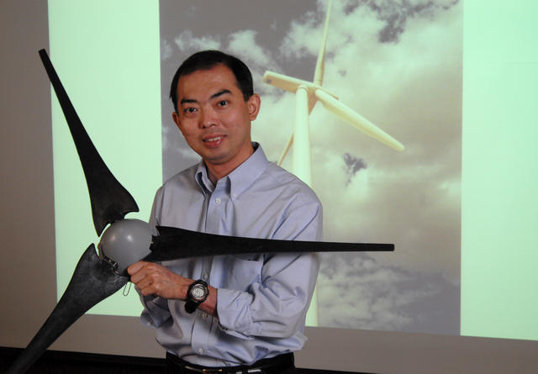
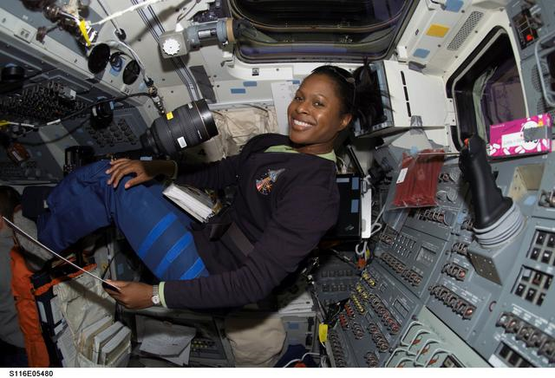
Famous Scientists Activity Name some famous scientists. http://www.online-stopwatch.com/rocket-timer
Notes:
List 5 scientists you know in your table group.

Slide 5
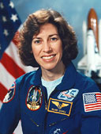
Notable Hispanic-American Scientists
Luis Walter Alvarez, Nobel Prize-winning physicist
Franklin Chang-Dìaz, astronaut
Mario Molina, Nobel Prize-winning chemist
Carlos Noriega, astronaut
Severo Ochoa, Nobel Prize-winning biochemist
Ellen Ochoa, Astronaut
Notes:
Ellen Ochoa
Astronaut Born: 5/10/1958 Birthplace: Los Angeles, California Astronaut Ellen Ochoa first left Earth in July 1991 and became the world's first Hispanic female astronaut. A mission specialist and flight engineer, she has since logged more than 900 hours in space on four flights, the last in 2002. Dr. Ochoa's many awards include NASA's Exceptional Service Medal (1997) and Outstanding Leadership Medal (1995). Besides being an astronaut, researcher, and engineer, Ochoa is a classical flutist.

Slide 6
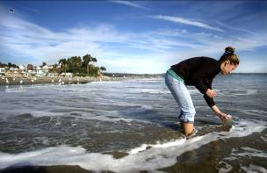
Encouraging Interest in Science Has Never Been More Important!
To create scientifically literate citizens
(to understand important issues)
To prepare our future workforce
(basic jobs now require technical skills)
To inspire the next generation of
scientists and engineers

Slide 7
Hot Jobs in STEM
DOL Bureau of Labor Statistics
Occupation | Median Pay, 2011 | Growth, 2010-2020
Biomedical Engineers | $81,540 | 62%
Medical Scientists | $76,700 | 36%
Geographers | $72,800 | 35%
Database Administrators | $73,490 | 31%
Biochemists and Biophysicists | $79,390 | 31%
Software Developers | $90,530 | 30%
Network and Computer Systems Administrators | $69,160 | 28%
Surveyors | $54,880 | 25%
Environmental Engineering Technicians | $43,390 | 24%
Architects | $72,550 | 24%
Environmental Science and Protection Technicians | $41,380 | 24%
Epidemiologists | $63,010 | 24%
Survey Researchers | $36,050 | 24%
Information Security Analysts, Web Developers, and Computer Network Architects | $75,660 | 22%
Computer Systems Analysts | $77,740 | 22%
Cartographers and Photogrammetrists | $54,510 | 22%
Environmental Engineers | $78,740 | 22%
Psychologists | $68,640 | 22%
Anthropologists and Archeologists | $54,230 | 21%
Geoscientists | $82,500 | 21%
Source: U.S. Bureau of Labor Statistics, Occupational Employment Statistics (OES)

Slide 8
It’s suicidal to create a society that
depends on science and technology . . .
in which no one knows anything about
science and technology.
- Carl Sagan

Slide 9
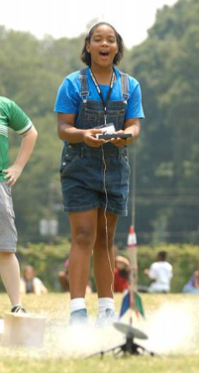
The Good News
In elementary school, students
(both boys and girls) like science.
NCES:
68% of 4th-grade boys
66% of 4th-grade girls
self-report they “like” science.
That’s fully two-thirds of 4th-grade students.
It’s as many girls as boys.
The same is true for math.
Source: National Center for Education Statistics (NCES)
Notes:
When kids are young, they are curious about the world and fascinated by how it works!

Slide 10
Discuss in Groups http://www.online-stopwatch.com/bomb-countdown/full-screen
Why do students drift away from science?
And why girls in greater numbers?
Think about – Jigsaw Activity
Stereotypes Tables 1&2
Media Tables 3-5
Aptitude Tables 6-8
Notes:
Why?
Some face lingering stereotypes that discourage their interest in math and science:
e.g., imagine a little girl who says she wants to be an electrical engineer--she may not get the same reaction as a little boy who says the same thing.
Some aren’t encouraged to follow their interests:
e.g., A young boy with a learning disability who loves math may not be encouraged to pursue math or science.
Many students don’t know what scientists do or who makes a good scientist.
Many students do not see the relevance of science, or connect it to the real world.

Slide 13
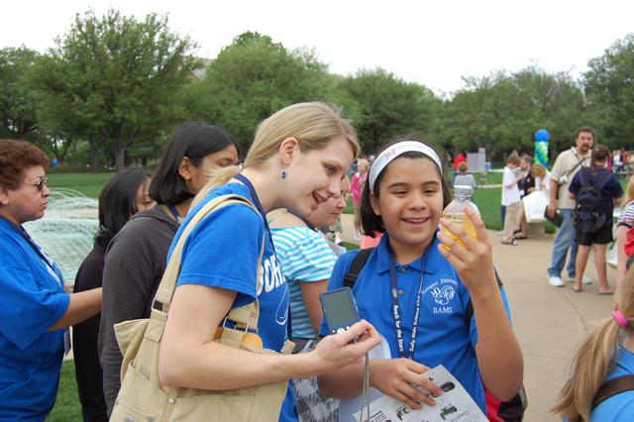
You Are Really Important!
As an educator, you . . .
Help build students’ confidence in their skills.
Help guide students’ understanding of themselves.
Help shape students’ attitudes and beliefs about their world and about science.
13
Notes:
Boys and girls on average hold different beliefs about their abilities in math and science, their interest in math and science, and their perceptions of the importance of math and science for their futures. In general, girls are less confident in their math abilities and show less interest in math and science careers, beginning in early adolescence.
Belief in one’s abilities plays a critical role in students’ ability to do well in all subject areas but particularly math and science. Research tells us that students - both boys and girls - who have a strong self-concept about their abilities in math and science are more likely to choose and perform well in elective math and science courses and to pursue math- and science-related majors. Clearly beliefs and interest strongly impact both education and career trajectories. This is one area teachers can make a huge difference. Improving student’s beliefs about their abilities can alter career choices and academic performance.

Slide 14
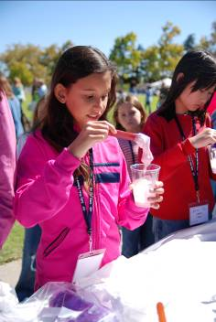
How Do We Keep Students Interested in Science?
Invite your students (every day) to demonstrate how science is relevant to their world and how they can make an impact through science.
Expose them to diverse scientists with whom they can identify.
Let them know scientists work collaboratively in
many different environments.
14
Notes:
First and most critically, educators can teach their students that math and science abilities, like all abilities, can be improved over time through consistent effort and learning. Many students believe that people are born with a fixed amount of intelligence and that the abilities that one is born with cannot be changed. Research shows that those with this fixed or unchangeable view of intelligence are more likely to experience greater discouragement and ultimately reduce their effort when they face difficulties or setbacks. In contrast, students who view their abilities as expandable tend to keep trying in the face of frustration.
Second, educators can provide feedback which focuses on strategies, efforts and the learning process, such as saying, “You worked really hard on that problem”, rather than simply, “Nice job”, or “You are so smart!”. This kind of feedback highlights the importance of effort so it can help create an environment where students are not discouraged by failure but view incorrect answers as opportunities for learning.
And lastly, we need to stress the importance of bringing science careers into the classroom. Students need to be exposed to role models with different ethnicities, genders and socio-economic backgrounds. This exposure can happen through assigned biographical readings about scientists and engineers or by calling attention to current events highlighting the achievements of men and women in math and science, and by making students aware of the numbers of men and women who receive advanced degrees in math and science every year.

Slide 15
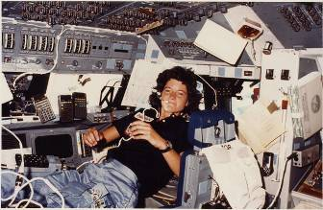
It Takes a Teacher…
I had a teacher who encouraged my
interest in science.
She challenged me to be curious, to ask
questions, and to think about things for myself.
She helped build my self-confidence.
All of these things helped me to become
a scientist and an astronaut.
- Sally Ride
Did you have a teacher who influenced you? How?
Notes:
Think about a teacher who influenced you, and how.

Slide 16
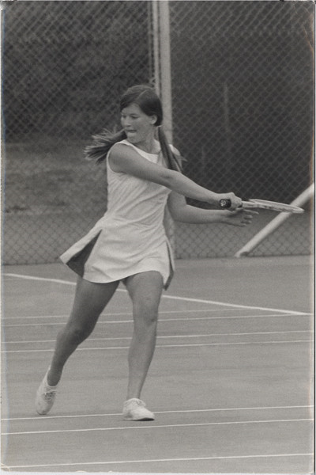
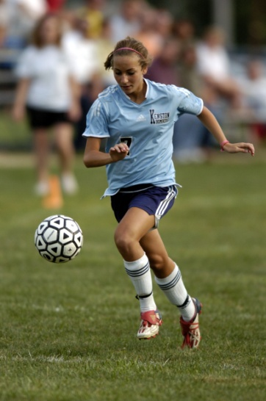
A Lot Has Changed in the Last Four Decades…
Percentage of women graduates
1970 2010
Law School 5% 47%
Business School 4% 40%
Medical School 8% 49%
Engineering (BS degree) <1% 20%
And there’s a similar story in high school sports.
1970 - 4% 2010 - 42%
16
Notes:
Changes in societal norms and slowly dissolving stereotypes have resulted in more opportunities and, in turn, more girls and women pursuing their interests. As more females entered law, business and the medical profession, they provided role models for the younger generation.

Slide 17
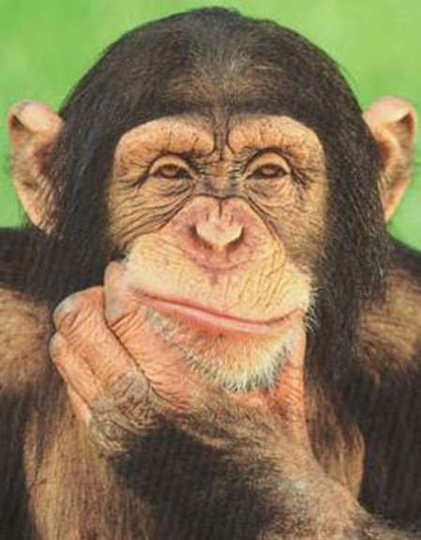
What Do Scientists Look Like?
Notes:
Let’s look back at the previous slide:
Science improves and grows only through the contributions of diverse perspectives
But are scientists really diverse – at least in our perceptions? Honestly, when we hear the word “scientist” what image pops into our heads?
(don’t respond to raised hands)
(make sure prior to this, there is paper and colored markers or pencils on each table)
Instead of talking about our images, let’s draw that image we have in our heads.
(give teachers 3-6 minutes to draw a scientist)
(have volunteer teachers hold up their drawings and describe them)

Slide 18
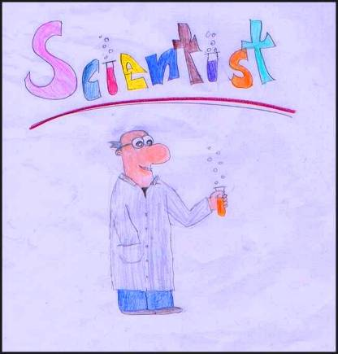
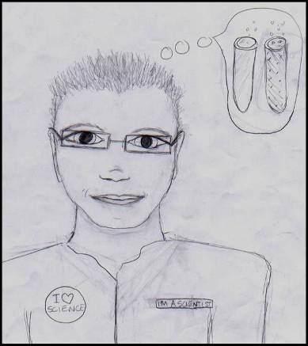
Notes:
Another white male in a lab coat. Again, hair challenged. Glasses. Alone. With his buddy, a test tube.
This guy is in a futuristic lab coat. Again, a white guy, alone. But this guy simply has dreams of test tubes…”

Slide 19
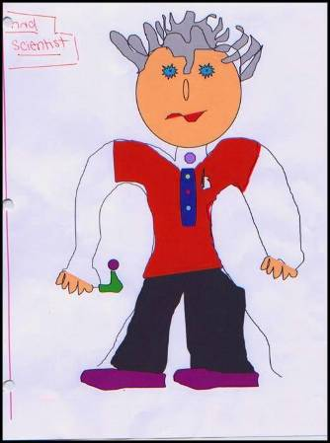
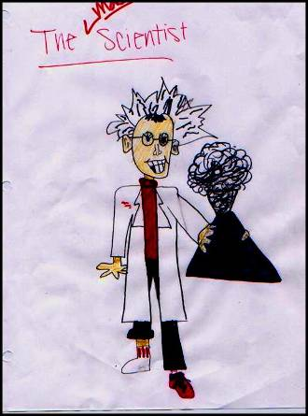
Notes:
And here are a couple mad scientist types.
Check out the guy with the exploding beaker. This guy is so science-obsessed that he grabbed different shoes and socks. Again, there seems to be a big emphasis on hair.

Slide 20
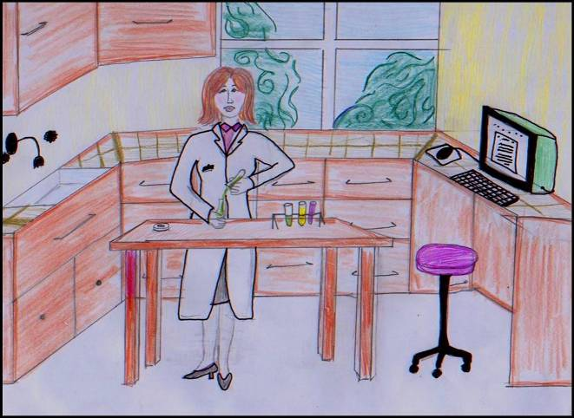
Notes:
These drawings came to us from a middle school teacher who for years has done this activity with her science classes at the beginning of every school year. These seven drawings were chosen from drawing from four classes, 72 students. She feels these are statistically a good representation of what she usually sees in her classes. This teacher has found that over the years, the drawings are, to quote her, “mostly men in lab coats, with bad hair and glasses.”
Although the 72 students are early evenly divided girl/boy, only 15 of the students drew females. And the vast majority of them were alone, in a labk, like this woman.
Many drawings seem to be crazy chemists who work alone.
Who here has done this activity?
Have you found these drawings to be representative of what the general perception of scientists is among your students?
Some tips for the drawing activity:
It can be a cartoon, based on a real person, anything!
When students finish, discuss.
Is it a crazy-haired man with a pocket protector and glasses?
Ask the student, “Does it look like YOU?”
As a follow-up, have students draw pictures of themselves as a scientist. Post them.

Slide 22
Young people have an image of scientists as eccentric old men with wild hair, smoking cigars, deep in thought, alone. Basically, they think of Einstein.
We need to change that image and give our children a much richer, nuanced view of who scientists are, what scientists do, and how they work.
Jacquelynne Eccles, 2005
Professor of Psychology
University of Michigan
Notes:
Dr. Jackie Eccles is a psychologist and a professor of education at the University of Michigan. She’s done extensive research and writing about adolescent development – especially family, school and social influences.
In one of her best known studies, she found that mothers who had read news reports citing boys are better at math, subsequently had lower expectations of their daughters' math competence than before.

Slide 23
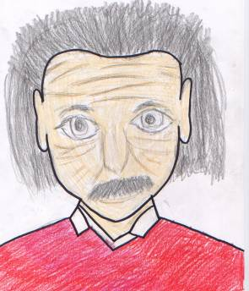
How Do We Get Students From
Notes:
How do we get students from a narrow perception of who a scientist is to…
Opening up their imaginations and knowledge
Exposing them to scientists who work in the field
Scientists who, like most scientists and engineers, work on teams
Who need to communicate
Who aren’t all white. And aren’t all male.
Who aren’t all geniuses
Who are real people with as many different stories and backgrounds as any profession
We have a framework how to open up students’ thinking.

Slide 24
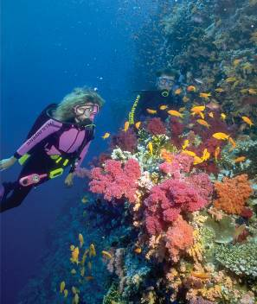
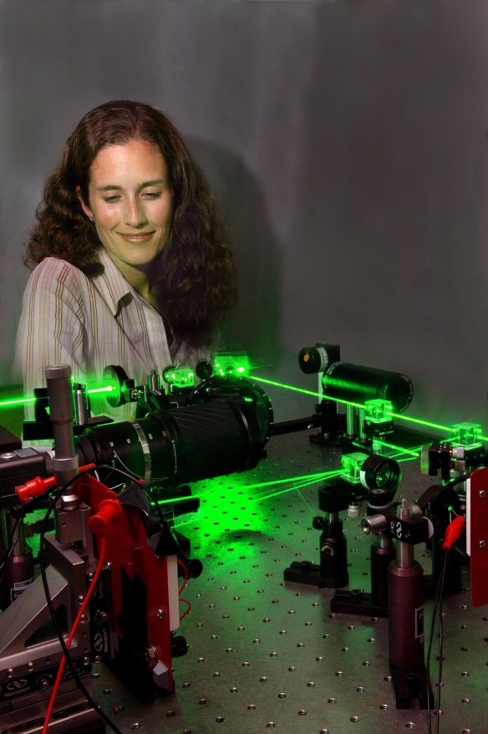
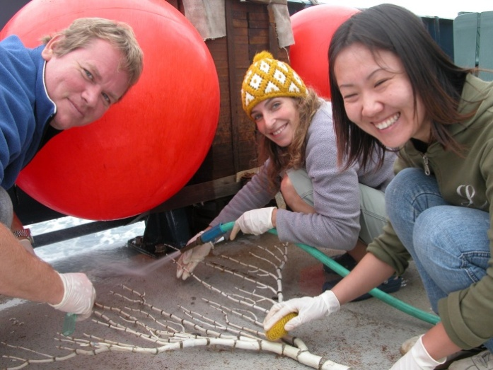
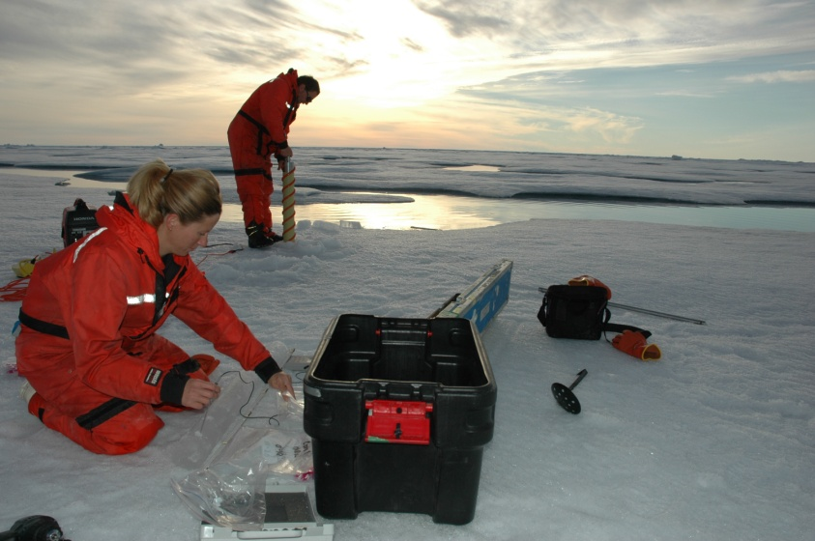
To…
Notes:
More images – scientists in groups, indoors, outdoors, diverse

Slide 25
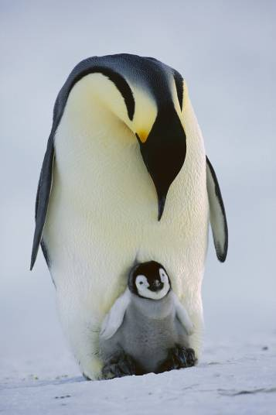
Thank You For Your Attention!

